Slide 1
The Beginning and The End
IB Physics | Astrophysics

Slide 2
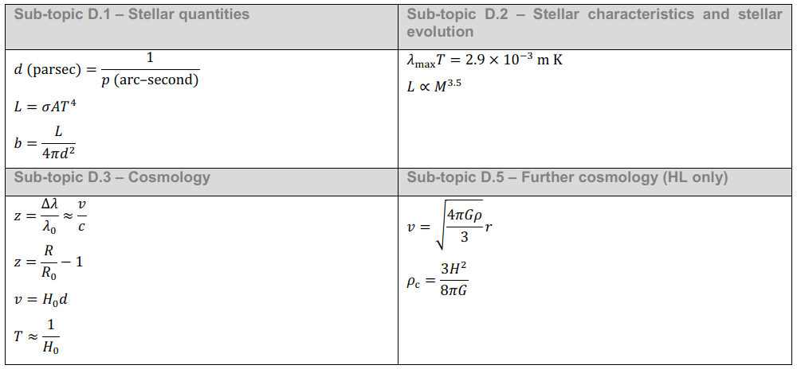
IB Physics Data Booklet

Slide 3
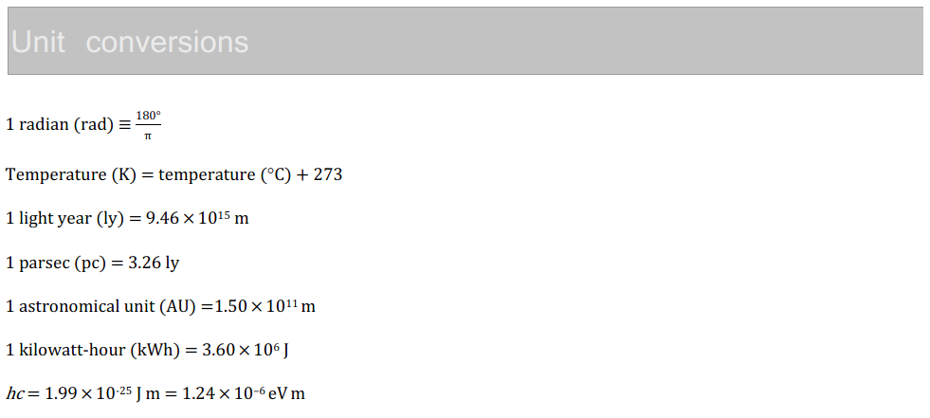
IB Physics Data Booklet

Slide 4
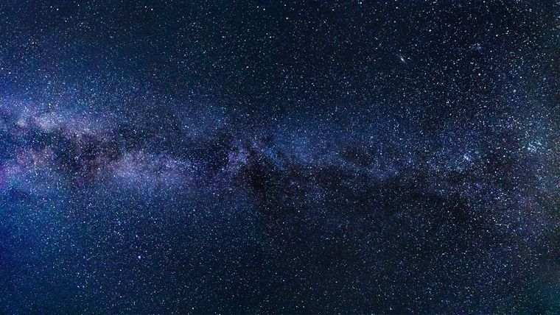
Measuring the Universe

Slide 5
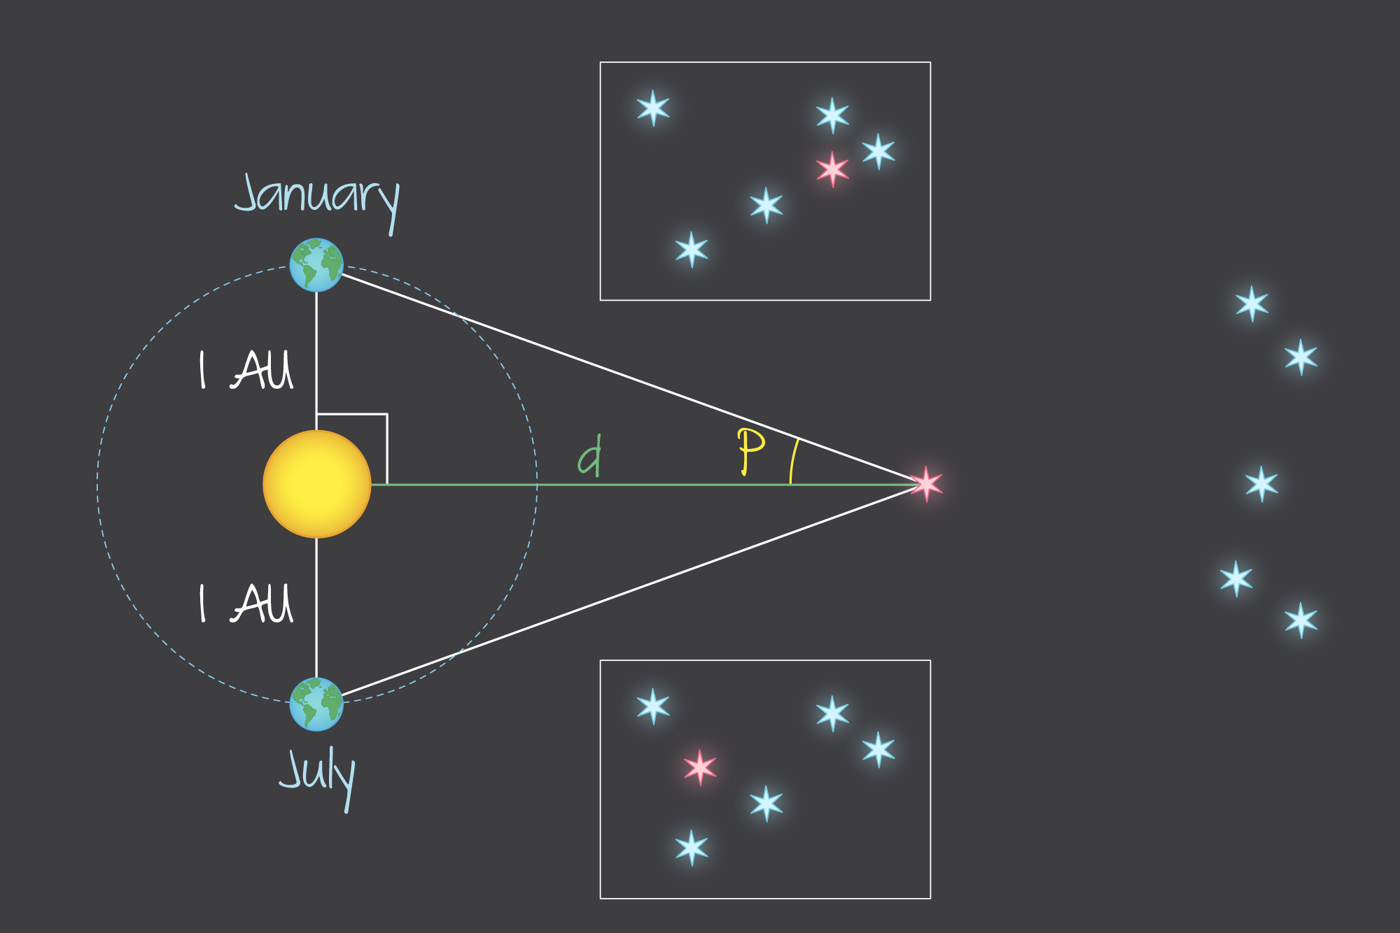
Distance | Parallax
$$d \left(parsec\right)=\frac{1}{p (arc second)}$$
1 parsec (pc) = 3.26 ly
Parallax

Slide 6
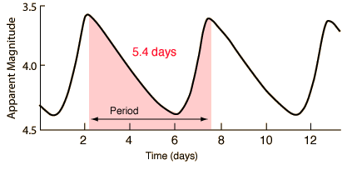
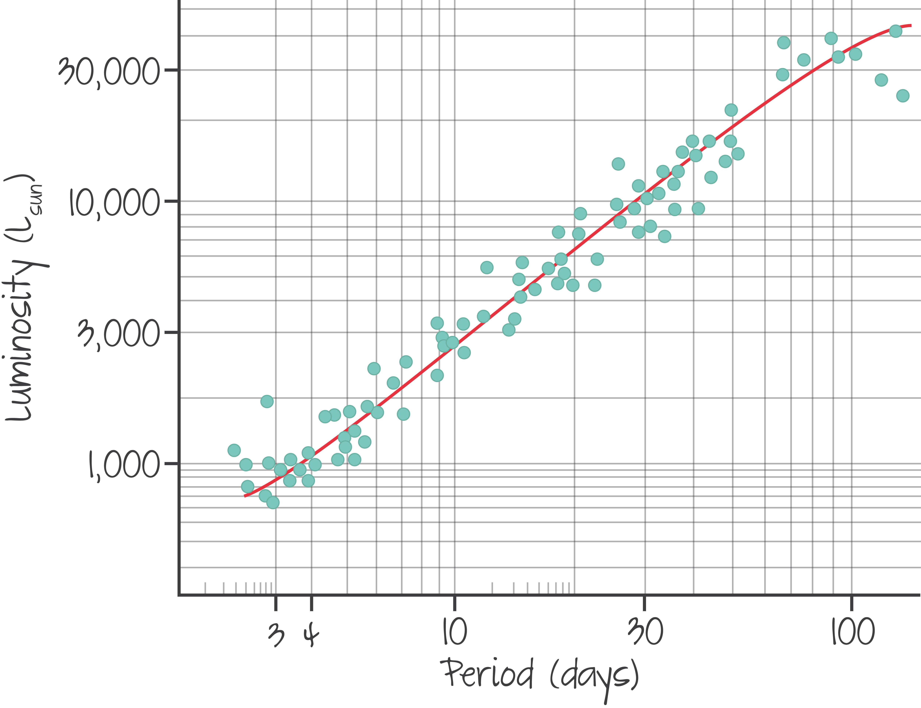
Distance | Cepheid Variables
Cepheids
Parallax
$$b=\frac{L}{4πd^{2}}$$

Slide 7
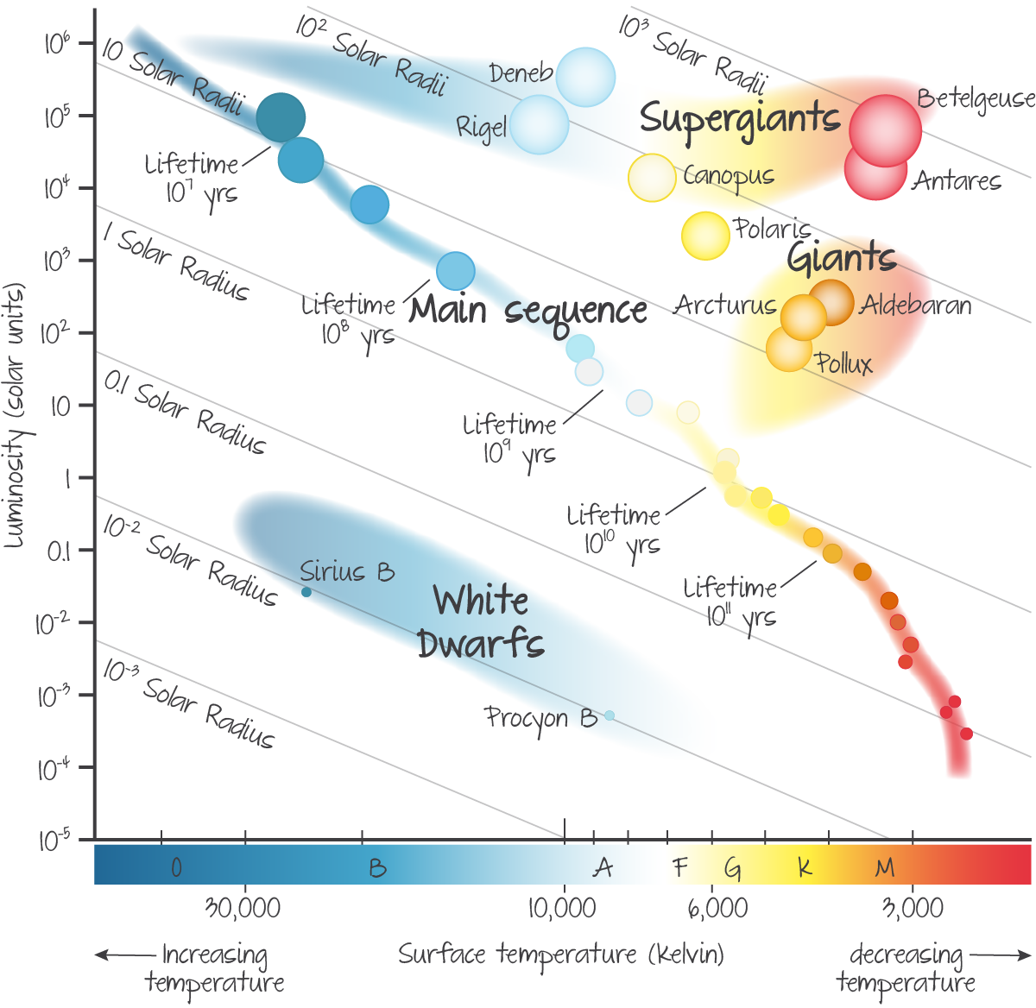
Distance | H-R Diagram
$$λ_{max}T=2.90×{10}^{−3} mK$$
H-R Diagram
Cepheids
Parallax
$$b=\frac{L}{4πd^{2}}$$

Slide 8
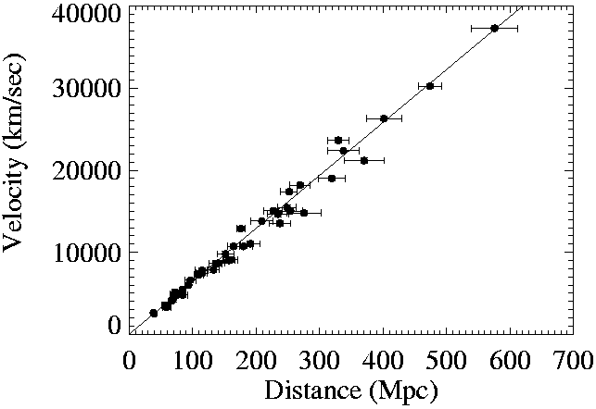
Distance | Redshift & Hubble’s Law
$$z=\frac{∆λ}{λ_{o}}≈\frac{v}{c}$$
Redshift
H-R Diagram
Cepheids
Parallax
$$v=H_{0}d$$
H₀ ≈ 70 km s⁻¹ Mpc⁻¹

Slide 9
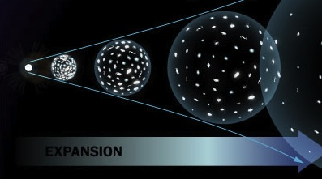
How Old is the Universe?
$$v=H_{0}d$$
$$H_{0}≈70 {km s}^{−1} {Mpc}^{−1}$$
$$v=\frac{d}{t}$$
$$H_{0}d=\frac{d}{t}$$
$$t=\frac{1}{H_{0}}$$
$$t=\frac{1}{70 {km s}^{−1} {Mpc}^{−1}}=0.0142 s Mpc{ km}^{−1}$$
$$\frac{0.0142 s Mpc}{km}$$
$$×\frac{{10}^{6} pc}{1 Mpc}$$
$$×\frac{3.26 ly}{1 pc}$$
$$×\frac{{9.46×10}^{15} m}{1 ly}$$
$$×\frac{1 km}{1000 m}$$
$$=4.4×{10}^{17} s$$
$$≈13.8 billion years$$

Slide 10
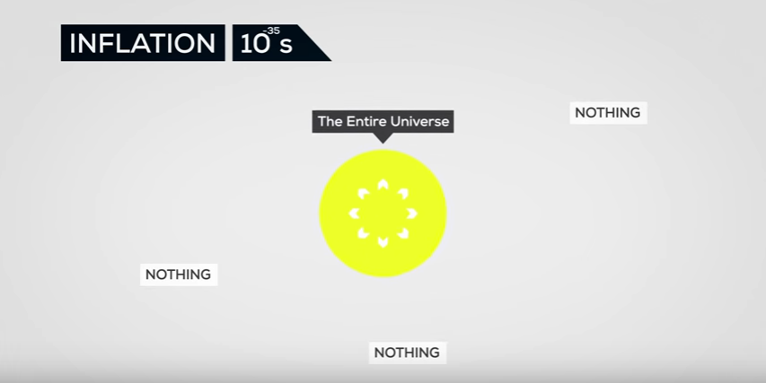
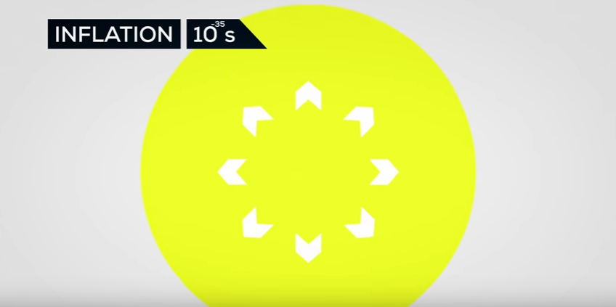
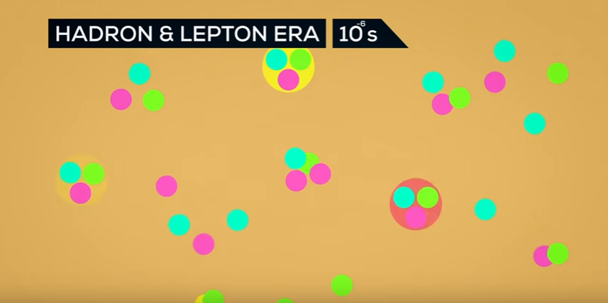
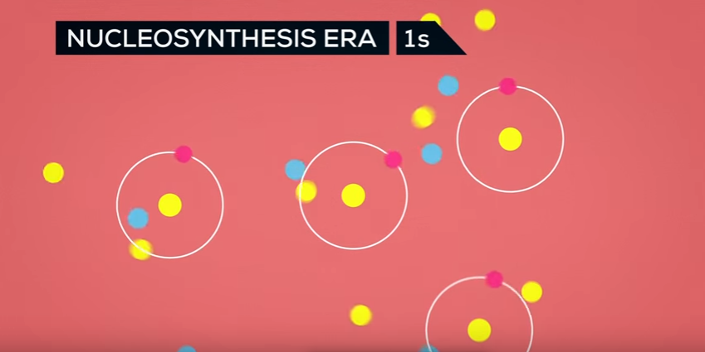
The “Big Bang”

Slide 11
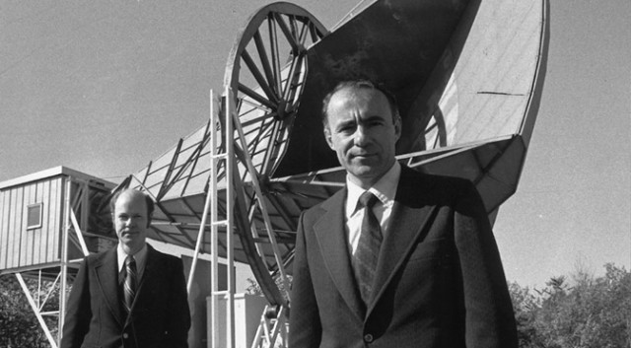
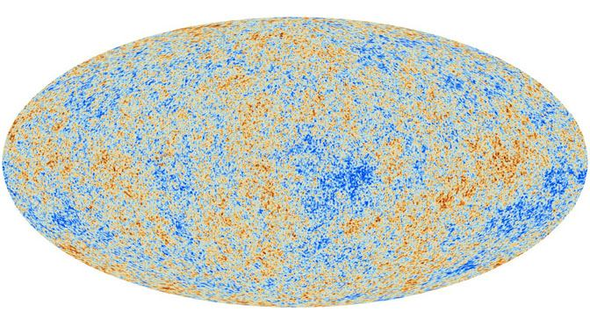
Where’s the Evidence??
CMB
Cosmic Microwave Background

Slide 12
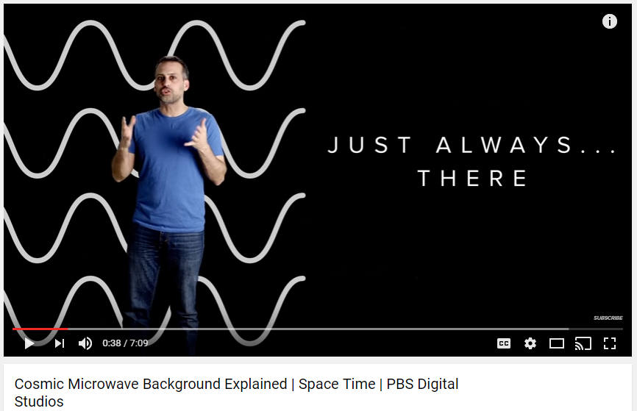
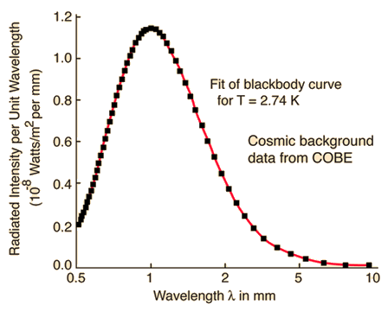
Cosmic Microwave Background
λ_{max} = 1 mm
0.001 m
$$T=\frac{2.9×{10}^{−3}}{0.001}$$
$$=2.9 K$$
Temperature of the Universe

Slide 13
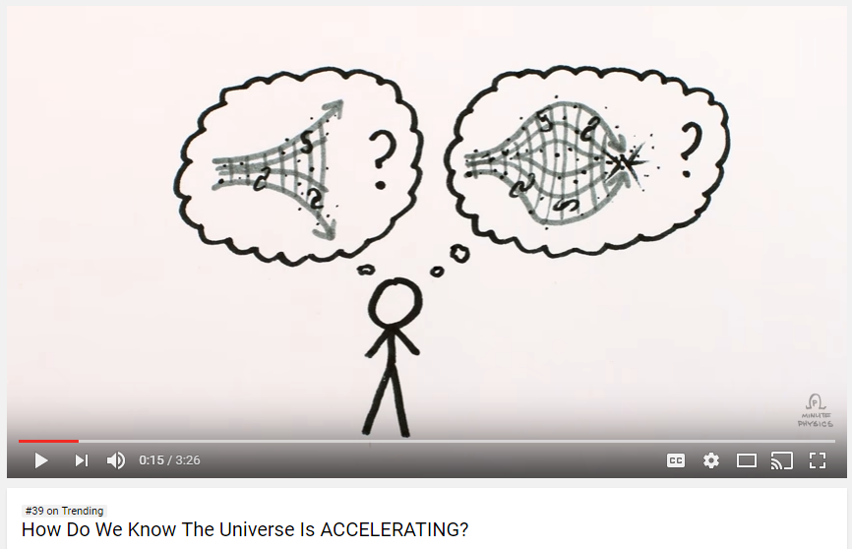
What’s Next?
Static and Infinite
Expanding and slowing to a stop
Expanding, slowing, and contracting in a “big crunch”
Expanding and accelerating

