Slide 1
Atomic Spectra
IB Physics | Atomic Physics

Slide 2
What is Light?
Wave
Energy
Particle
(photon)

Slide 3
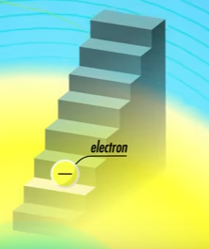
Light is Quantized
Photons of light can only have certain ______________ values of energy
discrete

Slide 4
Energy of a Photon
$$E=hf$$
Energy
[J]
Frequency
[Hz]
Planck’s Constant | h | 6.63 × 10⁻³⁴ J s

Slide 5
Energy of a Photon
$$E=hf$$
$$c=fλ$$
$$E=h\left(\frac{c}{λ}\right)$$
$$f=\frac{c}{λ}$$
$$λ=\frac{hc}{E}$$
$$c=3.00×{10}^{8} m s^{−1}$$

Slide 6
Quick Recap of eV
$$eV→$$
$$electron−volts$$
Unit of Energy
$$\left\{Energy in eV\right\}=\frac{\left\{Energy in J\right\}}{1.60×{10}^{−19}}$$

Slide 7
IB Physics Data Booklet

Slide 8
Try This…
Calculate the energy carried by one photon of microwaves of wavelength 9 cm (as might be used in wifi signals) in J and eV
0.09 m
$$E=\frac{hc}{λ}$$
$$=\frac{(6.63×{10}^{−34})(3×{10}^{8})}{(0.09)}=$$
$$2.21×{10}^{−24} J$$
$$\frac{1.99×{10}^{−24} }{1.60×{10}^{−19}}=$$
$$1.38×{10}^{−5} eV$$

Slide 9
Shortcut time ☺
Since h and c are both constants, hc acts as a constant as well
$$E=\frac{hc}{λ}$$
$$\frac{1.99×{10}^{−25} J m}{0.09 m}=$$
$$2.21×{10}^{−24} J$$
$$\frac{1.24×{10}^{−6} eV m}{0.09 m}=$$
$$1.38×{10}^{−5} eV$$

Slide 10
Energy Levels
Electrons in an atom exist at discrete energy levels
Absorbed
7
6
5
4
3
2
Emitted
1

Slide 11
Energy Levels
A photon is emitted whenever an electron transitions from one energy level down to a lower energy level
E₄
How many different transitions are possible between these four energy levels?
E₃
6
E₂
E₁

Slide 12
Energy Levels
n = ∞
0.00 eV
n = 5
-0.54 eV
n = 4
-0.85 eV
Excited States
n = 3
-1.51 eV
n = 2
-3.40 eV
Ground State
n = 1
-13.6 eV

Slide 13
Energy Transitions
Different Energy transitions result in different energies (wavelengths) of light that are absorbed or emitted
n = ∞
0.00 eV
n = 5
-0.54 eV
n = 4
-0.85 eV
n = 3
-1.51 eV
Paschen Series (IR)
n = 2
-3.40 eV
Balmer Series (Visible)
n = 1
-13.6 eV
Lyman Series (UV)

Slide 14
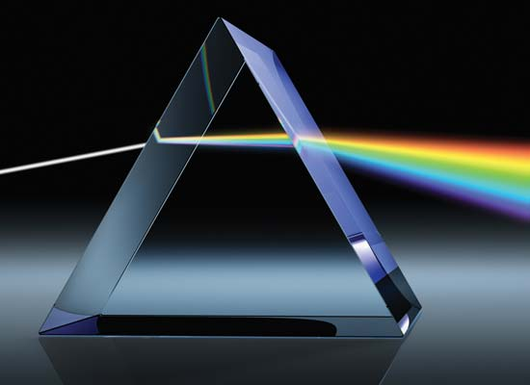
Continuous Spectrum
When white light from the sun passes through a prism, the light is dispersed into its component colors in a continuous spectrum

Slide 15
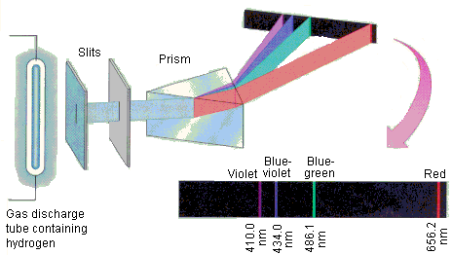
Emission Spectrum
If an electric current is passed through an element in the form of a low-pressure gas, it will produce its own unique emission spectrum

Slide 16
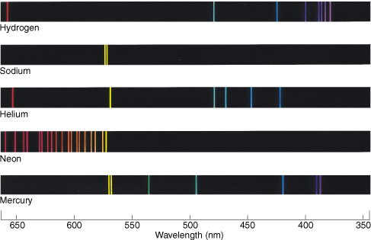
Emission Spectrum
These spectra can be used to identify elements like a fingerprint
These are known as Line Spectra

Slide 17
Absorption Spectrum
If white light is passed through a sample of gaseous atoms or molecules, it is found that the light of certain wavelengths is missing

Slide 18
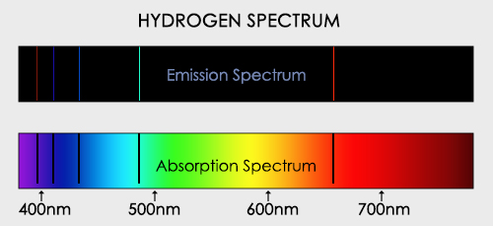
Absorption Spectrum
The emission and absorption spectra are negative images of each other

Slide 19
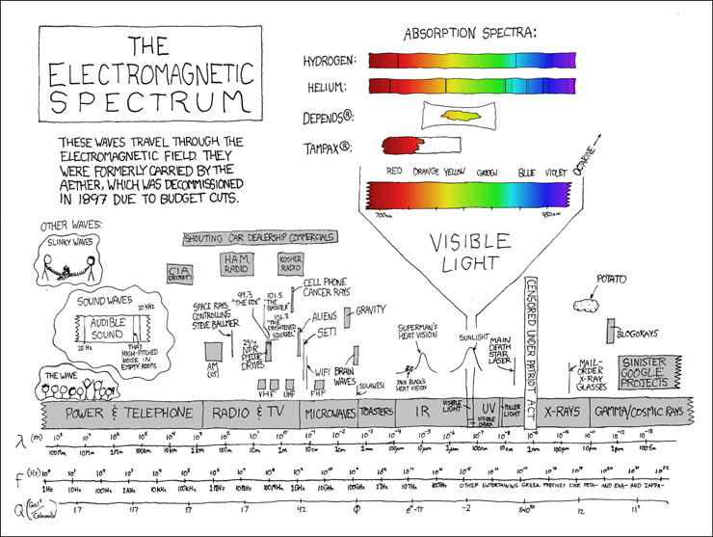
From Randall Monroe | xkcd.com

Slide 20
Calculating Wavelength Emitted
n = ∞
0.00 eV
What is the wavelength emitted?
n = 5
-0.54 eV
n = 4
-0.85 eV
n = 3
-1.51 eV
$$E=13.6−1.51=12.09 eV$$
n = 2
-3.40 eV
$$λ=\frac{1.24×{10}^{−6} eV m}{12.09 eV}=$$
$$1.03×{10}^{−7} m$$
$$103 nm$$
n = 1
-13.6 eV
$$λ=\frac{hc}{E}$$
hc | 1.99 × 10⁻²⁵ J m | 1.24 × 10⁻⁶ eV m

Slide 21
Try This…
n = ∞
0.00 eV
What is the wavelength emitted?
n = 5
-0.54 eV
n = 4
-0.85 eV
n = 3
-1.51 eV
$$E=3.40−0.85=2.55 eV$$
n = 2
-3.40 eV
$$λ=\frac{1.24×{10}^{−6} eV m}{2.55 eV}=$$
$$4.86×{10}^{−7} m$$
$$486 nm$$
n = 1
-13.6 eV
$$λ=\frac{hc}{E}$$
hc | 1.99 × 10⁻²⁵ J m | 1.24 × 10⁻⁶ eV m

Slide 22
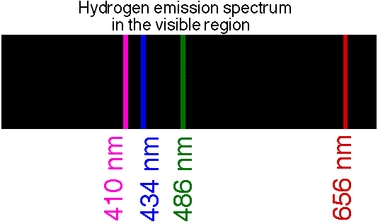
Working Backwards…
What is the energy in eV for a 434 nm blue emission line?
434 × 10⁻⁹ m
$$E=\frac{hc}{λ}$$
$$=\frac{1.24×{10}^{−6} eV m}{434×{10}^{−9} m}=$$
$$λ=\frac{hc}{E}$$
$$2.86 eV$$
hc | 1.99 × 10⁻²⁵ J m | 1.24 × 10⁻⁶ eV m

Slide 23
Working Backwards…
n = ∞
0.00 eV
Draw in the Energy Transition for a 434 nm blue emission line?
n = 5
-0.54 eV
n = 4
-0.85 eV
n = 3
-1.51 eV
What transition has an energy difference of 2.86 eV?
n = 2
-3.40 eV
n = 1
-13.6 eV
$$E=3.40−0.54=2.86 eV$$

