Slide 1
Particles and the Standard Model
IB Physics | Atomic Physics

Slide 2
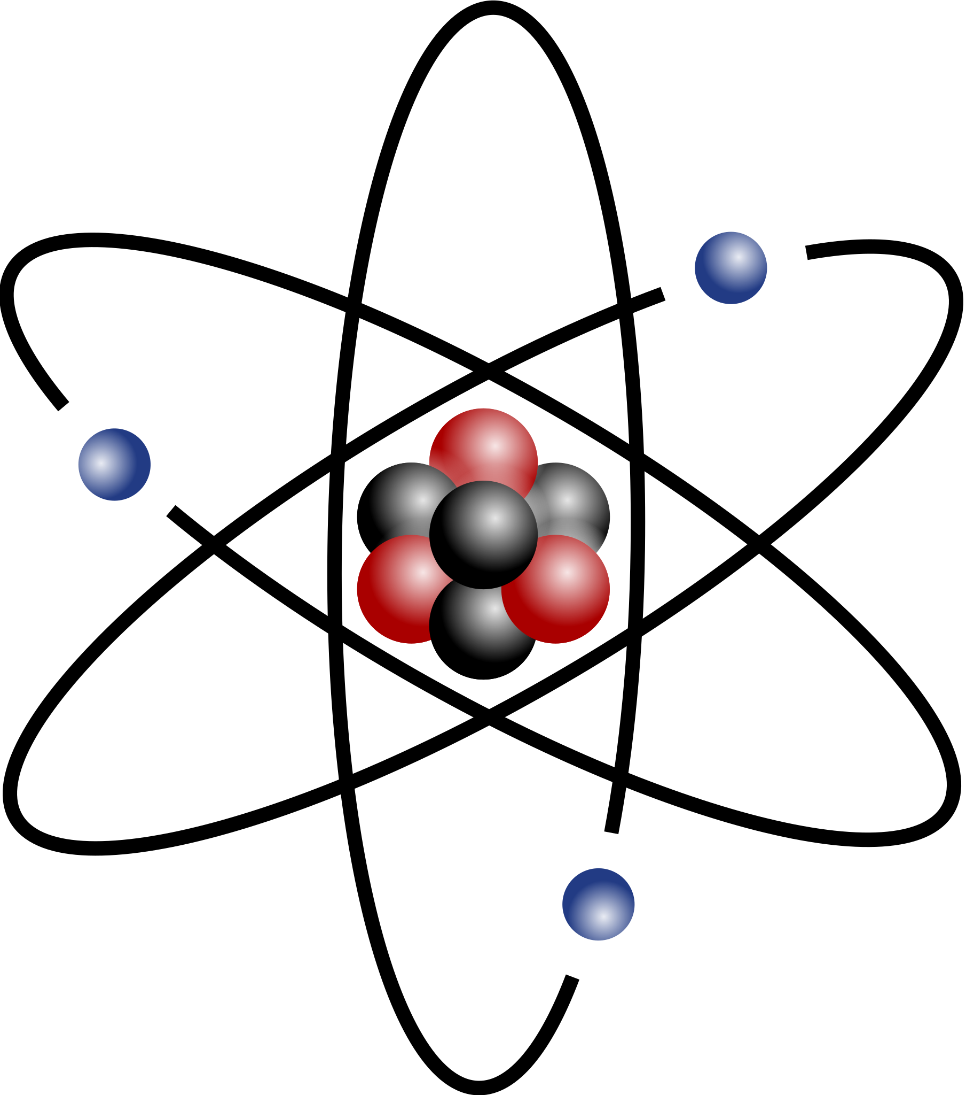
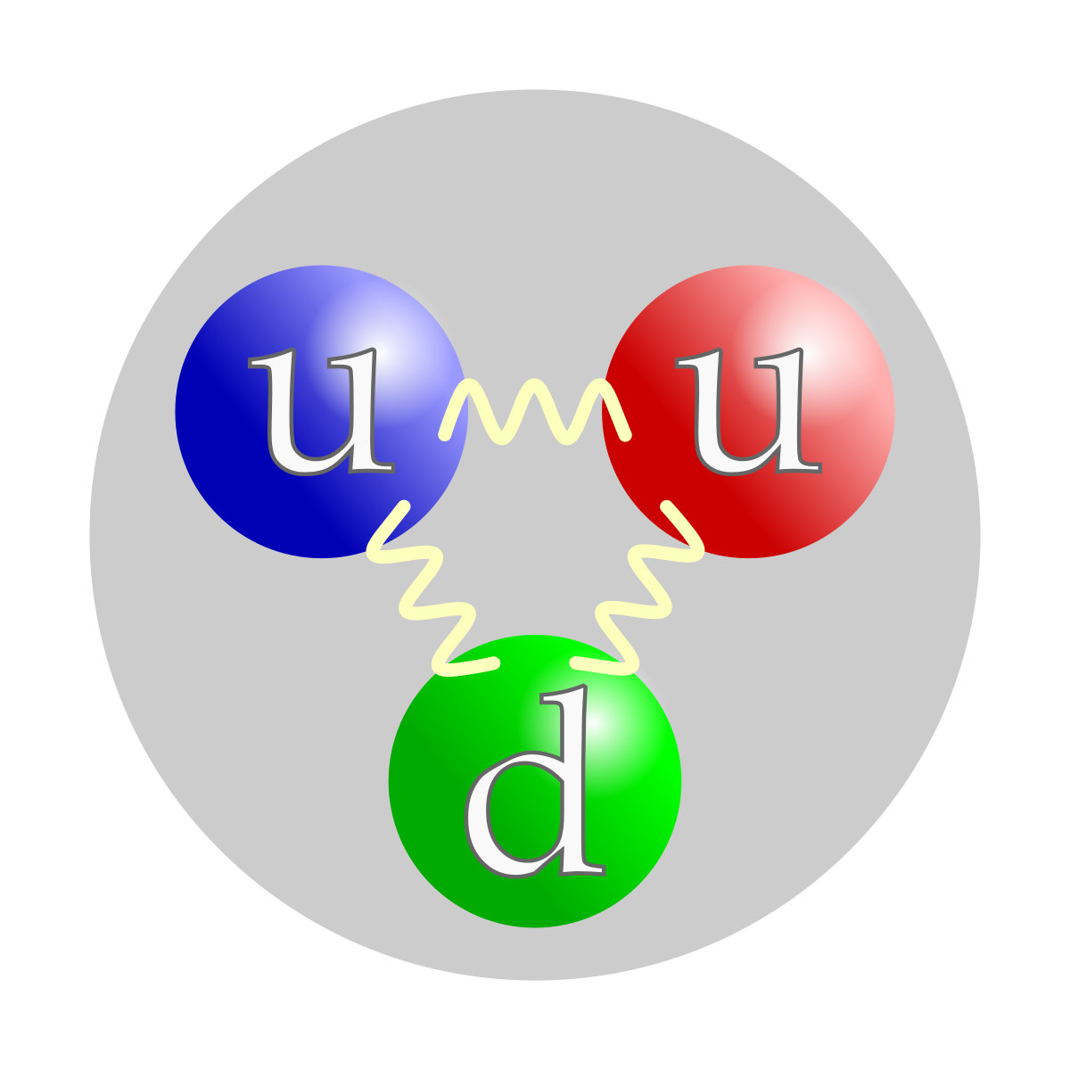
What is the “Fundamental Particle”?
+

Slide 3
Fundamental Particles
Charge | Quarks |  |  | Baryon Number
$$\frac{2}{3}$$ | $$u$$ | $$c$$ | $$t$$ | $$\frac{1}{3}$$
$$−\frac{1}{3}$$ | $$d$$ | $$s$$ | $$b$$ | $$\frac{1}{3}$$
All quarks have a strangeness number of 0 except the strange quark that has a strangeness number of –1
Charge | Leptons
$$−1$$ | $$e$$ | $$μ$$ | $$τ$$
$$0$$ | $$v_{e}$$ | $$v_{μ}$$ | $$v_{τ}$$
All leptons have a lepton number of 1 and antileptons have a lepton number of –1
Symbol | Name
$$u$$ | Up
$$d$$ | Down
$$c$$ | Charm
$$s$$ | Strange
$$t$$ | Top
$$b$$ | Bottom
Symbol | Name
$$e$$ | Electron
$$μ$$ | Muon
$$τ$$ | Tau
$$v_{e}$$ | Electron Neutrino
$$v_{μ}$$ | Muon Neutrino
$$v_{τ}$$ | Tau Neutrino
Antiparticles have the opposite charge as their corresponding particle and have a bar over their symbol
Symbol | Name | Charge
$$s$$ | Strange | $$−\frac{1}{3}$$
$$\overline{s}$$ | Antistrange | $$+\frac{1}{3}$$

Slide 4
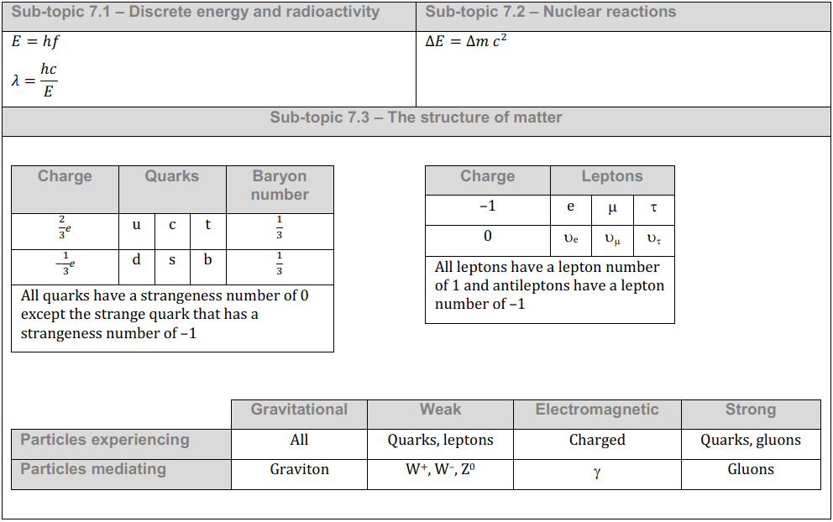
IB Physics Data Booklet

Slide 5
Fundamental Particles
Symbol | Name | Charge | Baryon #
$$u$$ | Up | $$+\frac{2}{3}$$ | $$\frac{1}{3}$$
$$d$$ | Down | $$−\frac{1}{3}$$ | $$\frac{1}{3}$$
$$c$$ | Charm | $$+\frac{2}{3}$$ | $$\frac{1}{3}$$
$$s$$ | Strange | $$−\frac{1}{3}$$ | $$\frac{1}{3}$$
$$t$$ | Top | $$+\frac{2}{3}$$ | $$\frac{1}{3}$$
$$b$$ | Bottom | $$−\frac{1}{3}$$ | $$\frac{1}{3}$$
Symbol | Name | Charge | Lepton #
$$e$$ | Electron | $$−1$$ | $$1$$
$$μ$$ | Muon | $$−1$$ | $$1$$
$$τ$$ | Tau | $$−1$$ | $$1$$
$$v_{e}$$ | Electron Neutrino | $$0$$ | $$1$$
$$v_{μ}$$ | Muon Neutrino | $$0$$ | $$1$$
$$v_{τ}$$ | Tau Neutrino | $$0$$ | $$1$$
Symbol | Name | Charge | Baryon #
$$\overline{u}$$ | Antiup | $$−\frac{2}{3}$$ | $$−\frac{1}{3}$$
$$\overline{d}$$ | Antidown | $$+\frac{1}{3}$$ | $$−\frac{1}{3}$$
$$\overline{c}$$ | Anticharm | $$−\frac{2}{3}$$ | $$−\frac{1}{3}$$
$$\overline{s}$$ | Antistrange | $$+\frac{1}{3}$$ | $$−\frac{1}{3}$$
$$\overline{t}$$ | Antitop | $$−\frac{2}{3}$$ | $$−\frac{1}{3}$$
$$\overline{b}$$ | Antibottom | $$+\frac{1}{3}$$ | $$−\frac{1}{3}$$
Symbol | Name | Charge | Lepton #
$$\overline{e}$$ | Antielectron (positron) | $$+1$$ | $$−1$$
$$\overline{μ}$$ | Antimuon | $$+1$$ | $$−1$$
$$\overline{τ}$$ | Antitau | $$+1$$ | $$−1$$
$${\overline{v}}_{e}$$ | Electron Antineutrino | $$0$$ | $$−1$$
$${\overline{v}}_{μ}$$ | Muon Antineutrino | $$0$$ | $$−1$$
$${\overline{v}}_{τ}$$ | Tau Antineutrino | $$0$$ | $$−1$$

Slide 6
Classifying Particles
Leptons
Hadrons
Electrons
Muons
Tau
Neutrinos
Mesons
Baryons
Pion (π)
Kaon (Κ)
Others
Proton
Neutron
Others

Slide 7
Baryons
All Baryons are formed from a combination of 3 quarks or antiquarks
d
Proton
Rule: | Charge must be an integer value (-1, 0, or +1)
u
u
+1
(uud)
u
Up Quark
Charge =
2/3
Charge | Quarks |  |  | Baryon Number
$$\frac{2}{3}$$ | $$u$$ | $$c$$ | $$t$$ | $$\frac{1}{3}$$
$$−\frac{1}{3}$$ | $$d$$ | $$s$$ | $$b$$ | $$\frac{1}{3}$$
All quarks have a strangeness number of 0 except the strange quark that has a strangeness number of –1
u
Neutron
d
d
0
d
Down Quark
Charge =
-1/3
(udd)

Slide 8
Mesons
All Mesons are formed from a combination of a quark and antiquark
$$−\frac{1}{3}$$
$$d$$
Kaon
Rule: | Charge must be an integer value (-1, 0, or +1)
$$+\frac{1}{3}$$
$$\overline{s}$$
0
$$−\frac{1}{3}$$
$$d$$
Charge | Quarks |  |  | Baryon Number
$$\frac{2}{3}$$ | $$u$$ | $$c$$ | $$t$$ | $$\frac{1}{3}$$
$$−\frac{1}{3}$$ | $$d$$ | $$s$$ | $$b$$ | $$\frac{1}{3}$$
All quarks have a strangeness number of 0 except the strange quark that has a strangeness number of –1
D-Meson
$$−\frac{2}{3}$$
$$\overline{u}$$
-1

Slide 9
Quark Confinement
Quarks have never been observed on their own
The amount of energy required to overcome the strong nuclear force holding the quarks together gets converted into mass and forms a new quark pair
$$d$$
$$d$$
$$\overline{s}$$
$$\overline{s}$$
$$d$$
$$\overline{s}$$

Slide 10
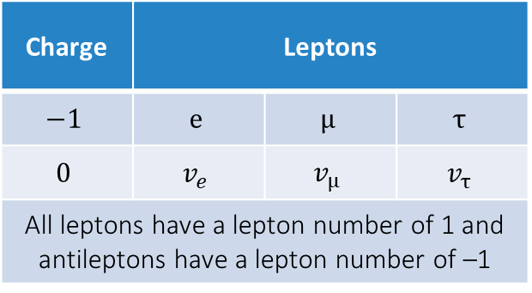
Conservation
For an interaction to be possible, the following must stay conserved:
Baryon # | Lepton # | Charge | Strangeness
$$n→p+e^{−}+{\overline{v}}_{e}$$
Baryon #
Lepton #
Charge
1
0
0
1
0
0
1
-1
0
1
-1
0
This interaction is valid because all properties are conserved

Slide 11
Conservation
$$p+e^{−}→n+v_{e}$$
Baryon #
Lepton #
Charge
1 | 0
0 | 1
+1 | -1
1 | 0
0 | 1
0 | 0
Yes
Valid
$$n+p→e^{+}+{\overline{v}}_{e}$$
Baryon #
Lepton #
Charge
1 | 1
0 | 0
0 | +1
0 | 0
-1 | -1
+1 | 0
No
Invalid

Slide 12
Exchange Particles
At the fundamental level of particle physics, forces are explained in terms of the transfer of exchange particles (gauge bosons) between the two particles experiencing the force
Repulsion
Attraction
These interactions are not observable, so we call them virtual particles

Slide 13
Types of Forces
photon
Weakest
Strongest

Slide 14
Sample IB Question

Slide 15
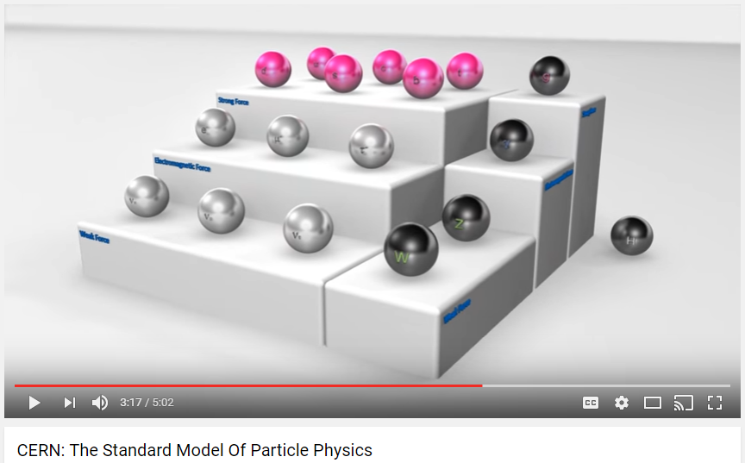
The Standard Model

Slide 16
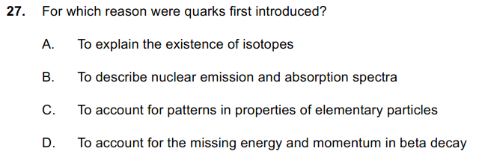
Sample IB Question

Slide 17
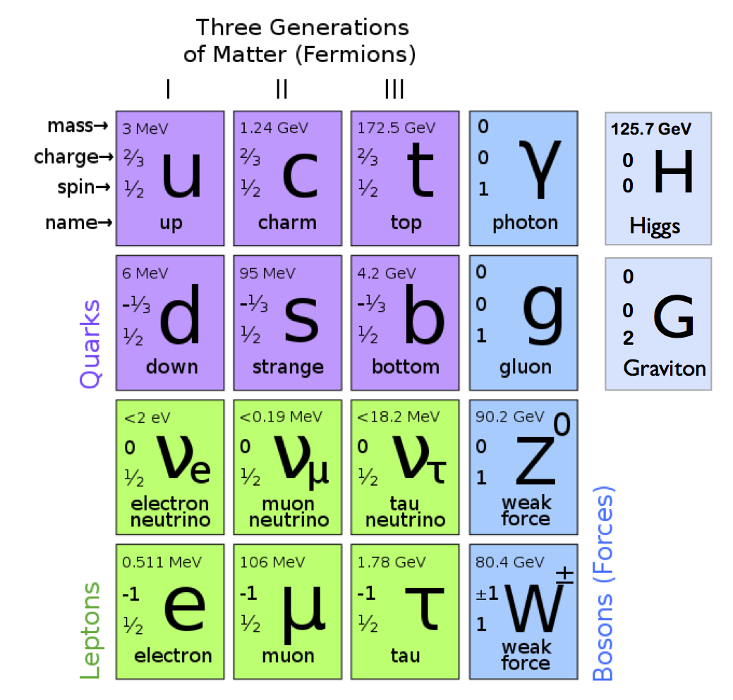
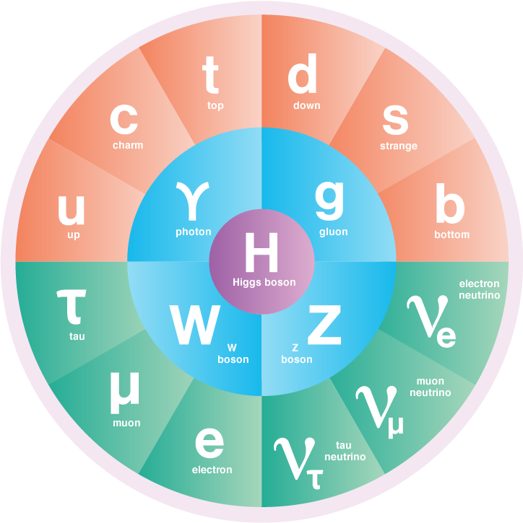
The Standard Model
Most Common
Currently Undiscovered

