Slide 1
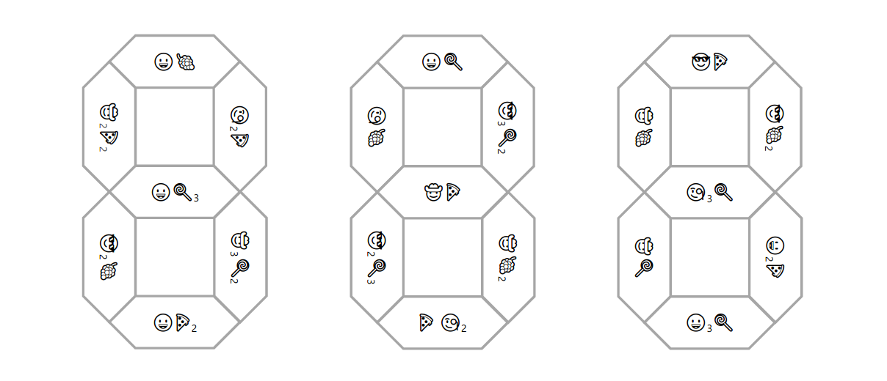
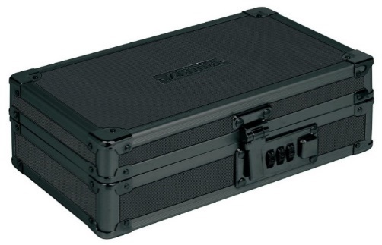
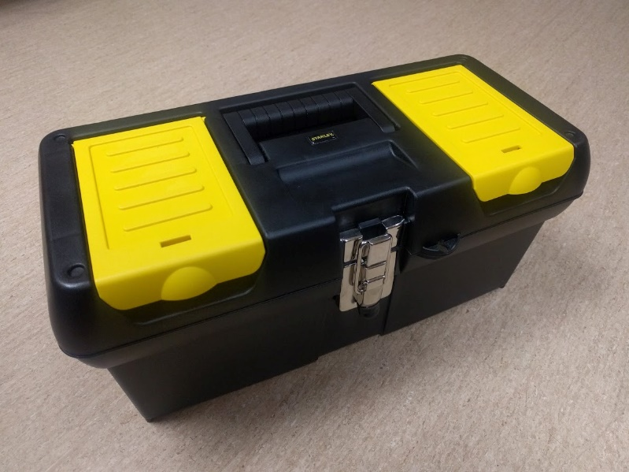
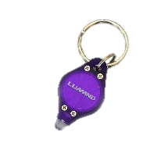
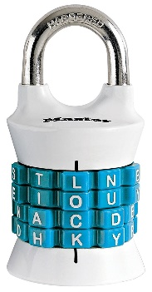
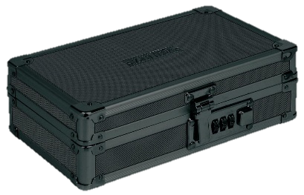
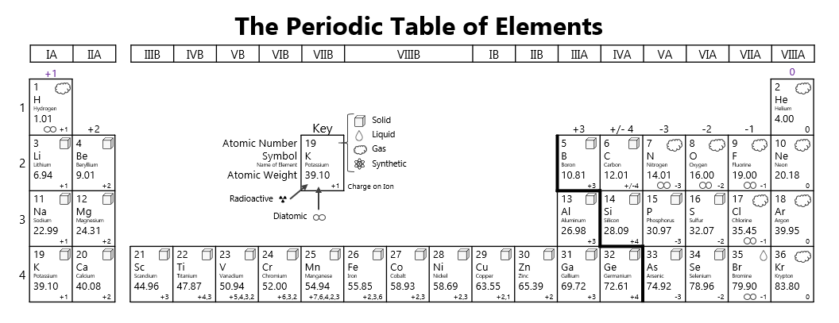
Taped on the Back
Match
The
Dot
Diagrams
Key on Periodic Table
Prize
Taped on the Bottom
On Table
N | A | O | H
7 | 4 | 3
1 | 3 | 2 | 4
4 | 5 | 8
Once locked, set combos to zeros when possible
Notes:
Reset Instructions

Slide 2
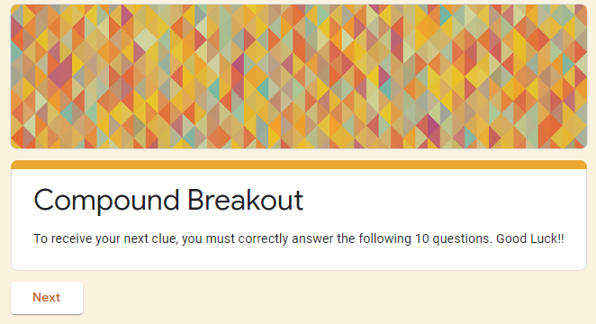
Match
The
Dot
Diagrams
Notes:
The Process

