Slide 1
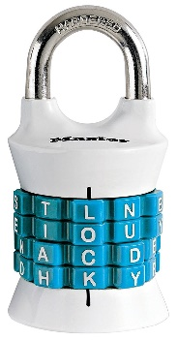
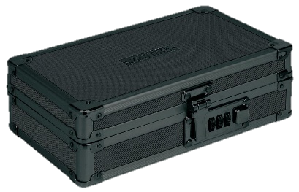
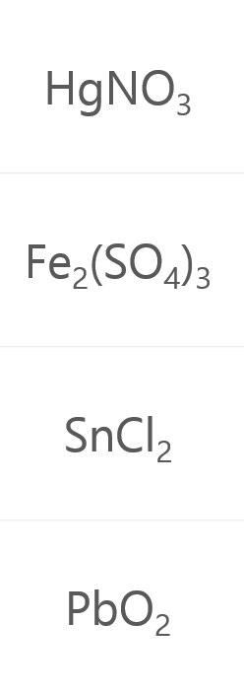
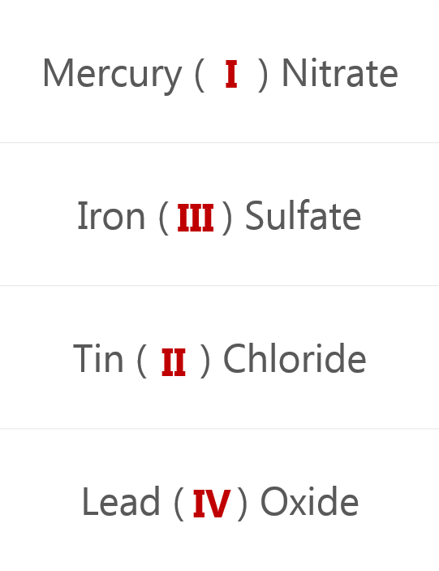
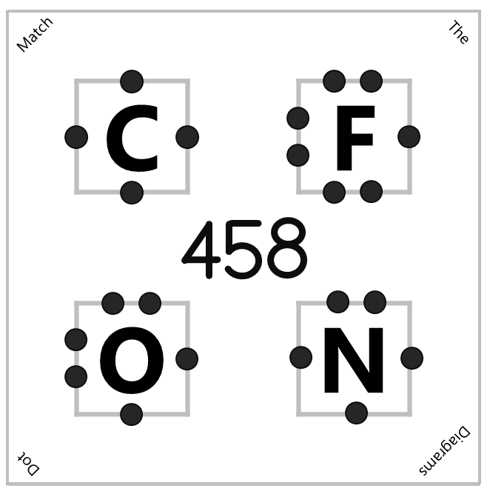
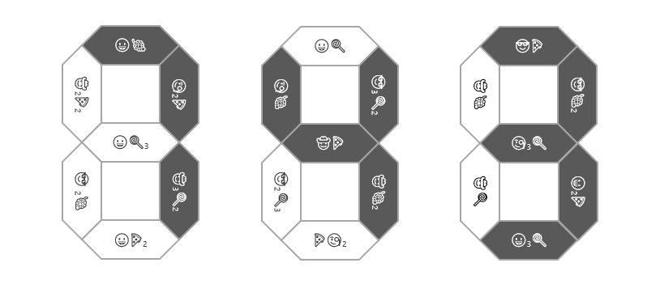
Bonding Breakout Solutions
“Can you feel the MERCURY rising? It's time to IRON out all of the kinks and keep working persistently through thick and TIN. Set the example and others will follow your LEAD!”
N | A | O | H
7 | 4 | 3
1 | 3 | 2 | 4
4 | 5 | 8
 | 🍇⁻ | 🍕²⁻ | 🍭⁻³
😀⁺ | 😀🍇 | 😀₂🍕 | 😀₃🍭
🧐⁺ | 🧐🍇 | 🧐₂🍕 | 🧐₃🍭
🤠²⁺ | 🤠🍇₂ | 🤠🍕 | 🤠₃🍭₂
😎⁺² | 😎🍇₂ | 😎🍕 | 😎₃🍭₂
Sodium Hydroxide - NaOH

Slide 2
😀🍇
😀🍭
😎🍕
🤠₂🍕₂
🧐₂🍕
🧐🍇
😎₃🍭₂
🤠🍇
😎🍇₂
😀🍭₃
🤠🍕
🧐₃🍭
😎 ₂🍇
🤠₃🍭₂
😎₂🍭₃
🤠🍇₂
🤠🍭
😀₂🍕
😀🍕₂
🍕🧐₂
😀₃🍭
Correct
 | 🍇⁻ | 🍕²⁻ | 🍭⁻³
😀⁺ | 😀🍇 | 😀₂🍕 | 😀₃🍭
🧐⁺ | 🧐🍇 | 🧐₂🍕 | 🧐₃🍭
🤠²⁺ | 🤠🍇₂ | 🤠🍕 | 🤠₃🍭₂
😎⁺² | 😎🍇₂ | 😎🍕 | 😎₃🍭₂

Slide 3
Match
The
C |  | F
O |  | N
Dot
Diagrams

