Slide 1
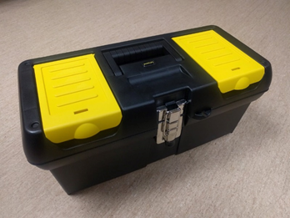
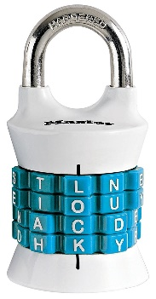
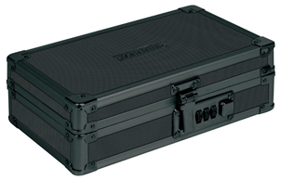
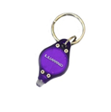
Breakout Components
Locks
Other
Containers
Notes:
Reset Instructions – Level 1

Slide 2
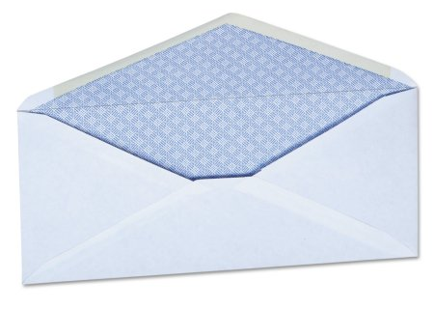
Taped on the Back
Taped on the Bottom
Notes:
Reset Instructions – Level 1

Slide 3
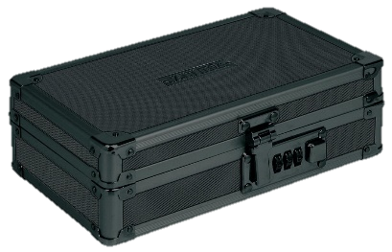
Notes:
The Process

Slide 4
Lock Combinations
Notes:
Lock Combinations

