Slide 1
Intro to Building by Design Project

Slide 2
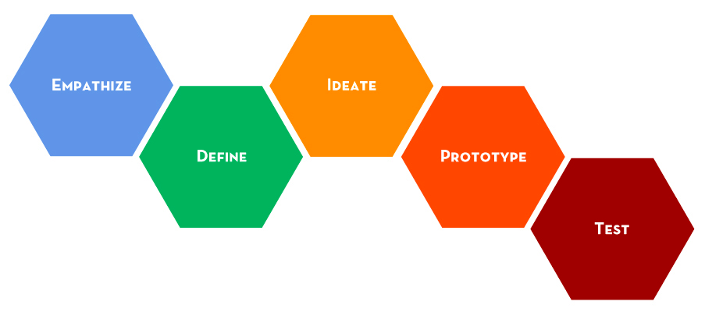
Design Process

Slide 3
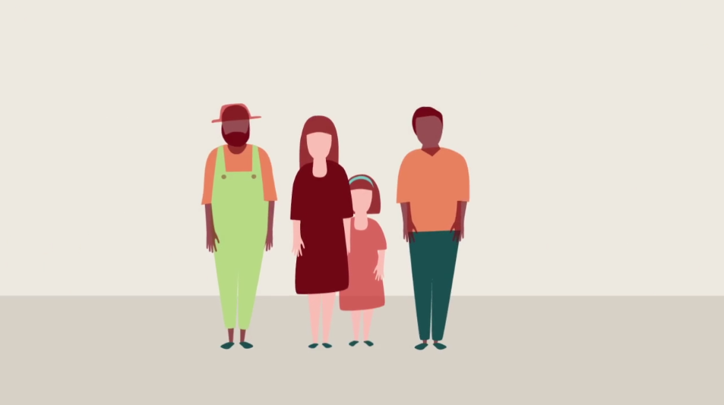
Human-Centered Design

Slide 4
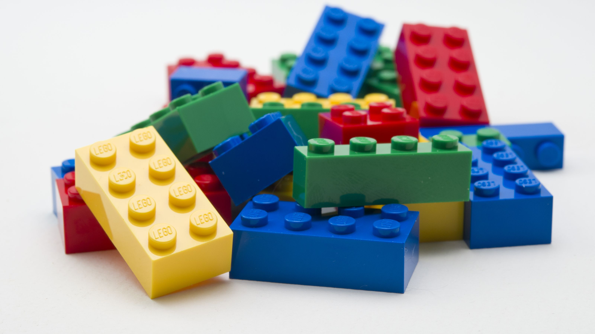
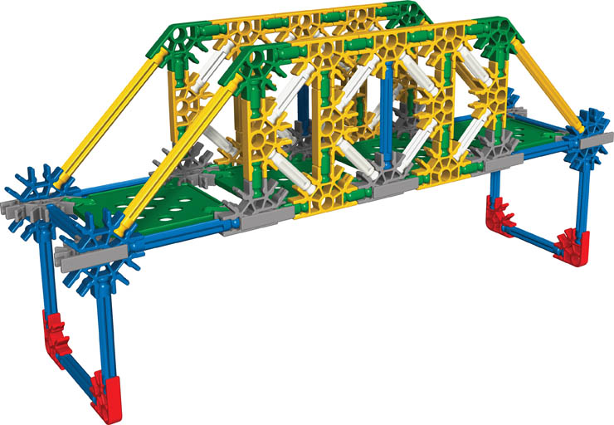
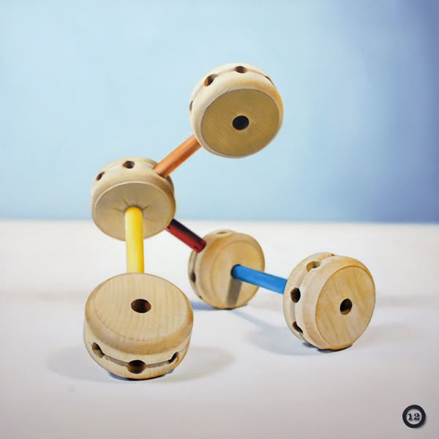
Build by Design Challenge
Design, build, and market a modular building toy prototype according to the client’s requirements

Slide 5
Question Time
Take 5 minutes to develop a list of questions that you are still unsure of after reading through the task

Slide 6
Qualitative vs Quantitative
Qualitative
Quantitative

Slide 7
Make this Quantitative…
Lebron James is tall.

Slide 8
Design Process

Slide 9
Consumer Criteria
“Nice to haves” – As many as possible
Make these Quantitative

Slide 10
Design Constraints
“Must haves” – All of these are required
There can be more constraints than just the manufacturing limits

Slide 11
Problem Statement
We as (our role) seek to (our task) in order to (reasons for design) for (our stakeholders)

Slide 12
Brainstorming
Before you dive into the materials and start building, it’s important to take a step back and develop a game plan
Rules for Brainstorming
Go for numbers, as many ideas as possible | Don’t judge, be positive and encouraging
Be visual, sketches help | Build on the ideas of others
Headline your idea, then quickly move on | Stay on Topic
One voice at a time. Everyone Shares | Encourage wild ideas
Think independently for the first 5 minutes… then compare ideas to create your group list

Slide 13
The Schedule
Monday | Tuesday | Wednesday | Thursday | Friday
Empathize
Define
Ideate
Prototype
Monday | Tuesday | Wednesday | Thursday | Friday
Test
Communicate

