Slide 1
Solutions
6
3
8
2
All-in-one
48 Ω
20 Ω
112 Ω
20 Ω
16 Ω
56 Ω
8 Ω
24 Ω
64 Ω
32 Ω
28 Ω
12 Ω
20 Ω
48 Ω
24 Ω
28 Ω
 | V | I | R
R₁ | 10 | 5 | 2
R₂ | 20 | 1 | 20
R₃ | 20 | 4 | 5
R₄ | 30 | 5 | 6
Total | 60 | 5 | 12
10 | 3 | 5 | 2 | 7 | 15 | 20 | 1 | 8 | 11 | 20 | 9 | 24 | 20 | 4 | 5 | 18 | 30 | 40 | 5 | 6
6 Ω
30 Ω
13 Ω
20 Ω
21 Ω
15 Ω
A
B
C
D
E
F

Slide 2
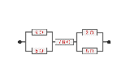
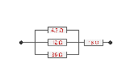
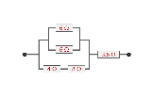
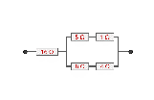
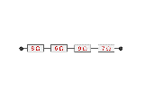
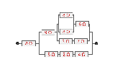
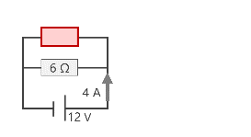
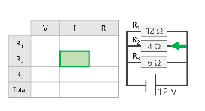
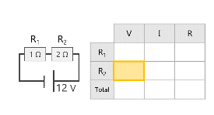
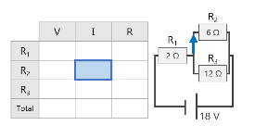
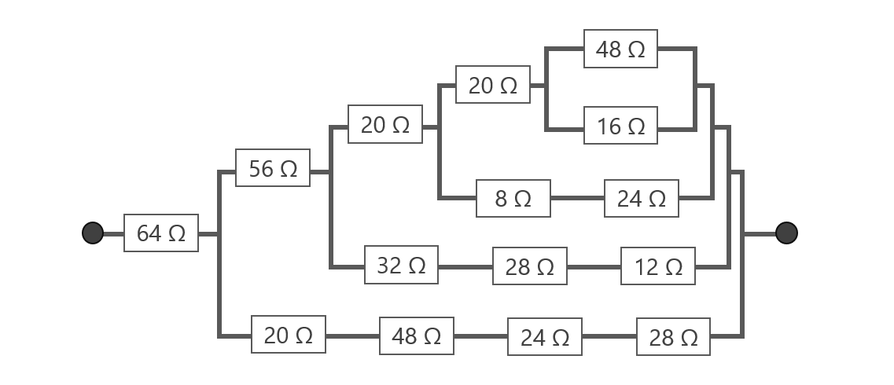
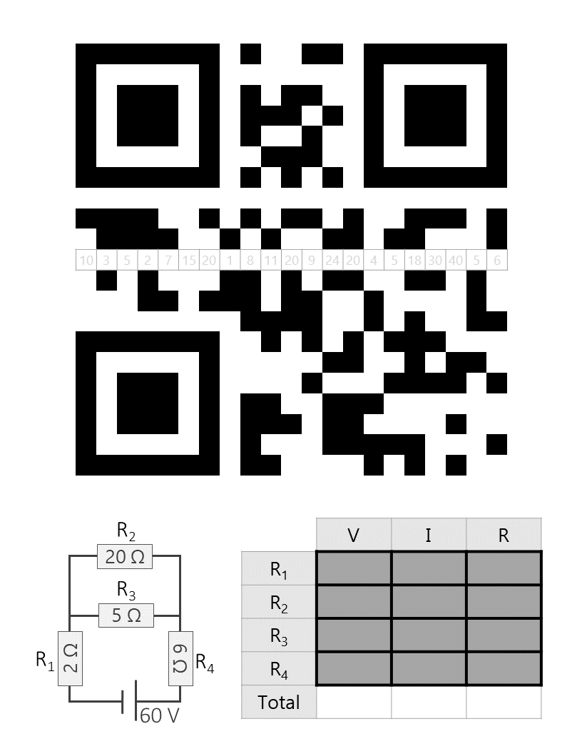
Scavenger Hunt Process
Prize Bag!!

Slide 3
1 | ___ ___ ___
2 | ___ ___ ___ ___
3 | ___ ___ ___
4 | ___ ___ ___ ___
1
0
5
6
3
8
2
1
1
2
N
E
A
T

Slide 4
6 Ω
5 Ω
1 Ω
6 Ω
3.6 Ω
16 Ω
4 Ω
8 Ω
8 Ω
4 Ω
6 Ω
20 Ω
4.5 Ω
8 Ω
6 Ω
9 Ω
7 Ω
12 Ω
18 Ω
36 Ω
30 Ω
21 Ω
8 Ω
9 Ω
2 Ω
6 Ω
7.8 Ω
9 Ω
8 Ω
6 Ω
8 Ω
8 Ω
3 Ω
7 Ω
13 Ω
15 Ω
8 Ω
2 Ω
4 Ω
105 Ω
6 Ω
30 Ω
13 Ω
20 Ω
21 Ω
15 Ω
A
B
C
D
E
F

Slide 5
6 Ω
6 Ω
4 A
12 V
R₁
 | V | I | R
R₁ | 12 | 1 | 12
R₂ | 12 | 3 | 4
R₃ | 12 | 2 | 6
Total | 12 | 6 | 2
12 Ω
R₂
4 Ω
R₃
6 Ω
12 V
R₂
 | V | I | R
R₁ | 6 | 3 | 2
R₂ | 12 | 2 | 6
R₃ | 12 | 1 | 12
Total | 18 | 3 | 6
R₁
6 Ω
2 Ω
R₃
12 Ω
18 V
 | V | I | R
R₁ | 4 | 4 | 1
R₂ | 8 | 4 | 2
Total | 12 | 4 | 3
R₁
R₂
1 Ω
2 Ω
12 V

Slide 6
112 Ω
48 Ω
20 Ω
20 Ω
16 Ω
56 Ω
8 Ω
24 Ω
64 Ω
32 Ω
28 Ω
12 Ω
20 Ω
48 Ω
24 Ω
28 Ω
Notes:
64, 32, 16

Slide 7
10 | 3 | 5 | 2 | 7 | 15 | 20 | 1 | 8 | 11 | 20 | 9 | 24 | 20 | 4 | 5 | 18 | 30 | 40 | 5 | 6
R₂
 | V | I | R
R₁ | 10 | 5 | 2
R₂ | 20 | 1 | 20
R₃ | 20 | 4 | 5
R₄ | 30 | 5 | 6
Total | 60 | 5 | 12
20 Ω
R₃
5 Ω
R₁
R₄
2 Ω
6 Ω
60 V

