Slide 1
Vertical Circular Motion with a Surface
IB Physics | Circular Motion

Slide 2
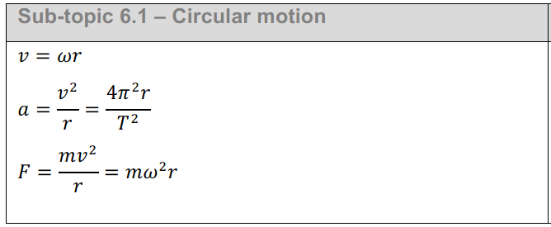
IB Physics Data Booklet
$v$ – linear velocity (m s⁻¹)
$ω$ – angular velocity (rad s⁻¹)
$r$ – radius (m)
$T$ – period (s)
$a$ – centripetal acceleration (m s⁻²)
$F$ – centripetal force (N)

Slide 3
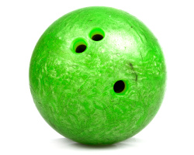
Remember Normal Reaction Force?
*Always perpendicular to the surface applying the force
R
F_{g}

Slide 4
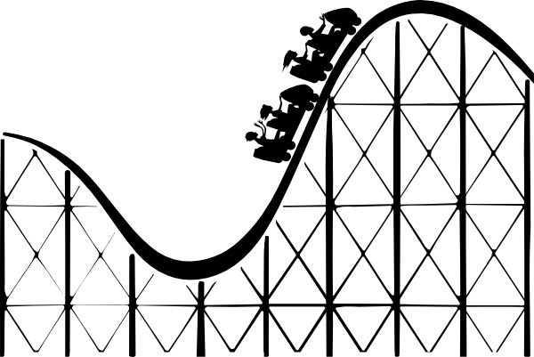


Roller Coaster | Bottom
$$F_{c}=\frac{mv^{2}}{r}$$
$$=\frac{(200){(10)}^{2}}{8}$$
m | 200 kg
v | 10 m s⁻¹
r | 8 m
F_{c}
F_{net}
F_{g}
R
$$=2500 N$$
$$F_{g}=mg$$
$$=\left(200\right)\left(9.81\right)=1962 N$$
R
$$F_{net}=R−F_{g}$$
F_{c}
or
$$R=2500+1962$$
F_{net}
$$R=4462 N$$
2500 N
F_{g}
8 m
2500 N
1962 N
10 m s⁻¹
4462 N

Slide 5
Roller Coaster | Top
$$F_{c}=\frac{mv^{2}}{r}$$
$$=\frac{(200){(5)}^{2}}{8}=625 N$$
m | 200 kg
v_{t} | 5 m s⁻¹
r | 8 m
F_{c}
F_{net}
F_{g}
R
5 m s⁻¹
$$F_{g}=mg$$
$$=\left(200\right)\left(9.81\right)=1962 N$$
F_{c}
R
8 m
or
F_{net}
F_{g}
625 N
$$F_{net}=F_{g}−R$$
$$R=1962−625$$
625 N
$$R=1337 N$$
1962 N
1337 N

Slide 6
Perceived Weight
The normal reaction force represents a rider’s “perceived weight”
1337 N
625 N
1962 N
R > F_{g} | “Squished into seat”
R < F_{g} | “Weightless”
4462 N
2500 N
1962 N

Slide 7
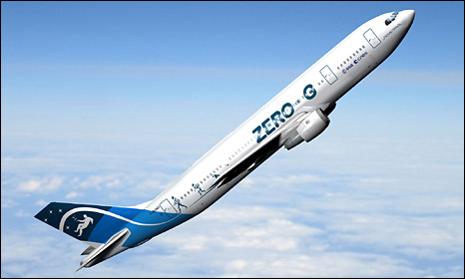
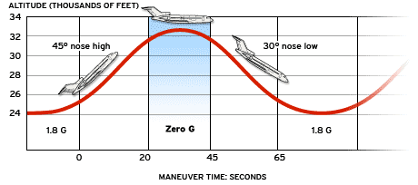
The ultimate “weightless” experience
F_{net}
R
F_{g}
F_{net}
F_{g}

Slide 8
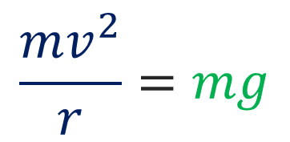
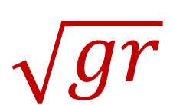
Loop the Loop!
The velocity needs to be fast enough that the R is greater than 0 N
$$F_{c}=F_{g}$$
R=0
F_{c}
$$\frac{mv^{2}}{r}=mg$$
F_{g}
$$v=\sqrt{gr}$$
$$\sqrt{gr}$$
Minimum velocity required =

Slide 9
Lesson Takeaways
I can compare the forces on an object at different positions in vertical circular motion
I can determine the magnitude and direction of the forces needed for the overall centripetal force
I can qualitatively describe how normal reaction force changes in a vertical circle
I can describe the experience of “weightlessness” in terms of normal reaction force

