Slide 1
Circular Motion Scenarios The Rotor
IB Physics | Circular Motion

Slide 2
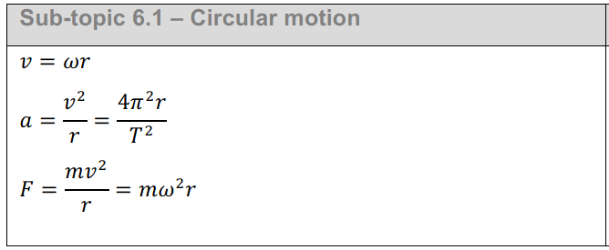
IB Physics Data Booklet
$v$ – linear velocity (m s⁻¹)
$ω$ – angular velocity (rad s⁻¹)
$r$ – radius (m)
$T$ – period (s)
$a$ – centripetal acceleration (m s⁻²)
$F$ – centripetal force (N)

Slide 3
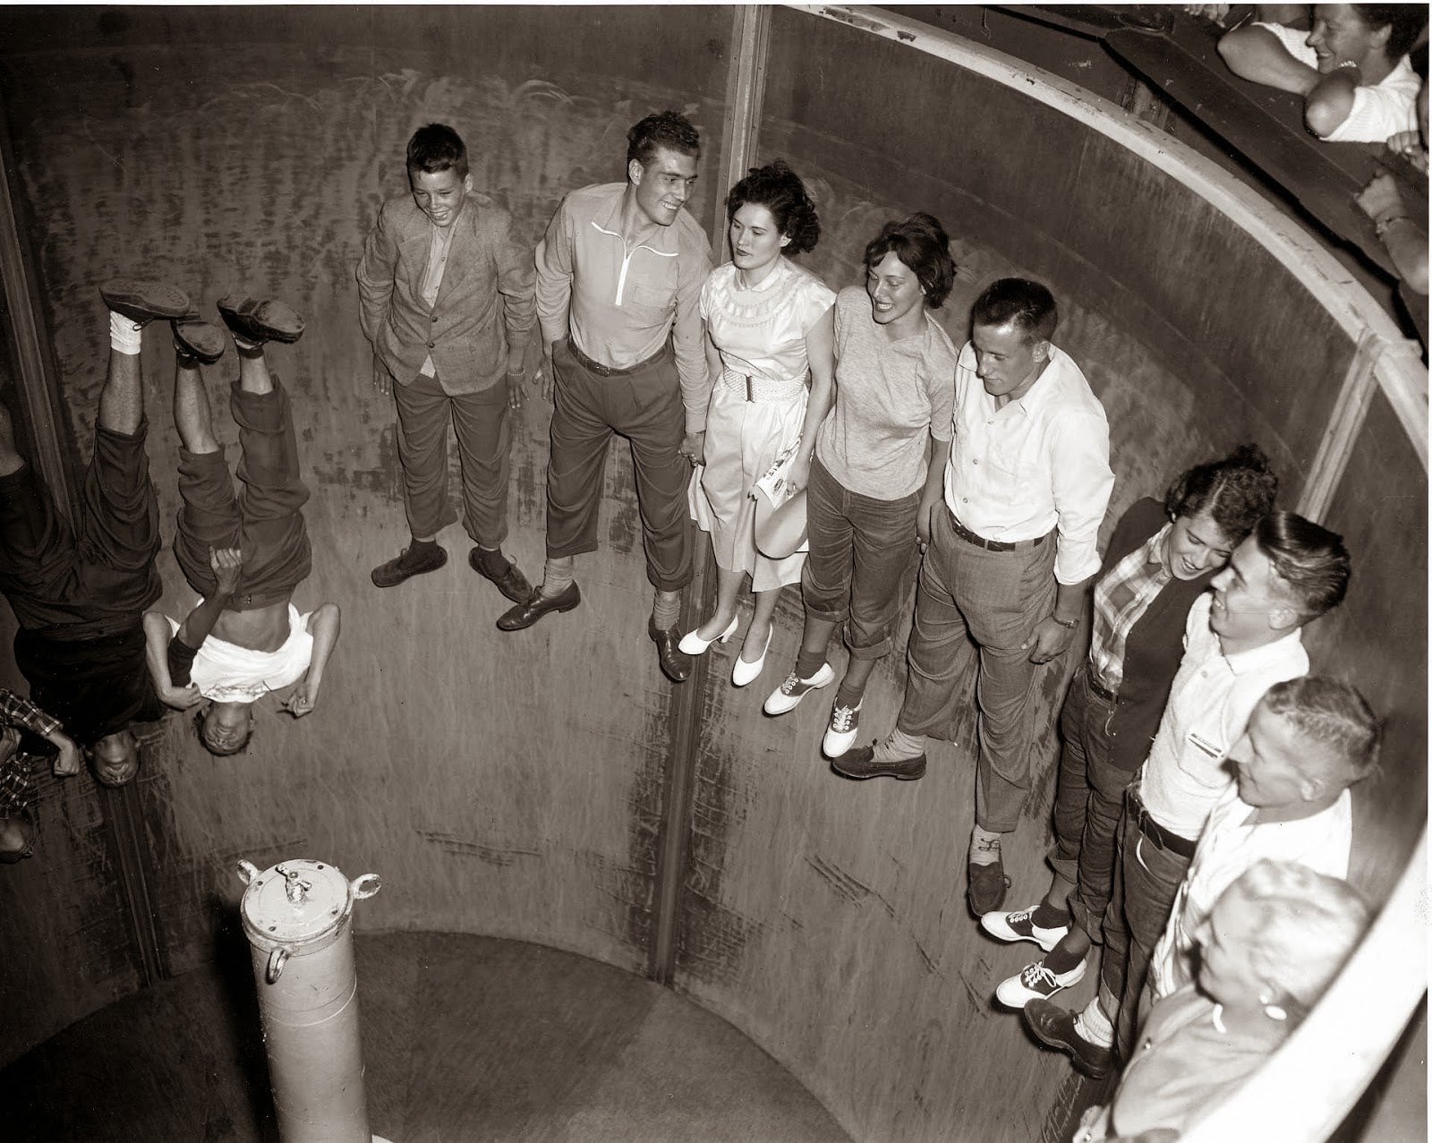
“The Rotor”
F_{f}
F_{f} = μR
F_{g} = mg
R
F_{g}

Slide 4
Remember “The Rotor”
We can use this example to discuss that there must be an inward force (centripetal force) acting towards the center. But why don’t they fall down?!?
Friction
F_{f}
R
F_{g}

Slide 5
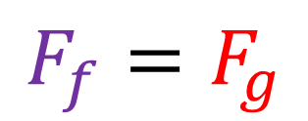
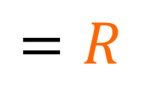
You can’t forget about Friction!
R
μ
Remember that friction is related to the normal force and the coefficient of friction (μ).
The only thing that is different here is that the normal force is the centripetal force.
$$F_{f}=F_{g}$$
$$F_{net}=F_{c}$$
$$=R$$
$$F_{f}=μR$$
F_{f}
$$F_{net}=R$$
R
$$F_{c}=R$$
F_{g}
$$F_{c}=\frac{mv^{2}}{r}=mω^{2}r$$

Slide 6
Give it a Shot!
The "Rotor" ride is the one which presses you against the walls of the spinning rotor as the floor drops away. The coefficient of static friction between the wall and the 75-kg rider is μ = 0.06. If the ride is rotating at an angular velocity of 5.2 rad s⁻¹, what must be the radius of the rotor?
$$ω$$
$$F_{f}=F_{g}$$
*Friction and weight are equal and opposite
$$μR=mg$$
F_{f}
$$(0.06)R=(75)(9.81)$$
*Normal Reaction Force is equal to the Centripetal Force
R
$$R=12,263 N$$
$$F_{c}=\frac{mv^{2}}{r}=mω^{2}r$$
F_{g}
$$F_{c}=R=mω^{2}r$$
$$r=6.05 m$$
$$12,263=(75){(5.2)}^{2}r$$

Slide 7
You didn’t need the mass ☺
The "Rotor" ride is the one which presses you against the walls of the spinning rotor as the floor drops away. The coefficient of static friction between the wall and the 75-kg rider is μ = 0.06. If the ride is rotating at an angular velocity of 5.2 rad s⁻¹, what must be the radius of the rotor?
$$F_{f}=μR$$
$$F_{g}=mg$$
$$F_{f}=F_{g}$$
F_{f}
$$F_{c}=mω^{2}r$$
$$F_{c}=F_{net}=R$$
$$μR=mg$$
R
F_{g}
$$μmω^{2}r=mg$$
$$μω^{2}r=g$$
solve for r

Slide 8
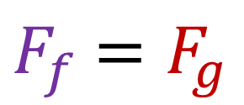
All Together Now!
$F_{f}$ $=F_{g}$
$$F_{c}=R$$
F_{f}
R
F_{g}

Slide 9
Lesson Takeaways
I can draw a free body diagram and solve a problem when circular motion is produced by a normal reaction force

