Slide 1
Circular Motion Scenarios The Pendulum
IB Physics | Circular Motion

Slide 2
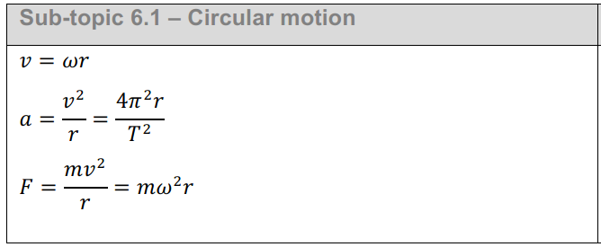
IB Physics Data Booklet
$v$ – linear velocity (m s⁻¹)
$ω$ – angular velocity (rad s⁻¹)
$r$ – radius (m)
$T$ – period (s)
$a$ – centripetal acceleration (m s⁻²)
$F$ – centripetal force (N)

Slide 3
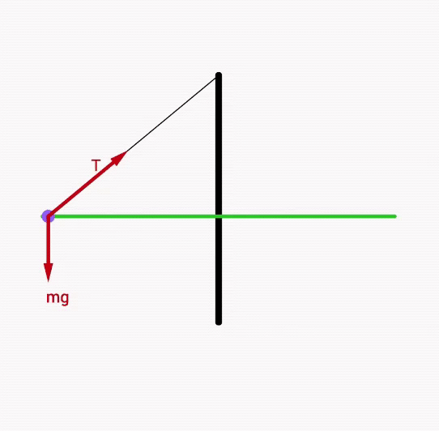
Pendulum Circle

Slide 4
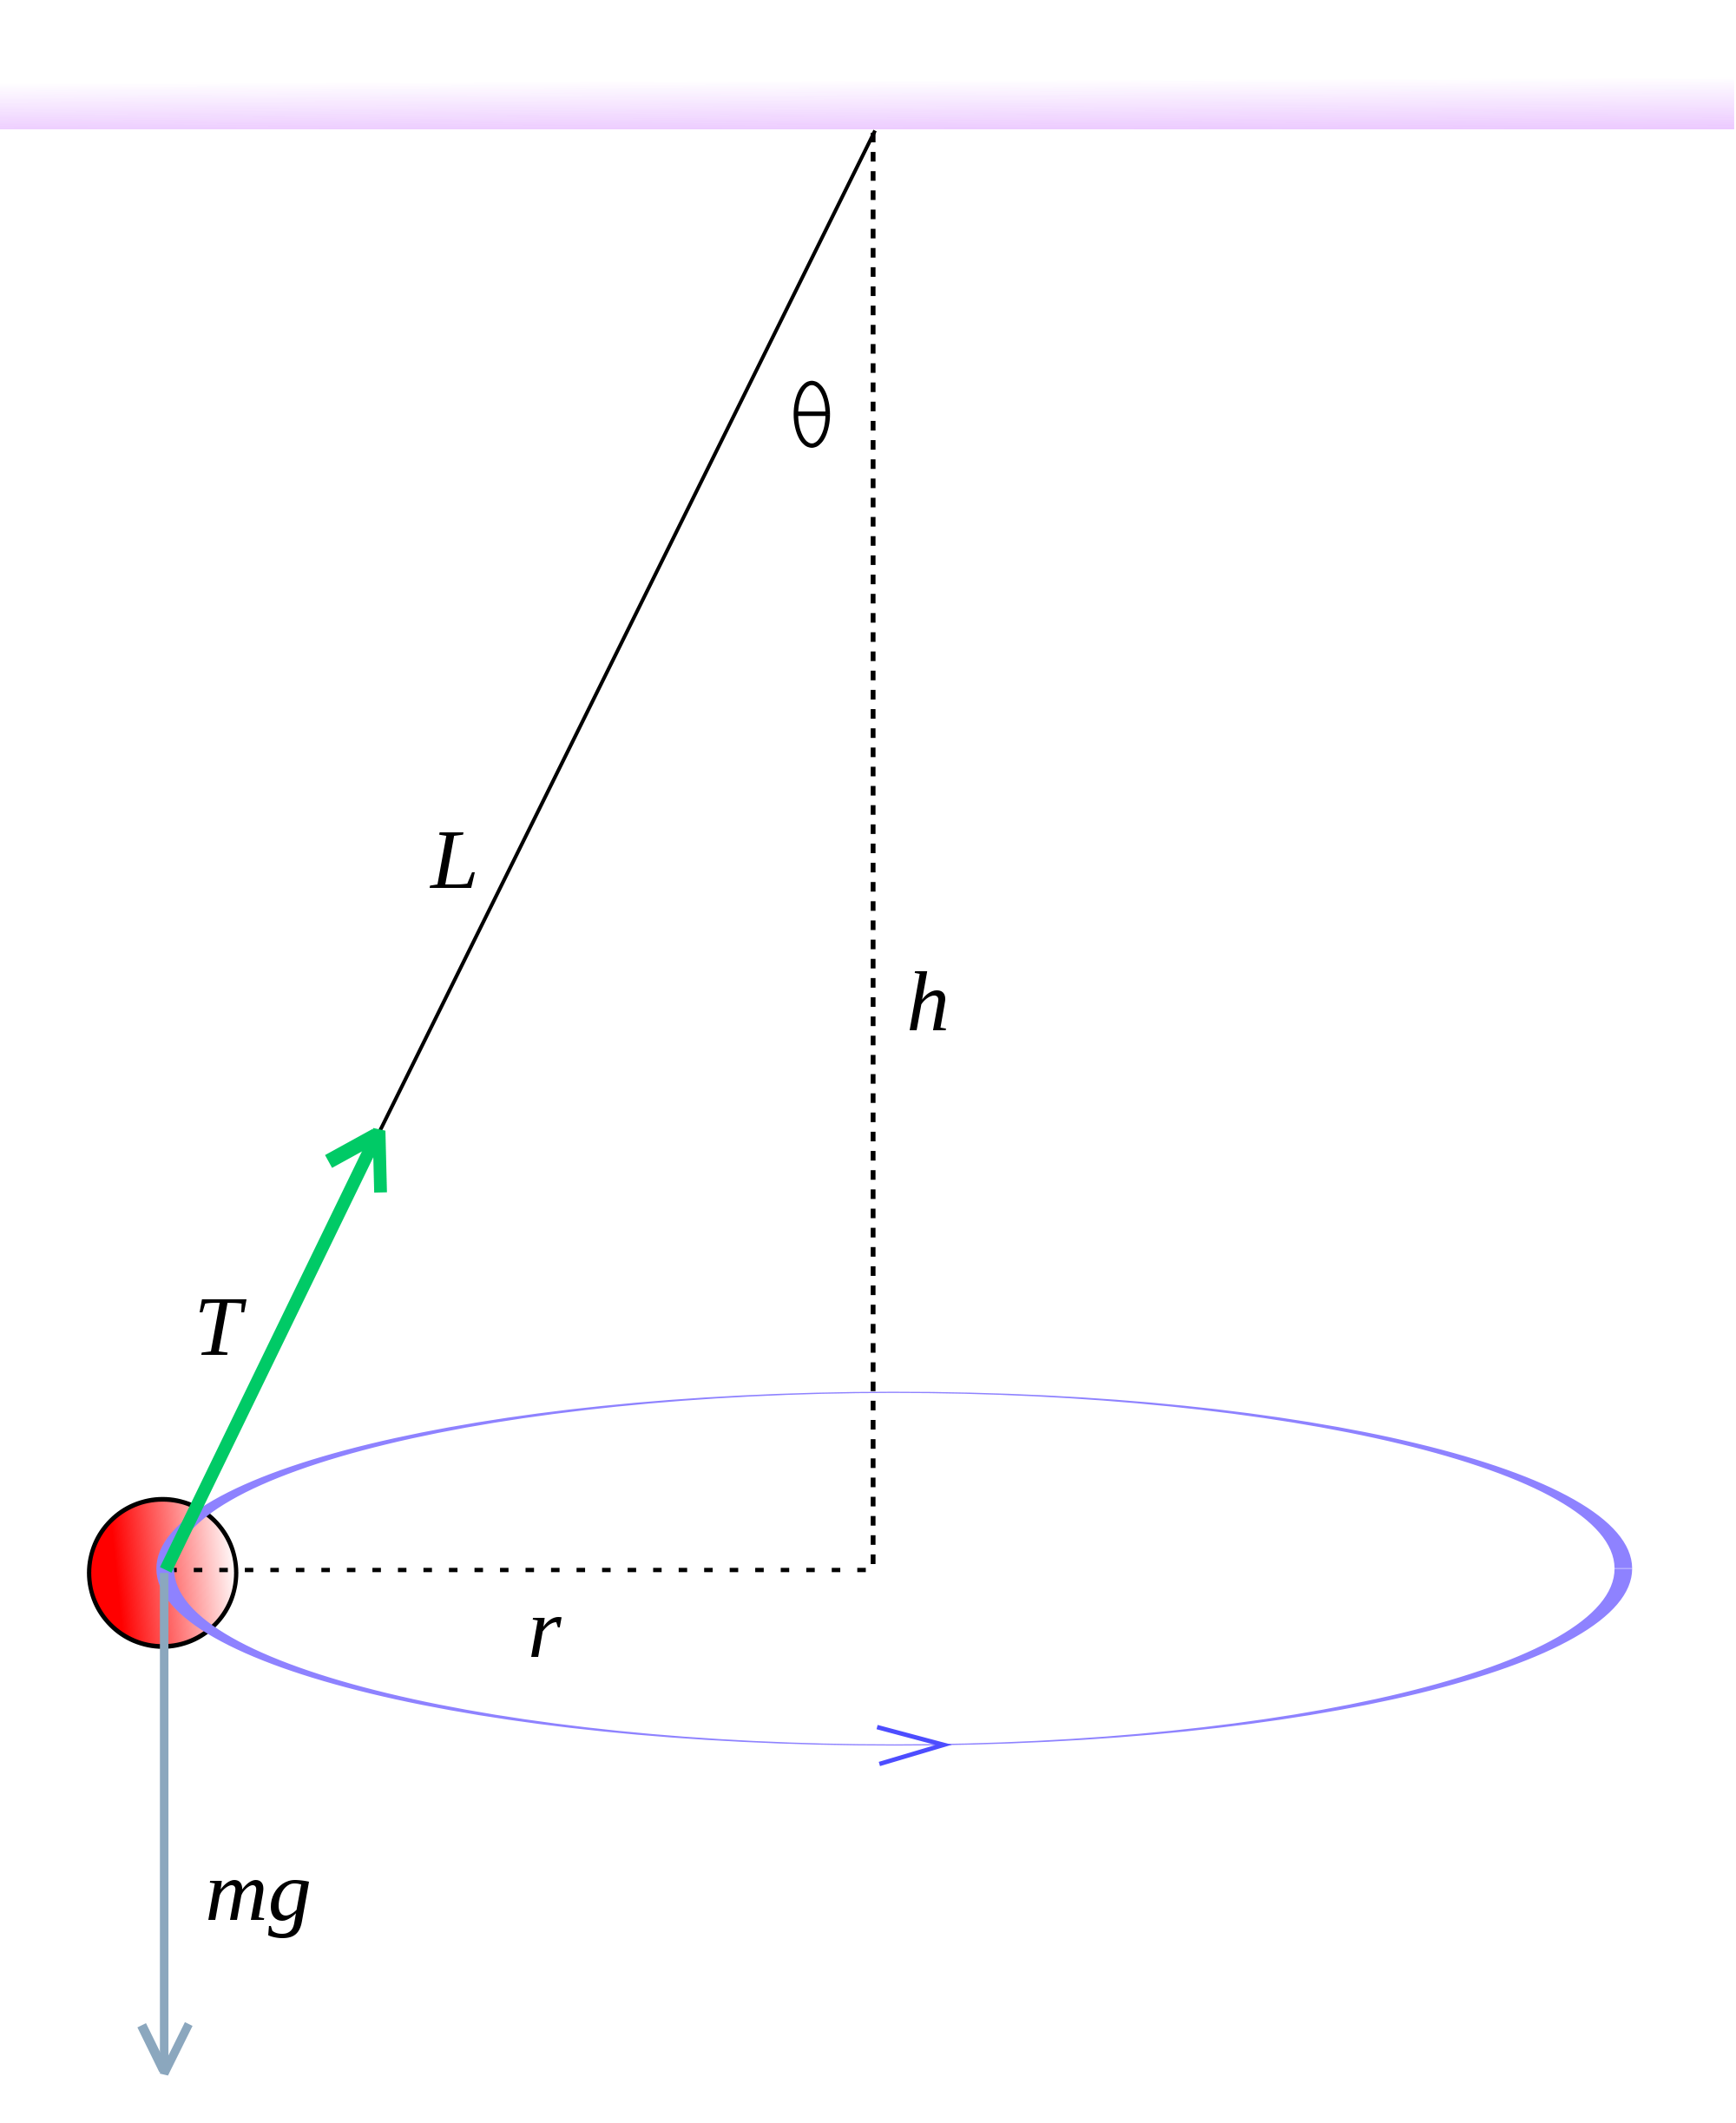
Pendulum Circle
T_{y}
T
$$F_{net}=F_{c}$$
$$=T_{x}$$
F_{c}
$T_{y}$ $=F_{g}$
T_{x}
F_{g} = mg

Slide 5
Pendulum Circle
What is centripetal force required to cause a 0.12 kg mass to swing in a horizontal circle with the string at an angle of 30°?
T_{y}
$T_{y}$ $=F_{g}$
$$=mg=\left(0.12\right)\left(9.81\right)=1.18 N$$
F_{c}
T_{x}
$$\tan\left(θ\right)=\frac{T_{x}}{T_{y}}$$
$$T_{x}=T_{y}tan\left(θ\right)$$
T
30°
T_{y}
$$T_{x}=1.18tan\left(30°\right)=0.68 N$$
F_{g} = mg
T_{x}
$$F_{c}=0.68 N$$
$$F_{net}=F_{c}=T_{x}$$
$$=0.68 N$$

Slide 6
CAUTION! There are two triangles
Distances | [m]
Forces | [N]
L
T
θ
θ
h
T_{y}
r
T_{x}

Slide 7
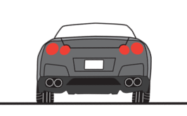
All Together Now!
$F_{f}$ $=F_{g}$
$$R=F_{g}$$
$T_{y}$ $=F_{g}$
$$F_{c}=R$$
$$F_{c}{=F}_{f}$$
$$F_{c}=T_{x}$$
F_{f}
R
T_{y}
R
F_{f}
T_{x}
F_{g}
F_{g}
F_{g}

Slide 8
Lesson Takeaways
I can draw a free body diagram and solve a problem when circular motion is produced by components of an angled tension force.

