Slide 1
Pigpen Cipher
The Pigpen Cipher is a Substitution Cipher that was used by the Freemasons in the 18th Century. They substituted each letter of the alphabet with a picture.
A | B | C
D | E | F
G | H | I
J | K | L
M | N | O
P | Q | R
 | S
T |  | U
 | V
 | W
X |  | Y
 | Z
It is a fairly simple cipher to use, where each letter is replaced by the lines and dots given by the position it sits on the table. For example:
A =
Q =
•
T =
Z =

Slide 2
Polybius Square
Each letter is then represented by its coordinates in the grid. For example, "BAT" becomes "12 / 11 / 44“. Hint: the row number always comes first.
 | 1 | 2 | 3 | 4 | 5
1 | A | B | C | D | E
2 | F | G | H | I/J | K
3 | L | M | N | O | P
4 | Q | R | S | T | U
5 | V | W | X | Y | Z

Slide 3
Atbash Cipher
The Atbash Cipher is a very old Substitution Cipher that was originally developed for use with the Hebrew alphabet. In fact, in the Book of Jeremiah there are several words that have been enciphered using the Atbash Cipher. It is generally considered one of the easiest ciphers to use as it follows a very simple substitution method. The first letter of the alphabet is replaced with the last letter, the second letter is replaced with the second from last, and so on.
Using the English alphabet, the key to this cipher is shown below:
a | b | c | d | e | f | g | h | i | j | k | l | m | n | o | p | q | r | s | t | u | v | w | x | y | z
Z | Y | X | W | V | U | T | S | R | Q | P | O | N | M | L | K | J | I | H | G | F | E | D | C | B | A
HXRVMXV → science

Slide 4
Affine Cipher
The Affine Cipher is a cipher that uses math to encode the message. It works by converting every letter in the alphabet into a number and performing a function on that number.
To convert letters into numbers, or vise-versa use the following system where each letter gets a number:
a | b | c | d | e | f | g | h | i | j | k | l | m | n | o | p | q | r | s | t | u | v | w | x | y | z
1 | 2 | 3 | 4 | 5 | 6 | 7 | 8 | 9 | 10 | 11 | 12 | 13 | 14 | 15 | 16 | 17 | 18 | 19 | 20 | 21 | 22 | 23 | 24 | 25 | 26
19-3-9-5-14-3-5 → science

Slide 5
Caesar Cipher
The Caesar Shift Cipher has a long history of usage, dating back to Julius Caesar (100BC—44BC). He used the cipher to protect messages of military importance, and it is believed that he used many other substitution ciphers as well (although this is the only one we have evidence of him using, as quoted by Suetonius). The cipher works by substituting for each letter the letter that is k letters further along the alphabet, where k is the key. Below is the completed table for a shift of 3.
Below is the completed table for a shift of 3:
 |  |  | a | b | c | d | e | f | g | h | i | j | k | l | m | n | o | p | q | r | s | t | u | v | w | x | y | z
A | B | C | D | E | F | G | H | I | J | K | L | M | N | O | P | Q | R | S | T | U | V | W | X | Y | Z | A | B | C
VFLHQFH → science

Slide 6
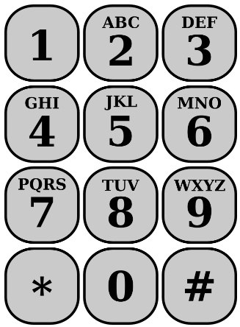
Phone Characters
The 2-9 buttons on a phone each correspond to some letters in the English alphabet. The challenge is that while each letter can only map to one number, each number can represent 3 or 4 different letters. We can remove this ambiguity by indicating how many which letter by pressing the key more than once.
For Example:
(2) → A (22) → B (222) → C

Slide 7
Keyword Cipher
The most commonly used method, is to use a keyword, which generates the key. Usually this is implemented as follows. The keyword is chosen as a memorable word to both the sender and the receiver. To generate the key (the ciphertext alphabet), you first use the letters from the keyword in the order they appear in the keyword (but without repeating any letters). Once all the letters from the keyword have been used, you now insert the remaining letters of the alphabet in alphabetical order. (make sure you don’t reuse letter from the keyword)
Below is the completed table for a keyword of ZEBRA:
a | b | c | d | e | f | g | h | i | j | k | l | m | n | o | p | q | r | s | t | u | v | w | x | y | z
Z | E | B | R | A | C | D | F | G | H | I | J | K | L | M | N | O | P | Q | S | T | U | V | W | X | Y

Slide 8
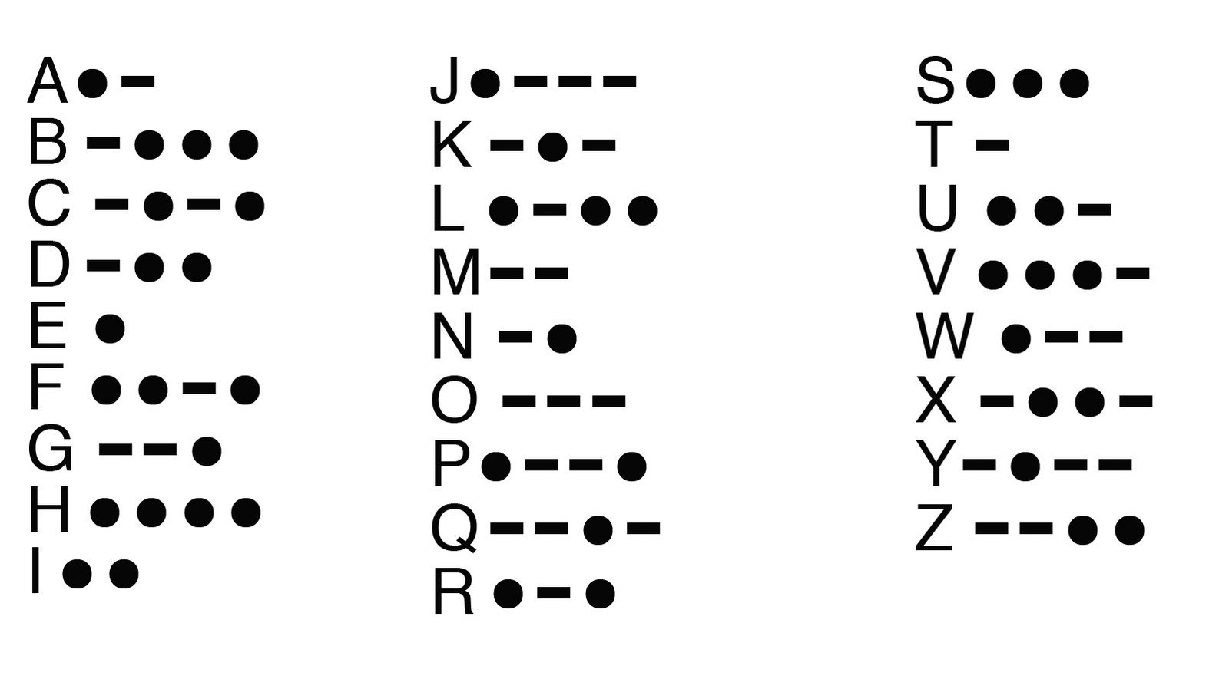
Morse Code
Morse code was commonly used to transmit text information as a series of on-off tones, lights, or clicks. Skilled listeners can translate these dots and dashes back into letters and words once the message is received.

