Slide 1
Electrical Properties
IB Physics | Electricity
Voltage
Current
Resistance
Power

Slide 2
Remember back…
What is potential energy?
Stored Energy
Voltage
Current
Resistance
Power

Slide 3
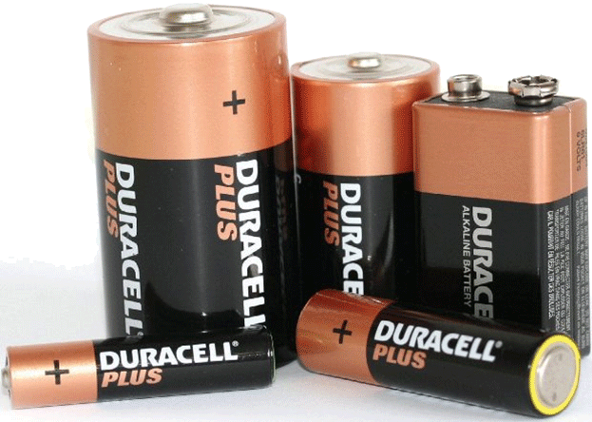
Voltage
Difference
Voltage is the Potential Energy ____________ between two locations
Voltage = Potential Difference
p.d.
Symbol: | Unit:
V
Volts [V]
Voltage
Current
Resistance
Power

Slide 4
Current
The rate at which charges
move through a conductor
Flow of Electrons
Symbol: | Unit:
I
Amperes [A]
-
-
-
-
-
-
-
-
-
-
-
-
-
-
-
-
-
-
-
-
-
Voltage
Current
Resistance
Power

Slide 5
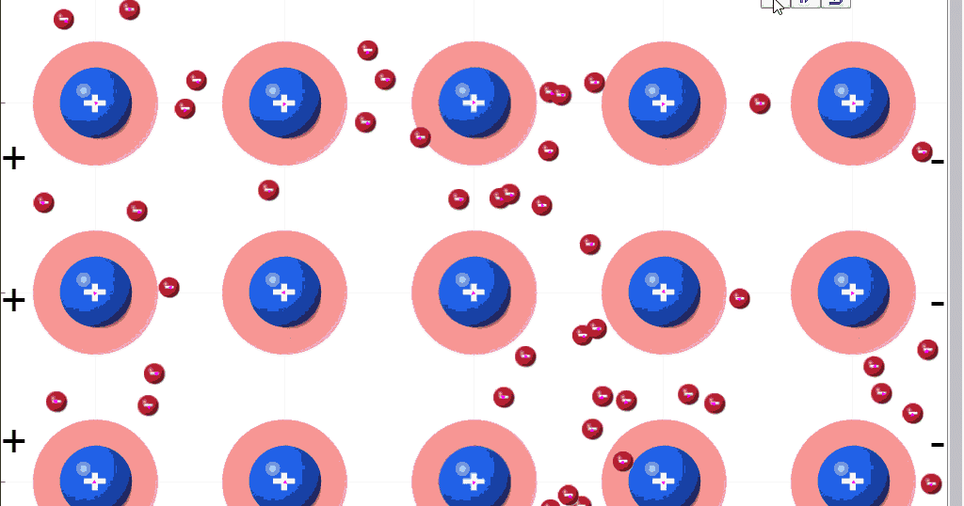
Current
Why do the electrons flow instead of protons or neutrons?
Outside of the atom so they are more easily transferred
Voltage
Current
Resistance
Power

Slide 6
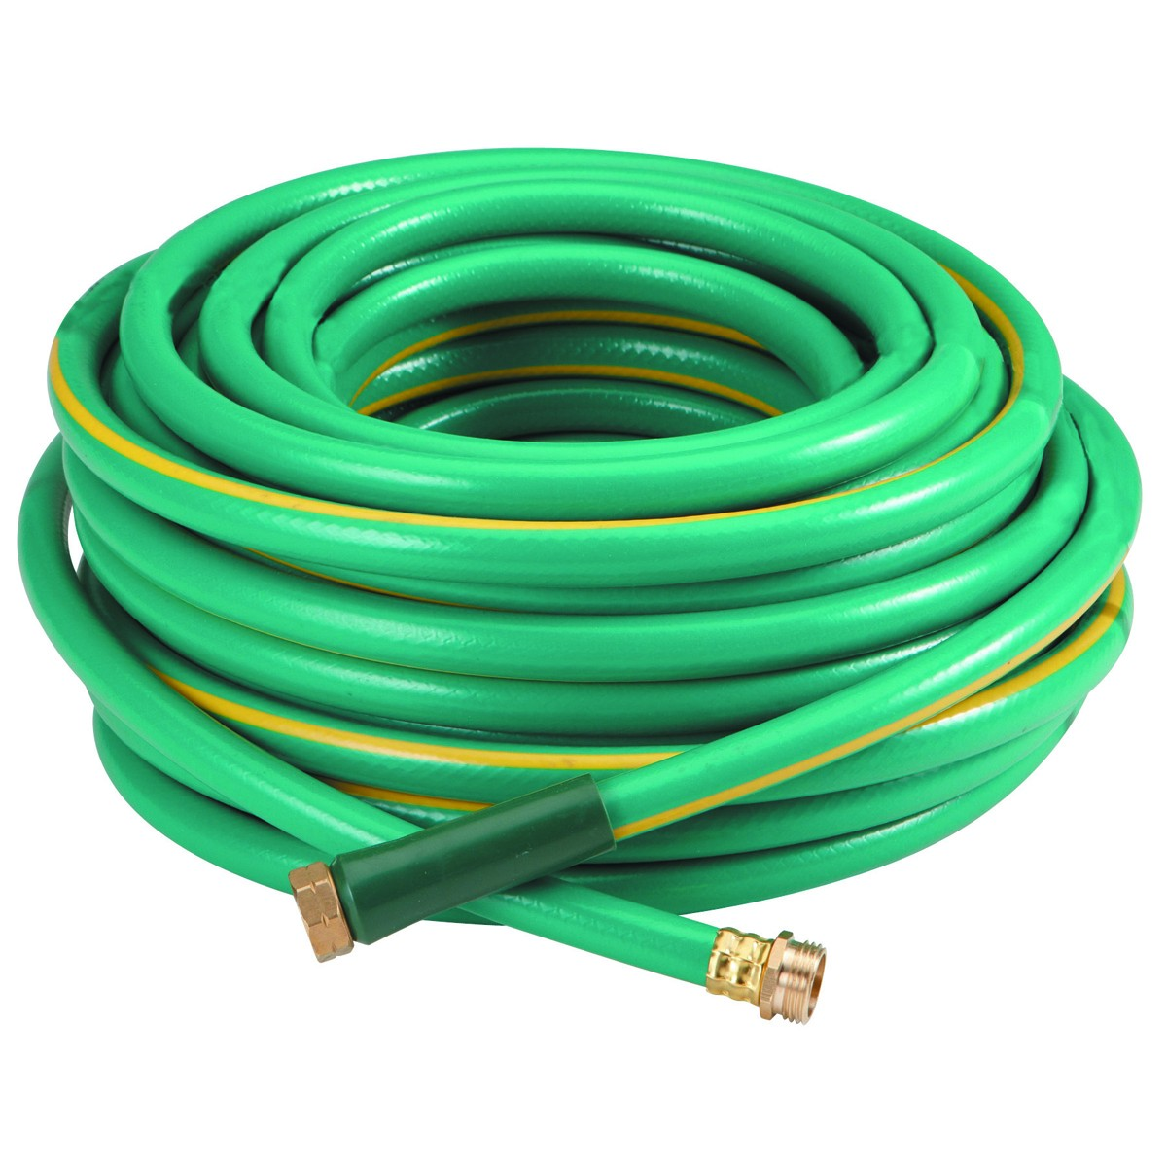
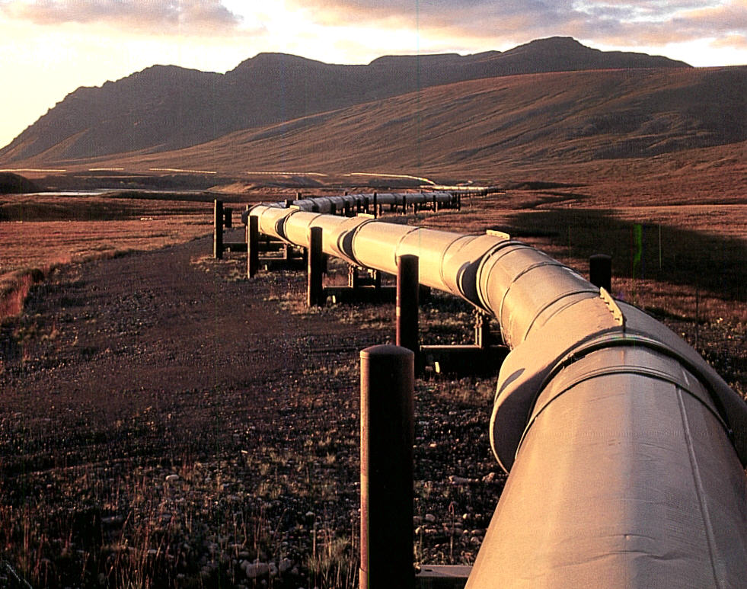
Resistance
How difficult it is for electrons to flow
Symbol: | Unit:
R
Ohms [Ω]
Which one has more resistance for water flow?
Voltage
Current
Resistance
Power

Slide 7
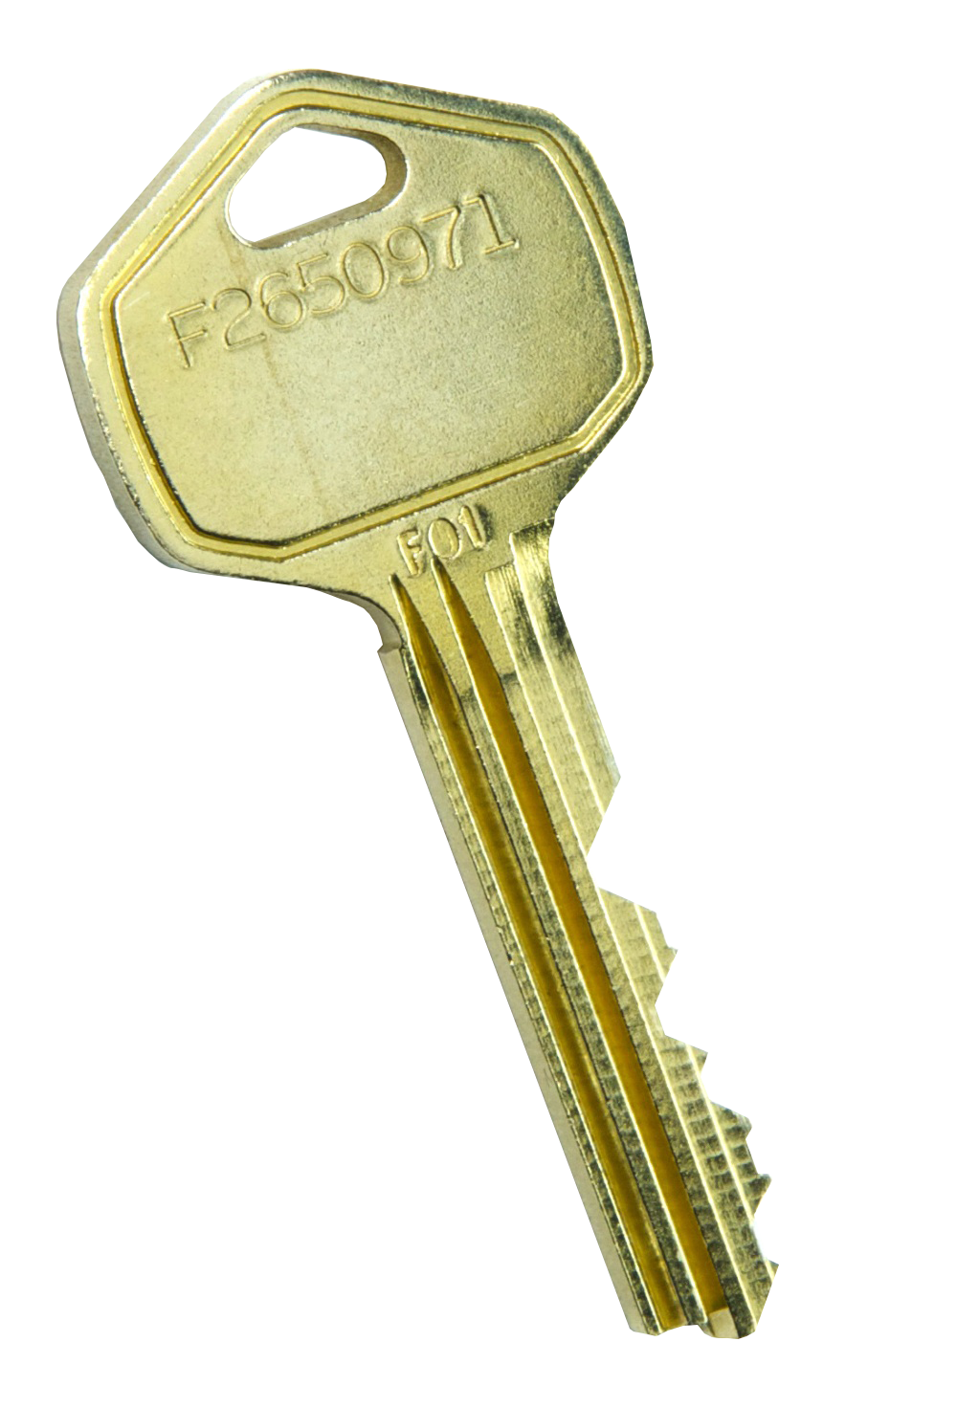
Conductors and Insulators
low
Conductors have a ___________ resistance
Insulators have a ___________ resistance
high
Voltage
Current
Resistance
Power

Slide 8
Electrical Properties
Property | What is it? | Symbol | Unit
Voltage | Potential Difference
Current | The rate at which the charges move through wire
Resistance | How hard it is for current to flow through a conductor
V
Volts
[V]
I
Amps
[A]
R
Ohms
[Ω]
Voltage
Current
Resistance
Power

Slide 9
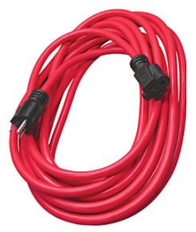
How are they Related?
Voltage
Current
$$V∝I$$
Resistance
Current
$$R∝1/I$$
Voltage
Current
Resistance
Power

Slide 10
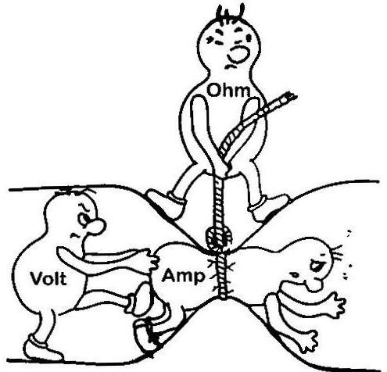
How are they Related?
Voltage
Current
Resistance
Power

Slide 11
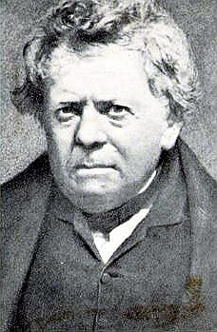
Ohm’s Law
*Memorize*
Mathematical relationship between the electrical properties
V
$$V=I×R$$
$$I=\frac{V}{R}$$
×
I
R
$$R=\frac{V}{I}$$
Voltage
Current
Resistance
Power

Slide 12
IB Physics Data Booklet
Voltage
Current
Resistance
Power

Slide 13
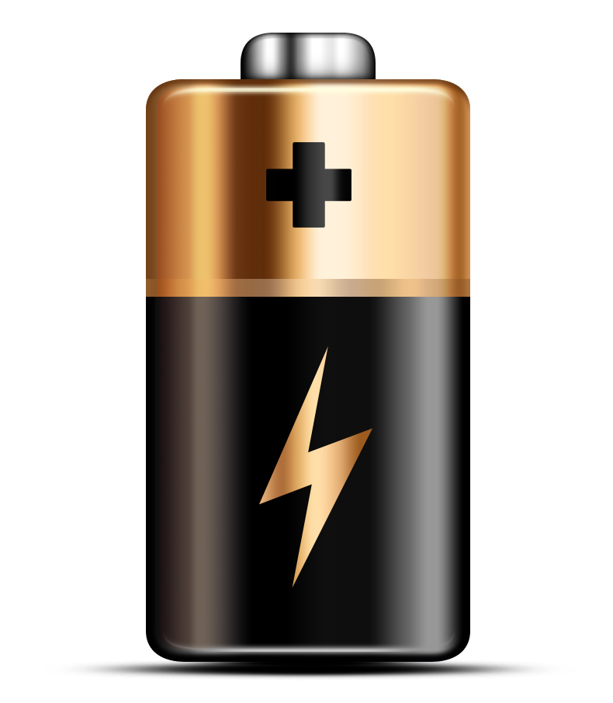
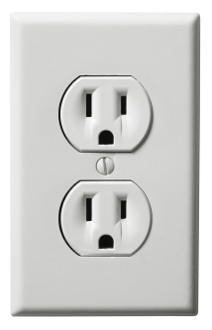
$$R=\frac{V}{I}$$
Try this…
What is the voltage of a battery that produces a current of 1.5 amps through a 3 ohm resistor?
$$I=1.5 A$$
$$R=3 Ω$$
$$V=I×R$$
$$=1.5×3$$
$$=4.5 V$$
$$V= ??$$
What resistance would produce a current of 5 amps from a 120-volt power source?
$$I=5 A$$
$$R=\frac{V}{I}$$
$$=\frac{120}{5}$$
$$V=120 V$$
$$=24 Ω$$
$$R= ??$$
Voltage
Current
Resistance
Power

Slide 14
Remember Power?
P
Symbol: | Unit:
Watts [W]
New Equations:
$$I=\frac{V}{R}$$
$$V=IR$$
$$P=VI$$
$$P=VI$$
$$P=VI$$
$$P=\frac{V^{2}}{R}$$
$$P=I^{2}R$$
Voltage
Current
Resistance
Power

Slide 15
IB Physics Data Booklet
Voltage
Current
Resistance
Power

Slide 16
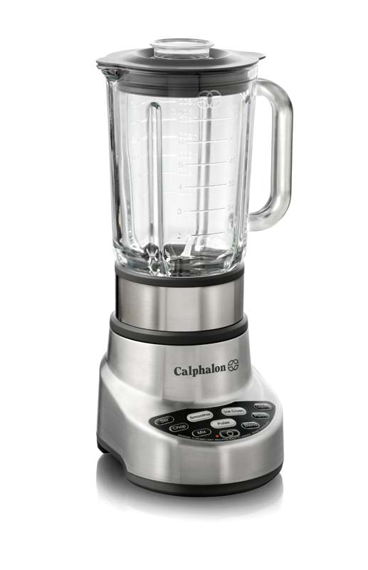
Calculating Power
A blender runs on 5 amps of current on a 120 V. How much power is it drawing?
$$I=5 A$$
$$V=120 V$$
$$P=VI$$
$$=(120)(5)$$
$$=600 W$$
$P=VI=$ $I^{2}R=\frac{V^{2}}{R}$
Voltage
Current
Resistance
Power

Slide 17
Different Devices… Different Power
Common Appliances | Estimated Watts
Blender | 300-1000
Microwave | 1000-2000
Waffle Iron | 800-1500
Toaster | 800-1500
Hair Dryer | 1000-1875
TV 32" LED/LCD | 50
TV 42" Plasma | 240
Blu-Ray or DVD Player | 15
Video Game Console (Xbox / PS4 / Wii) | 40-140
What do you notice?
Heat
Voltage
Current
Resistance
Power

Slide 18
Lesson Takeaways
I can describe the properties of Voltage, Current, Resistance, and Power
I can use Ohm’s Law to mathematically relate these electrical properties and solve for an unknown
Voltage
Current
Resistance
Power

