Slide 1
Circuits
IB Physics | Electricity

Slide 2
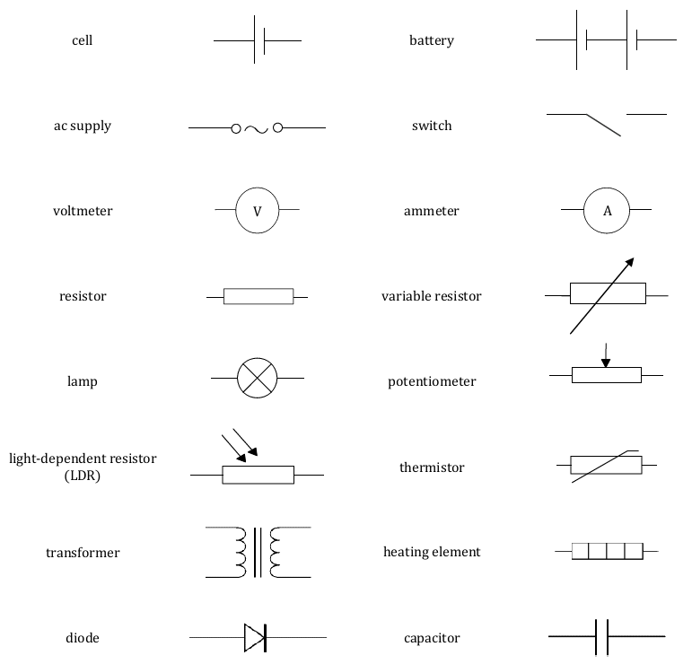
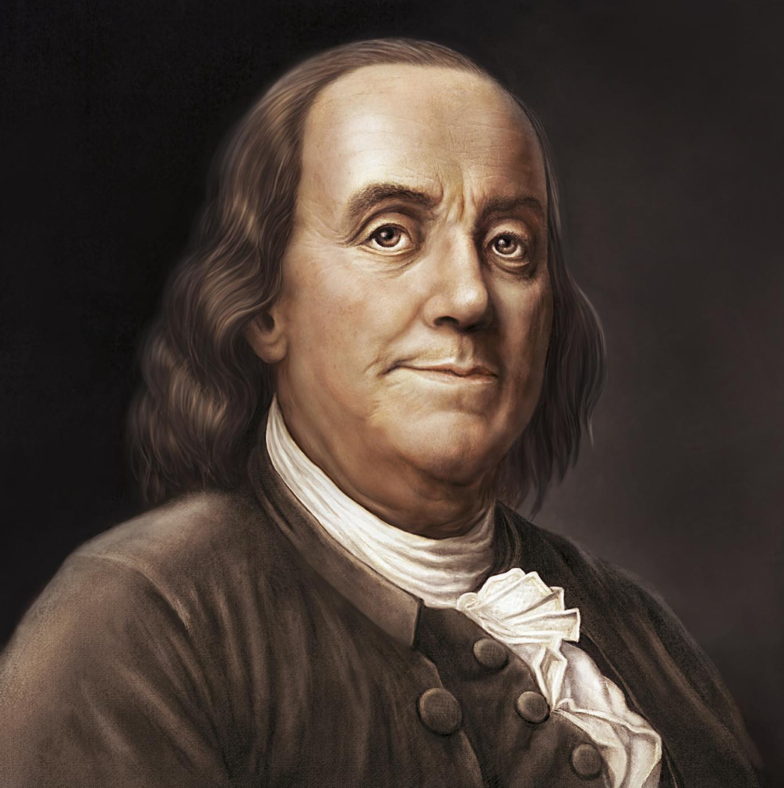
Circuits
‒
+
Long side indicates the positive terminal
‒
+
Closed
Open
Electron
Flow
Conventional Current
*Ben Franklin defined current as the flow of positive charges

Slide 3
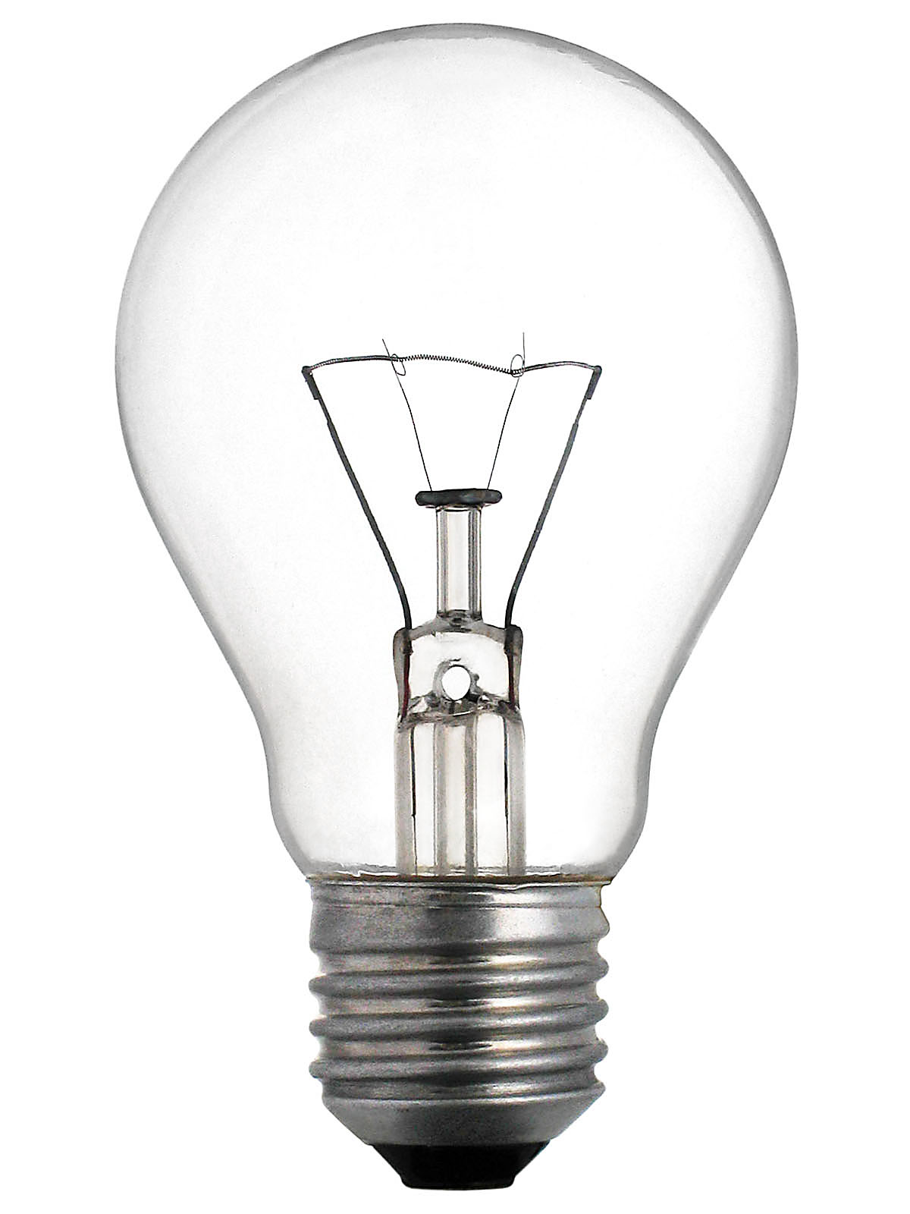
Resistance in a Circuit
There are many different components that act as resistors when placed in a circuit

Slide 4
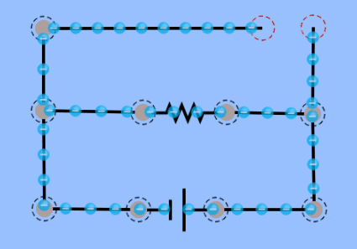
Resistance and Electron Flow
Electrons will
follow the path of ______________
least resistance
short circuit

Slide 5
Combining Components
Series
Parallel
R₁
R₁
R₂
R₂
R₁
R₁
R₂
R₃
R₂
R₃

Slide 6
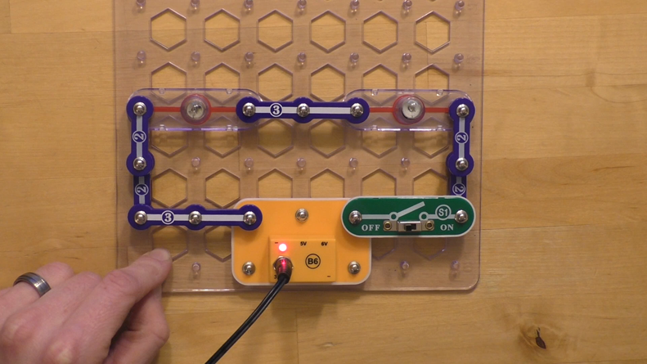
Connecting in Series
Components in one single pathway
Current flows the same through everything
R₁
R₂
R₃

Slide 7
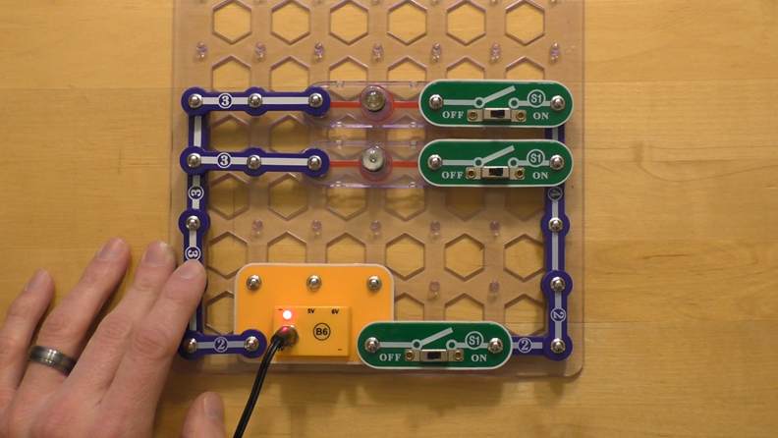
Connecting in Parallel
Separate branches
Current splits up between the different pathways
R₁
R₂

Slide 8
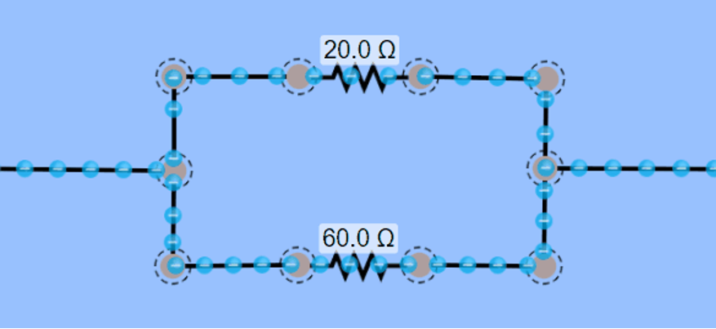
Connecting in Parallel
Which resistor has less resistance?

Slide 9
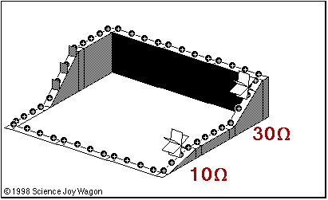
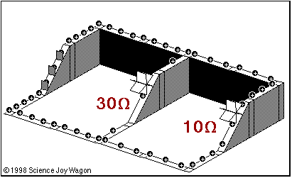
Water Flow Model
Battery

Slide 10
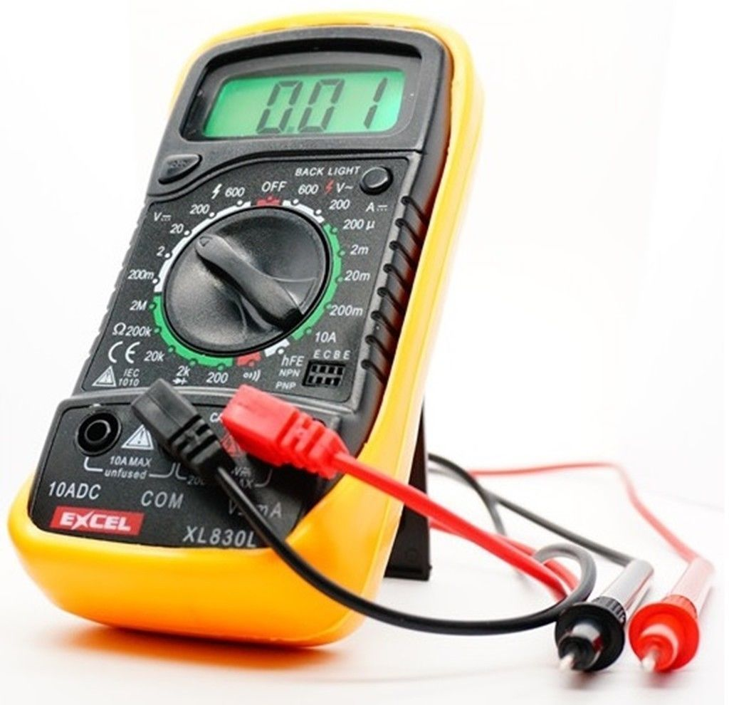
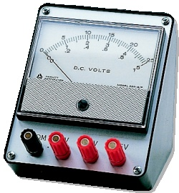
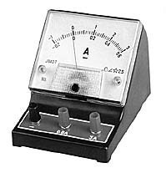
Measuring Circuits
When we measure voltage or current in a circuit, we need to connect our instrumentation in the right way
Voltmeter
V
Ammeter
A

Slide 11
Ammeter
series
Hooked up in ____________ with the component being measured
A
To measure the current, the current must flow through the ammeter

Slide 12
Voltmeter
parallel
Hooked up in ____________ with the component being measured
To measure the potential difference (voltage) a voltmeter needs to connect to two locations
V

Slide 13
Lesson Takeaways
I can describe the direction of conventional current compared to the movement of charges through a circuit
I can identify component combinations as parallel or series
I can describe how current flows through parallel and series resistors
I can describe the set up to measure current and voltage in a circuit

