Slide 1
Resistivity
IB Physics | Electricity

Slide 2
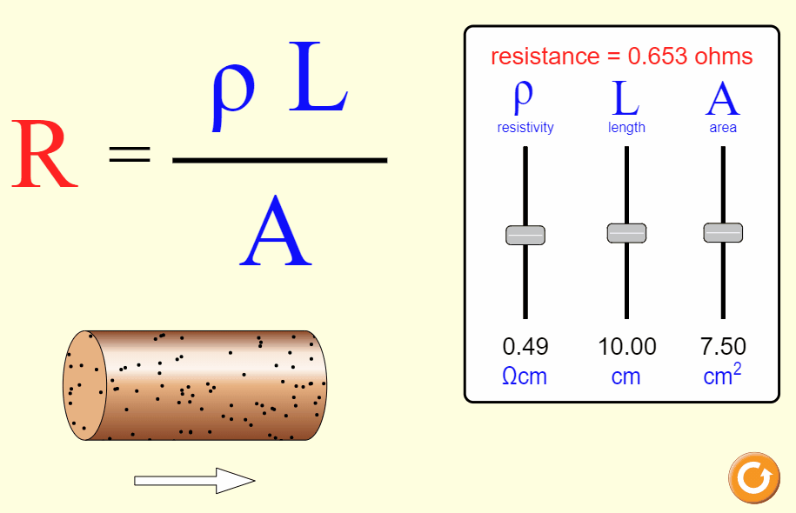
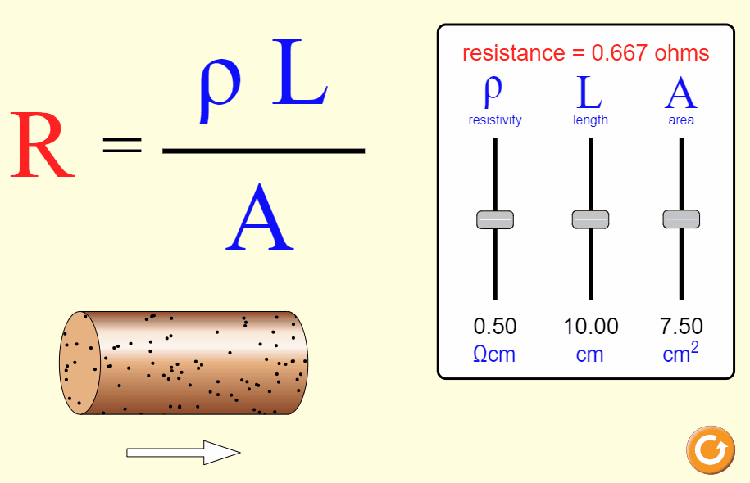
Resistance
What factors affect the resistance of a wire?
Cross-sectional Area
Length
Material

Slide 3
Resistance
Imagine that you are testing the resistance of a straw while drinking a milkshake…
$$R∝\frac{1}{A}$$
$$R∝L$$

Slide 4
Calculating Resistance
$$R=ρ\frac{L}{A}$$
R →
L →
A →
ρ →
Resistance
[Ω]
Length
[m]
$$A=πr^{2}$$
Area
[m²]
Resistivity
[Ωm]

Slide 5
IB Physics Data Booklet
$$R=ρ\frac{L}{A}$$

Slide 6
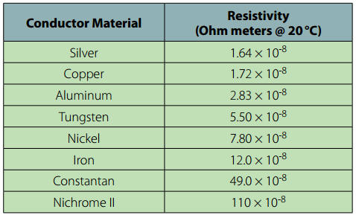
Resistivity
Resistivity ρ changes depending on the material used.
Lower Resistivity → Better Conductor

Slide 7
Resistivity – Try This #1
Calculate the resistance of a 1.8 m length of iron wire of with a diameter of 3 mm
$$R=(12.0×{10}^{−8})\frac{(1.8)}{(7.07×{10}^{−6})}$$
$$R=ρ\frac{L}{A}$$
L = 1.8 m
$$R=0.0306 Ω$$
𝜌 = 12.0 × 10⁻⁸ Ωm
A = π(0.003/2)²
= 7.07 × 10⁻⁶ m²

Slide 8
Resistivity – Try This #2
A current of 4 A flowed through a 75 m length of metal alloy wire of area 2.4 mm² when a p.d. of 12 V was applied across its ends. What was the resistivity of the alloy?
$$ρ=\frac{RA}{L}$$
$$R=\frac{V}{I}$$
$$=\frac{12}{4}=3 Ω$$
$$ρ=\frac{(3)(2.4×{10}^{−6})}{(75)}$$
$$L=75 m$$
$$A=2.4 {mm}^{2}×{\left(\frac{1 m}{1000 mm}\right)}^{2}$$
$$=9.6×{10}^{−8} Ωm$$
$$A=2.4×{10}^{−6} m^{2}$$

Slide 9
Graphing Ohm’s Law
Linear Relationship means that our component is ________________
Ohmic
Current / A
Low Resistance
Resistance is constant
High Resistance
Potential Difference / V

Slide 10
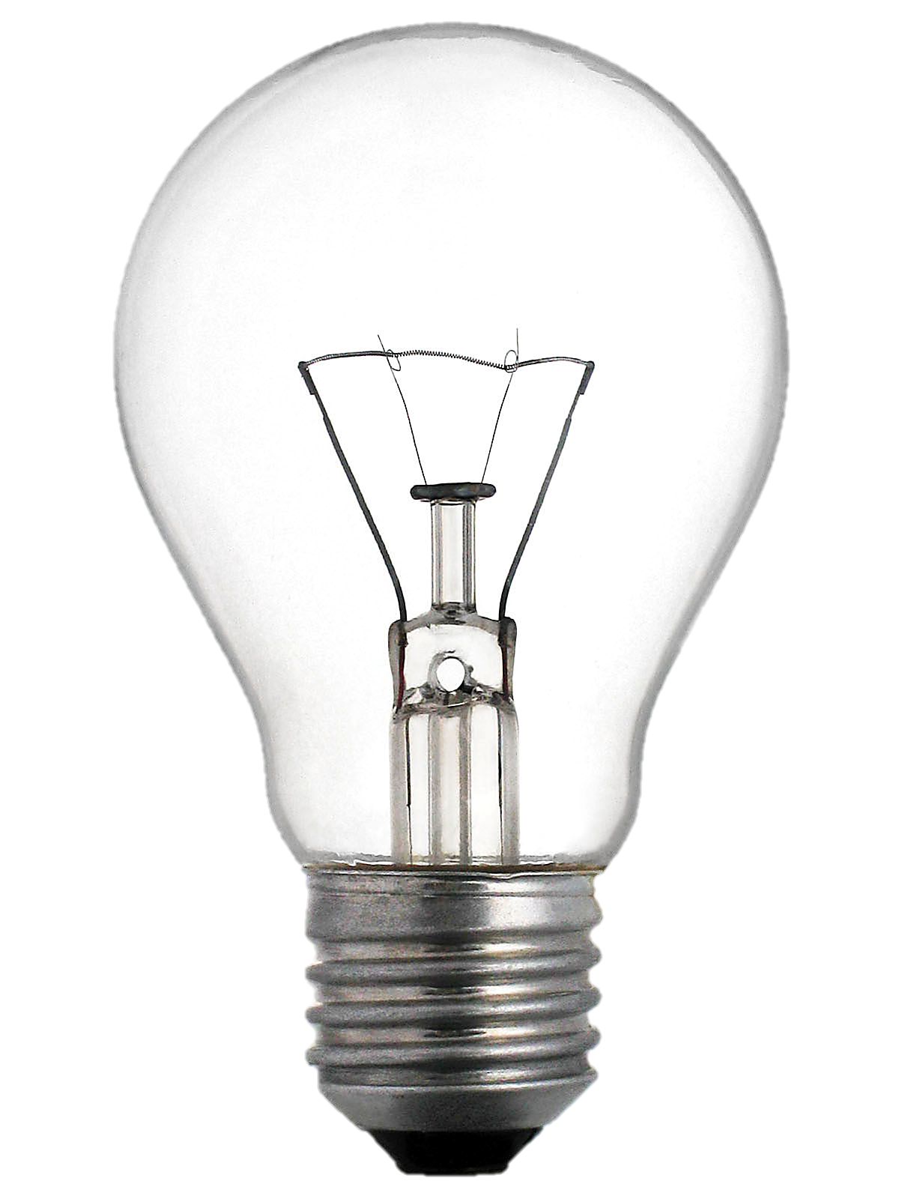
Graphing Ohm’s Law
Many/most electrical resistors don’t follow Ohm’s Law all of the time… For example, incandescent light bulbs have much more resistance as they heat up
Non-ohmic
Non-linear Relationship means that our component is ____________

Slide 11
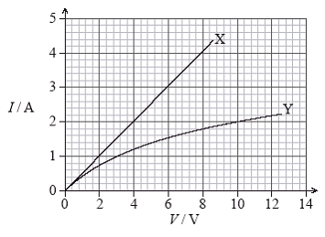
Graphing Ohm’s Law
Find V and R for the resistors X and Y when the current is 2A
4 V
$$R=\frac{V}{I}$$
X
V
I
R
2 A
$$R=\frac{4 V}{2 A}$$
2 Ω
10 V
Y
V
I
R
$$R=\frac{V}{I}$$
2 A
5 Ω
$$R=\frac{10 V}{2 A}$$

Slide 12
Straw Competition
Whole Straw
2/3 of a Straw
1/3 of a Straw
2 Short Straws
3 Short Straws

Slide 13
Straw Competition
With the same full deep breath for each set up, time how quickly you can completely exhale all of your air
What it is | What it represents | Time to exhale (sec)
Whole Straw | 3 resistors in ____________
2/3 of a Straw | 2 resistors in ____________
1/3 of a Straw | 1 resistor
2 Short Straws | 2 resistors in ____________
3 Short Straws | 3 resistors in ____________
series
series
Time Decreases
parallel
(less resistance)
parallel
When done collecting data, answer reflection questions on next slide

Slide 14
Straw Competition - Reflection
What does this model show about resistors in series?
What does this model show about resistors in parallel?
Adding resistors in series increases overall resistance
Adding resistors in parallel decreases overall resistance

Slide 15
Combining Resistors | Series
When combining resistors in series, the resistances are simply added up as if they were one large resistor
$$R_{total}=R_{1}+R_{2}+…$$
R₁
R₂
R₁
R₂
R₃
R_{1,2}
R_{1,2,3}

Slide 16
Combining Resistors | Parallel
When combining resistors in parallel, the overall resistance decreases to produce a smaller equivalent resistance
$$\frac{1}{R_{total}}=\frac{1}{R_{1}}+\frac{1}{R_{2}}+…$$
$$R_{total}={\left({R_{1}}^{−1}+{R_{1}}^{−1}+…\right)}^{−1}$$
$${R_{total}}^{−1}=\left({R_{1}}^{−1}+{R_{1}}^{−1}+…\right)$$
R₁
R₁
R₂
R₂
R₃
R_{1,2}
R_{1,2,3}

Slide 17
Combining Resistors – Try This
4 Ω
4 Ω
6 Ω
8 Ω
6 Ω
2.4 Ω
18 Ω
$$R_{T}=\frac{1}{\frac{1}{4}+\frac{1}{6}}$$
$$R_{T}=4+6+8=18 Ω$$
$$={\left(4^{−1}+6^{−1}\right)}^{−1}=2.4 Ω$$

Slide 18
IB Physics Data Booklet

Slide 19
Warm up
Which example has the least resistance? Assume that every resistor is the same.

Slide 20
Combining Resistors – Review
Series
$$R_{total}=R_{1}+R_{2}+…$$
Parallel
$$\frac{1}{R_{total}}=\frac{1}{R_{1}}+\frac{1}{R_{2}}+…$$
4 Ω
4 Ω
6 Ω
8 Ω
6 Ω
$$\frac{1}{4 Ω}+\frac{1}{6 Ω}=\frac{1}{2.4 Ω}$$
$$4 Ω+6 Ω+8 Ω=18 Ω$$

Slide 21
Equivalent Resistance
3 Ω
1 Ω
3 Ω
6 Ω
$${\left(3^{−1}+6^{−1}\right)}^{−1}=2 Ω$$
1 Ω
2 Ω
3 Ω
$$1+2+3=6 Ω$$
6 Ω

Slide 22
Try This | Equivalent Resistance
$$7+2=9 Ω$$
7 Ω
2 Ω
10 Ω
8 Ω
$$10+8=18 Ω$$
9 Ω
18 Ω
$${\left(9^{−1}+{18}^{−1}\right)}^{−1}=6 Ω$$
6 Ω

