Slide 1
Circuit Analysis
IB Physics | Electricity

Slide 2
Review of Parallel Circuits
Separate branches
Current splits up between the different pathways
Junctions
R₁
R₂

Slide 3
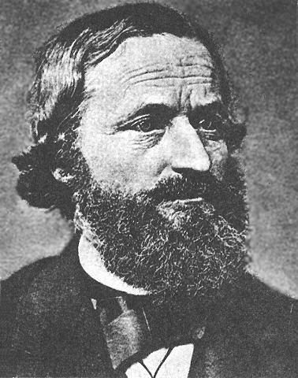
Kirchhoff’s First Law
The total current coming into a junction must equal the total current leaving the same junction
3 A
9 A
5 A
5 A
2 A
4 A

Slide 4
Kirchhoff’s First Law
$$ΣI=0 (junction)$$
Entering Junction | →● | Positive
Exiting Junction | ●→ | Negative
( ) + ( ) + ( ) = 0
( ) + ( ) + ( ) = 0
+5
-3
-2
+5
-9
+4
3 A
9 A
5 A
5 A
2 A
4 A

Slide 5
IB Physics Data Booklet

Slide 6
Follow the Current…
1 A
2 A
6 A
1 A
7 A
3 A
5 A
4 A
9 A

Slide 7
Try This
I₁ =
0.1 A
0.2 A
0.3 A
I₂ =
1.1 A
I₃ =
2.0 A
0.6 A
2.0 A

Slide 8
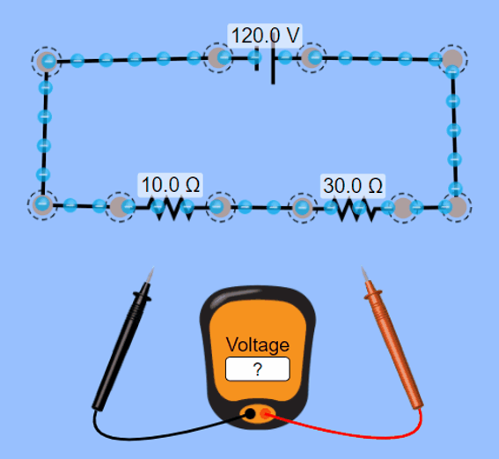
Review of the Water Flow Model
“potential difference”
Each resistor has a “voltage drop”
p.d.
Battery
p.d.
p.d.
The voltage used by the resistors equals the voltage supplied by the battery

Slide 9
Kirchhoff’s Second Law
The sum of the voltages (potential differences) provided must equal the voltages dissipated across components
$$ΣV=0 (loop)$$
Across Batteries
Negative to Positive | → | Positive
Positive to Negative | → | Negative
Over Resistors:
Always Negative
12 V
( ) + ( ) + ( ) = 0
+12
-4
-8
Resistor
8 V
4 V

Slide 10
Kirchhoff’s Second Law
Across Batteries
$$ΣV=0 (loop)$$
Negative to Positive | → | Positive
Positive to Negative | → | Negative
Over Resistors:
Always Negative
( ) + ( ) + ( ) + ( ) = 0
+12
-2
-9
-1
Resistor
12 V
1 V
2 V
9 V

Slide 11
IB Physics Data Booklet

Slide 12
The Big Three
Ohm’s Law: If you know two of the three electrical properties: V, I, or R
$$R=\frac{V}{I}$$
Kirchhoff’s Voltage Law
Kirchhoff’s Current Law
$$ΣV=0 (loop)$$
$$ΣI=0 (junction)$$
Draw a loop
The voltage provided must equal the voltage dissipated
Useful if you have parallel branches to solve for
Calculate the current coming out of the battery (total current)
If this splits into parallel branches, the total should still add up

Slide 13
Calculating Circuits - Series
No Junction: Current is the same throughout
 | V | I | R
R₁ |  |  | 1 Ω
R₂ |  |  | 3 Ω
R₃ |  |  | 2 Ω
Total | 12 V
R₁
R₂
R₃
1 Ω
3 Ω
2 Ω
2 V
2 A
6 V
2 A
2 A
12 V
4 V
2 A
Loop: Voltage supplied equals voltage dissipated
2 A
6 Ω
$$I_{T}=\frac{V}{R}=\frac{12}{6}=2 A$$
$$R_{T}=1+3+2=6 Ω$$
$$V=I×R=$$

Slide 14
Calculating Circuits - Parallel
R₁
6 Ω
 | V | I | R
R₁ |  |  | 6 Ω
R₂ |  |  | 3 Ω
Total | 12 V
R₂
12 V
2 A
2 A
4 A
3 Ω
12 V
4 A
6 A
6 A
2 Ω
12 V
$$R_{T}={\left(6^{−1}+3^{−1}\right)}^{−1}=2 Ω$$
Loop: Voltage supplied equals voltage dissipated
$$I_{T}=\frac{V}{R}=\frac{12}{2}=6 A$$
$$I=\frac{V}{R}=$$
Junction: Current in = Current out

Slide 15
Patterns
Series Circuit
Voltage is divided between components
Current is the same for all components
Parallel Circuit
Voltage is the same for each branch
Current splits at each junction

Slide 16
Lesson Takeaways
I can use Kirchhoff’s First Law to determine an unknown current at a junction
I can use Kirchhoff’s Second Law to determine an unknown current at a junction
I can calculate voltage, current, and resistance for every component in a simple series or parallel circuit
I can compare and contrast the properties for simple series and parallel circuits

