Slide 1
Potential Dividers
IB Physics | Electricity

Slide 2
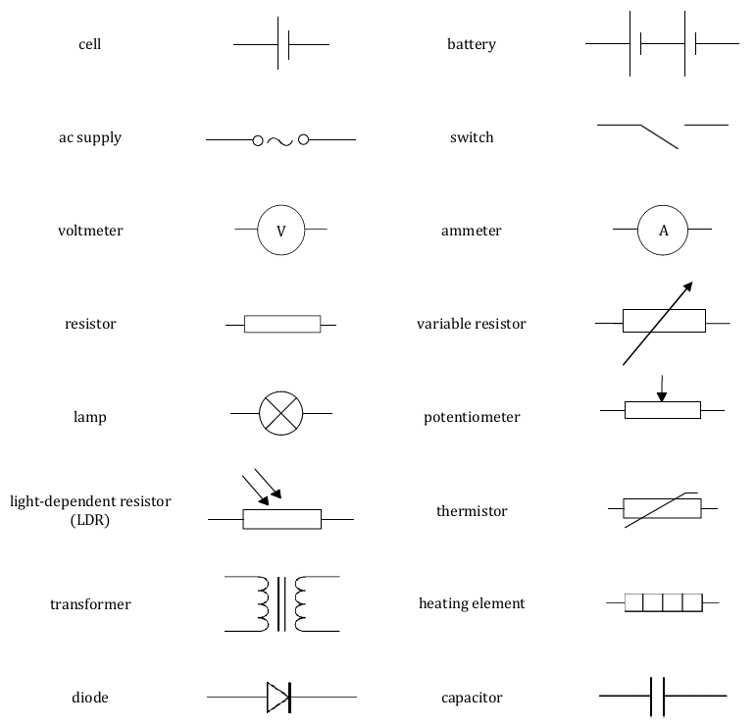
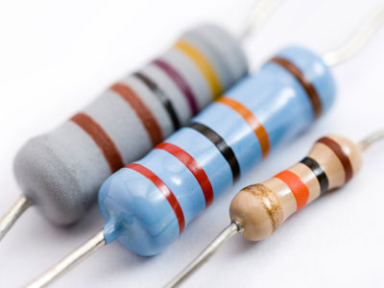
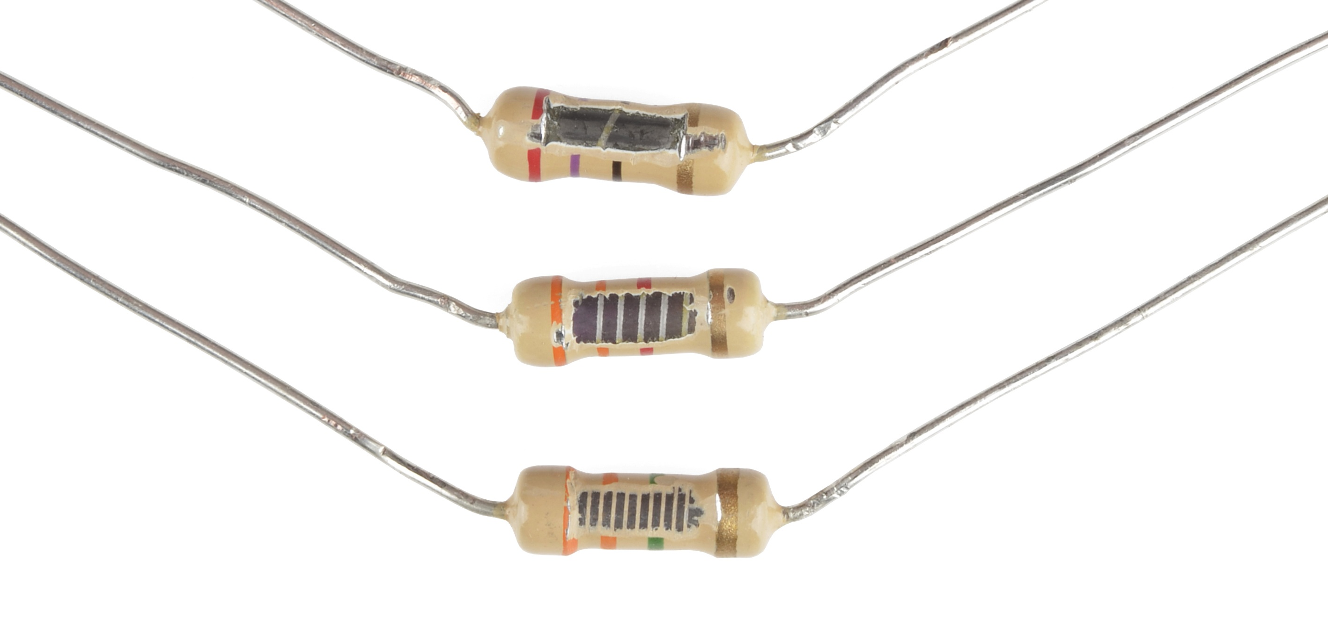
Types of Resistors

Slide 3

Resistor
Increasing Resistance
More length
Less Area
$$R=ρ\frac{L}{A}$$

Slide 4
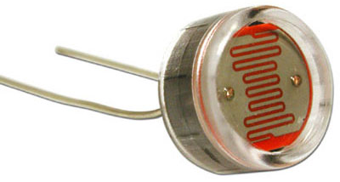
Types of Resistors
Light
Resistance
Inverse Relationship

Slide 5
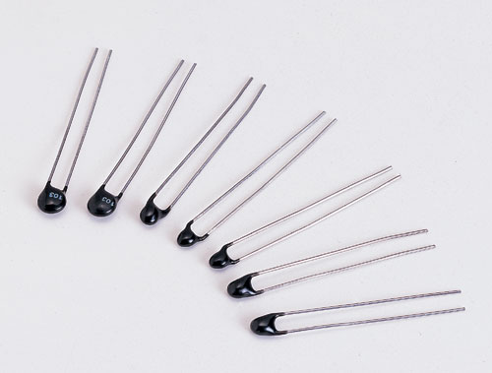
Types of Resistors
Heat
Resistance
Inverse Relationship

Slide 6
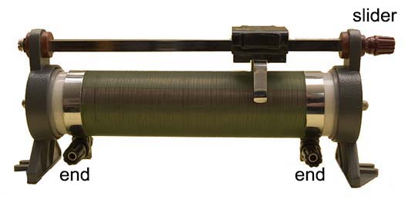
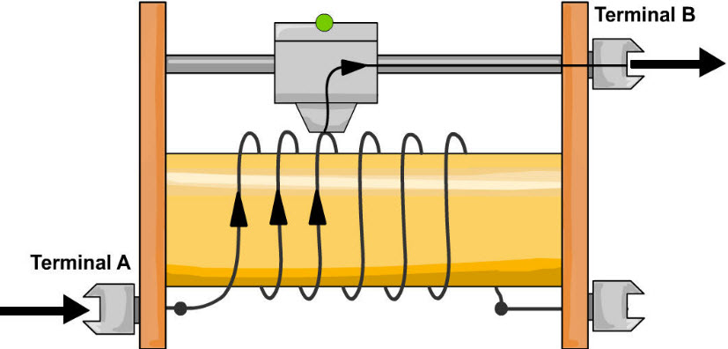
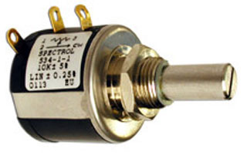
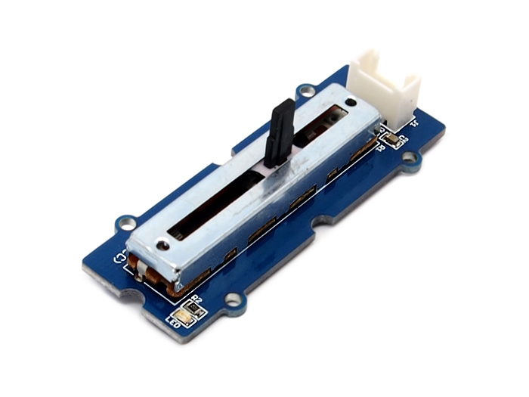
Types of Resistors

Slide 7
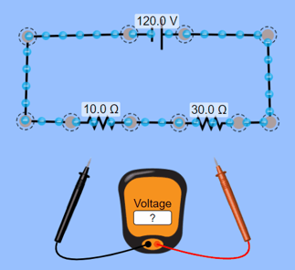
Potential Divider
“potential difference”
Each resistor has a “voltage drop”
p.d.
Battery
p.d.
p.d.
The total voltage supplied by the battery is “divided” across the different resistors

Slide 8
Potential Divider
V_{in}
R₁
R₂
Allows circuit designers to tune the voltage that is being delivered to the desired components
V_{out}

Slide 9
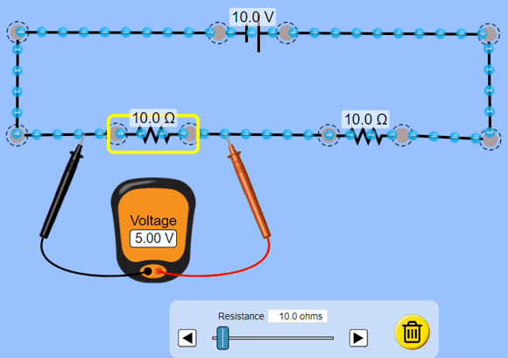
Relationship between R₁ and V_{out}
R₁
V_{out}
R₁
V_{out}

Slide 10
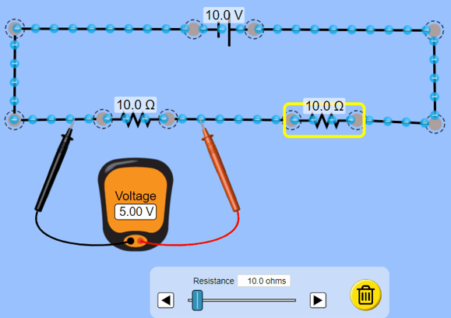
Relationship between R₂ and V_{out}
R₂
V_{out}
R₂
V_{out}

Slide 11
Potential Divider
V_{in}
Relationship between R₁ and V?
R₁
R₁
V_{out}
V_{out}
R₁
R₂
Relationship between R₂ and V?
V_{out}
R₂
R₂
V_{out}
V_{out}

Slide 12
Potential Divider
$$I_{T}=\frac{V}{R}=\frac{10}{250}=0.04 A$$
Find the Output Voltage:
V_{out}
$$V=I×R$$
 | V | I | R
R₁ |  |  | 30 Ω
R₂ |  |  | 220 Ω
Total | 10 V
$$=0.04×30$$
1.2 V
0.04 A
30 Ω
220 Ω
R₁
R₂
0.04 A
0.04 A
250 Ω
1. Calculate total resistance and current
10.0 V
2. Current is the same for each resistor
3. Calculate voltage across R₁

Slide 13
Potential Divider | Night Light
7.0 V
Electronic Switch
A light-dependent resistor (LDR) has R = 8 Ω in bright light and R = 140 Ω in low light. An electronic switch will turn on a light when its p.d. is above 7.0 V. What should the value of R₂ be?
*Night light should turn on in low light
140 Ω
 | V | I | R
R₁
R₂
Total
R₁
R₂
7.0 V
0.05 A
140 Ω
9.0 V
2.0 V
0.05 A
40 Ω
Calculate current through R₁
Current is the same throughout circuit (no current through switch)
Use voltage loop to find voltage across R₂
Calculate resistance of R₂
9.0 V
0.05 A

Slide 14
Potential Divider | Sprinkler System
6.0 V
A thermistor has a resistance of 2.5 Ω when it is in the heat of a fire and a resistance of 650 Ω in when at room temperature. An electronic switch will turn on a sprinkler system when its p.d. is above 6.0 V. What should the value of R₁ be?
Electronic Switch
*Sprinkler should activate when hot
2.5 Ω
 | V | I | R
R₁
R₂
Total
R₁
R₂
6.0 V
1.2 A
5 Ω
9.0 V
3.0 V
1.2 A
2.5 Ω
Use voltage loop to find voltage across R₂
Calculate current through R₂
Current is the same throughout circuit (no current through switch)
Calculate resistance of R₁
9.0 V
1.2 A

Slide 15
Lesson Takeaways
I can identify the different circuit diagram symbols for different types of resistors
I can describe how environmental changes can affect the resistance of LDRs and Thermistors
I can describe how changing resistor values can affect the voltage drop in a potential divider circuit
I can design a potential divider circuit to perform a certain task

