Slide 1
Non-Ideal Meters
IB Physics | Electricity

Slide 2
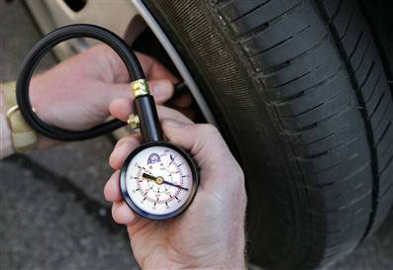
The Observer Effect
When taking any scientific measurement, there is always the possibility that the act of taking the measurement will change what is being measured

Slide 3
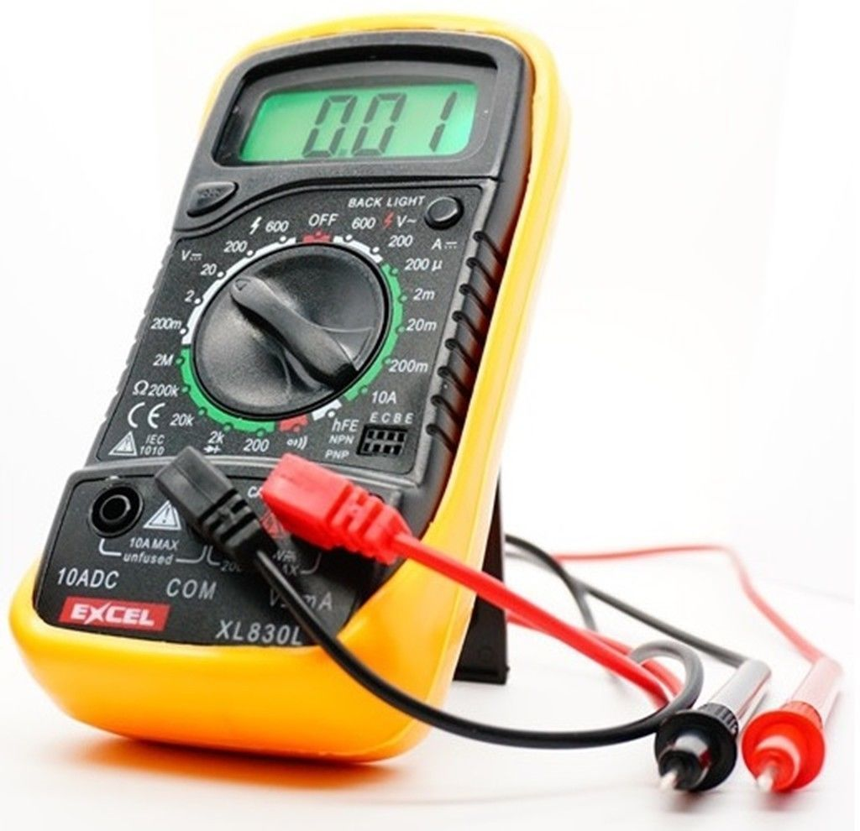
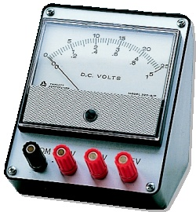
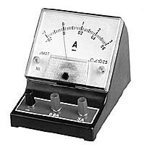
The Observer Effect
When we measure voltage or current in a circuit, we want to make sure to minimize an effect that our tool has on the circuit so that we get the most accurate results
Voltmeter
V
Ammeter
A

Slide 4
Ammeter
Hooked up in series with the component being measured
Ideal Ammeter:
[R = ]
A
0 Ω

Slide 5
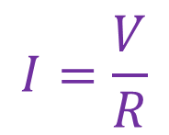
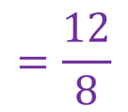
Measuring the Current
What is the reading for the current flowing through this ideal ammeter?
6 Ω
2 Ω
A
R₁
R₂
$$R_{T}=8 Ω$$
0 Ω
$$I=\frac{V}{R}$$
$$=\frac{12}{8}$$
$$=1.5 A$$
12 V
The ammeter has no effect on the current that it’s measuring

Slide 6
What if Ammeter isn’t ideal?
2 Ω
What is the reading for the current flowing through this ideal ammeter?
A
$$10 Ω$$
6 Ω
2 Ω
R₁
R₂
$$R_{T}=8 Ω$$
0 Ω
2 Ω
$$1.2 A$$
$$I=\frac{V}{R}$$
$$=\frac{12}{8}$$
$$=1.5 A$$
12 V
$$10$$
The non-ideal ammeter’s resistance slows down the current that it’s measuring

Slide 7
Voltmeter
Hooked up in parallel with the component being measured
V
Ideal Voltmeter:
[R = ]
∞ Ω

Slide 8
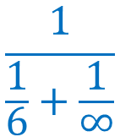
Measuring the Voltage
∞ Ω
What is the reading for the ideal voltmeter across the resistor R₁?
V
R₁
R₂
$$\frac{1}{\frac{1}{6}+\frac{1}{∞}}$$
6 Ω
2 Ω
$$R_{T}=$$
$$+ 2$$
$$12−3$$
$$V=IR$$
$$V=\left(1.5\right)(2)$$
0
$$V_{1}=9 V$$
$$V_{2}=3 V$$
$$R_{T}= 6 +2$$
$$= 8 Ω$$
$$I=\frac{V}{R}=\frac{12}{8}$$
12 V
$$1.5 A$$

Slide 9
Measuring the Voltage
12 Ω
∞ Ω
12 Ω
What is the reading for the ideal voltmeter across the resistor R₁?
V
R₁
R₂
$$\frac{1}{\frac{1}{6}+\frac{1}{∞}}$$
6 Ω
2 Ω
$$R_{T}=$$
$$+ 2$$
$$12−3$$
$$V=IR$$
$$4$$
$$V=\left(1.5\right)(2)$$
$$V_{1}=9 V$$
$$2$$
$$12$$
$$8 V$$
$$V_{2}=3 V$$
$$4 V$$
$$R_{T}= 6 +2$$
$$= 8 Ω$$
$$4$$
$$6 Ω$$
$$I=\frac{V}{R}=\frac{12}{8}$$
$$6$$
12 V
$$1.5 A$$
$$2 A$$

Slide 10
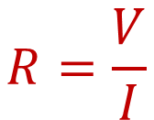
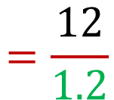
Try This
Calculate the resistance of this non-ideal meter:
Ammeter Reading | 1.2 A
Current is the same for all components
Calculate total resistance from voltage and current
Calculate ammeter resistance
$$R=\frac{V}{I}$$
$$=\frac{12}{1.2}$$
3 Ω
6.5 Ω
$$=10 Ω$$
R₁
R₂
A
$$R_{T}=10 Ω$$
$$=3+6.5+A$$
1.2 A
$$A=0.5 Ω$$
12 V

Slide 11
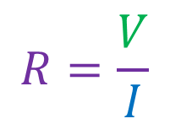
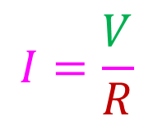
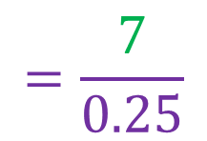
Try This
Calculate the resistance of this non-ideal meter:
Voltmeter Reading | 7 V
Use voltage loops to calculate voltage for R₁ and R₂
Calculate current for R₁ and R₂
Use current junction to find current through meter
Calculate resistance of voltmeter
V
0.25 A
$$I=\frac{V}{R}$$
$$R=\frac{V}{I}$$
$$=\frac{7}{0.25}$$
7 V
5 V
R₁
R₂
4 Ω
2.5 Ω
1.75 A
2 A
$$R=28 Ω$$
0.25 A
1.75 A
2 A
12 V

Slide 12
Lesson Takeaways
I can connect a meter to measure current or voltage
I can describe the conditions required for an ideal ammeter or voltmeter
I can calculate for a situation when the meter isn’t ideal

