Slide 1
Batteries
IB Physics | Electricity

Slide 2
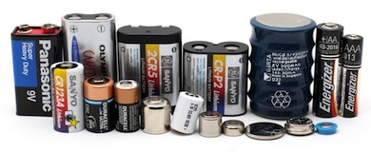
Batteries
Primary Cells
One time use
Secondary Cells
Rechargeable
Battery Shape | Chemistry | Nominal Voltage | Rechargable?
AA, AAA, C, and D | Alkaline or Zinc-carbon | 1.5V | No
9V | Alkaline or Zinc-carbon | 9V | No
Coin cell | Lithium | 3V | No
Silver Flat Pack | Lithium Polymer (LiPo) | 3.7V | Yes
AA, AAA, C, D (Rechargeable) | NiMH or NiCd | 1.2V | Yes
Car battery | Six-cell lead-acid | 12.6V | Yes

Slide 3
Recharging?
Some batteries can reverse the chemical reaction that produces the potential difference by passing a current through the battery in the opposite direction as it would normally travel
Recharging Circuit
+V

Slide 4
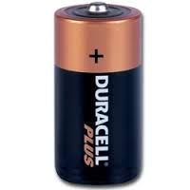
Batteries | emf
We’ve been describing batteries so far as the voltage that they provide to the circuit, but that’s not the whole story…
Electromotive Force (emf)
The total energy transferred in the source per unit charge passing through it
Symbol
ε
ε
Unit
r
Volts [V]

Slide 5
Batteries | Internal Resistance
All batteries have some amount of internal resistance
Symbol
r
ε
Unit
r
Ohms [Ω]

Slide 6
Batteries | emf
What is the emf for a battery shown below?
$$R_{T}=7+3+0.5$$
$$=10.5 Ω$$
$$ε=IR_{T}$$
$$=(1.2)(10.5)$$
ε
$$ε=12.6 V$$
0.5 Ω
1.2 A
7 Ω
3 Ω

Slide 7
IB Physics Data Booklet
Essentially the same as V = IR

Slide 8
Batteries | emf
What is the emf for a battery shown below?
R
r
$$R_{T}=7+3+0.5$$
$$=10.5 Ω$$
$$ε=IR_{T}$$
$$=(1.2)(10.5)$$
ε
$$ε=12.6 V$$
0.5 Ω
1.2 A
7 Ω
3 Ω

Slide 9
Batteries | Terminal Voltage
What is the terminal voltage for a battery shown below?
$$V_{1}=IR=(1.2)(7)$$
$$=8.4 V$$
$$V_{2}=IR=(1.2)(3)$$
$$=3.6 V$$
12.6 V
0.5 Ω
$$V_{T}=8.4 V+3.6 V$$
$$V_{T}=12 V$$
1.2 A
7 Ω
3 Ω

Slide 10
Batteries | Internal Resistance
What is the internal resistance of this battery as shown below?
$$ε=I(R+r)$$
$$9=3(2.5+r)$$
emf = 9 V
$$r=0.5 Ω$$
r
3 A
2.5 Ω

Slide 11
Graphing Internal Resistance
$$ε=I(R+r)$$
$$y=mx+b$$
$$y=mx+b$$
$$ε=IR+Ir$$
$$ε=IR+Ir$$
V
$$V=(−r)I+ε$$
$$V=(−r)I+ε$$
$$V=IR$$
$$ε=V+Ir$$
$$V=ε−Ir$$
I

Slide 12
Lesson Takeaways
I can describe the difference between primary and secondary cells
I can define the electromotive force and describe how is it is different than the battery’s terminal voltage
I can solve for a circuit that includes a battery with internal resistance
I can describe how

