Slide 1
Calculating Energy
IB Physics | Energy & Momentum

Slide 2
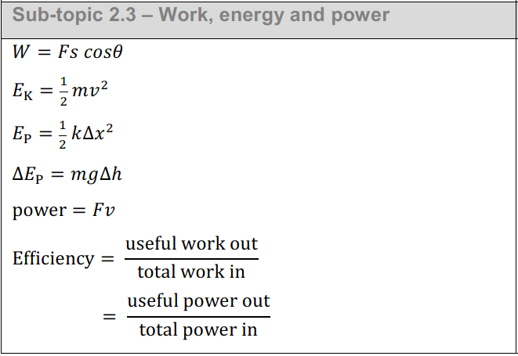
Energy Calculations
Kinetic Energy (KE)
Potential Energy (PE)

Slide 3
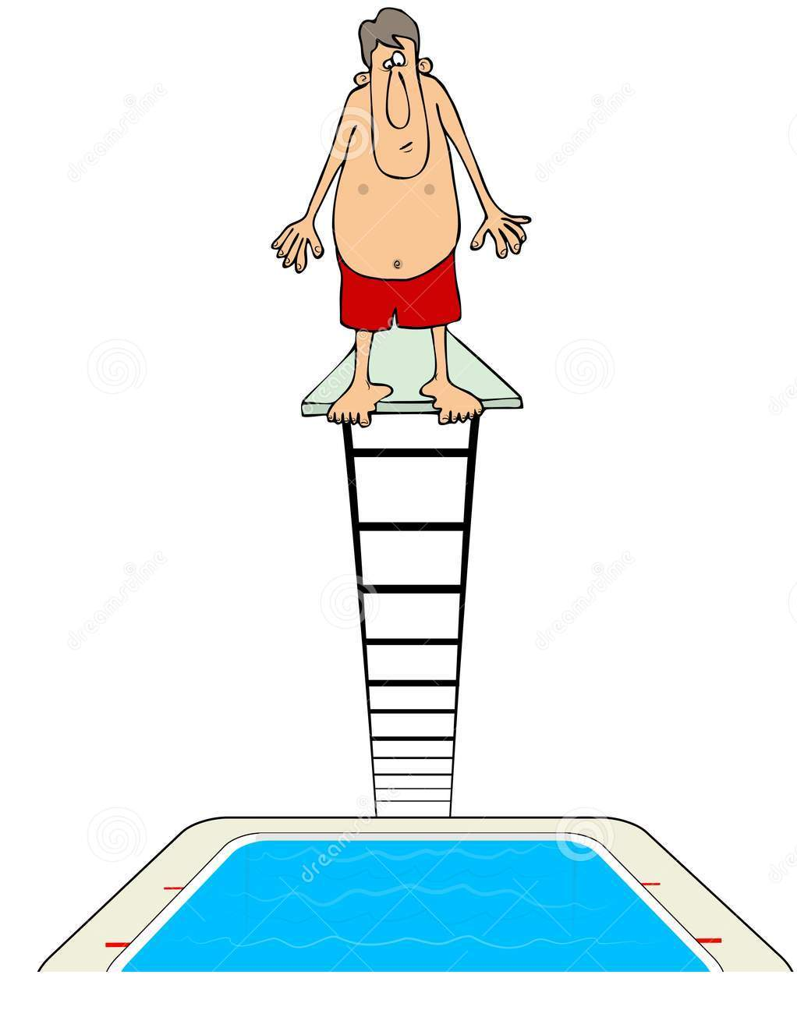
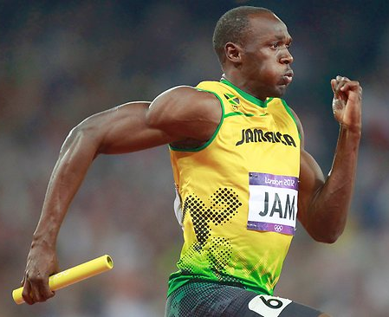
Who has more energy??
100 kg
100 kg
7.67 m/s
3 m
$$KE=\frac{1}{2}mv^{2}$$
$$PE=mgh$$
$$=\frac{1}{2}(100){(7.67)}^{2}$$
$$=(100)(9.81)(3)$$
$$=2941 J$$
$$=2943 J$$

Slide 4
Understanding Relationships
How does PE change when you triple the height?
3 times PE
How does KE change when you triple the velocity?
3²
9 times KE

Slide 5
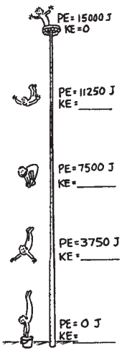
Conservation of Mechanical Energy
Total Energy Before = Total Energy After
3750 J
7500 J
11250 J
15000 J

Slide 6
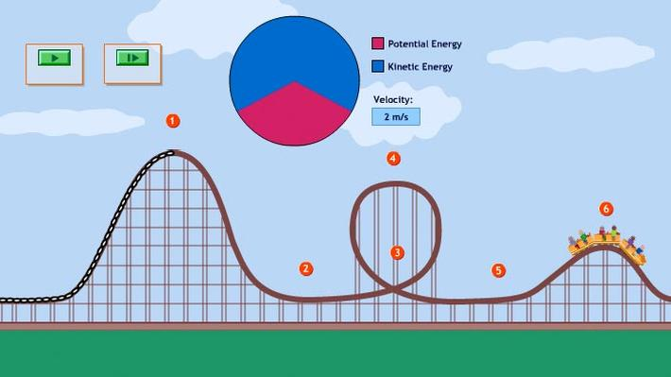
Conservation of Energy
Click here for Simulation

Slide 7
Conservation of Energy
A 2-kg ball is released from a height of 20 m. What is its velocity when its height has decreased to 5 m?
0 m/s
PE
$$Initial Energy=Final Energy$$
$$PE+KE=PE+KE$$
$$mgh=mgh+\frac{1}{2}mv^{2}$$
20 m
$$(2)(9.81)(20)=(2)(9.81)(5)+\frac{1}{2}(2)v^{2}$$
v = ?
$$392.4=98.1+v^{2}$$
PE
KE
5 m
$$v=17.2 m/s$$

Slide 8
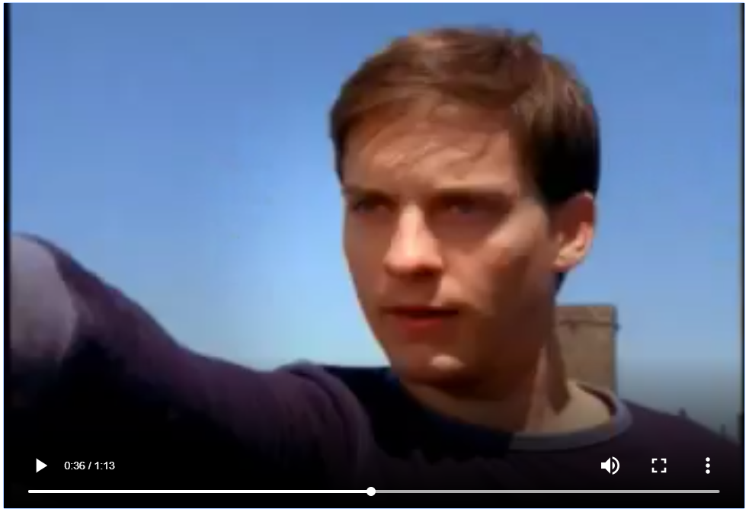
Try this
The height of the building Spider-Man (a.k.a. Peter Parker, a.k.a. Tobey McGuire) starts off on is 6 stories, or 18 meters high. The height of the building he wants to swing to is 1 story, or 3 meters high. Tobey McGuire is has a mass of approximately 72 kg. Use conservation of energy to calculate his speed when his feet touch the roof of the second building
$$Initial Energy=Final Energy$$
$$PE+KE=PE+KE$$
$$mgh=mgh+\frac{1}{2}mv^{2}$$
$$(72)(9.81)(18)=(72)(9.81)(3)+\frac{1}{2}(72)v^{2}$$
$$12,714=2,119+{36v}^{2}$$
$$v=17.2 m/s$$

Slide 9
Notice any similarities??
The final velocity is the same in each example. Same height change, mass doesn’t matter!

Slide 10
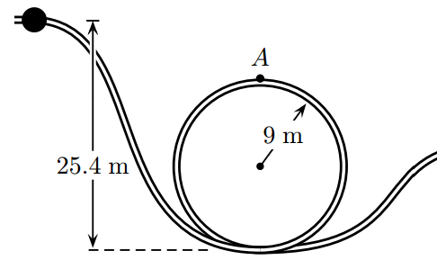
Try this
*if you aren’t given the mass, you should write out the equation and the mass will cancel
What is the velocity of a marble at point A?
Initial Energy = Final Energy
$$PE+KE=PE+KE$$
PE
$$mgh=mgh+\frac{1}{2}mv^{2}$$
PE
KE
$$(9.81)(100)=(9.81)(70)+\frac{1}{2}v^{2}$$
$$v=24.3 m/s$$
100 m
70 m

Slide 11
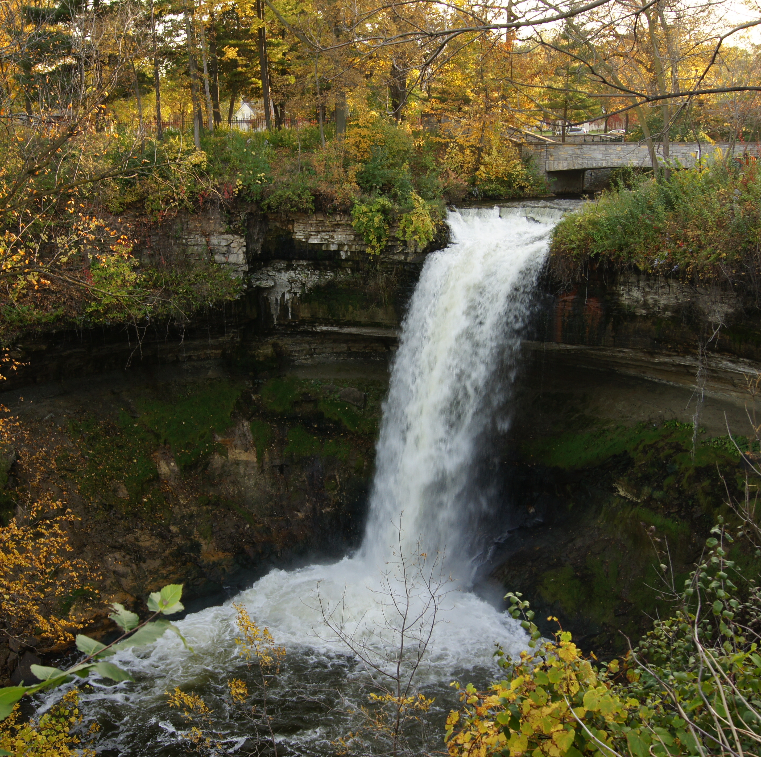
No Mass? No Problem…
Water at the bottom of a waterfall has a velocity of 30 m/s after falling 16 meters. What is the water speed at the top?
PE
KE
KE
$$PE+KE=PE+KE$$
$$\frac{1}{2}mv^{2}+mgh=\frac{1}{2}mv^{2}$$
$$\frac{1}{2}v^{2}+(9.81)(16)=\frac{1}{2}{(30)}^{2}$$
$$v=24.2 m/s$$

Slide 12
Lesson Takeaways
I can describe and calculate kinetic energy and gravitational potential energy
I can explain the implications of the conservation of energy and show that the total energy in a closed system is always the same
I can interpret a scenario and set up an equality based on the energies present at different locations
I can use the conservation of energy to solve for an unknown energy or variable in a problem

