Slide 1
Impulse
IB Physics | Energy & Momentum

Slide 2
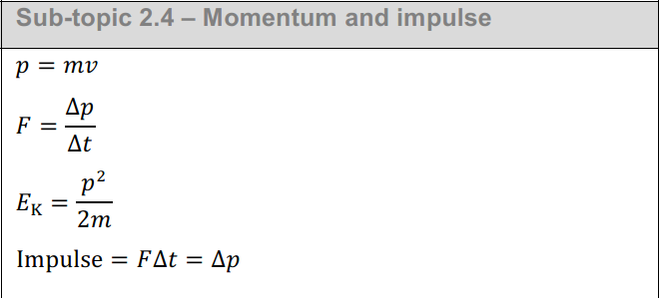
IB Physics Data Booklet

Slide 3
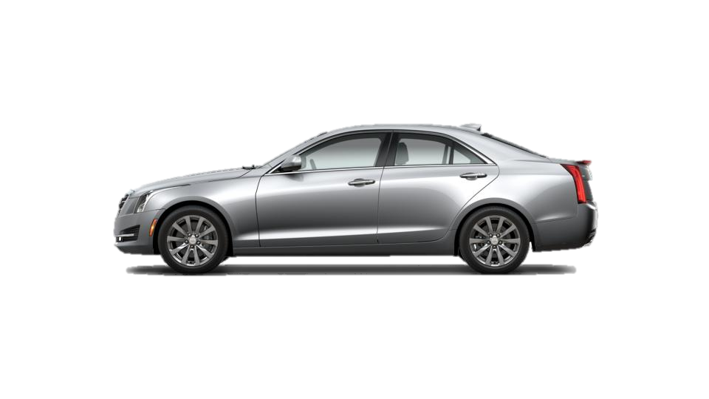
Remember Work?
Work = Force × Distance
2,000 kg
5,000 N
0 m s⁻¹
v = ?
100 m
Initial Energy = 0 J
Work = (5,000 N)(100 m) = 500,000 J
Energy added to system
Final Energy = 500,000 J
= ½mv²
= ½(2,000 kg)v²
Final Velocity = v = 22.36 m s⁻¹

Slide 4
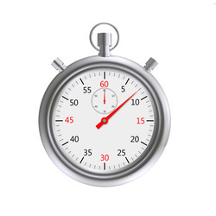
Introducing Impulse
Time
Impulse = Force × _________
8.94 s
2,000 kg
5,000 N
0 m s⁻¹
v = ?
100 m
Initial Momentum = 0 kg m s⁻¹
Impulse = (5,000 N)(8.94 s) = 44,700 kg m s⁻¹
Momentum added to system
Final Momentum = 44,700 kg m s⁻¹
= mv
= (2,000 kg)v
Final Velocity = v = 22.35 m s⁻¹

Slide 5
Impulse
Work → Change in Energy
Momentum
Impulse → Change in ____________
What about Units?
[N] = [kg][m s⁻²]
Impulse = F × t
= [N][s]
= [kg][m s⁻²][s]
= [N][s]
Impulse = [N s]
or [kg m s⁻¹]*
*same unit as momentum

Slide 6
IB Physics Data Booklet
Same equation

Slide 7
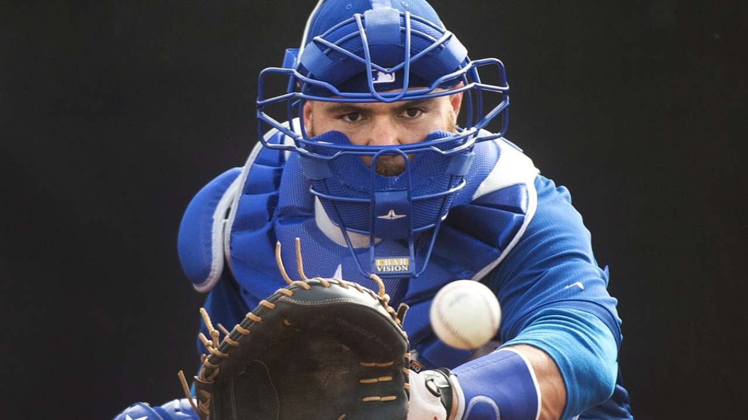
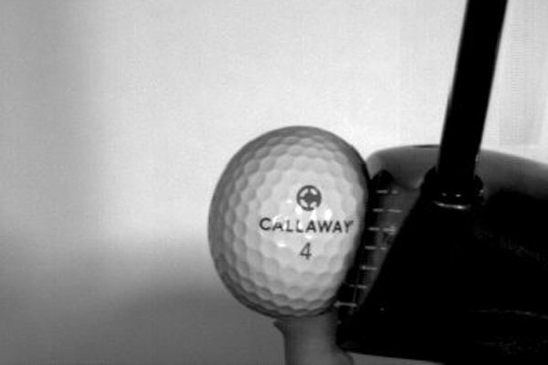
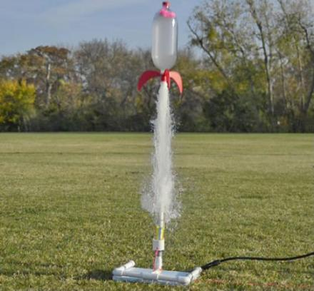
Impulse and Momentum
Impulse can act to increase or decrease an object’s momentum
Final Velocity
$$0 m/s$$
Initial Velocity
$$0 m/s$$
Initial Velocity
$$0 m/s$$

Slide 8
How are these the same? different?
5 kg
5 kg

Slide 9
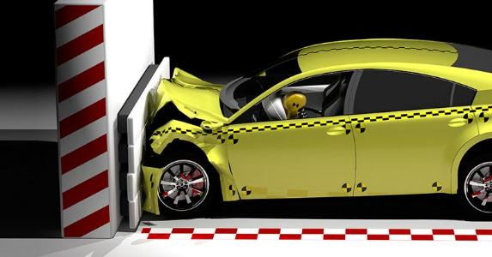
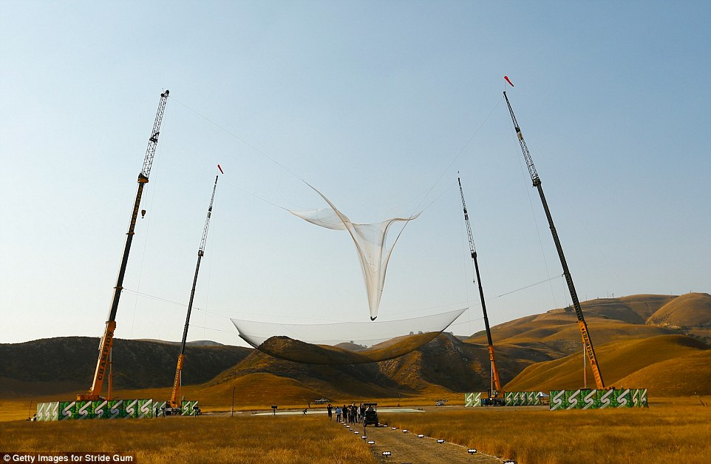
Impulse → Slowing Down
How can we decrease the force acting on an object?

Slide 10
Impulse and Momentum
$$Impulse=F∆t=∆p$$
Short Time
F × Δt
Large Force
Same Mass
F × Δt
=
F × Δt
Same Momentum
Same Impulse
Long Time
F × Δt
Small Force

Slide 11
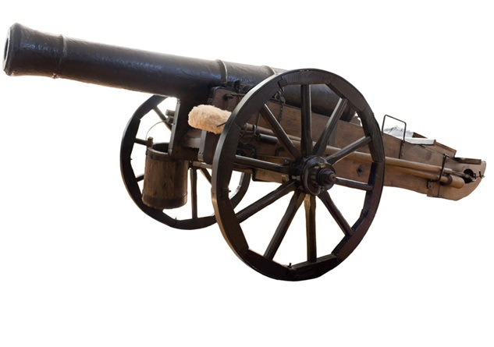
Impulse to Speed Up
Should a cannon have a long or short barrel to produce to largest final velocity? Why?
Both designs will experience the same force but the long barrel experiences that force for more time and creates a larger impulse / change in momentum

Slide 12
Marshmallow Shooter

Slide 13
Marshmallow Shooter
$$Impulse=F∆t=∆p$$
$$=m∆v$$
v
Same Force
Same Mass
v
v
More Time → More Velocity

Slide 14
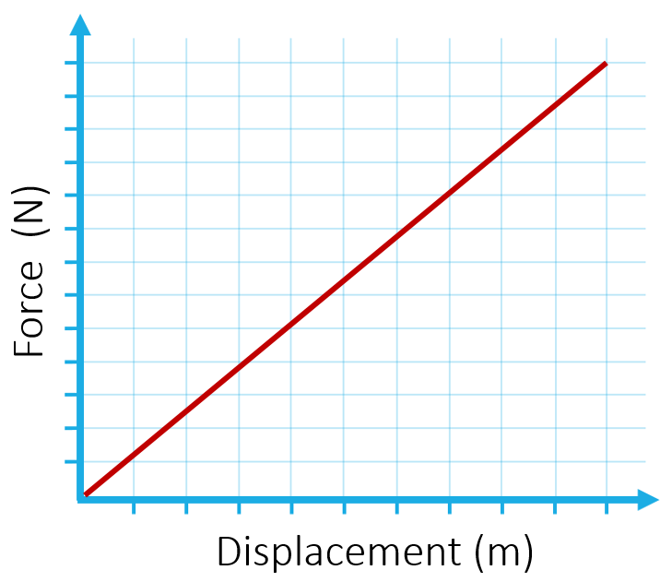
What if the force isn’t constant?
13
Remember how we found work done by a varying force?
Area = (y-axis)(x-axis)
12
11
Impulse = (force)(time)
10
Impulse = Ft
9
Force (N)
8
7
6
5
Area = (y-axis)(x-axis)
4
Work = (force)(displacement)
3
2
½(8)(10) = 40 N s
W = Fs
1
1
2
3
4
5
6
7
8
9
10
Time (s)

Slide 15
Which impulse is larger?
13
Same
12
11
Twice the time
Half the force
10
½(12)(4) = 24 N s
9
Force (N)
8
7
6
5
4
½(6)(8) = 24 N s
3
2
1
1
2
3
4
5
6
7
8
9
10
Time (s)

Slide 16
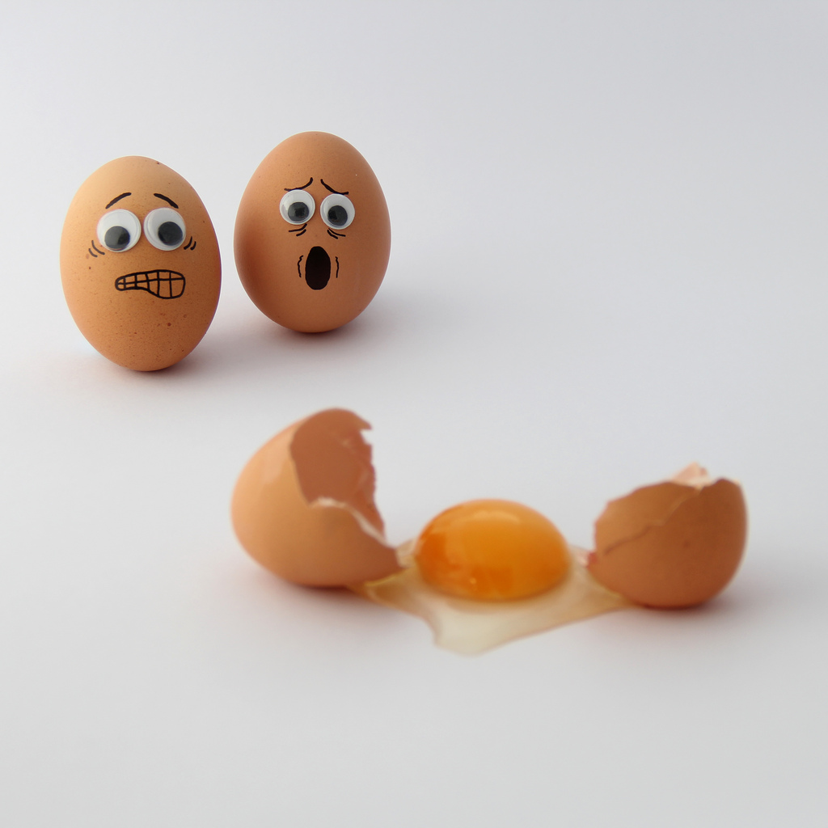
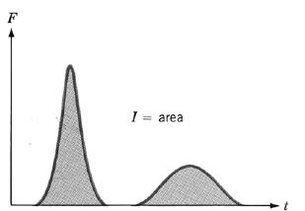
The force matters!
Increase time to decrease force below a dangerous threshold

Slide 17
Lesson Takeaways
I can describe the meaning of impulse and how it is related to momentum change
I can conceptually describe how to decrease the force experienced in a collision
I can determine the impulse of a collision from a force vs time graph

