Slide 1
Impulse & Momentum Calculations
IB Physics | Energy & Momentum

Slide 2
Impulse Review
Work → Change in Energy
Impulse → Change in Momentum
$$Impulse=F∆t=∆p$$

Slide 3
Impulse Slowing Down
Short Time
F × Δt
Large Force
Same Mass
Same Momentum
Same Impulse
Long Time
F × Δt
Small Force

Slide 4
Impulse Speeding Up
$$Impulse=F∆t=∆p$$
$$=m∆v$$
v
Same Force
Same Mass
v
v
More Time → More Velocity

Slide 5
Slapshot!
A hockey puck has a mass of 0.115 kg. A player takes a slap shot which exerts a force of 31.0 N for 0.15 sec. How fast will the puck be moving?
Initial Momentum
Impulse Added
Final Momentum
Initial Momentum = 0 kg m s⁻¹
Impulse = FΔt
= (31 N)(0.15 s)
= 4.65 kg m s⁻¹
Final Momentum = 4.65 kg m s⁻¹
= mv
= (0.115 kg)v
Final Velocity = v = 40.4 m s⁻¹

Slide 6
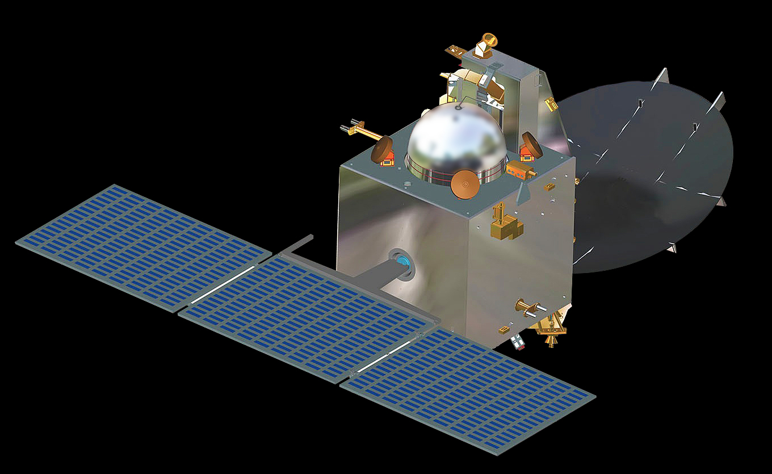
Impulse and Momentum
The 440 newton Liquid Apogee Motor (LAM) of India's Mars Orbiter Spacecraft, was successfully fired for a duration of 3.968 seconds on September 22, 2014. This operation of the spacecraft's main liquid engine was also used for the spacecraft's trajectory correction and changed its velocity by 2.18 m s⁻¹. What was the mass of the spacecraft at the time of this engine firing?
Initial Momentum
Impulse Added
Final Momentum
Impulse = FΔt = Δp
Impulse = FΔt
= (440 N)(3.968 s)
= 1746 kg m s⁻¹
Change in Momentum = 1746 kg m s⁻¹
= (m)(Δv)
1746 kg m s⁻¹ = (m)(2.18)
m = 801 kg

Slide 7
Direction Matters
u
Assume u is 30 m s⁻¹ to the left and v is 10 m s⁻¹ to the right. What is the change in velocity?
-30 m s⁻¹
v
10 m s⁻¹
Change in Velocity = 40 m s⁻¹

Slide 8
Try This…
A 500 g baseball moves to the left at 20 m s⁻¹ striking a bat. The bat is in contact with the ball for 0.002 s, and it leaves in the opposite direction at 40 m s⁻¹. What was average force on ball?
Initial Momentum
Final Momentum
Impulse
Added
p = (0.5)(-20)
p = (0.5)(40)
-10 kg m s⁻¹
Δp
20 kg m s⁻¹
30 kg m s⁻¹
20 m s⁻¹
Impulse = FΔt = Δp
m = 0.5 kg
Impulse = F(0.002 s) = 30 kg m s⁻¹
F = 15,000 N

Slide 9
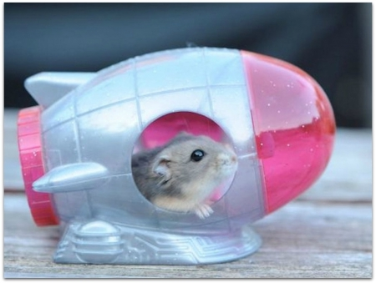
Impulse from a Graph
A hamster’s rocket (0.5 kg) has a variable force as shown in the graph. What is the final velocity after 10 seconds if it starts from rest?
13
12
11
Impulse Added
10
Initial Momentum
Final Momentum
9
40
Force (N)
8
0
40
7
6
p = mv
5
4
3
40 = (0.5)v
2
½(8)(10) = 40 N s
1
v = 80 m/s
1
2
3
4
5
6
7
8
9
10
Time (s)

Slide 10
Try This…
Kara Less was applying her makeup when she drove into South's busy parking lot last Friday morning. Unaware that Lisa Ford was stopped in her lane, Kara rear-ended Lisa's rental car. Kara's 1300-kg car was moving at 5 m s⁻¹ and stopped in 0.4 seconds. What was the force?
Initial Momentum
Impulse
Final Momentum
Decreases Momentum
Initial Momentum = mv = (1,300)(5) = 6,500 kg m s⁻¹
Final Momentum = 0 kg m s⁻¹
Impulse = 6,500 kg m s⁻¹ = (F)(0.4 s)
Force = F = 16,250 N

Slide 11
Lesson Takeaways
I can use impulse and momentum to solve for an unknown force
I can use impulse and momentum to solve for an unknown velocity
I can calculate the change in velocity when there is a direction change
I can calculate change in momentum from a Force vs Time graph

