Slide 1
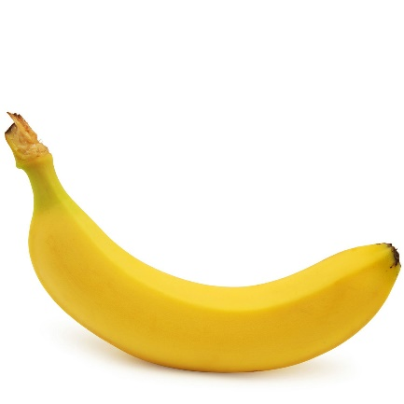
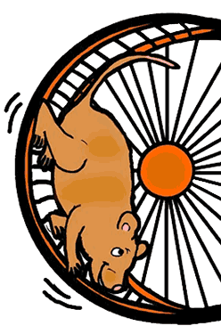
A
Roughly how fast is a 0.2 kg banana moving when it hits the ground if it’s dropped from 1.25 m?
A hamster can do 50 Joules of work in 5 seconds. How many hamsters would be needed to power a 60 W light bulb?
C
B
Calculate the kinetic energy of a 62.5 g
golf ball flying through the air at 16 m/s

Slide 2
50 kg
60 kg
70 kg
80 kg
90 kg
100 kg

