Slide 1
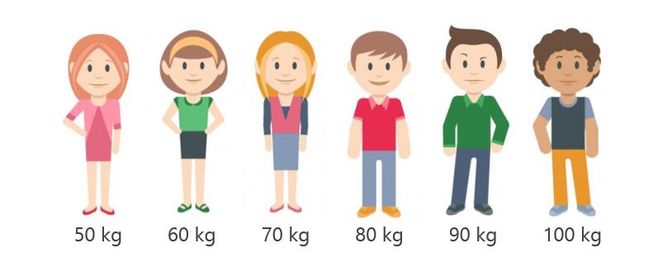
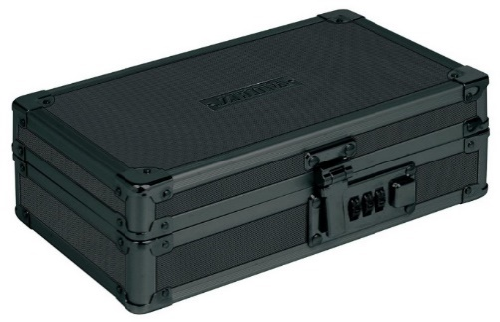
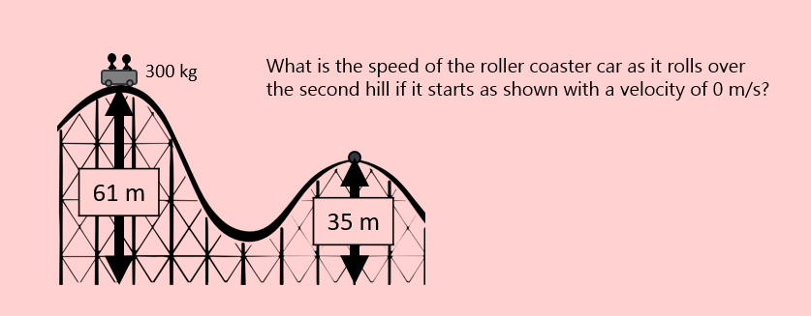
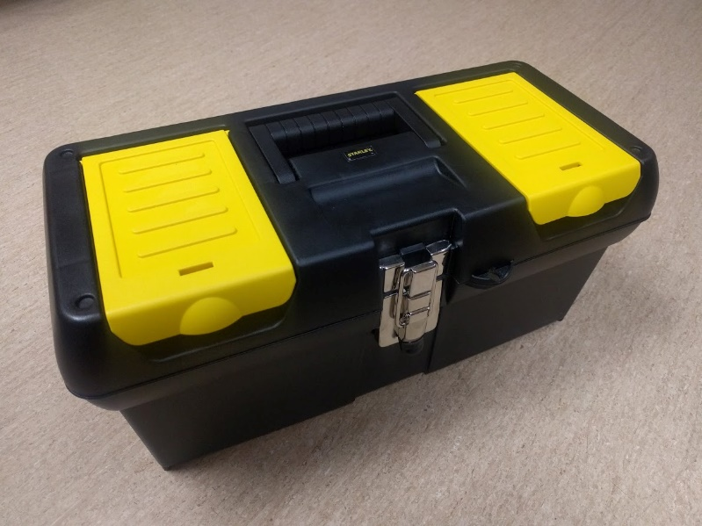
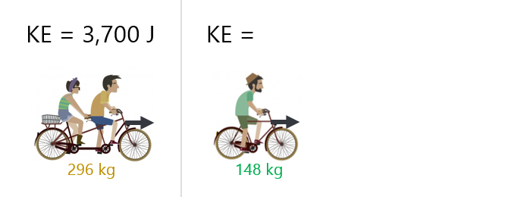
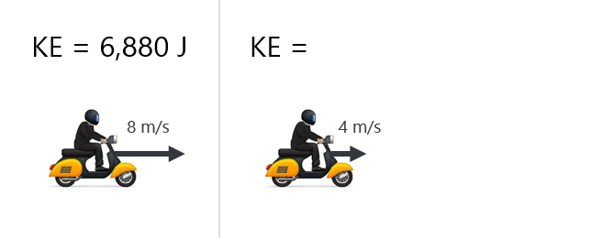
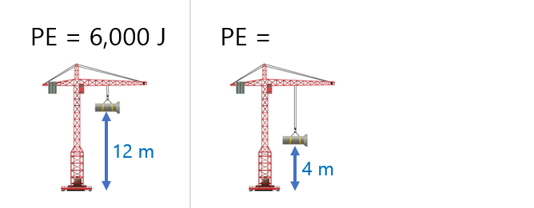
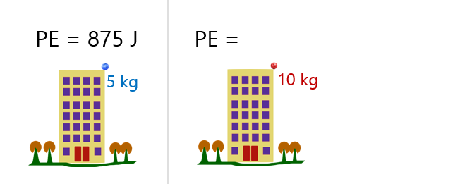
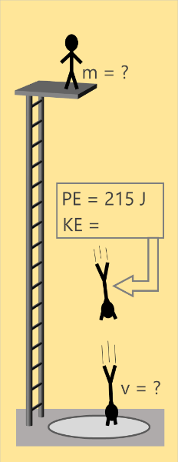
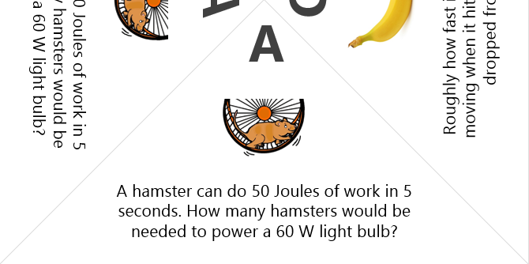
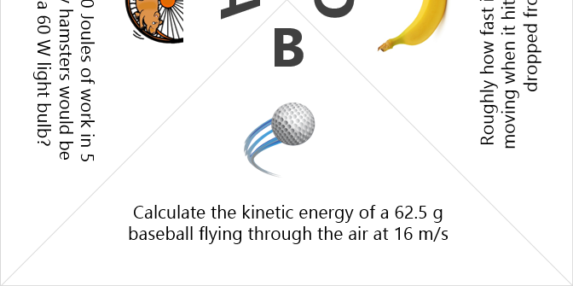
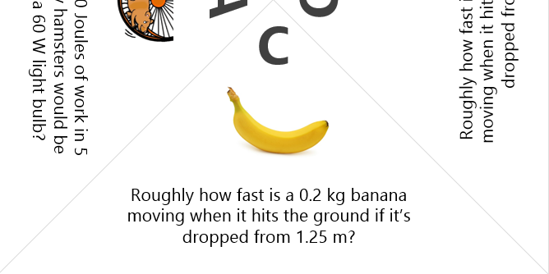
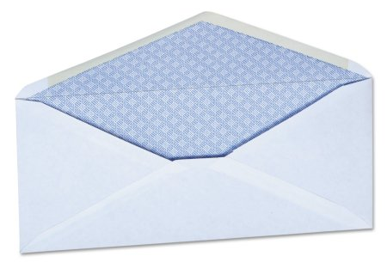
Taped on the Back
Key with number
Prize
Reset Instructions
Replace all materials
Lock the boxes (685 – PUSH – 6354 – 425)
Once locked, set combinations to zeros when possible
Taped on the Bottom
Key with Roman Numeral
Notes:
Reset Instructions – Level 2

Slide 2
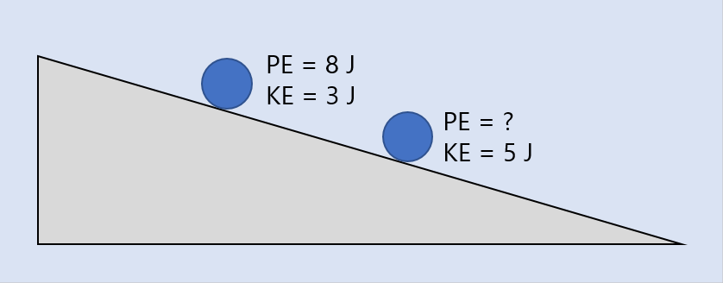
Taped on the Back
Key with number
Prize
Reset Instructions
Replace all materials
Lock the boxes (685 – PUSH – 6354 – 425)
Once locked, set combinations to zeros when possible
Taped on the Bottom
Key with Roman Numeral
Notes:
Reset Instructions – Level 1

Slide 3
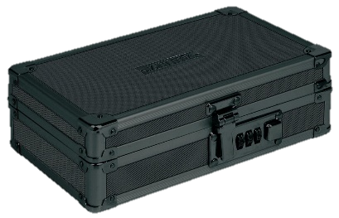
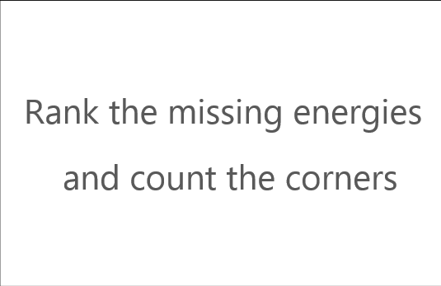
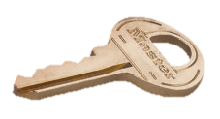
Number
Roman
Numeral
Notes:
The Process

Slide 4
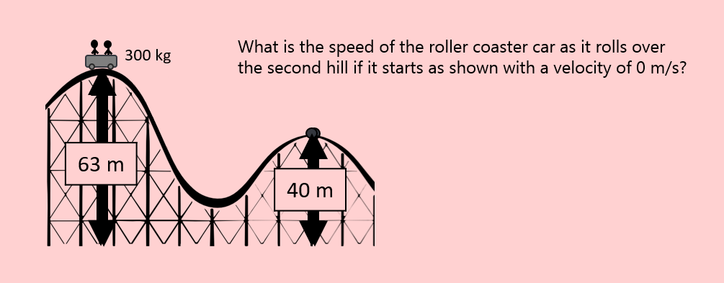
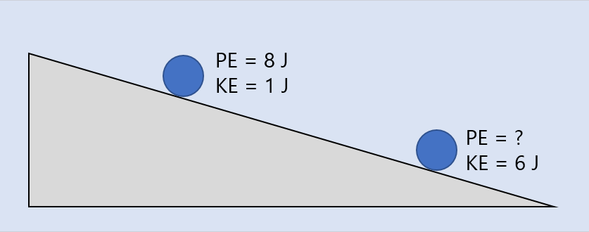
Setting up the group-specific clues
To help ensure that that there is agreement with the clue, the solution, and the key, it is important that you put the right clue in each box. This works best if you have the boxes numbered so you can keep track of everything. Each level of the clue has the group number hidden in the problem.
Level 1 - The group number is the second digit of the initial height
Level 2 - The group number is the KE at the top of the ramp
Group 1
Group 3
Notes:
Group-specific clues

