Slide 1
Energy Sources Overview
IB Physics | Energy Production

Slide 2
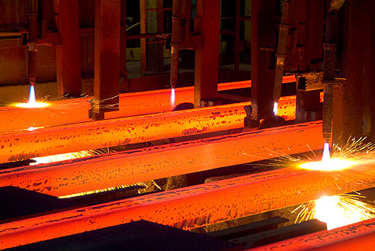
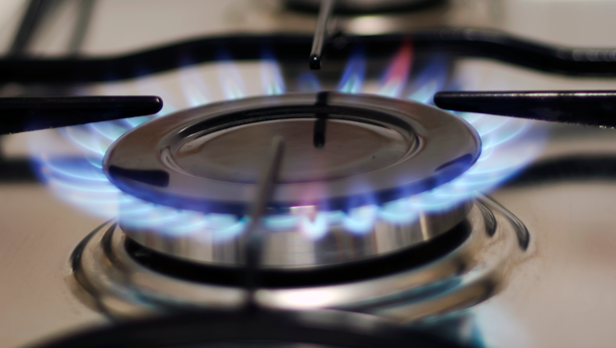
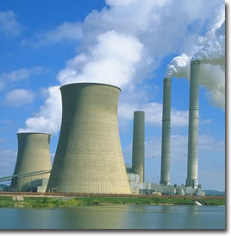
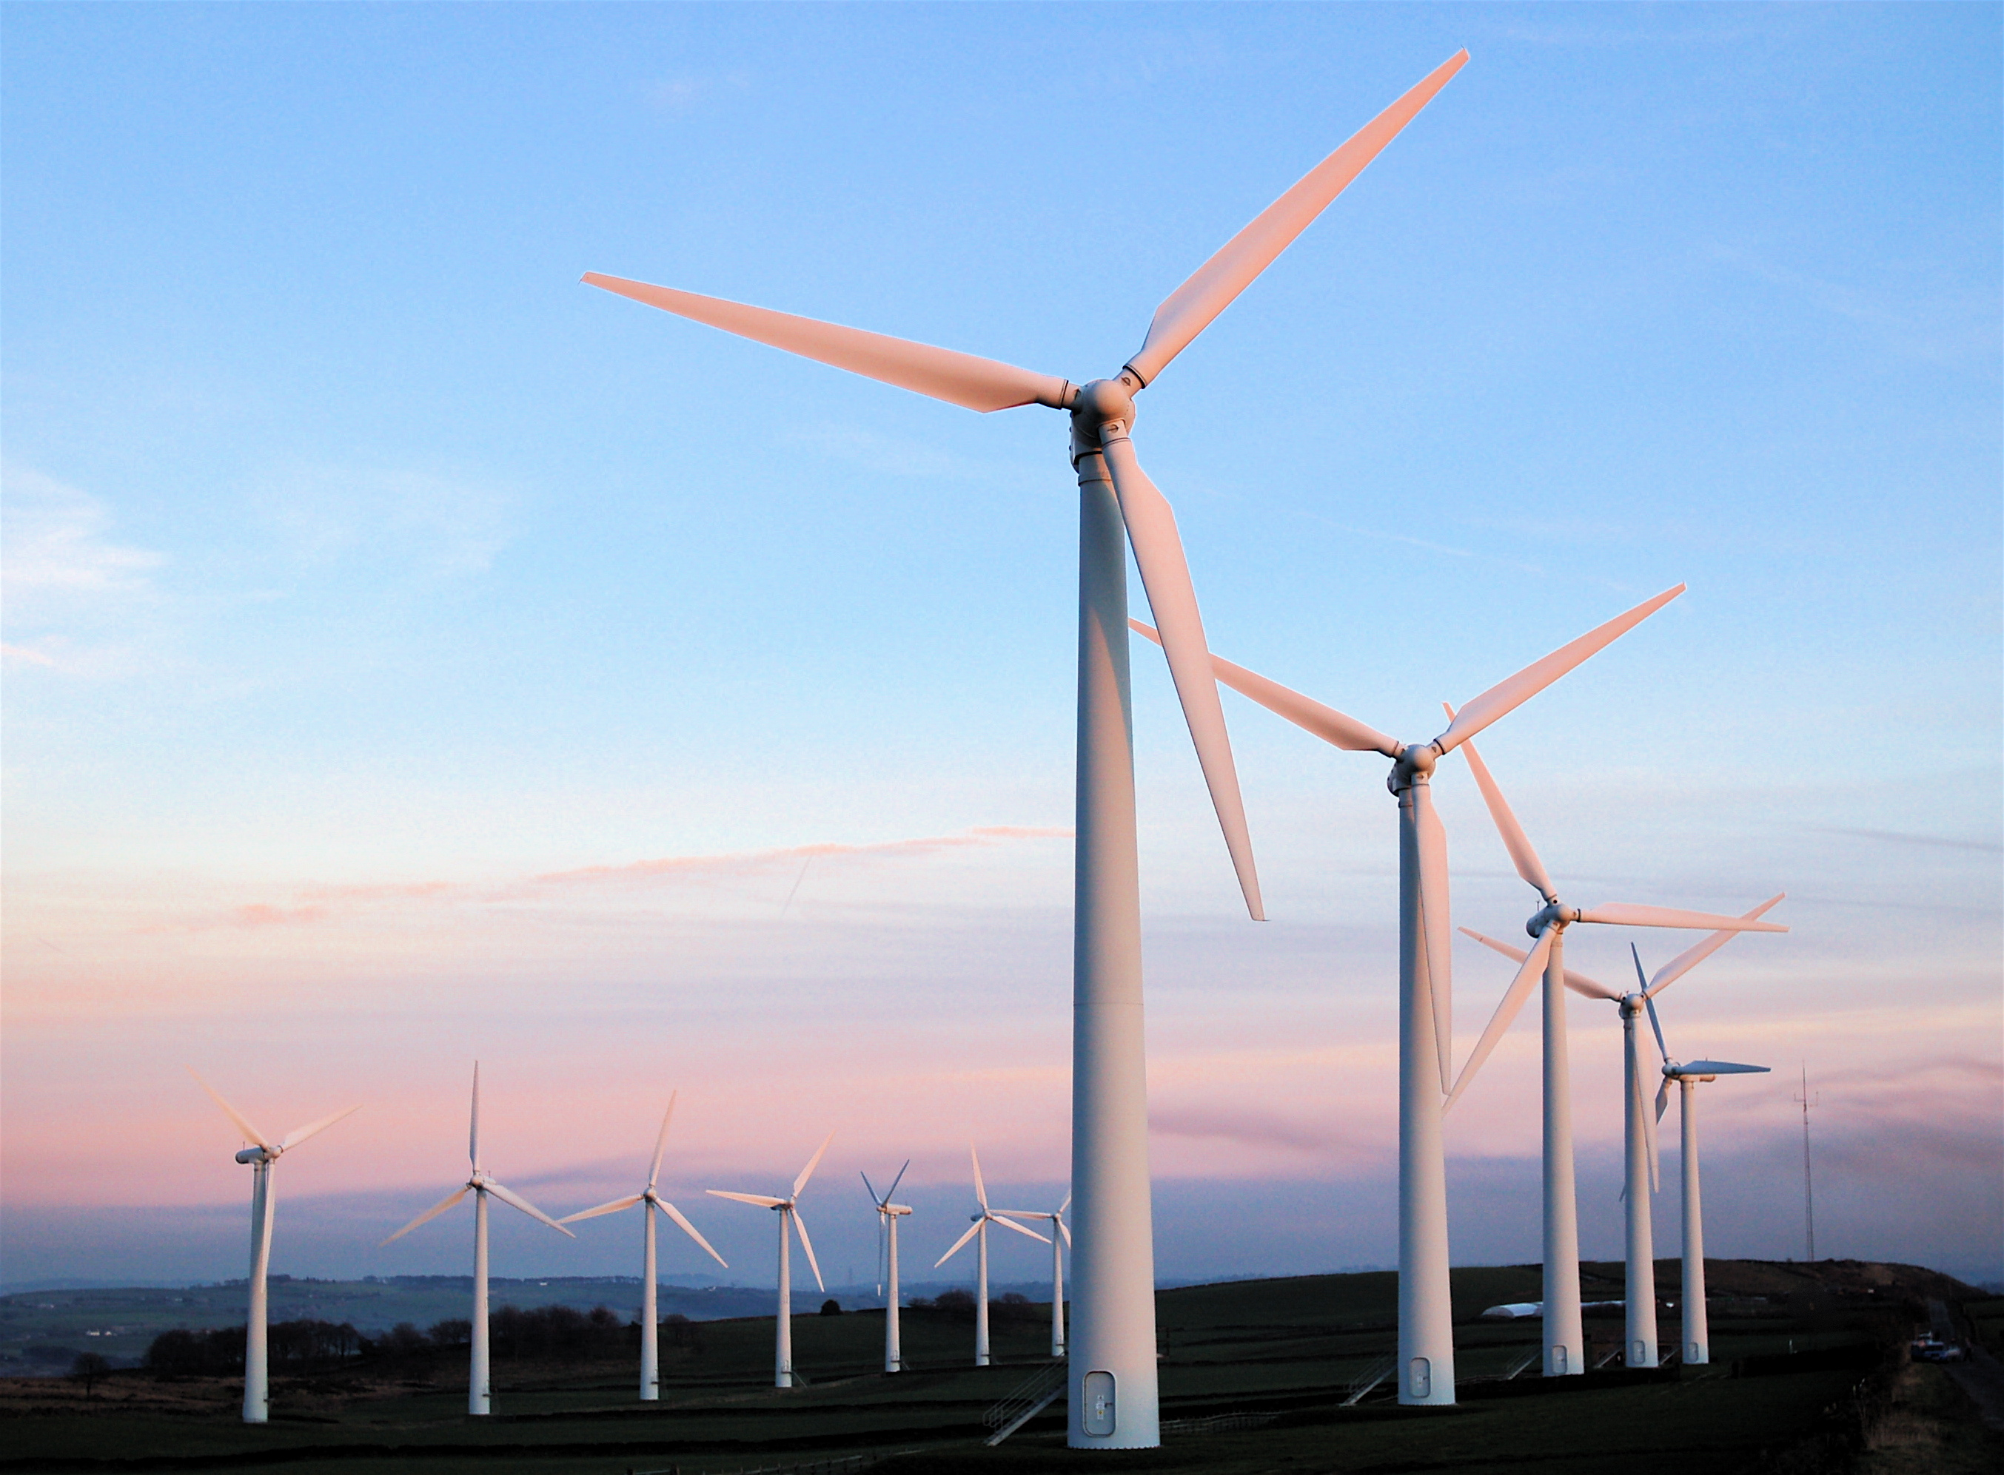
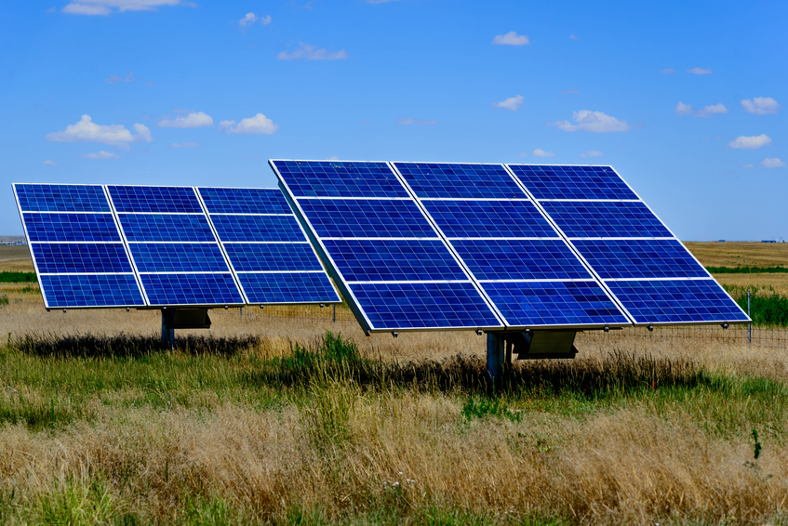
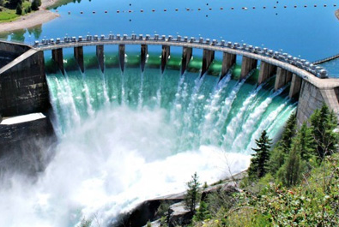
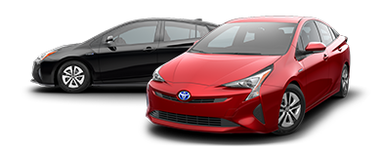
What is Energy Used For?
Residential/Commercial
Industrial
Electric Power
Transportation

Slide 3
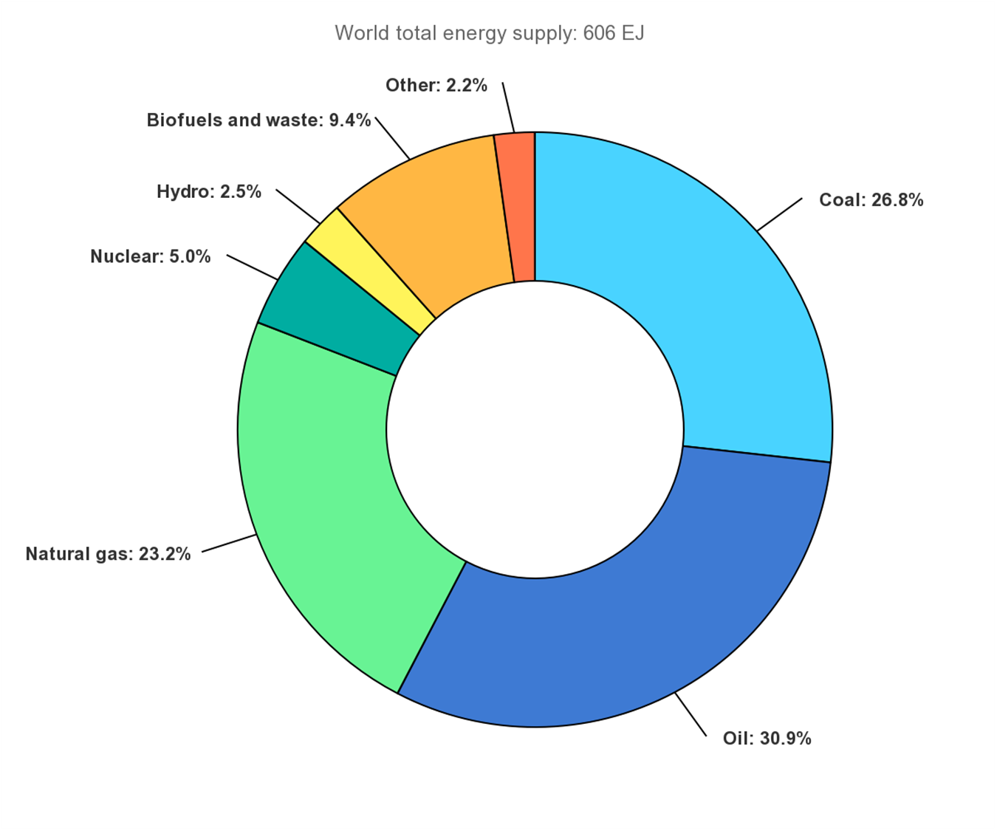
Where does our Energy Come From?
World Sources
List Sources in Order:
Oil
Coal
Natural Gas
Biofuels
Nuclear
Hydropower
2019 Global Energy Supply
~31%
~27%
~23%
~9%
~5%
~2.5%
IEA, Global share of total energy supply by source, 2019, IEA, Paris
https://www.iea.org/data-and-statistics/charts/global-share-of-total-energy-supply-by-source-2019

Slide 4
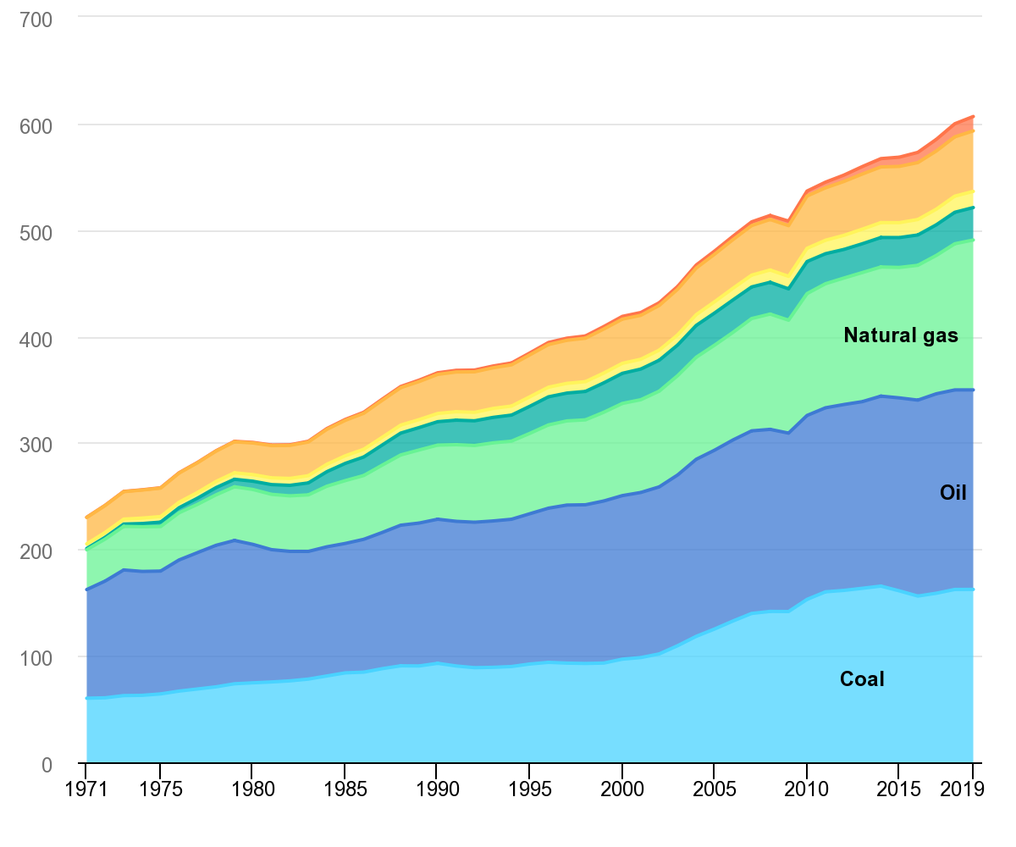
This changes over time
Global Energy Supply by Source
Other
Biofuels
Hydro
Nuclear
Energy (EJ)
IEA, World total energy supply by source, 1971-2019, IEA, Paris
https://www.iea.org/data-and-statistics/charts/world-total-energy-supply-by-source-1971-2019

Slide 5
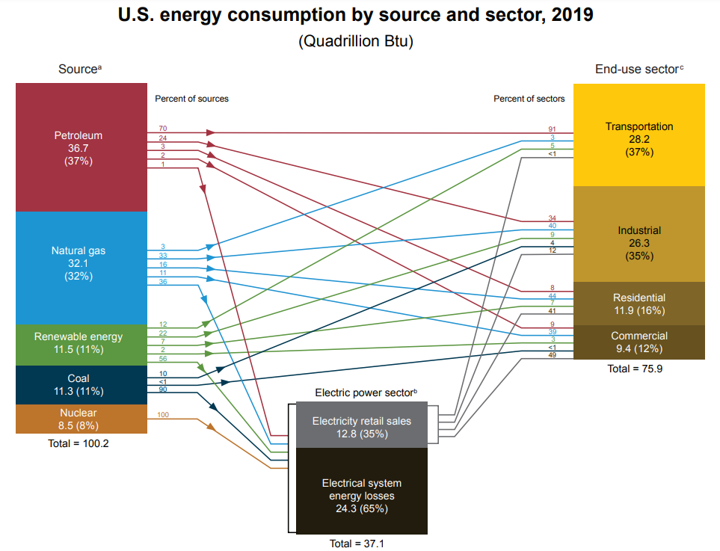
Used in Many Ways…
https://www.eia.gov/totalenergy/data/monthly/pdf/flow/css_2019_energy.pdf

Slide 6
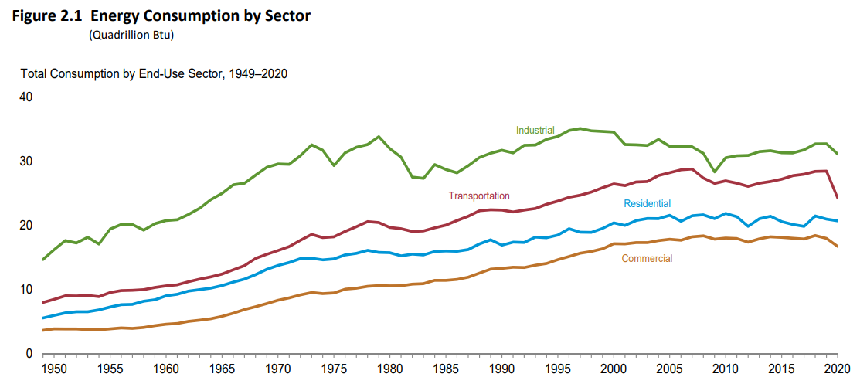
Used in Many Ways…
https://www.eia.gov/totalenergy/data/monthly/pdf/mer.pdf

Slide 7
Primary vs. Secondary Sources
Primary energy sources are sources found in the natural environment
Secondary energy sources are useful transformations of the primary sources. (typically used to store energy)
Electricity
– Batteries, Stored Hydropower

Slide 8
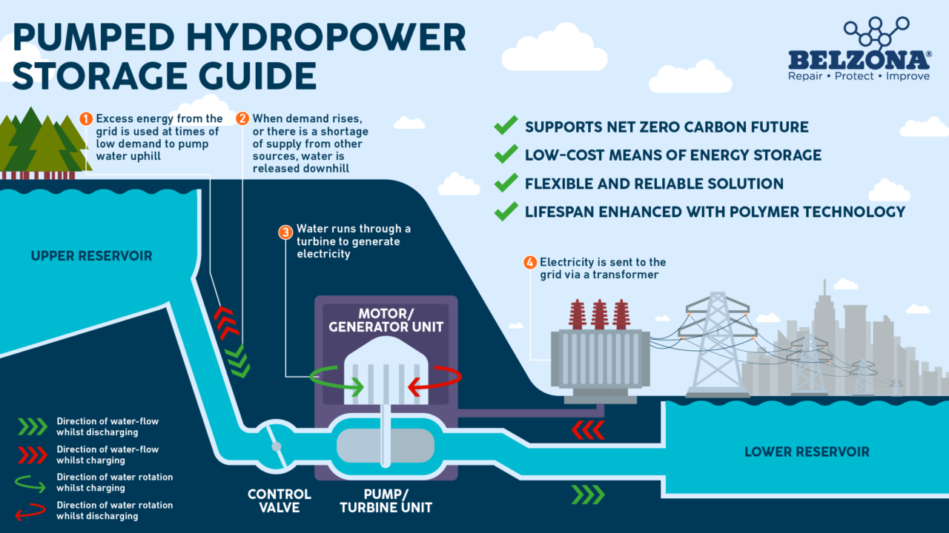
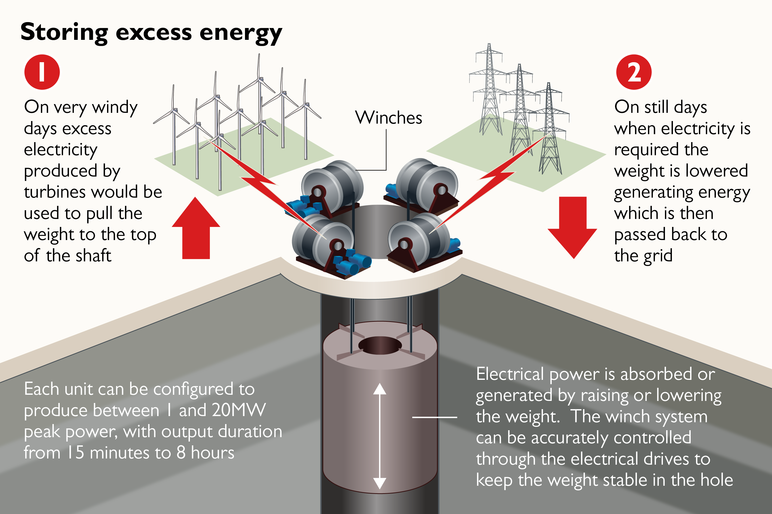
Other Secondary Sources…

Slide 9
What is the Ultimate Primary Source?
The Sun

Slide 10
Which one is the best?
That’s a hard question and depends on many factors
Some of the big ones are:
Energy Density
Cost
Availability and Location
Politics
Safety
Environmental

Slide 11
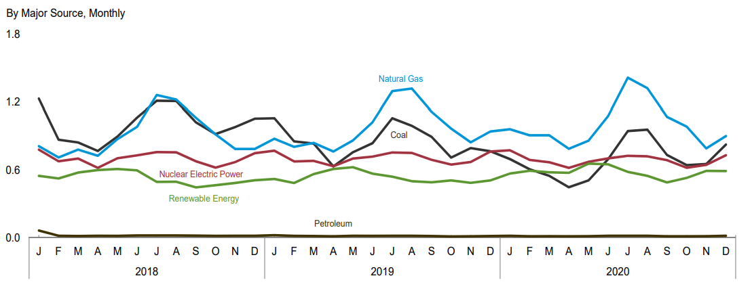
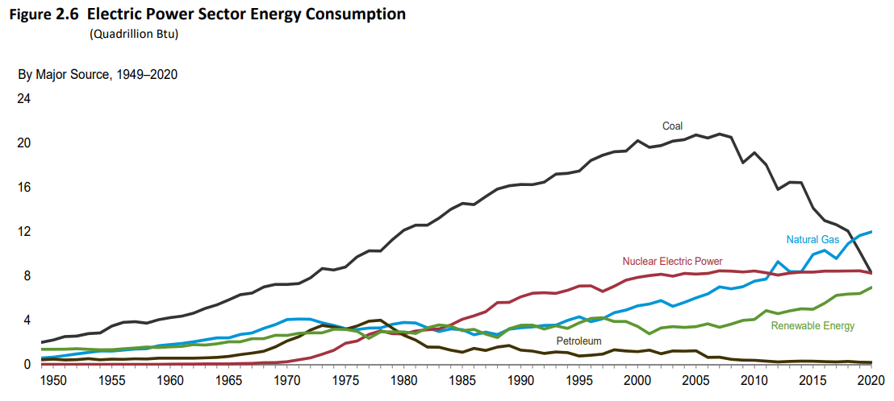
U.S. Electricity Generation
https://www.eia.gov/totalenergy/data/monthly/pdf/mer.pdf

Slide 12
Renewable vs. Non Renewable
Highlight the primary energy sources that are considered renewable
*Note: this doesn’t mean that it cannot ever be replaced, just that it won’t happen in any sort of useful time frame…

Slide 13
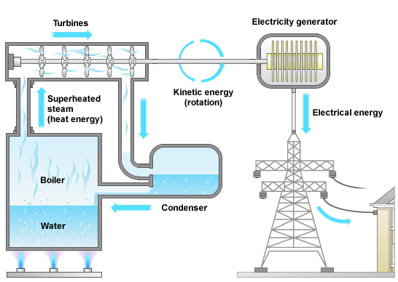
Efficiency
Almost every energy source has the same general path

Slide 14
Sankey Diagram
Sometimes it’s easiest to represent energy flow in a picture.
In these diagrams the width of the arrow represents the amount of energy
Energy Out
Energy
In
Energy Lost

Slide 15
Sankey Diagrams
Which process is more efficient?
Out
Out
A
B
In
In

Slide 16
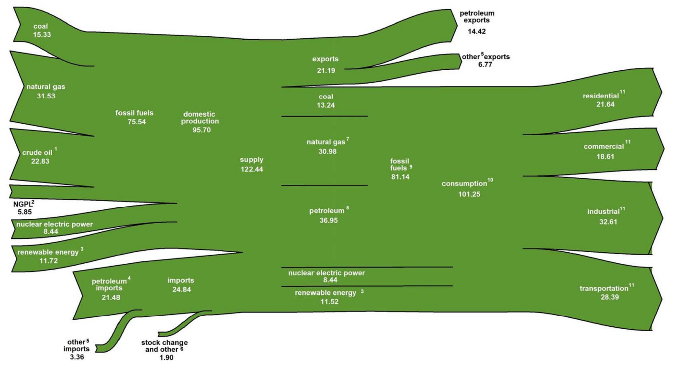
U.S. Energy Flow 2018
*Measurements listed in quadrillion Btu
https://www.eia.gov/totalenergy/data/monthly/pdf/flow/total_energy.pdf

Slide 17
Cost
https://www.lazard.com/perspective/lcoe2020

Slide 18
CO₂ Emissions
Highlight the primary energy sources that are produce Carbon Dioxide
*Note: this is just one of several greenhouse gases. We’ll discuss this.

Slide 19
Location Dependency and Politics

Slide 20
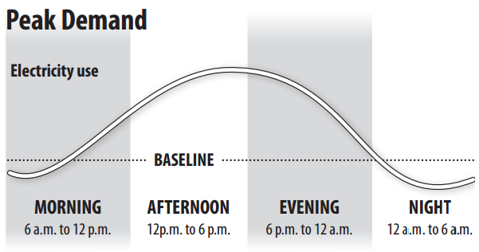
Energy Load Requirements
Energy needs to be available when electricity is most needed but should also be available other times as well.

Slide 21
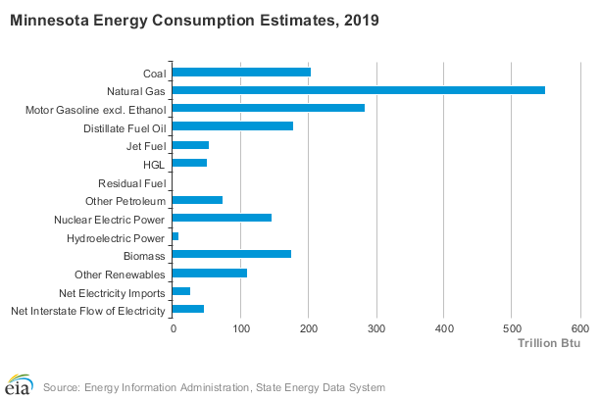
Where does our Energy Come From?
From the U.S. Energy Information Administration | https://www.eia.gov/state/?sid=MN

Slide 22
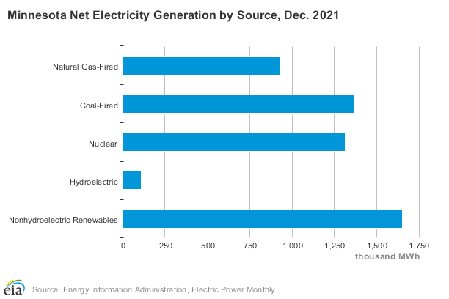
Where does our Energy Come From?
From the U.S. Energy Information Administration | https://www.eia.gov/state/?sid=MN

Slide 23
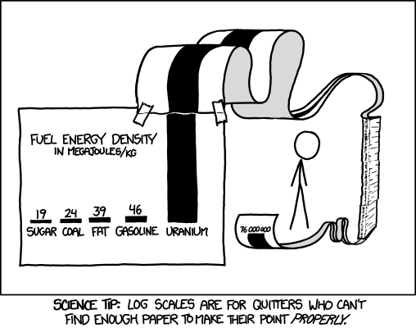
Energy Density
Specific Energy = Energy per Unit Mass [J kg⁻¹]
Energy Density = Energy per Unit Volume [J m⁻³]
$$\frac{E}{m}$$
$$E_{S}=$$
$$\frac{E}{V}$$
$$E_{D}=$$

Slide 24
Energy Density
Material | Specific Energy / MJ kg⁻¹ | Energy Density / MJ m⁻³
Uranium – (Nuclear Fission) | 83,000,000 | 15,000,000,000,000
Natural Gas (Methane) | 54 | 37
Gasoline/Petrol | 46 | 34,000
Crude Oil | 42 | 36,500
Coal | 32 | 23,000
Ethanol | 30 | 21,000
Wood | 17 | Varies
Average Food | 17 | Varies
Why are Specific Energy and Energy Density important?
Higher energy density lowers transportation and storage costs

Slide 25
Power and Energy
Energy
Joules [J]
Power
Watts [W]
How are these quantities related?
$$1 W=1 \frac{J}{s}$$

Slide 26
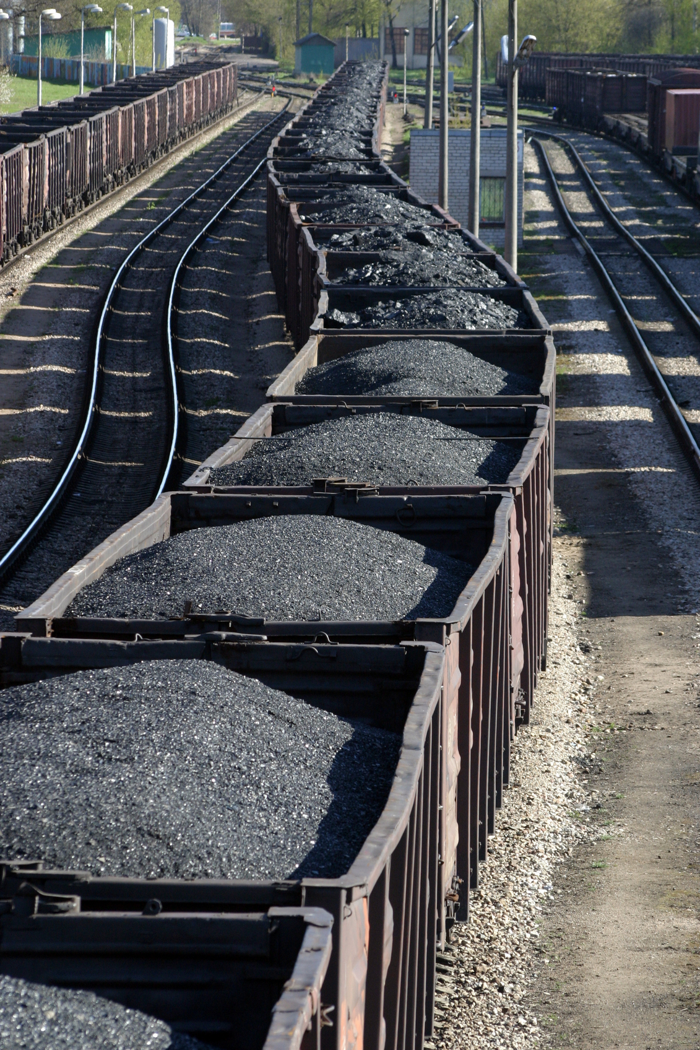
Energy Density
How much coal must be supplied per day to run a 500 MW power plant at 30% efficiency? (Specific Energy of coal is 32 MJ kg⁻¹)
30% efficient
$$E_{in}×0.3=500 \frac{MJ}{s}$$
1,500 kg
1,500 kg
1,500 kg
1,500 kg
1,500 kg
$$E_{in}=1,700 \frac{MJ}{s}$$
1,500 kg
1,500 kg
$$\frac{1,700 MJ}{1 s}$$
$$×\frac{1 kg}{32 MJ}=$$
$$53.1 \frac{kg}{s}$$
1,500 kg
>3000 cars per day!
$$\sim 4,600,000 \frac{kg}{day}$$
How many train cars per day?

Slide 27
Energy Density
If a nuclear power plant powered by uranium-235 (83,000,000 MJ kg⁻¹) has the same output (500 MW) and the same efficiency (30%) as the coal-fired plant of the previous example, how many kg of nuclear fuel will it burn per day? Per year?
30% efficient
$$E_{in}×0.3=500 \frac{MJ}{s}$$
$$E_{in}=1,700 \frac{MJ}{s}$$
$$\frac{1,700 MJ}{1 s}$$
$$×\frac{1 kg}{83,000,000 MJ}$$
$$=0.00002 \frac{kg}{s}$$
$$\sim 646 \frac{kg}{year}$$
$$\sim 1.77 \frac{kg}{day}$$

