Slide 1
Nuclear Power
IB Physics | Energy Production

Slide 2
Remember Binding Energy per Nucleon?
Nuclide | # of p | # of n | Nucleus Mass
Iodine-127 |  |  | 126.87544u
53
74
Mass Defect
m_{e} | 0.000549u
m_{p} | 1.007276u
m_{n} | 1.008665u
53 × 1.007276 u
74 × 1.008665 u
$$128.026838u$$
$$–126.87544u$$
$$=1.15140u$$
1u | 931.5 MeV c⁻²
$$1.15140 u×\frac{931.5 MeV c^{−2}}{1 u}$$
$$=1072.53 MeV c^{−2}$$
Convert mass to MeV c⁻²
$$E=mc^{2}$$
$$=\left(1072.53 MeV c^{−2}\right)c^{2}$$
$$=1072.53 MeV$$
$${1072.53 MeV}/{127}=$$
$$8.45 MeV per Nucleon$$

Slide 3
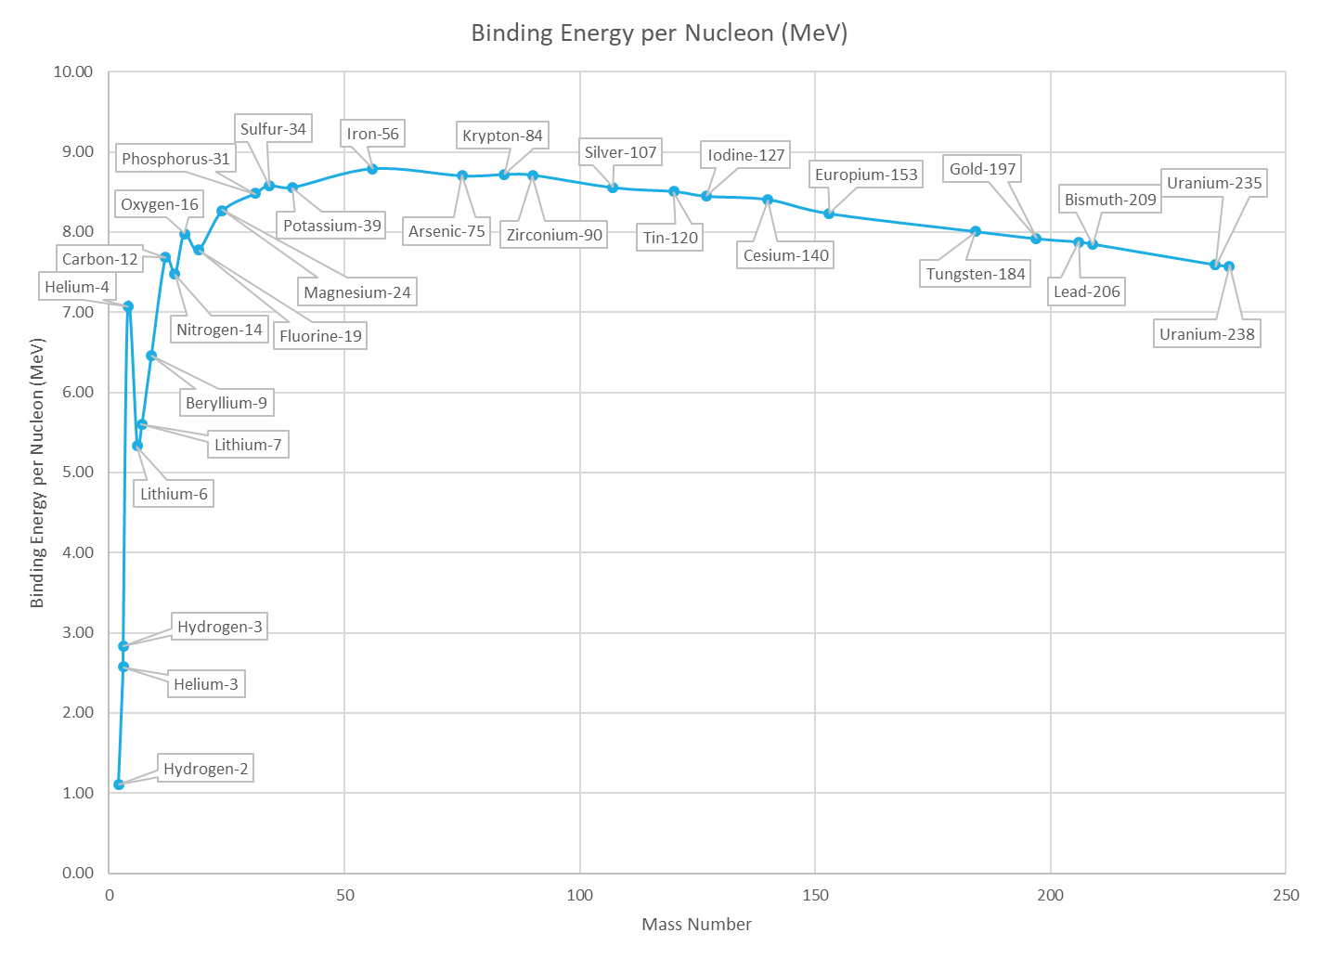
Binding Energy per Nucleon
Iron-56
(most stable)

Slide 4
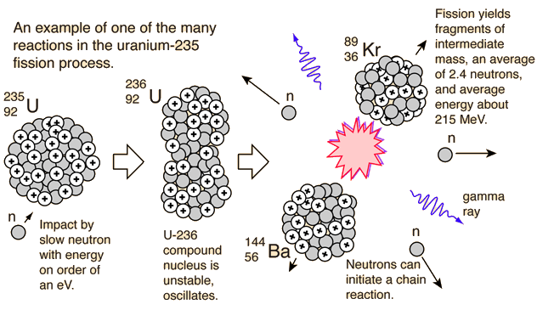
Fission
$${}_{0}^{1}n+{}_{92}^{235}U$$
$$→{}_{92}^{236}U$$
3
$$→{}_{56}^{144}{Ba}+{}_{36}^{89}{Kr}+___{}_{0}^{1}n$$

Slide 5
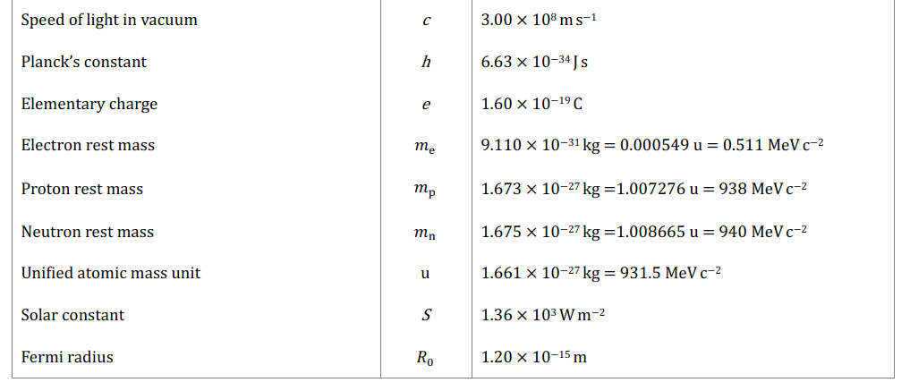
IB Physics Data Booklet

Slide 6
Fission
$${}_{0}^{1}n + {}_{92}^{235}U → {}_{37}^{93}{Rb} + {}_{55}^{141}{Cs} +2{}_{0}^{1}n + {}_{0}^{0}γ$$
1.675
390.173
154.248
233.927
2 × 1.675
× 10⁻²⁷ kg
× 10⁻²⁷ kg
× 10⁻²⁷ kg
× 10⁻²⁷ kg
× 10⁻²⁷ kg
>
391.848 × 10⁻²⁷ kg
391.525 × 10⁻²⁷ kg
391.848 × 10⁻²⁷ kg - 391.525 × 10⁻²⁷ kg
= 0.323 × 10⁻²⁷ kg
$$0.323×{10}^{−27} kg×\frac{1 u}{1.661×{10}^{−27} kg}=0.19446 u$$
$$0.19446 u×931.5=181.14 MeV$$
Mass Defect | 0.19446 u
Energy Released | 181.14 MeV

Slide 7
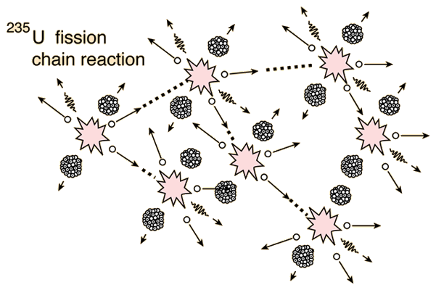
Chain Reaction

Slide 8
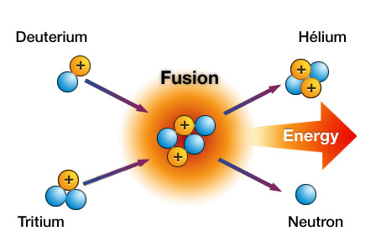
Fusion

Slide 9
Hydrogen-2 | 2.0141 u
Helium-3 | 3.0161 u
Neutron | 1.0087 u
Fusion
$${}_{1}^{2}H+{}_{1}^{2}H→{}_{2}^{3}{He}+{}_{0}^{1}n$$
(2.0141 u + 2.0141 u) – (3.0161 u + 1.0087 u)
= 0.0034 u
4.0282 u
4.0248 u
0.0034 u × 931.5 = 3.1671 MeV
Mass Defect | 0.0034 u
Energy Released | 3.1671 MeV

Slide 10
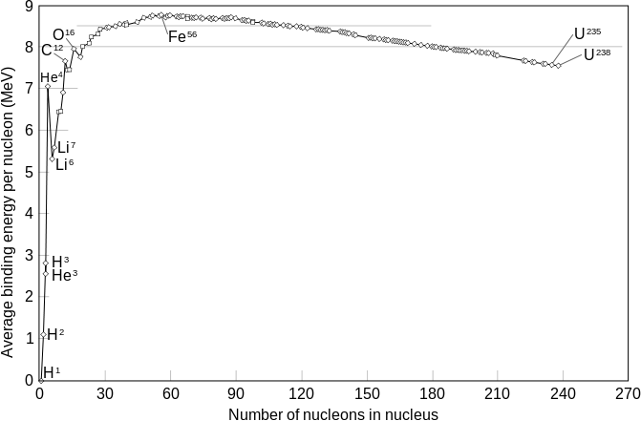
Fusion vs. Fission
Fusion
Fission

Slide 11
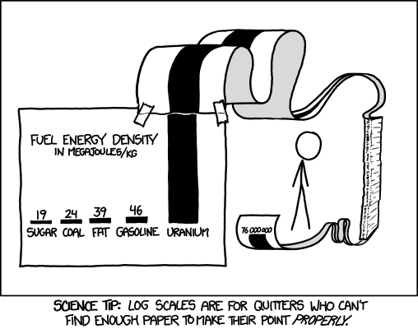
Energy Density
Specific Energy = Energy per Unit Mass [J kg⁻¹]
Energy Density = Energy per Unit Volume [J m⁻³]
$$E_{S}=\frac{E}{m}$$
$$E_{D}=\frac{E}{V}$$

Slide 12
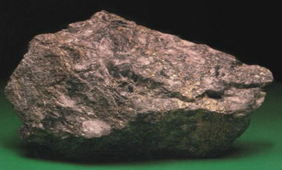
Uranium
Uranium found in the earth’s crust is primarily comprised of two different isotopes of Uranium
$${}_{92}^{238}U$$
$${}_{92}^{235}U$$
Uranium-238
Uranium-235
99.3%
0.7%
37% | Kazakhstan, Russia, and Uzbekistan
30% | Canada
17% | Australia
10% | Malawi, Namibia, Niger, and South Africa
6% | United States
Where does the uranium used by the US come from?

Slide 13
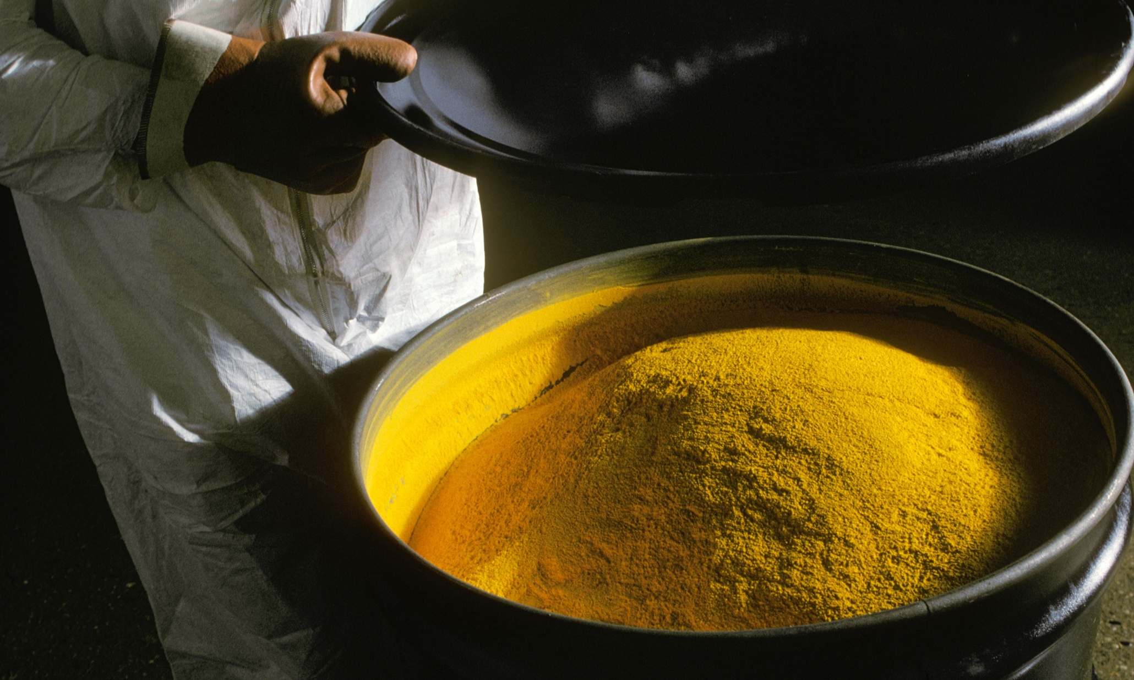
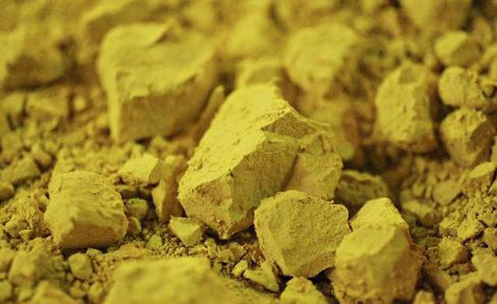
Yellowcake Uranium
Uranium ore is milled into a U₃O₈ powder known as yellowcake

Slide 14
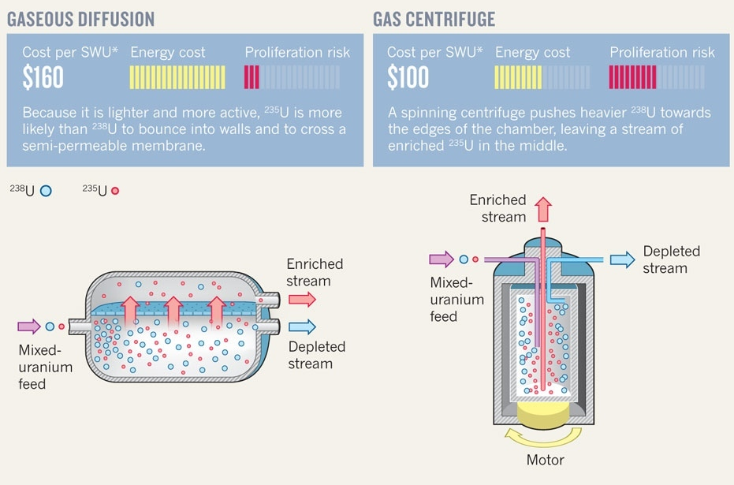
Uranium Enrichment
The yellowcake is converted into Uranium Hexafluoride gas and enriched to create a mixture with a higher percentage of U-235 nuclides

Slide 15
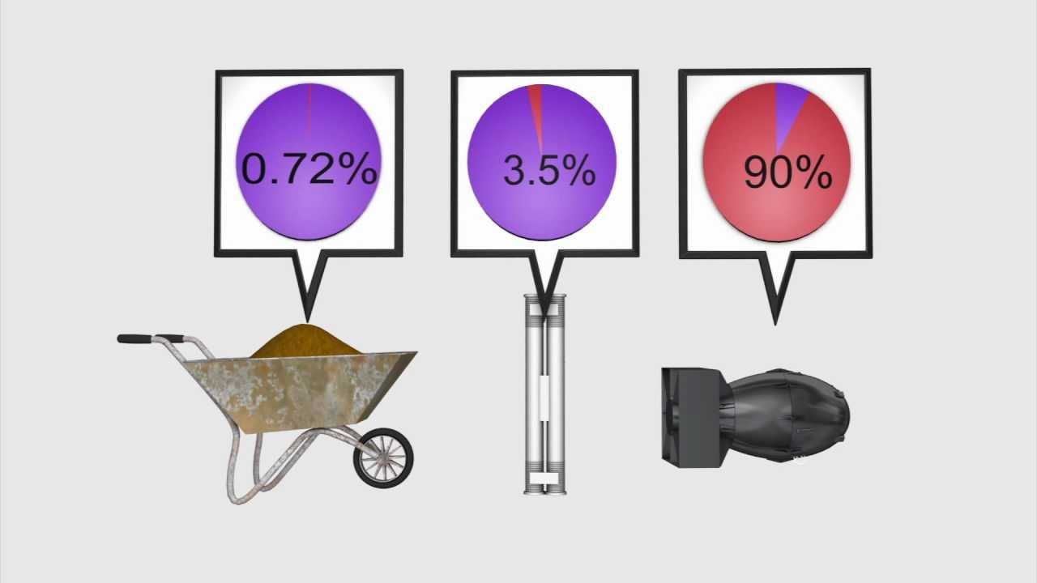
Uranium Enrichment
Fuel-Grade
Uranium Ore
Weapons-Grade

Slide 16
Uranium Enrichment
0.72% U-235

Slide 17
Uranium Enrichment
4% U-235

Slide 18
Uranium Enrichment
90% U-235

Slide 19
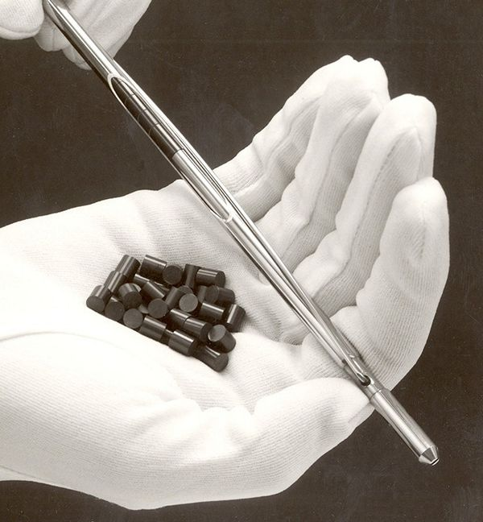
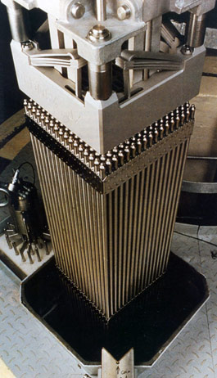
Uranium Fuel Rods

Slide 20
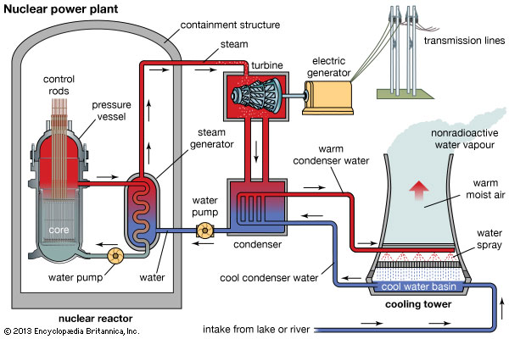
Nuclear Power Plant

Slide 21
Chain Reaction
For a controlled chain reaction, each reaction should trigger one other reaction
Important Factors
Only about 4% of the fuel is actually comprised of fissionable U-235 atoms
Neutrons have to traveling relatively slowly to be captured by a U-235 atom

Slide 22
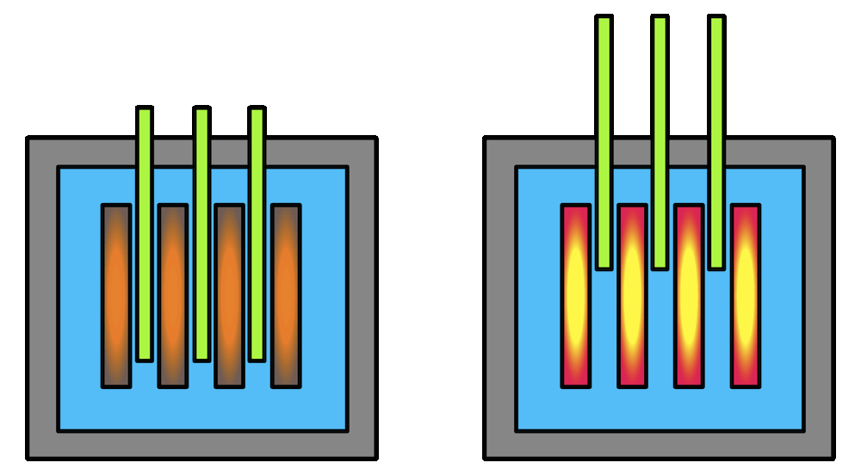
Chain Reaction
Moderator - water or graphite
Control Rods - boron
Slows down neutrons
Absorbs neutrons

Slide 23
Chain Reaction
Too Fast!
U-235
Moderator
U-235
U-235
Control Rod
U-235

Slide 24
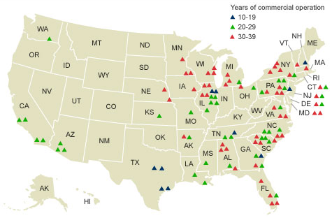
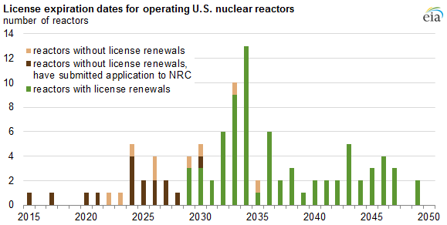
Nuclear Power Plants
The US currently has about 100 nuclear power plants in operation representing about 20% of the total generated electricity
Nuclear Power Plants are retired after 60 years so the forecast is a decreasing number in the coming years…

Slide 25
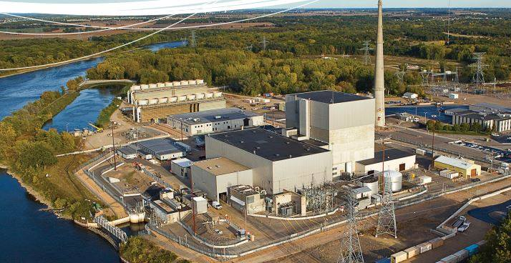
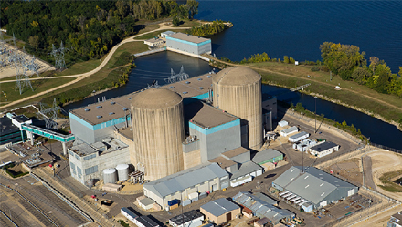
Nuclear Power in Minnesota
Monticello Nuclear Power Plant | Monticello, MN
Prairie Island Nuclear Power Plant | Red Wing, MN

Slide 26
Nuclear Waste
After the fuel can no longer be used to efficiently create electricity, the spent nuclear waste needs to be disposed of.
Isotope | Half Life
Strontium-90 | 28 years
Caesium-137 | 30 years
Plutonium-239 | 24,000 years
Caesium-135 | 2.3 million years
Iodine-129 | 15.7 million years
How long until it’s safe?
Radioactive Isotopes found in spent nuclear fuel

Slide 27
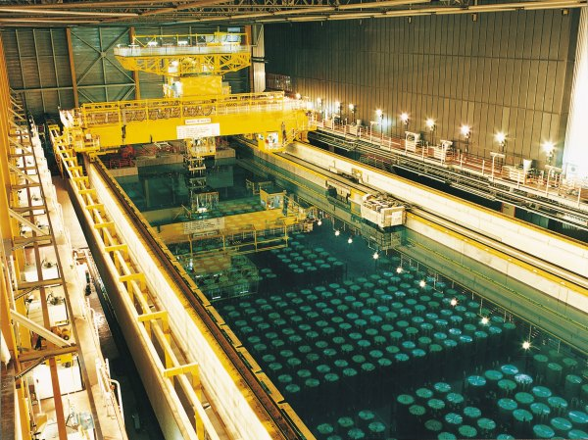
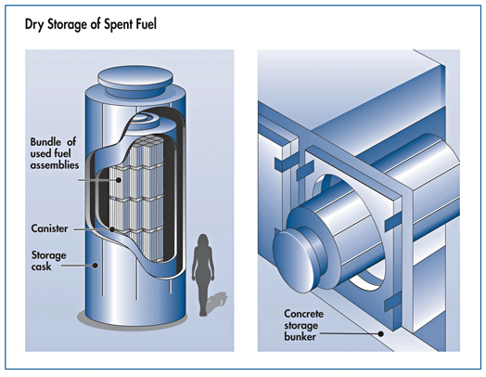
Nuclear Waste - Disposal
Most of the waste is stored onsite

Slide 28
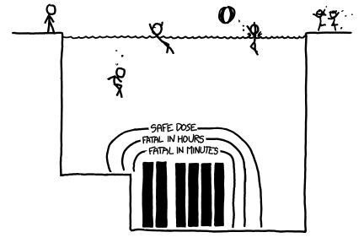
Nuclear Waste - Disposal

Slide 29
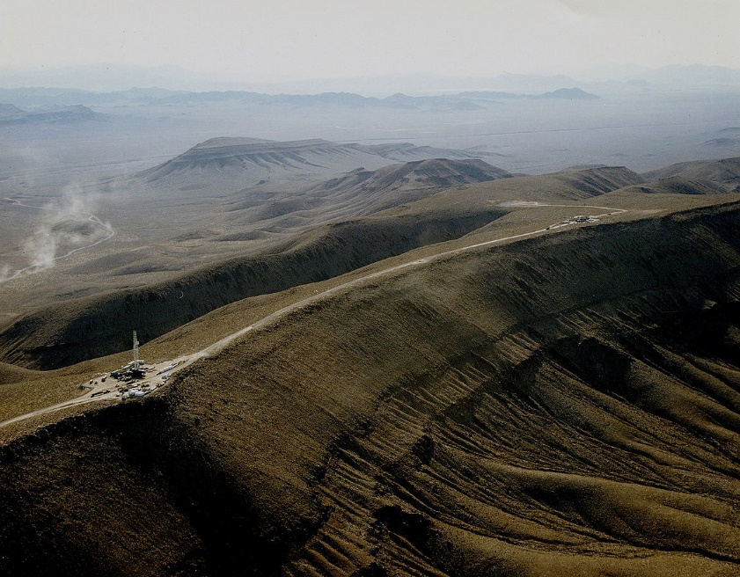
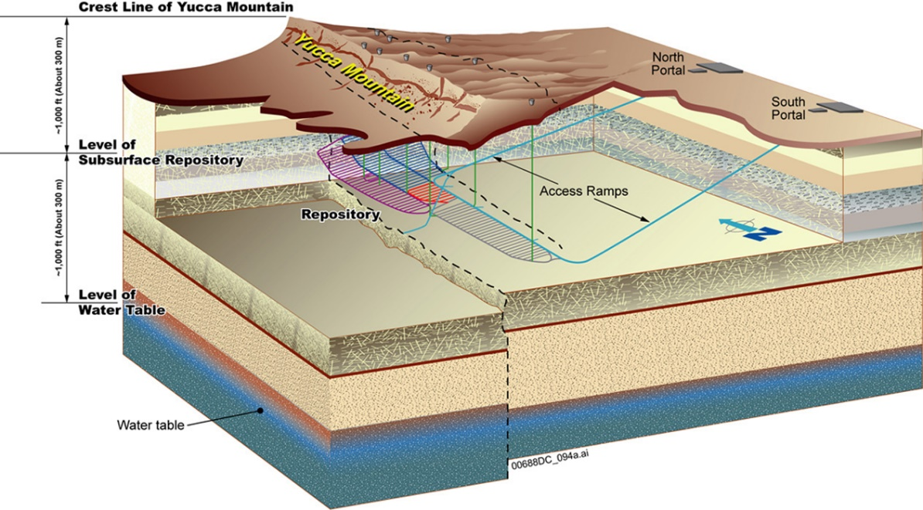
Nuclear Waste - Disposal
Yucca Mountain

Slide 30
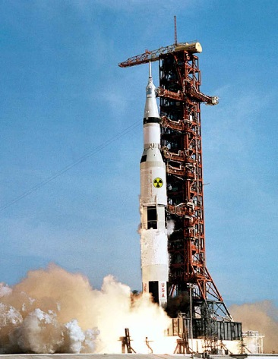
Nuclear Waste - Disposal
Any better options out there???
Ideas | Examples
Long-term above ground storage | Investigated in France, Netherlands, Switzerland, UK, and USA. Not currently planned to be implemented anywhere.
Disposal in outer space (proposed for wastes that are highly concentrated) | Investigated by USA. Investigations now abandoned due to cost and potential risks of launch failure.
Rock-melting (proposed for wastes that are heat-generating) | Investigated by Russia, UK, and USA. Not implemented anywhere. Laboratory studies performed in the UK.
Disposal at subduction zones | Investigated by USA. Not implemented anywhere. Not permitted by international agreements.
Sea disposal | Implemented by Belgium, France, Germany, Italy, Japan, Netherlands, Russia, South Korea, Switzerland, UK, and USA. Not permitted by international agreements.
Sub seabed disposal | Investigated by Sweden and UK (and organisations such as the OECD Nuclear Energy Agency). Not implemented anywhere. Not permitted by international agreements.
Disposal in ice sheets (proposed for wastes that are heat-generating) | Investigated by USA. Rejected by countries that have signed the Antarctic Treaty or committed to providing solutions within national boundaries.
Deep well injection (for liquid wastes) | Implemented in Russia for many years for LLW and ILW. Investigations abandoned in the USA in favour of deep geological disposal of wastes in solid form.

Slide 31
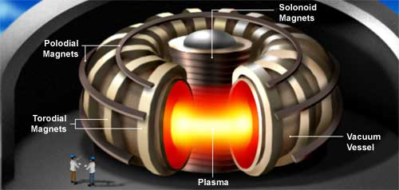
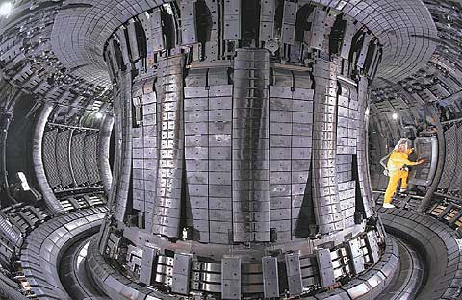
Fusion as a Power Source
Fusion reactions have been successfully controlled using strong magnetic fields but the energy used to run the magnets exceeds the energy released in the reaction…

Slide 32
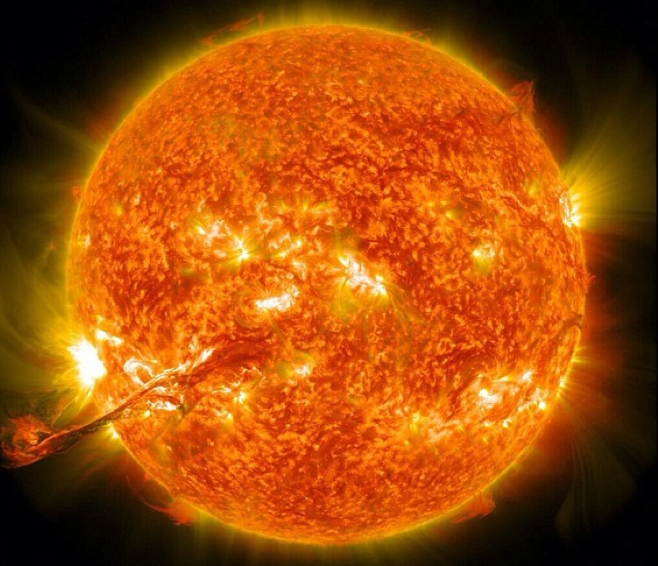
Conditions for Fusion
It’s significantly more difficult to create fusion reactions here on earth
High Pressure
High Temperature
+
+

