Slide 1
Thermal Energy Transfer & Black Body Radiation
IB Physics | Energy Production

Slide 2
Heat Transfer
There are 3 primary ways that heat is transferred:
Conduction
Convection
Radiation

Slide 3
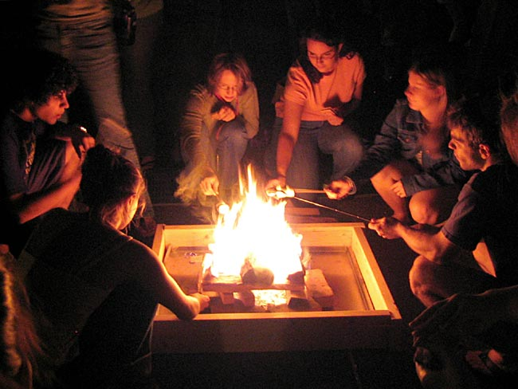
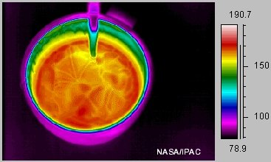
Conduction
contact
Conduction occurs between objects in direct __________

Slide 4
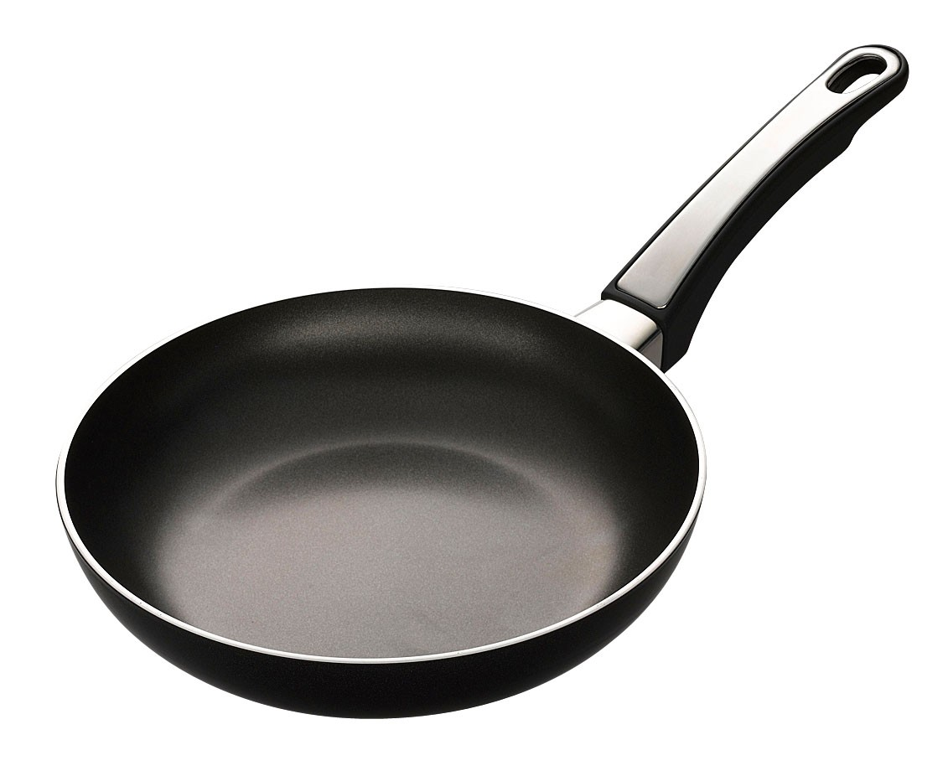
Conduction
Why does this frying pan have a plastic handle?
Plastic has a high specific heat and doesn’t conduct heat very quickly

Slide 5
Convection
Convection occurs when fluids (liquids or gases) move around due to temperature differences
rises
A
Hot Air ________
B
C
sinks
Cold Air ________
D
Where should I roast my marshmallow?

Slide 6
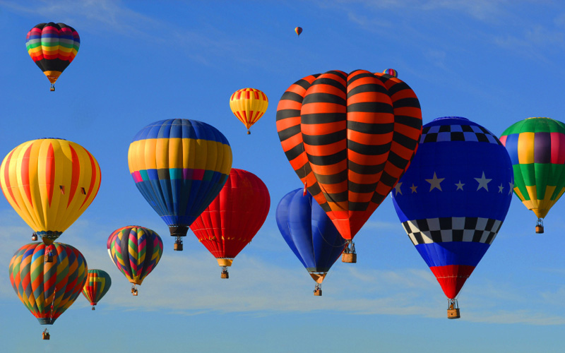
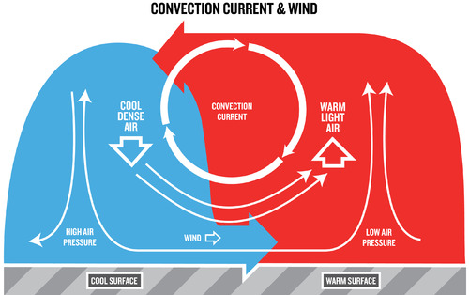
Convection
Why does hot air rise?
High Temperature
High Volume
High Volume
Same Mass
Lower Density

Slide 7
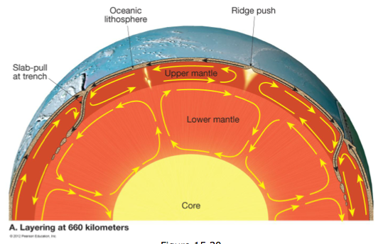
Convection

Slide 8
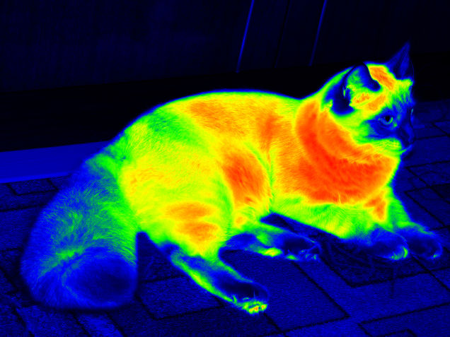
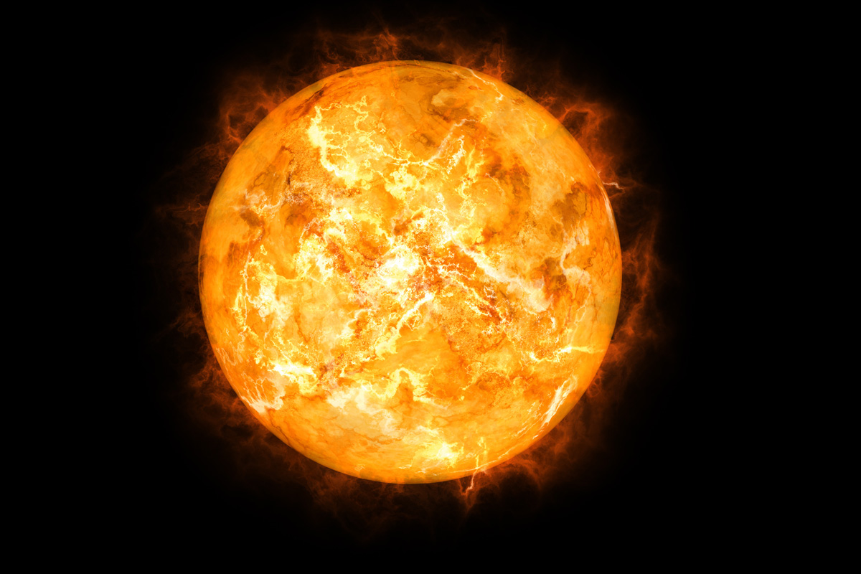
Radiation
Radiation is energy that is transferred as waves such as visible light and infrared
a vacuum
Radiation can travel through __________________

Slide 9
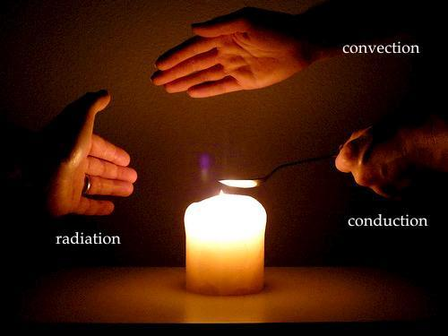
Label Me
B
Convection
C
Conduction
A
Radiation

Slide 10
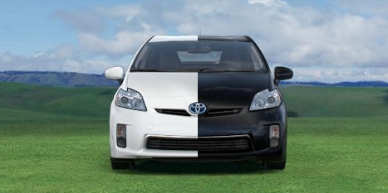
Emissivity
What color car heats up the most in the sun?
Black – Absorbs more light

Slide 11
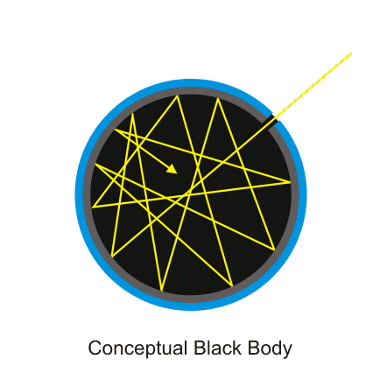
Black Body Radiator
A black body radiator is an object that is perfectly opaque and absorbs all energy

Slide 12
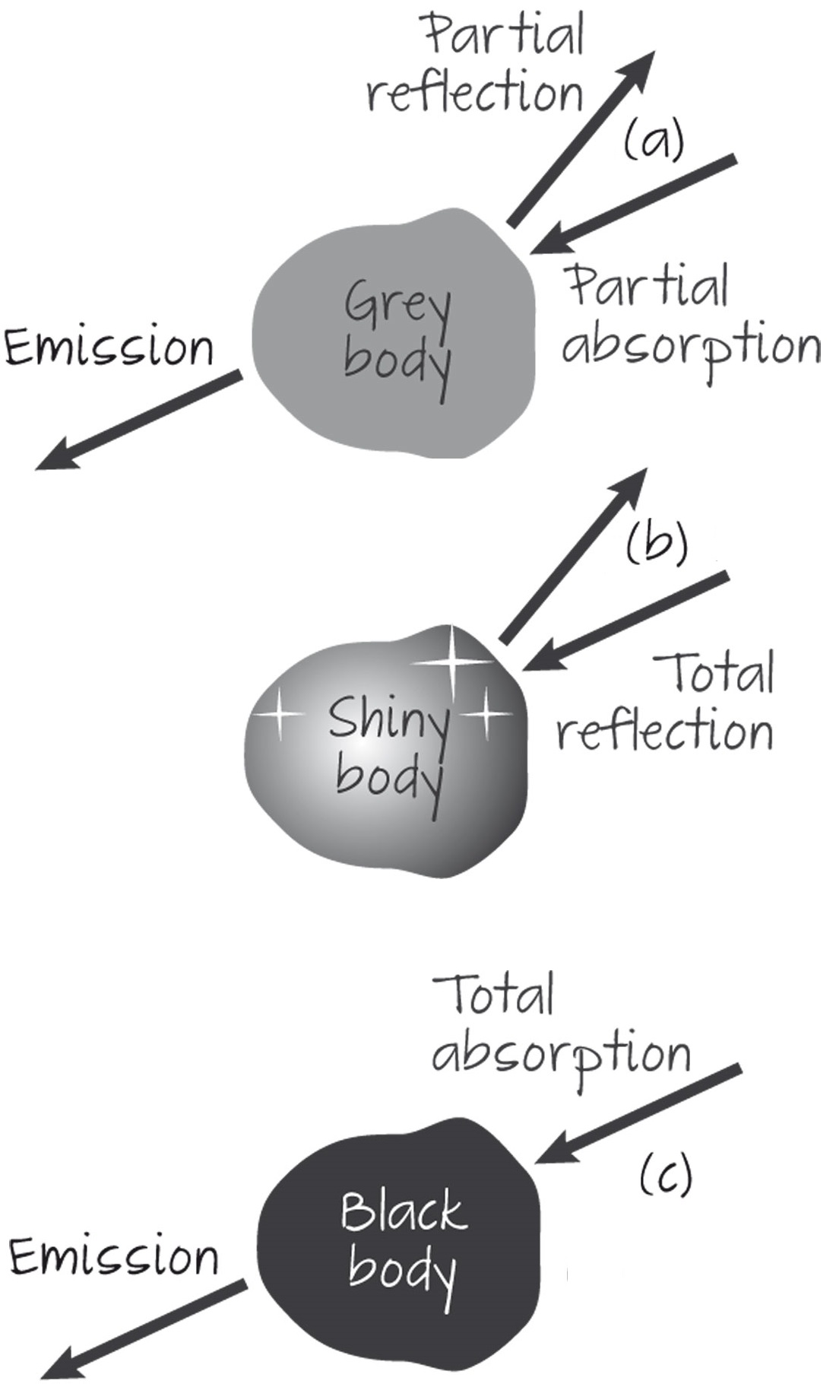
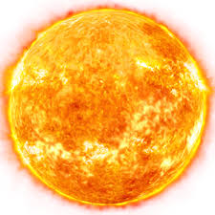
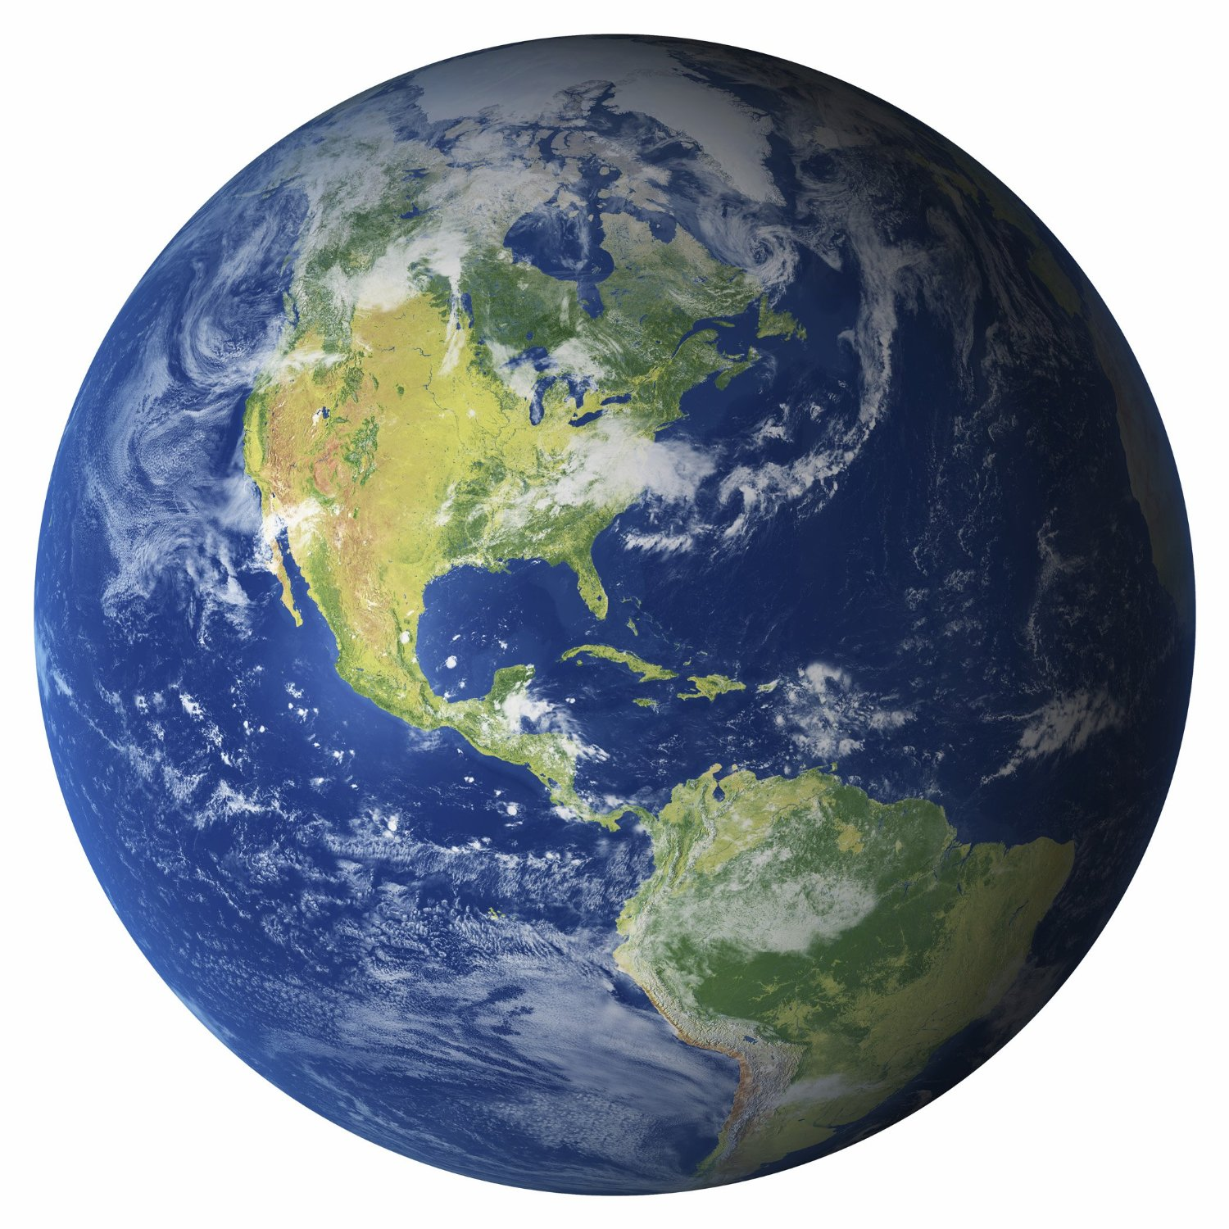
Emissivity
Emissivity | e | $$\frac{power radiated by a surface}{power radiated from a black body of the same temperature and area}$$
The emissivity is used to adjust for an object that isn’t a perfect black-body radiator
This value is always between 0 and 1
1
0.6
$$e≈$$
$$e≈$$

Slide 13
Stefan-Boltzmann Law
$$P=eσAT^{4}$$
Power
[W]
Absolute Temperature
[K]
e is usually = 1
Surface Area
[m²]
5.67 × 10⁻⁸ W m⁻² K⁻⁴
A_{sphere} = 4πr²
Emissivity | e | $$\frac{power radiated by a surface}{power radiated from a black body of the same temperature and area}$$
Stefan-Boltzmann Constant | σ | 5.67 × 10⁻⁸ W m⁻² K⁻⁴

Slide 14
Try This
A star has a radius of 8.3 × 10⁷ m and a surface temperature of 7500°C. Calculate the power it emits.
e = 1
σ = 5.67 × 10⁻⁸ W m⁻² K⁻⁴
A = 4π(8.3 × 10⁷)² = 8.66 × 10¹⁶ m²
T = 7500 + 273 = 7773 K
$$P=eσAT^{4}$$
$$P=(1)(5.67×{10}^{−8})(8.66×{10}^{16}){(7773)}^{4}$$
$$P=1.79×{10}^{25} W$$

Slide 15
Proportionality
How much more heat energy is radiated from a 80°C cup of water than from a 20°C cup of water?
$$P=eσAT^{4}$$
*Careful! Temperature must be converted into Kelvin
$$T_{1}=80+273=353 K$$
e, σ, and A are all the same before and after…
$$T_{2}=20+273=293 K$$
$$\frac{P_{1}}{P_{2}}=\frac{eσA{T_{1}}^{4}}{eσA{T_{2}}^{4}}$$
$$=\frac{{353}^{4}}{{293}^{4}}$$
$$=2.1 times more$$

Slide 16
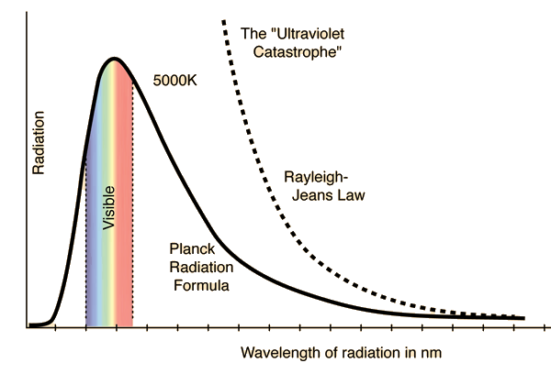
Radiated Energy
When a black body radiator is heated up, it emits a range of different wavelengths
Predicted
Actual

Slide 17
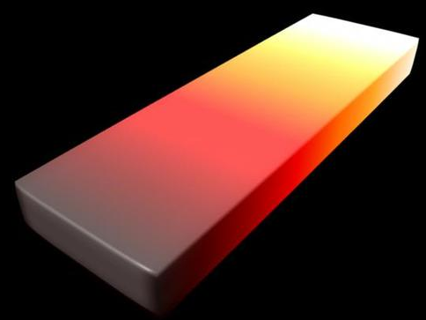
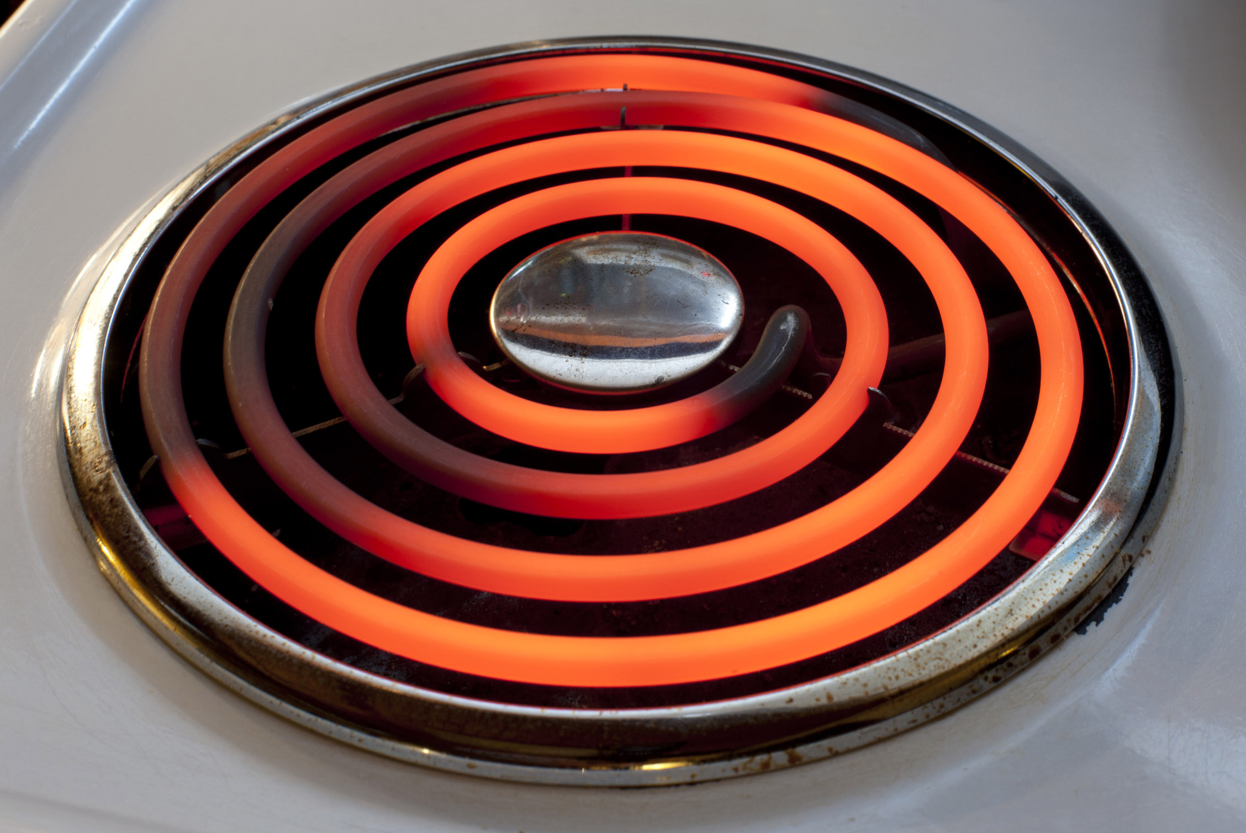
Glowing Hot
If the temperature is high enough the radiation that is emitted is in the visible spectrum
5000 K
4000 K
3000 K
2000 K
Infrared
1000 K
Visible
Red Light

Slide 18
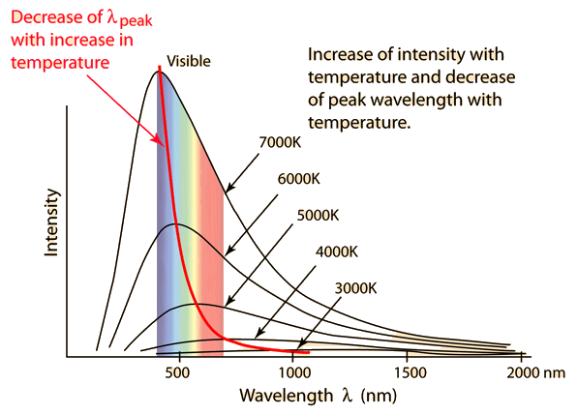
Wien’s Displacement Law
$$λ_{max}(metres)=\frac{2.90×{10}^{−3}}{T (kelvin)}$$
*Note: This assumes perfect blackbody radiation

Slide 19
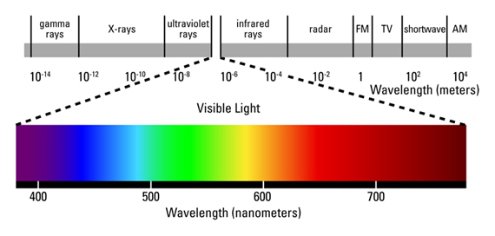
Try This
$$λ_{max}(metres)=\frac{2.90×{10}^{−3}}{T (kelvin)}$$
At what wavelength is the emitted radiation of the Sun maximized if it has a surface temperature of 5780 K?
$$λ=\frac{2.90×{10}^{−3}}{5780}=$$
$$5.02×{10}^{−7}m=$$
$$502 nm$$
What is the most prevalent color of sunlight?
Green

Slide 20
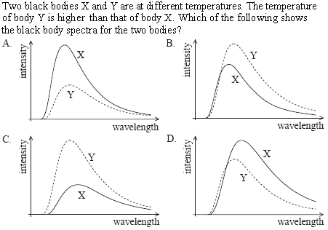
Sample IB Question

Slide 21
Takeaways from Today
Know the difference between:
Conduction
Convection
Radiation
Black Body Radiators
Emissivity
Stefan-Boltzmann Law
Wien’s Displacement Law
$$P=eσAT^{4}$$
$$λ_{max}(metres)=\frac{2.90×{10}^{−3}}{T (kelvin)}$$

