Slide 1
Radiation from the Sun
IB Physics | Energy Production

Slide 2
Intensity
$$Intensity=\frac{Power}{A}$$
$$Units=\frac{W}{m^{2}}=Wm^{−2}$$

Slide 3
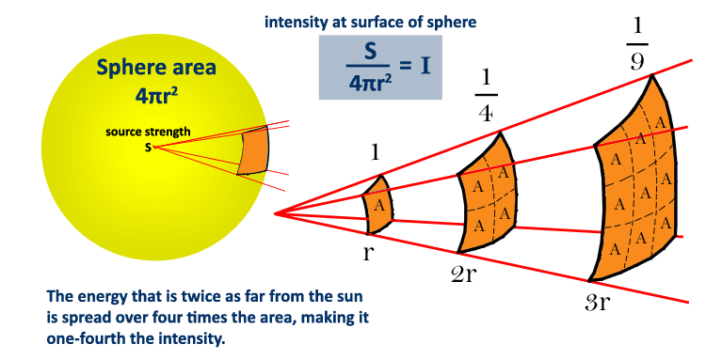
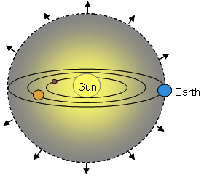
Intensity
Calculate the intensity of the Sun’s radiation arriving to Earth
Sun’s Power = 3.84 × 10²⁶ W
Earth’s Distance from Sun = 150 × 10⁶ km
$$I=\frac{P}{A}$$
$$=\frac{3.84×{10}^{26}}{4π{(150×{10}^{9})}^{2}}$$
$$I=1358 Wm^{−2}$$

Slide 4
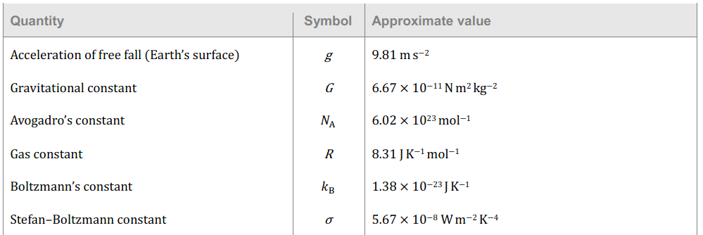
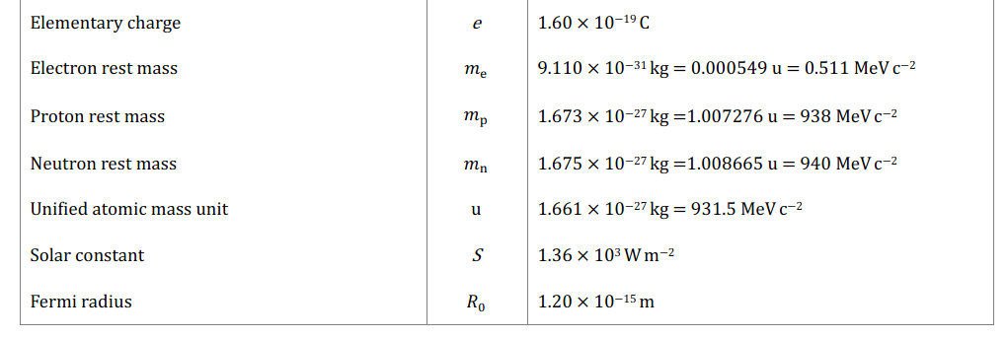
Solar Constant
The average intensity falling on an area above the earth’s atmosphere perpendicular to the direction traveled by the radiation
S =
1360 W m⁻²
= 1.36 × 10³ W m⁻²

Slide 5
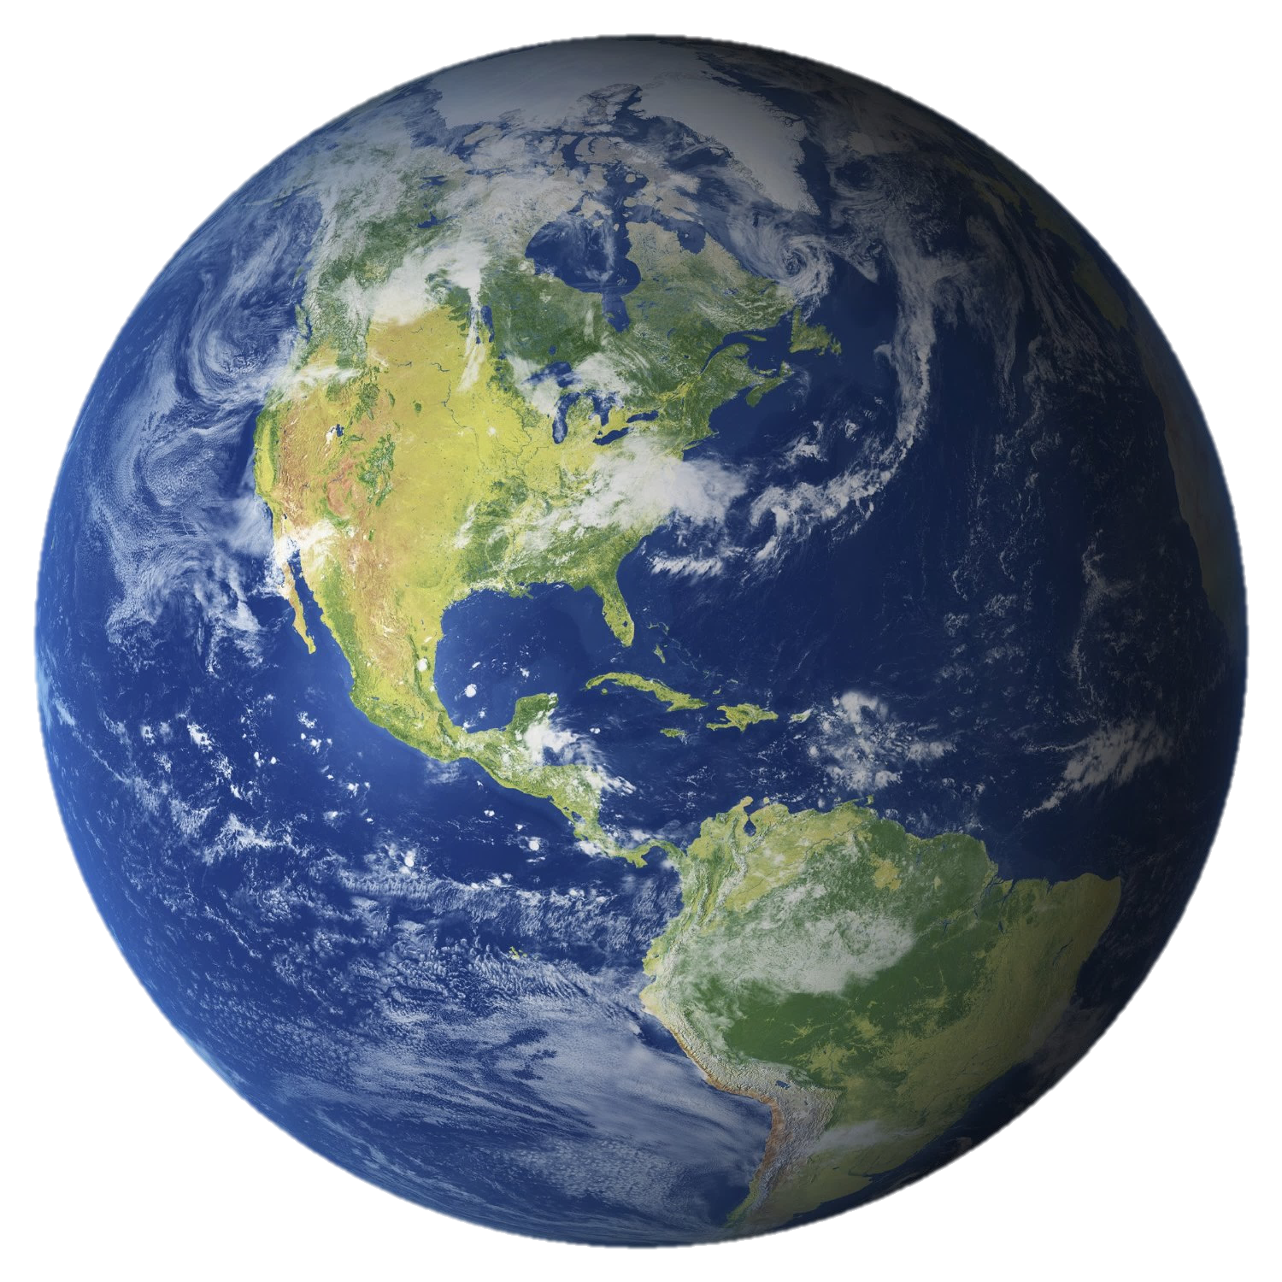
Average Solar Intensity on Earth
Earth’s Radius = 6.37 × 10⁶ m
Area of sun power captured:
1360 W m⁻²
$$πr^{2}=π{(6.37×{10}^{6})}^{2} =$$
$$1.27×{10}^{14} m^{2}$$
Total sun power captured:
$$1.27×{10}^{14} m^{2}×\frac{1360 W}{1 m^{2}}=$$
$$1.7×{10}^{17} W$$
Total Power Received by the Earth
Average Solar Intensity on Earth
$$1.7×{10}^{17} W$$
Average spread out across Earth’s surface:
$$\frac{P}{A_{sphere}}$$
$$=\frac{1.7×{10}^{17} W }{4π{(6.37×{10}^{6})}^{2}}=$$
$$340 W m^{2}$$
$$340 W m^{2}$$

Slide 6
Albedo vs. Emissivity
Albedo
Emissivity | e
$$\frac{power scattered by a body}{incident power}$$
$$\frac{power radiated by a surface}{power radiated from a black body }$$
% Reflected
% Absorbed

Slide 7
Albedo vs. Emissivity
80 W
60 W
Incident
Reflected
Albedo
Emissivity
$$\frac{60}{80}=0.75$$
$$\frac{20}{80}=0.25$$

Slide 8
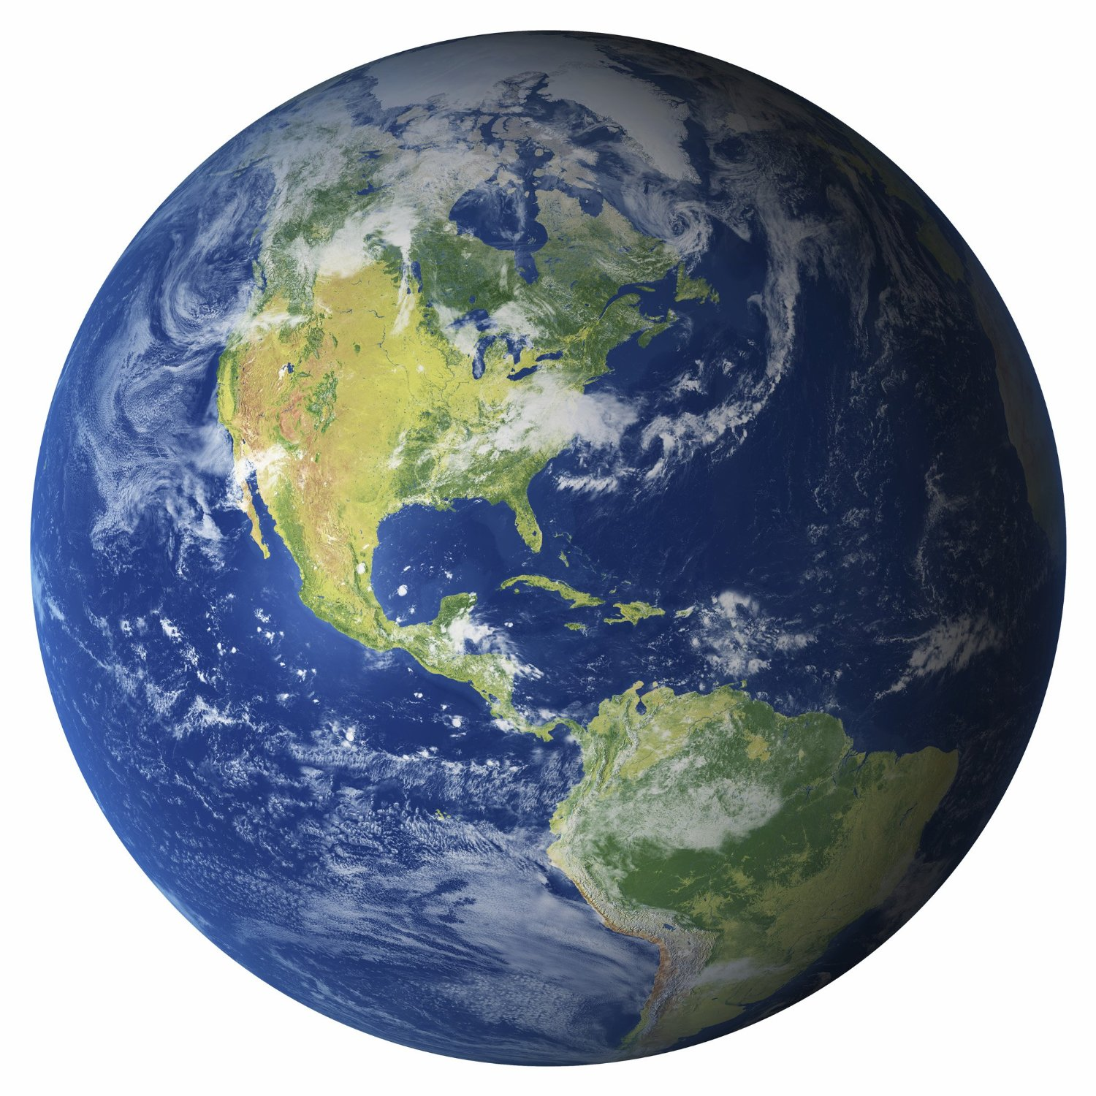
Albedo of Earth
Incident
Reflected
340 W m⁻²
102 W m⁻²
$$Albedo=\frac{102}{340}=0.3$$

Slide 9
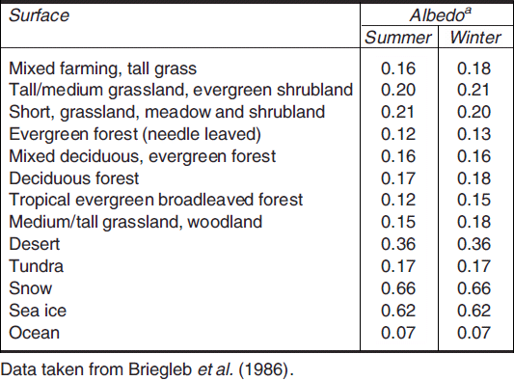
Albedo of Earth
Highest Albedo?
0.66
Snow
Lowest Albedo?
0.07
Ocean

Slide 10
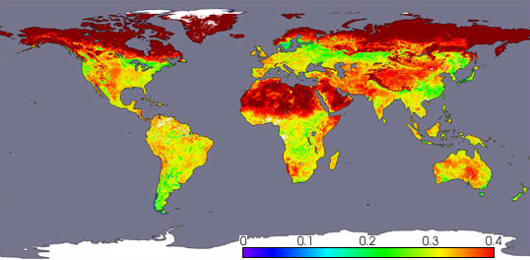
Albedo of Earth
White and gray areas: No data.
April, 2002, Terra satellite, NASA

Slide 11
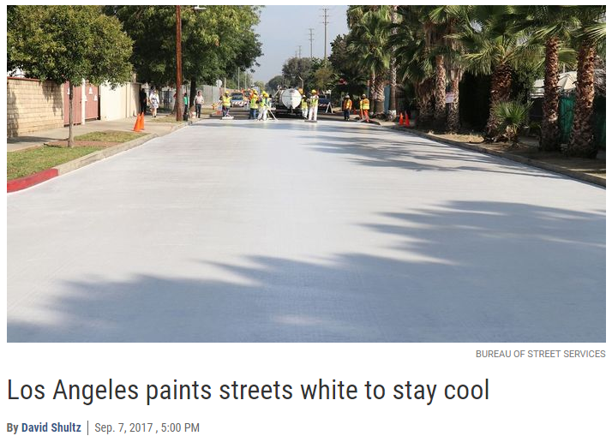
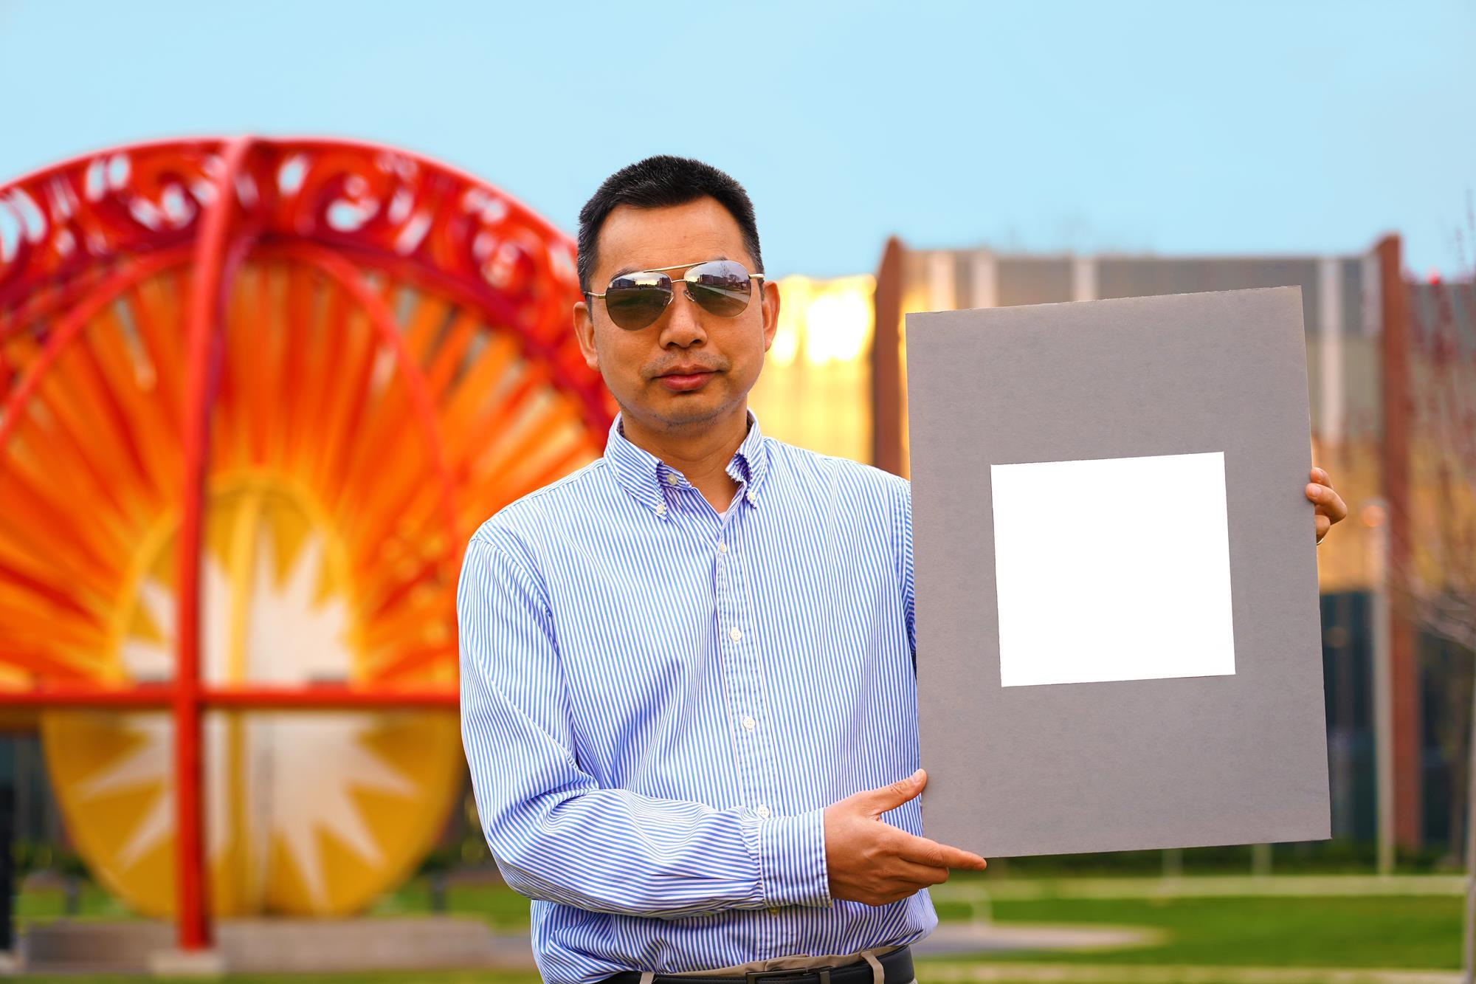
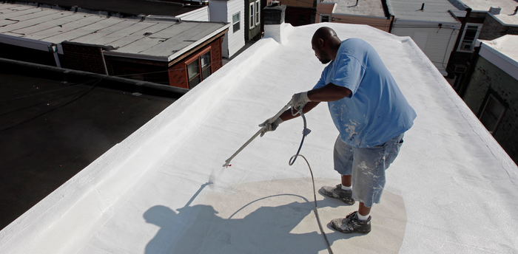
Adjusting our Albedo

Slide 12
Thermal Equilibrium
In order to maintain a constant global temperature, the Earth must emit the same amount of energy that it absorbs
340 W m⁻²
340 W m⁻²

Slide 13
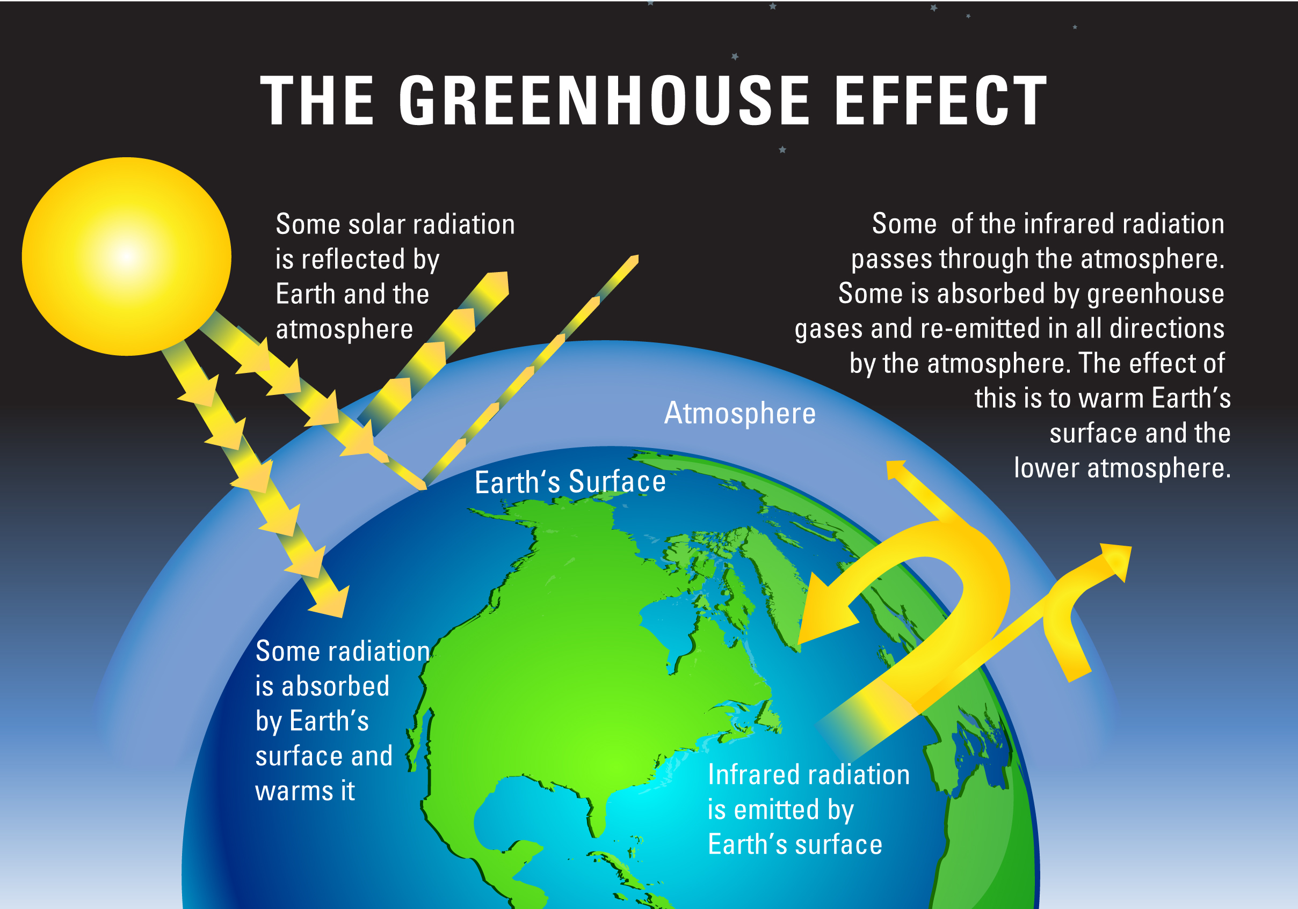
Greenhouse Effect
If there was no atmosphere, the earth would experience a net loss of energy and reach equilibrium at an average temperature about 30°C colder than it is currently.

Slide 14
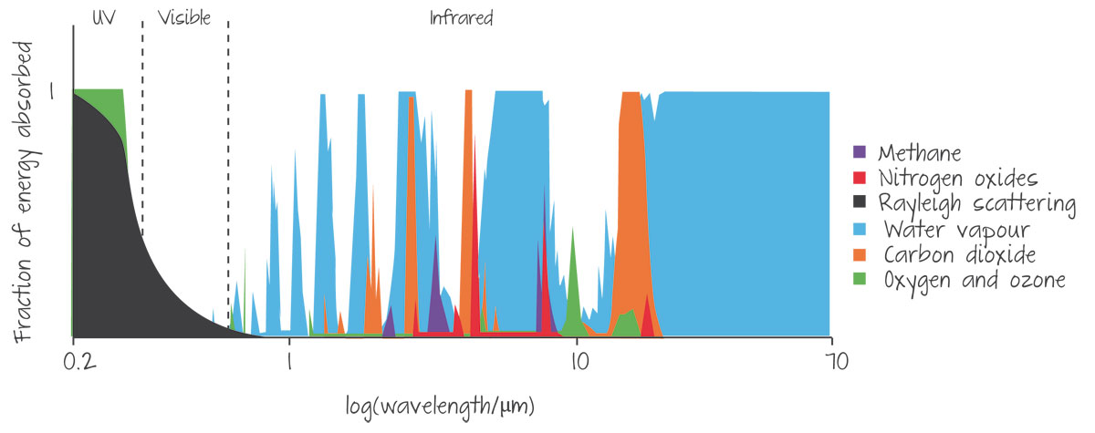
Role of the Atmosphere
1
2
3
4
5
Water Vapor
Carbon Dioxide
Rank the following Greenhouse Gases based on the amount of infrared energy they absorb
Methane
Nitrogen Oxides
Oxygen/Ozone
More on this later…

