Slide 1
Climate Change
IB Physics | Energy Production

Slide 2
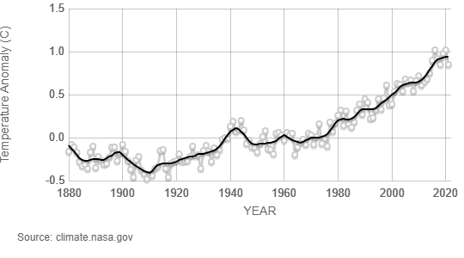
Temperature has been Rising

Slide 3
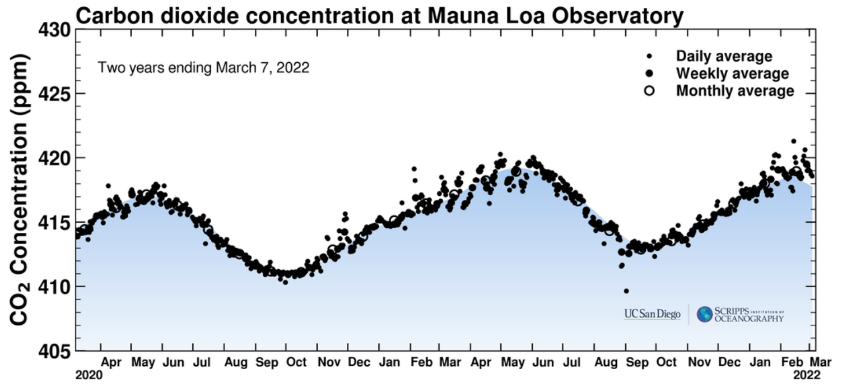
CO₂ Concentration | 2 years
Latest CO₂ Reading: 417.88 ppm
https://scripps.ucsd.edu/programs/keelingcurve/

Slide 4
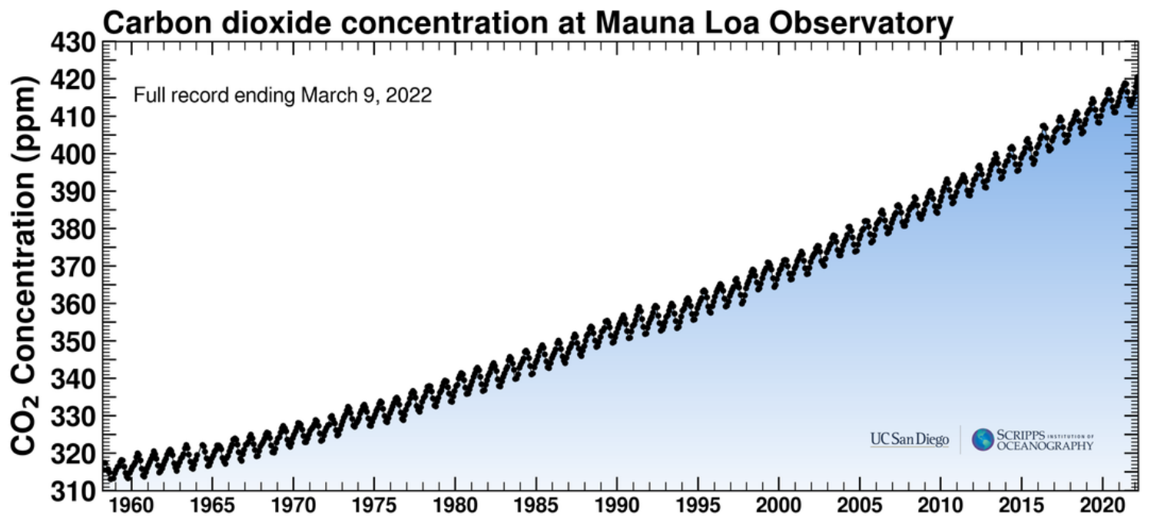
CO₂ Concentration | 63 years
https://scripps.ucsd.edu/programs/keelingcurve/

Slide 5
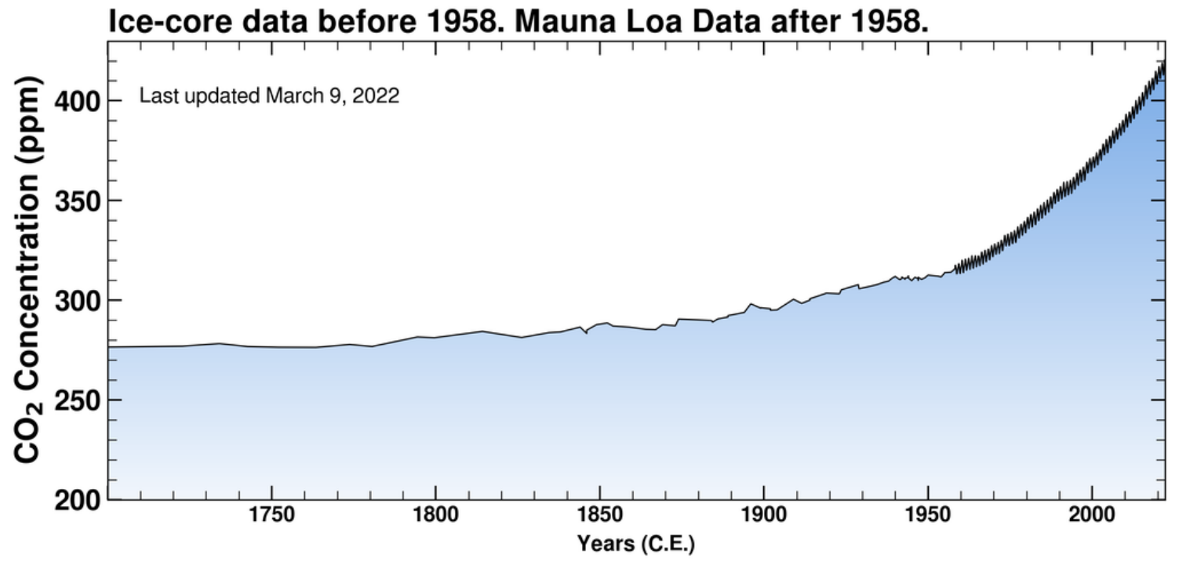
CO₂ Concentration | 300 years
https://scripps.ucsd.edu/programs/keelingcurve/

Slide 6
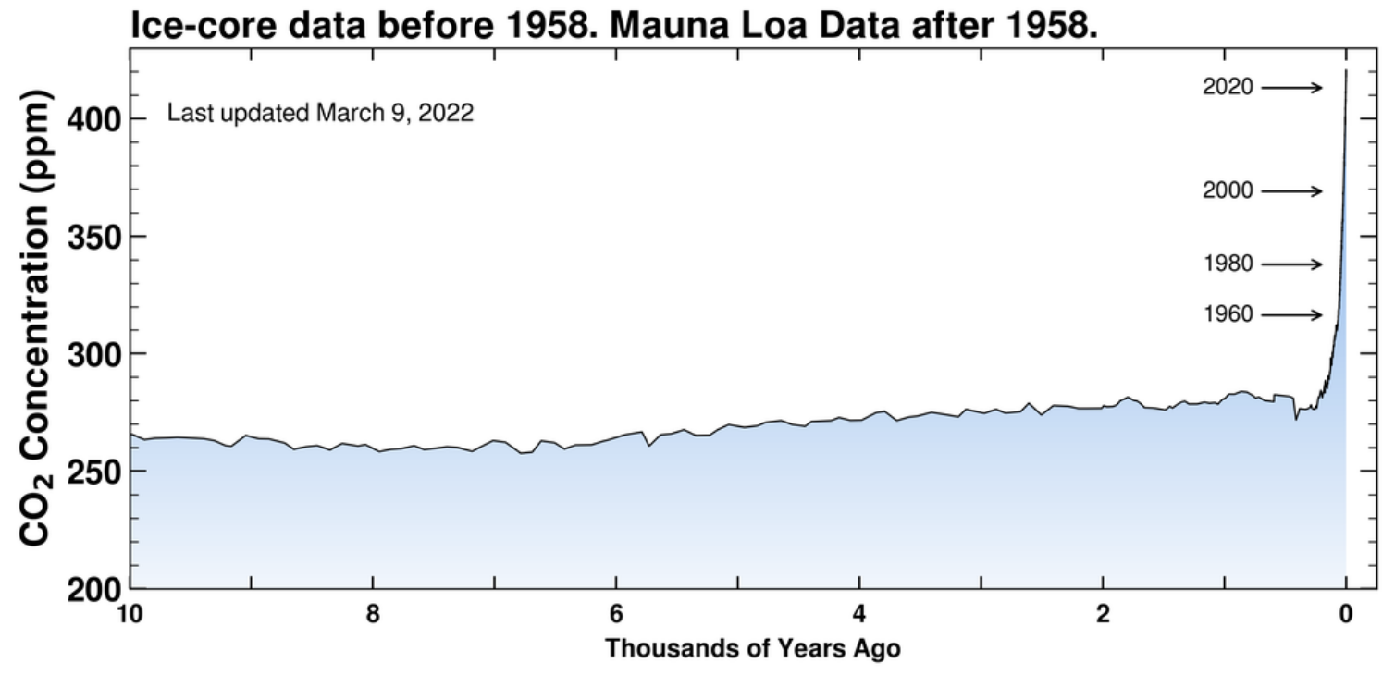
CO₂ Concentration | 10,000 years
https://scripps.ucsd.edu/programs/keelingcurve/

Slide 7
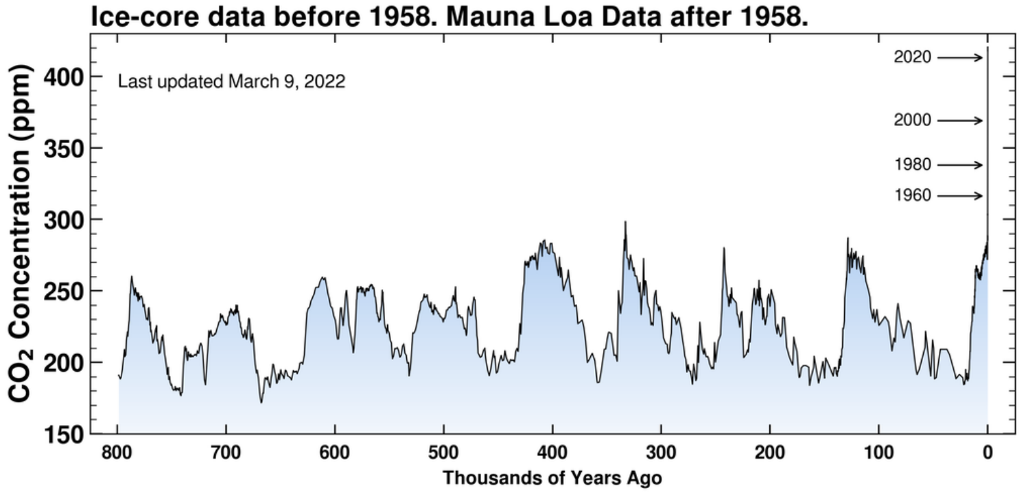
CO₂ Concentration | 800,000 years
https://scripps.ucsd.edu/programs/keelingcurve/

Slide 8
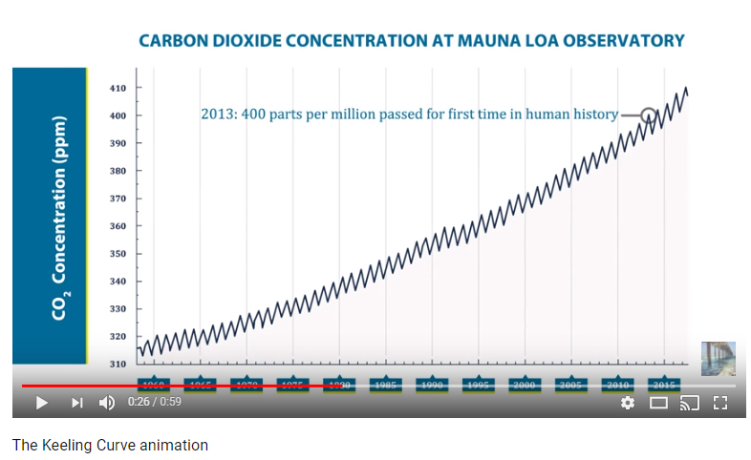
CO₂ Concentration
https://scripps.ucsd.edu/programs/keelingcurve/

Slide 9
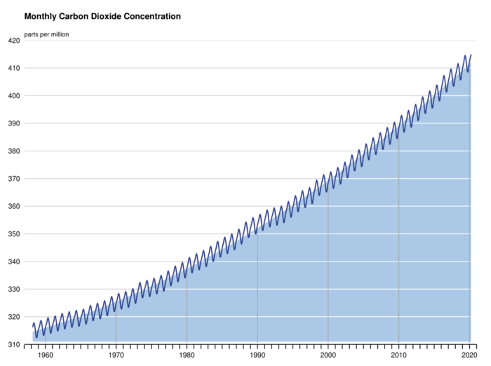
Why does the level fluctuate yearly?
Seasons
*There are more land (plants) in the Northern Hemisphere that remove CO₂ from the atmosphere during the summer months

Slide 10
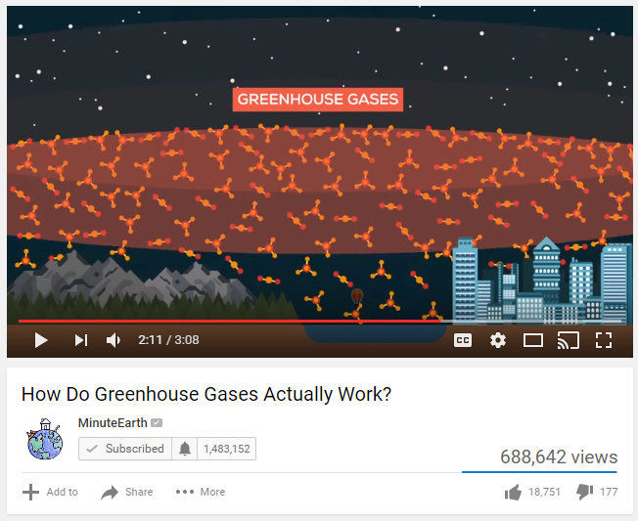
The Greenhouse Effect
Gas molecules absorb and reemit infrared radiation
*This happens because the shape of these molecules means that they have natural vibration frequency that matches the frequency of infrared waves

Slide 11
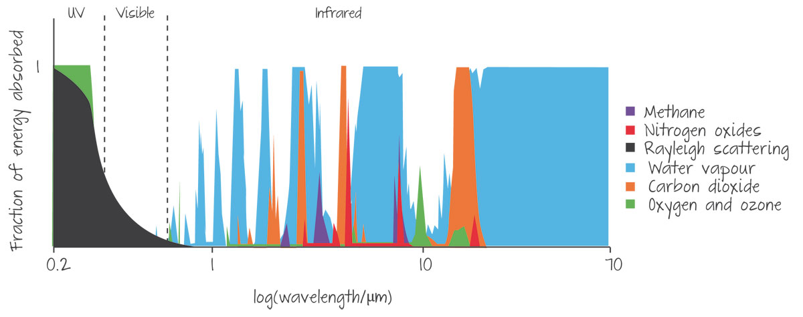
The Top Greenhouse Gases
1
2
3
4 | Nitrogen Oxides
5 | Oxygen/Ozone
Water Vapor
Carbon Dioxide
Rank the following Greenhouse Gases based on the amount of infrared energy they absorb
Methane

Slide 12
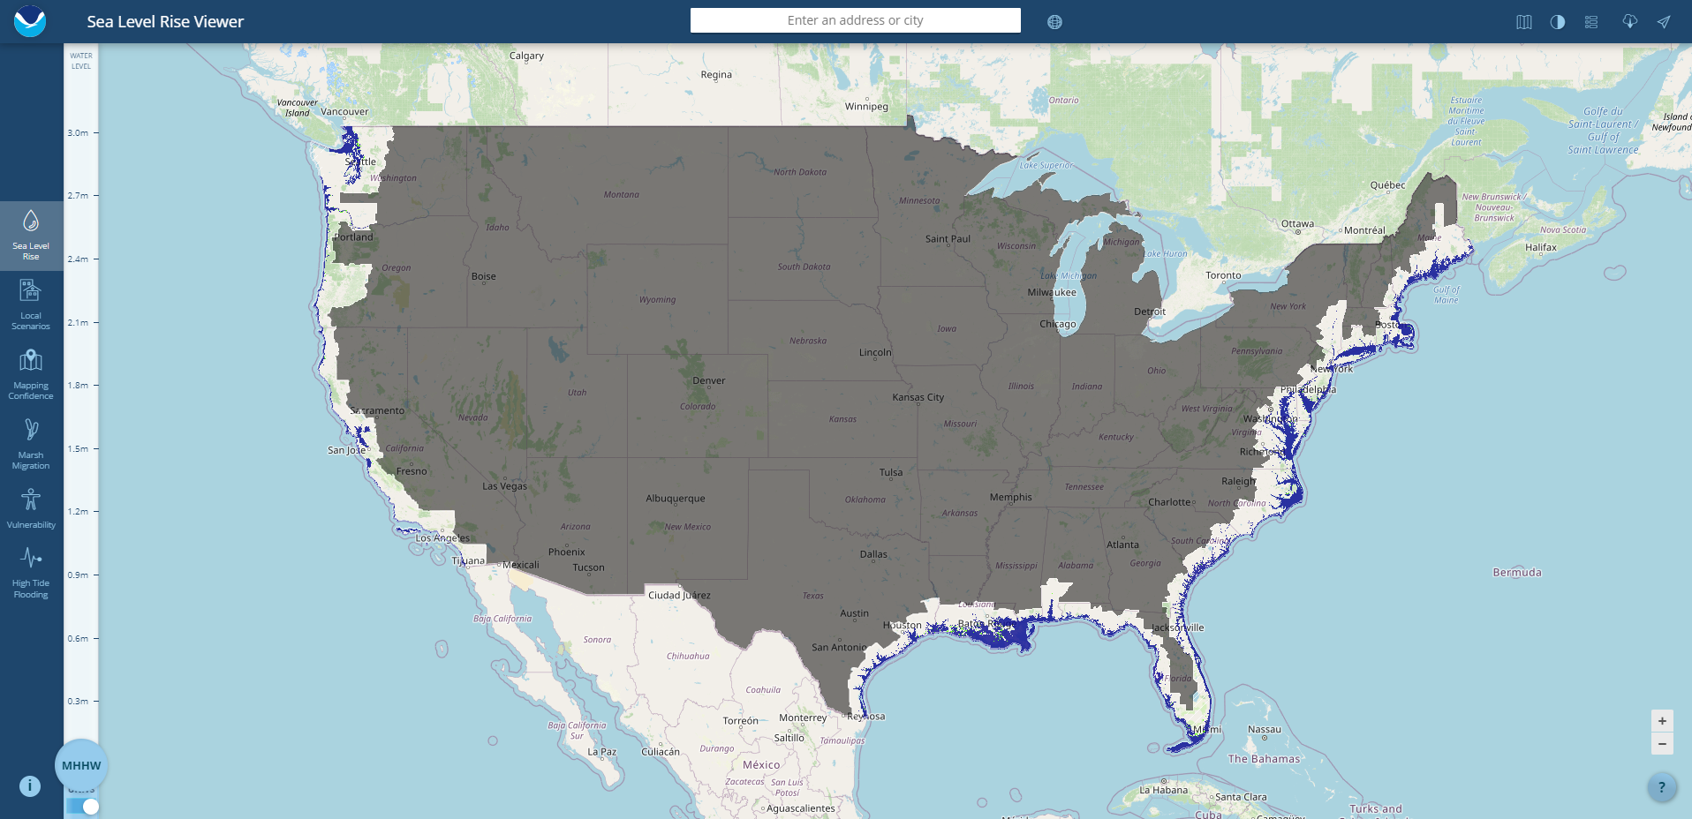
Impacts of Climate Change
https://coast.noaa.gov/slr/#

Slide 13
Impacts of Climate Change
https://www.climatecentral.org/gallery/graphics/sea-level-rise-and-population-impact

Slide 14
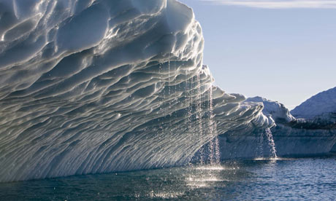
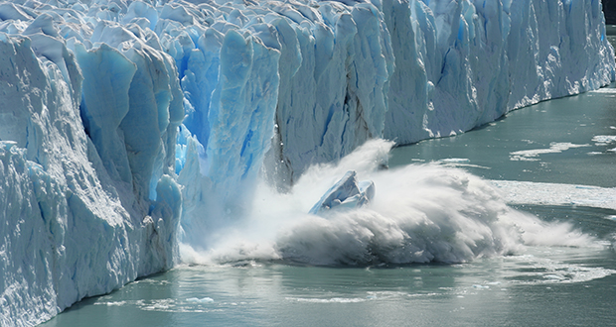
Sea Levels Rising | Melting Ice
A melting iceberg does not cause a direct change in sea level
A melting glacier adds water to the ocean and causes a direct change in sea level
Why?

Slide 15
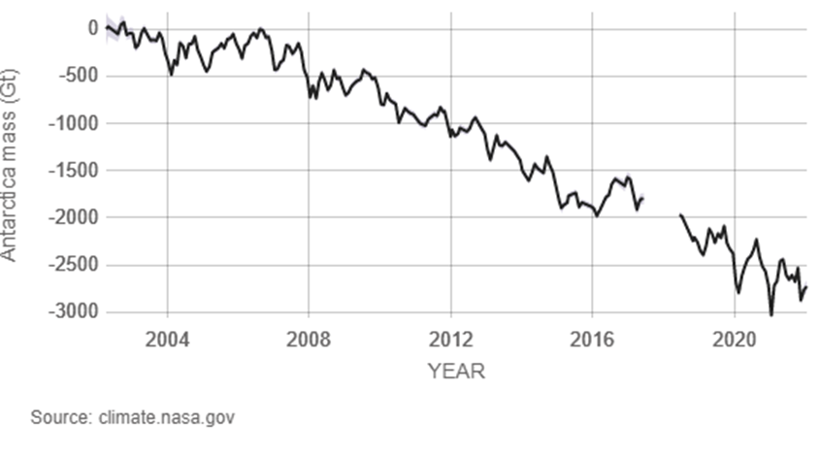
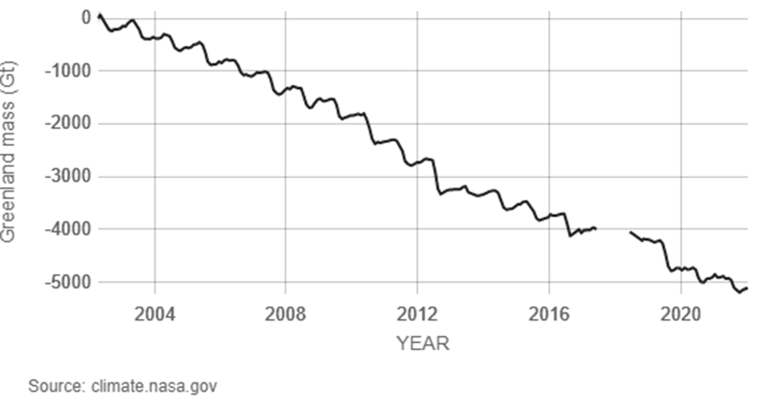
Sea Levels Rising | Melting Ice
Antarctica ice mass is decreasing at a rate of 1521 billion tons per year
Greenland ice mass is decreasing at a rate of 275 billion tons per year

Slide 16
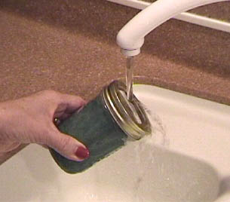
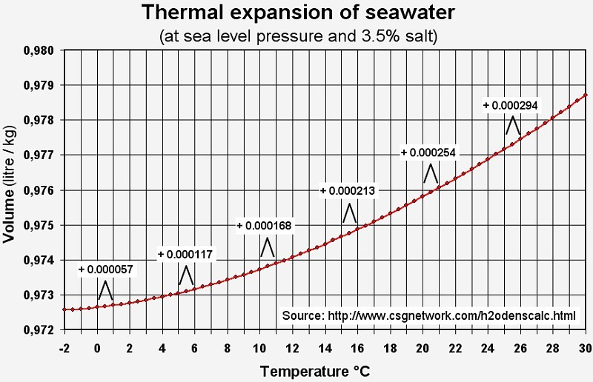
Sea Levels Rising | Expansion
When most objects are heated they expand. Water is no different.

Slide 17
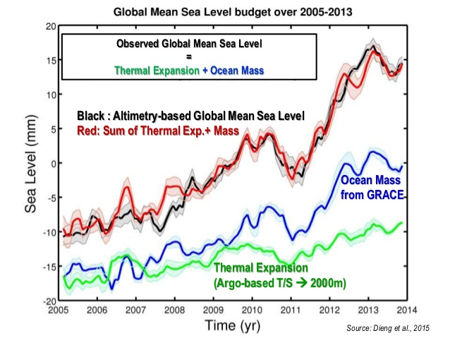
Sea Levels Rising

Slide 18
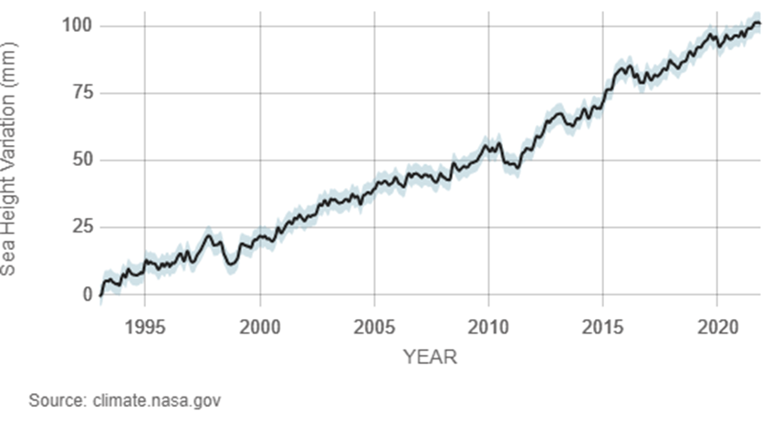
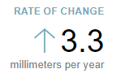
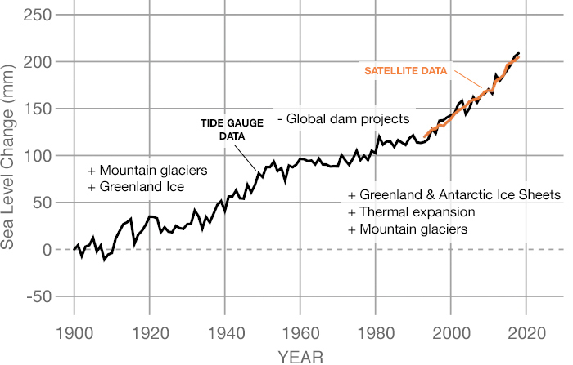
Ground Based Sea Level | 1900-Present
https://climate.nasa.gov/vital-signs/sea-level/

Slide 19
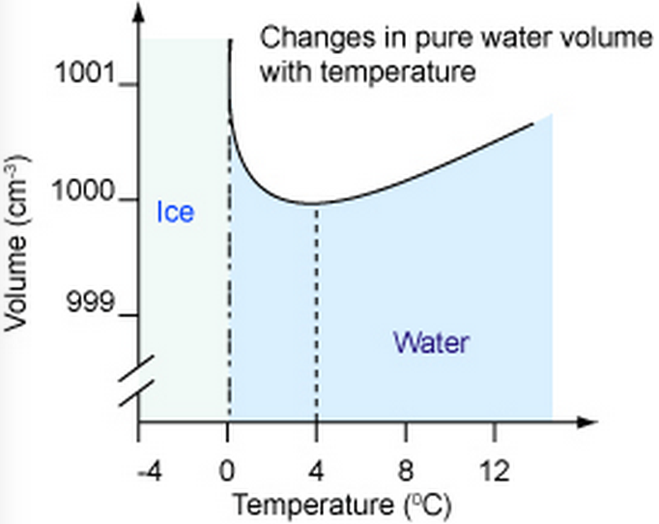
Sea Levels Rising

Slide 20
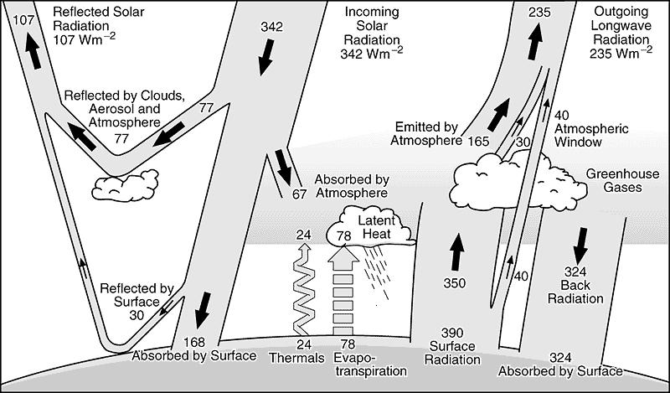
Thermal Equilibrium
(in)
342 W m⁻²
=
342 W m⁻²
(out)

Slide 21
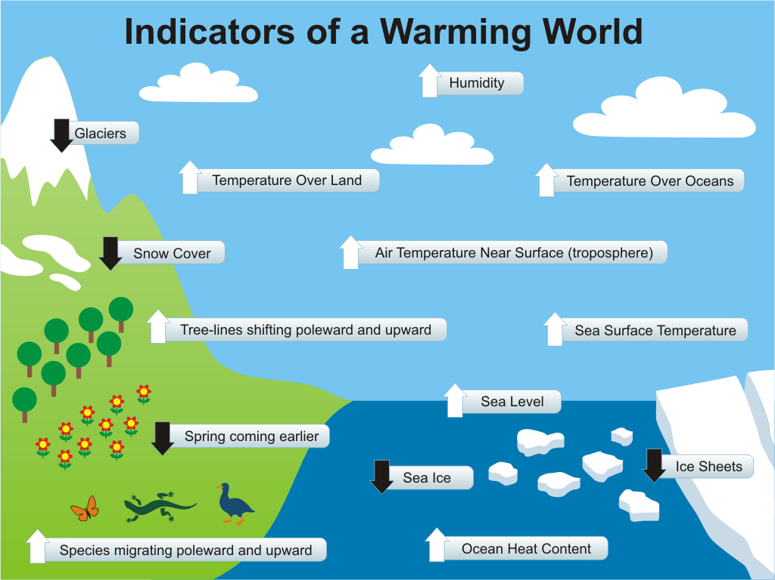

Slide 22
Feedback Loops
Positive Feedback Loop
Negative Feedback Loop
Warming of Earth leads to events that further warm the Earth
Warming of Earth leads to events that start to cool the Earth
Melting ice
Higher temps decrease ice cover on the planet
Decreases albedo
Melting permafrost
Releases methane
Methane on ocean floor
Higher ocean temperatures release frozen methane deposits
More Clouds
Higher temps evaporate more water
Increase Albedo
Increased Photosynthesis
More CO₂ leads to more plant life that absorbs CO₂
Renewable Investment
Higher temperatures lead to a greater urgency for change

Slide 24
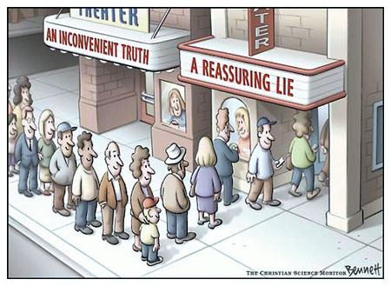
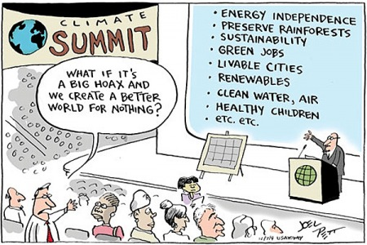
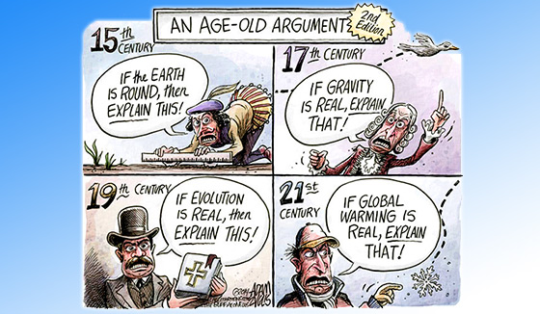
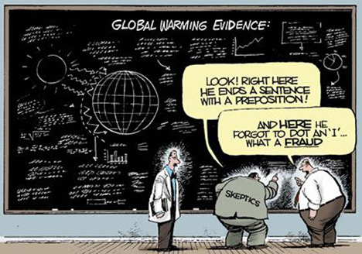
Why Deny?

