Slide 1
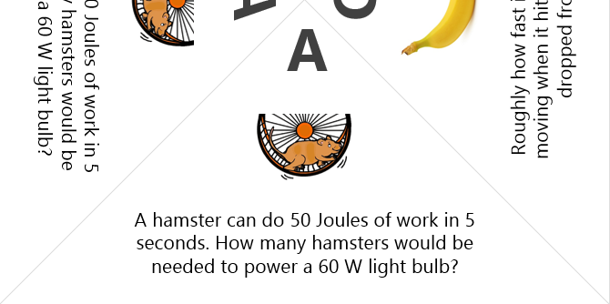
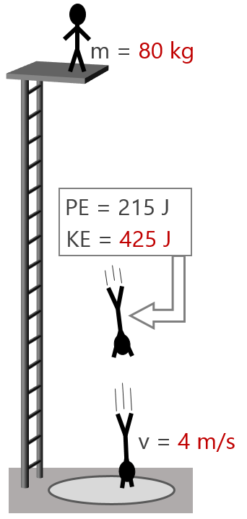
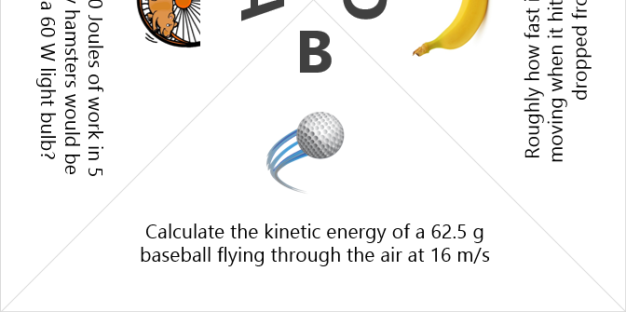
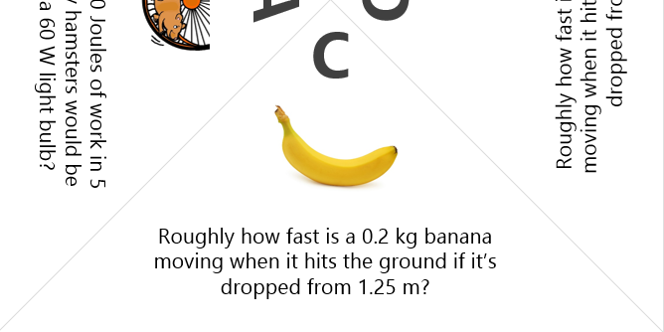
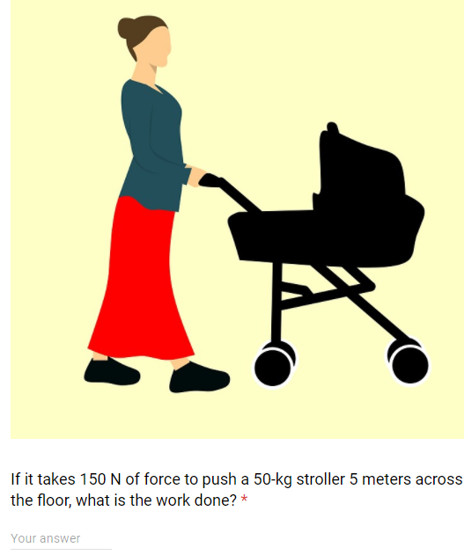
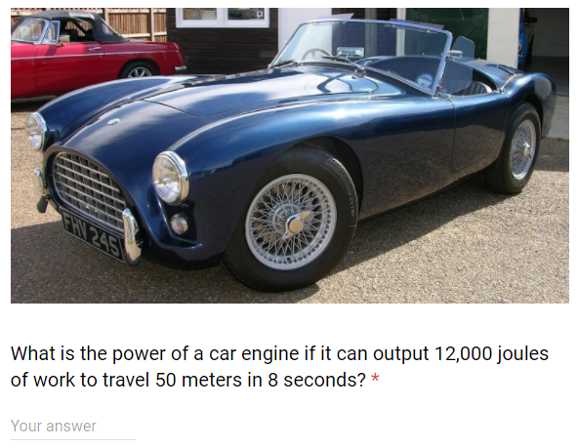
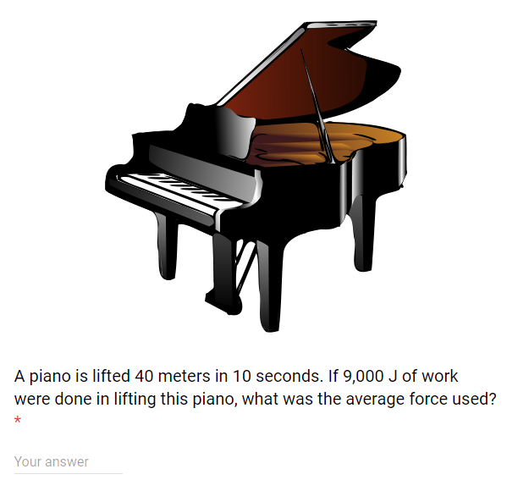
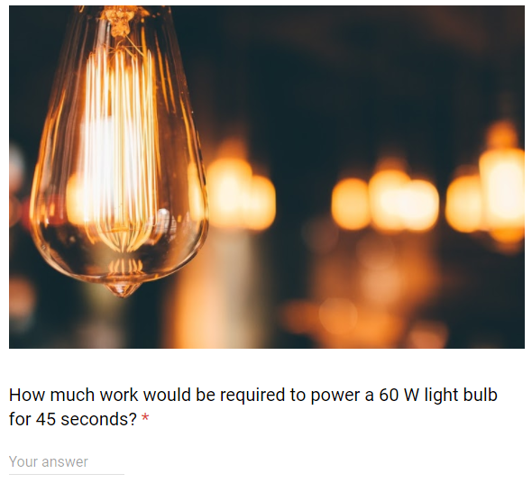
Scavenger Hunt Solutions
6
8
5
750 J
 | Level 1 | Level 2
1 | 3.4 J | 22.80 m/s
2 | 4.5 J | 18.44 m/s
3 | 6.1 J | 21.45 m/s
4 | 2.3 J | 16.45 m/s
5 | 1.7 J | 17.32 m/s
6 | 8.8 J | 14.83 m/s
7 | 5.3 J | 24.08 m/s
8 | 7.2 J | 13.42 m/s
1500 W
225 N
2700 J
6
3
5
4

Slide 2
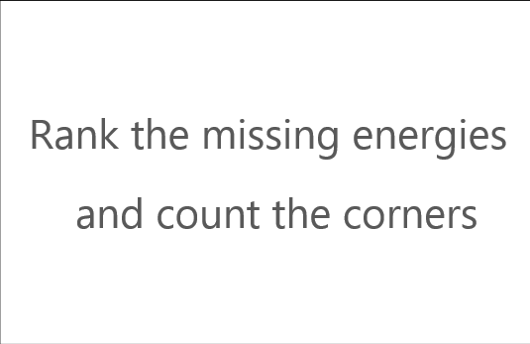
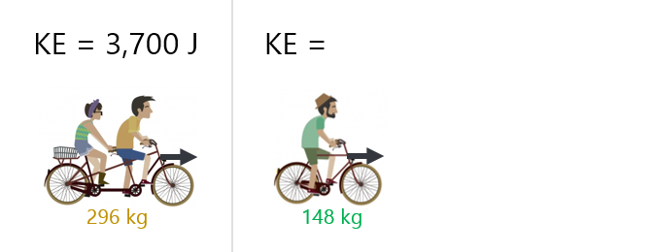
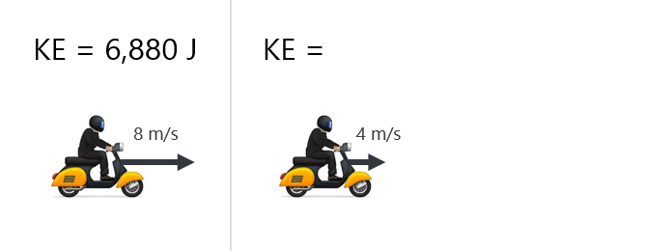
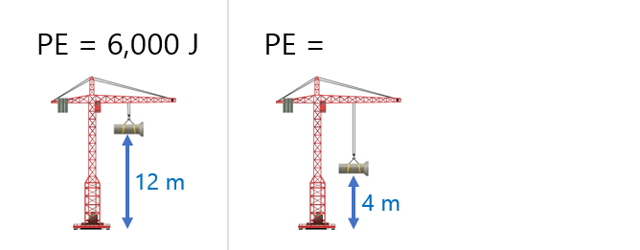
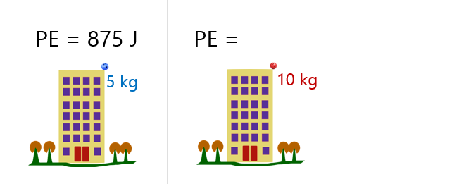
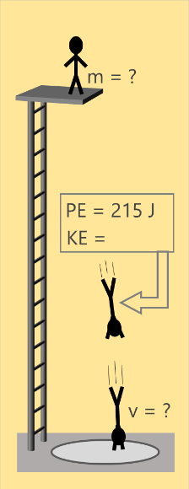
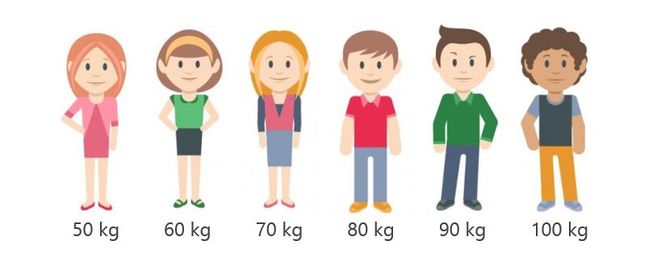
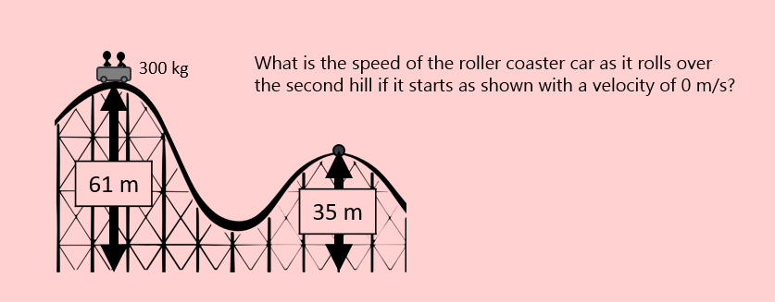
Scavenger Hunt Solutions
 | Level 1 | Level 2
1 | 3.4 J | 22.80 m/s
2 | 4.5 J | 18.44 m/s
3 | 6.1 J | 21.45 m/s
4 | 2.3 J | 16.45 m/s
5 | 1.7 J | 17.32 m/s
6 | 8.8 J | 14.83 m/s
7 | 5.3 J | 24.08 m/s
8 | 7.2 J | 13.42 m/s

Slide 3
1 | ___ ___ ___ ___
2 | ___ ___ ___
3 | ___ ___ ___ ___
4 | ___ ___ ___
P
U
S
H
6
8
5
6
3
5
4
4
2
5

Slide 4
 | Group 1
 | Group 2
 | Group 3
 | Group 4
300 kg
What is the speed of the roller coaster car as it rolls over the second hill if it starts as shown with a velocity of 0 m/s?
61 m
22.80 m/s
35 m
300 kg
What is the speed of the roller coaster car as it rolls over the second hill if it starts as shown with a velocity of 0 m/s?
52 m
18.44 m/s
35 m
300 kg
What is the speed of the roller coaster car as it rolls over the second hill if it starts as shown with a velocity of 0 m/s?
63 m
21.45 m/s
40 m
300 kg
What is the speed of the roller coaster car as it rolls over the second hill if it starts as shown with a velocity of 0 m/s?
54 m
16.73 m/s
40 m

Slide 5
 | Group 5
 | Group 6
 | Group 7
 | Group 8
300 kg
What is the speed of the roller coaster car as it rolls over the second hill if it starts as shown with a velocity of 0 m/s?
45 m
17.32 m/s
30 m
300 kg
What is the speed of the roller coaster car as it rolls over the second hill if it starts as shown with a velocity of 0 m/s?
36 m
14.83 m/s
25 m
300 kg
What is the speed of the roller coaster car as it rolls over the second hill if it starts as shown with a velocity of 0 m/s?
47 m
24.08 m/s
18 m
300 kg
What is the speed of the roller coaster car as it rolls over the second hill if it starts as shown with a velocity of 0 m/s?
38 m
13.42 m/s
29 m

Slide 6
 | Group 1
 | Group 2
 | Group 3
 | Group 4
PE = 8.4 J
KE = 1 J
3.4 J
PE = ?
KE = 6 J
PE = 8.5 J
KE = 2 J
4.5 J
PE = ?
KE = 6 J
PE = 8.1 J
KE = 3 J
6.1 J
PE = ?
KE = 5 J
PE = 8.3 J
KE = 4 J
2.3 J
PE = ?
KE = 10 J

Slide 7
 | Group 5
 | Group 6
 | Group 7
 | Group 8
PE = 8.7 J
KE = 5 J
1.7 J
PE = ?
KE = 12 J
PE = 10.8 J
KE = 6 J
8.8 J
PE = ?
KE = 8 J
PE = 8.3 J
KE = 7 J
5.3 J
PE = ?
KE = 10 J
PE = 8.2 J
KE = 8 J
7.2 J
PE = ?
KE = 9 J

