Slide 1
Engineering Communication

Slide 2
Draw me a Monster
One Tail
Two Feet
Three Heads
Four Eyes
Five Horns
Spots
Pointy Teeth
Must include all of these characteristics

Slide 3
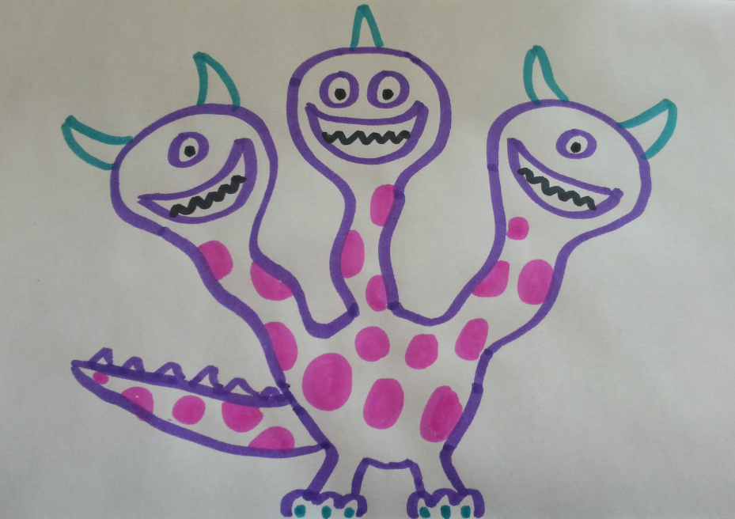
Draw me a Monster
One Tail
Two Feet
Three Heads
Four Eyes
Five Horns
Spots
Pointy Teeth
You all drew this, right?

Slide 4
Why Communicate?
Engineers design things
But the story doesn’t end there…

Slide 5
Why Communicate?
An idea is worthless until it is communicated to the world

Slide 6
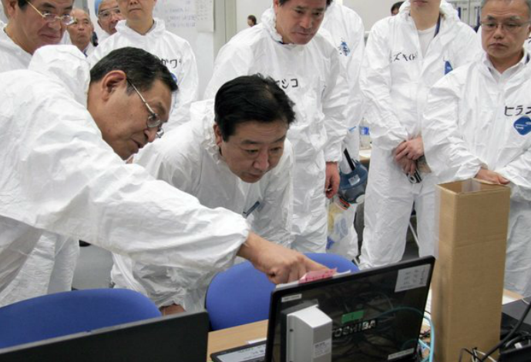
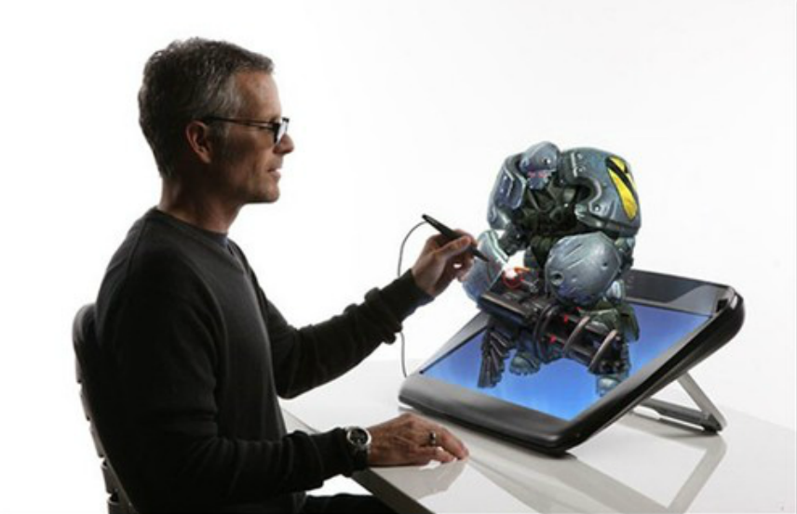
Why Communicate?
Across time zones
Across cultures
Across history

Slide 7
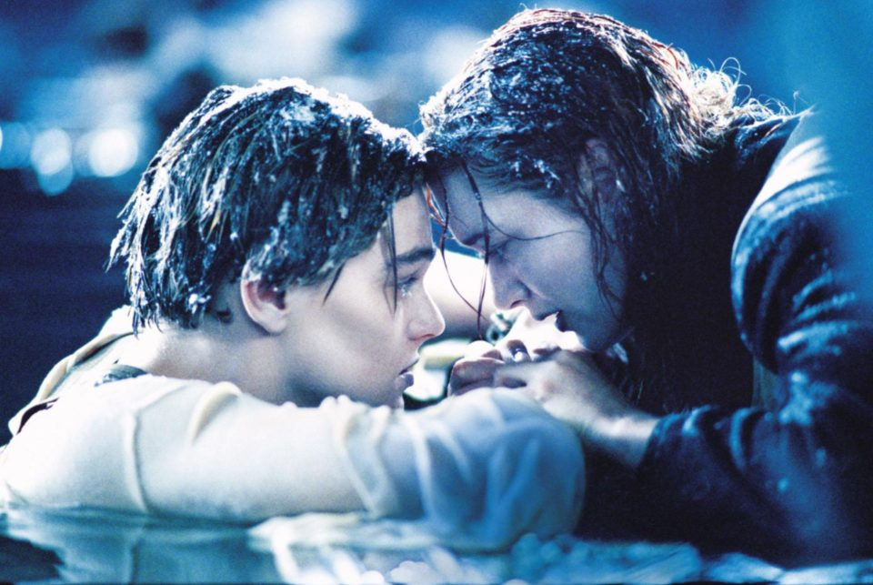
Communication is about letting go…

Slide 8
Why Communicate?
We need to communicate our design in a way that no longer requires our presence
Luckily, we have some strategies and conventions to help us out

Slide 9
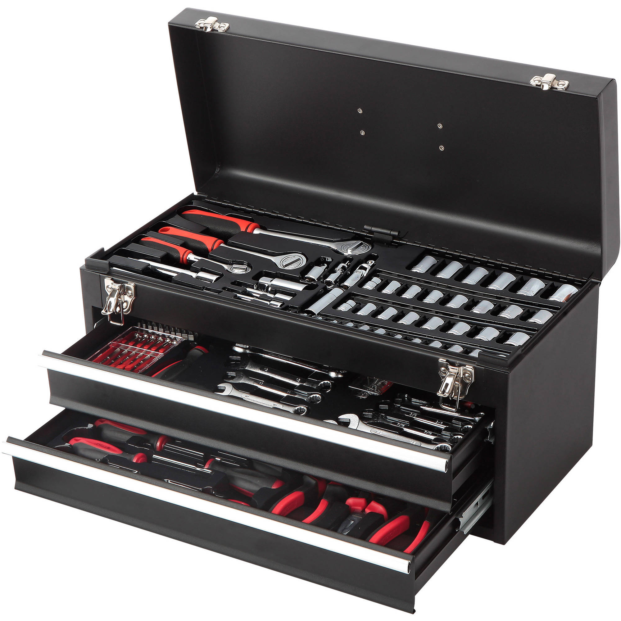
Tools for your Toolbox

Slide 10
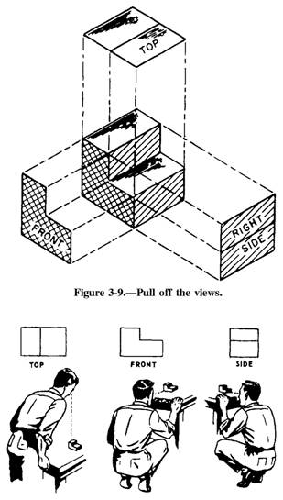
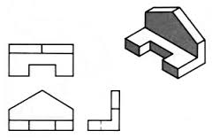
Multi-view Drawings

Slide 11
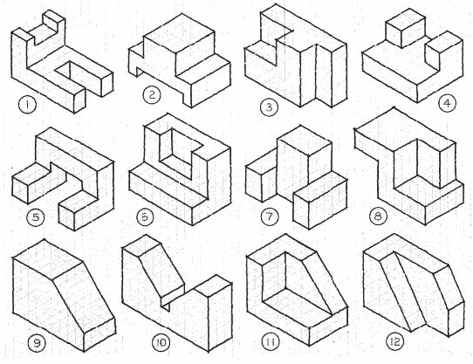
Isometric Drawings

Slide 12
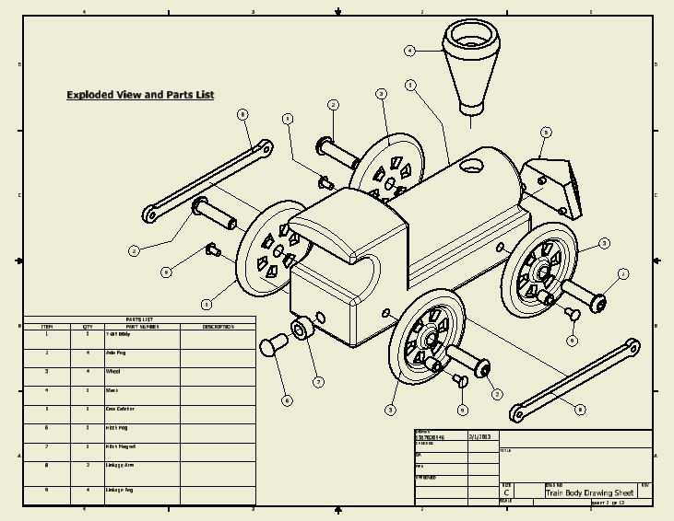
Assembly Drawings

Slide 13
LEGO Communication

Slide 14
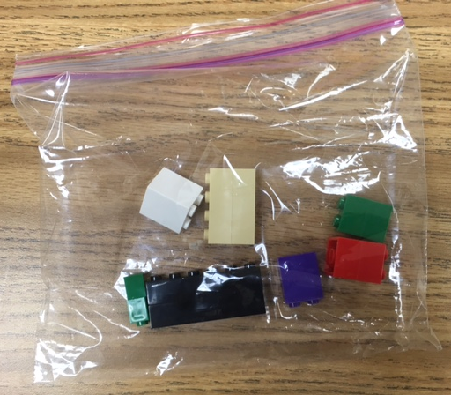
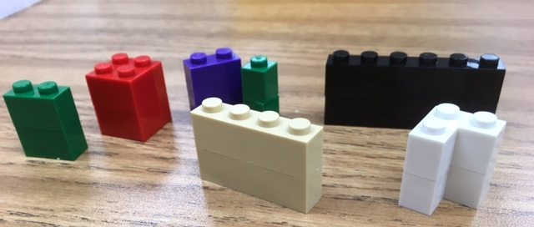
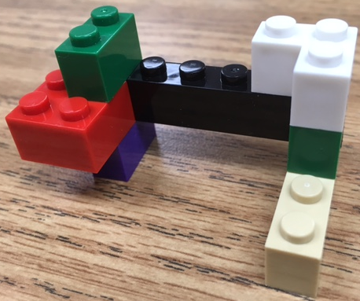
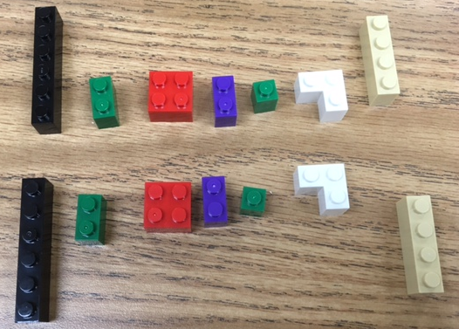
LEGO Communication

Slide 15
LEGO Communication
Separate LEGO bag into two identical sets
Using only one set, build something interesting
On a piece of paper (or iPad), communicate your design so that someone else can build it. No photos but drawings are ok

