Slide 1
Static Electricity
IB Physics | Force Fields

Slide 2
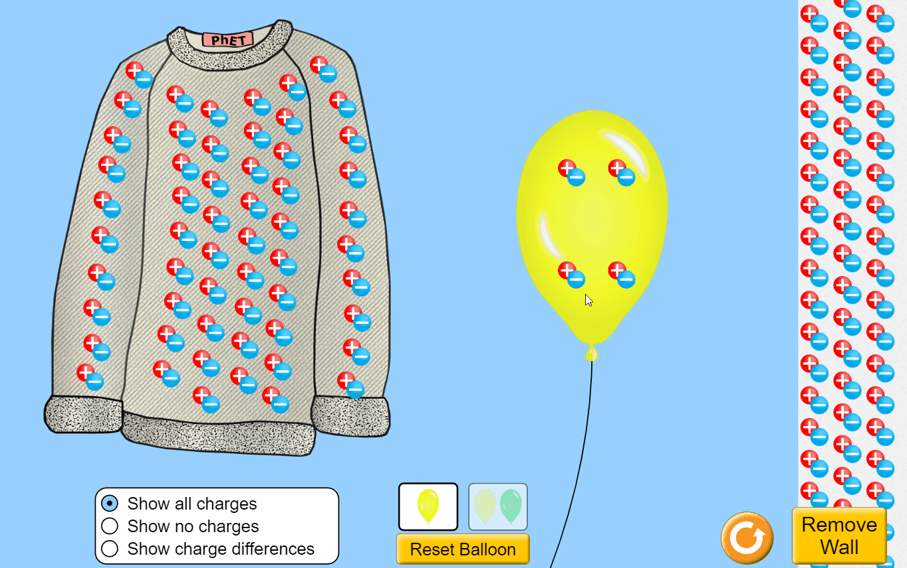
PhET Simulation
What happens when you rub the balloon on the sweater?
Electrons transfer from the sweater to the balloon
Click here for Simulation

Slide 3
Charge on an Atom
The protons and neutrons are buried deep in the nucleus and cannot easily be touched
electrons orbiting the nucleus
are easily lost or gained

Slide 4
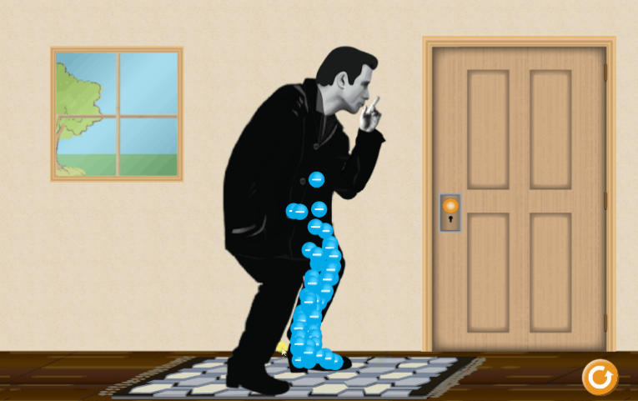
How do objects become charged?
Friction | Contact | Induction
What happens when you rub John Travoltage’s foot on the rug?
The foot gains electrons from rubbing on the carpet and the electrons spread out
Click here for Simulation

Slide 5
How do objects become charged?
Friction | Contact | Induction
What is the charge of each object?
Draw in the Electrons
-
-
+
-
-
-
-
+
charge = -4
+
charge = 0
-
-
charge = -3
-
-
charge = -1
+
-
-
+
+
-
-
-
-
+
+
+
+
Before
-
After
-

Slide 6
How do objects become charged?
Friction | Contact | Induction
What happens when you bring the balloon over to the wall?
The electrons in the wall redistribute and move away from the negative source
Click here for Simulation

Slide 7
How do objects become charged?
Friction | Contact | Induction
What is the charge of this object?
Draw in the Electrons for the ball
-
-
+
+
-
-
-
+
+
-
+
-
-
-
+
-
+
-
+
+
+
-
+
-
-
-
+
-
+
-
+
-
Before
After

Slide 8
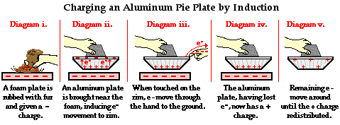
How do objects become charged?
Friction | Contact | Induction

Slide 9
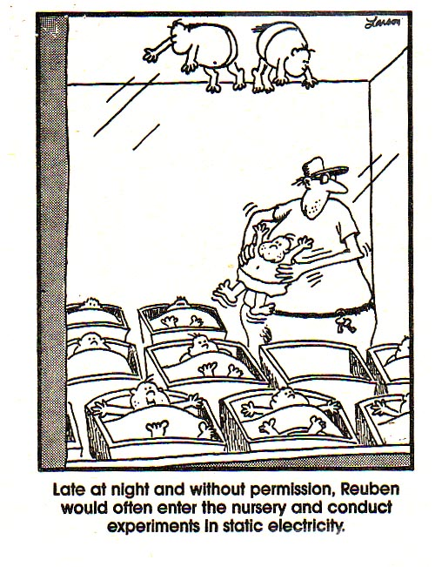
Use your knowledge responsibly

Slide 10
Charge Interactions
+
-
+
+
-
+
-
-
Opposite Charges
Like Charges
Attract
Repel

Slide 11
Which one has more force?
Which charged pair has larger electrostatic forces acting?
+
+
smaller distance = greater force
r
+
+
2r

Slide 12
Which one has more force?
Which charged pair has larger electrostatic forces acting?
1 µC
1 µC
+
+
r
2 µC
1 µC
+
+
greater charge = greater force
r

Slide 13
Coulomb’s Law
$$F=k\frac{q_{1}q_{2}}{r^{2}}$$
The force of attraction or repulsion between two point charges is directly proportional to the product of the two charges and inversely proportional to the square of the distance between them.
-
Symbol
Unit
+
Electrostatic Force
Object 1 Charge
Object 2 Charge
Separation Distance
F
F
$$F$$
$$[N]$$
q₁
q₂
$$q_{1}$$
$$[C]$$
r
F
F
$$q_{2}$$
$$[C]$$
q₁
q₂
-
-
$$r$$
$$[m]$$

Slide 14
Coulomb’s Constant
$$F=k\frac{q_{1}q_{2}}{r^{2}}$$
$$k=8.99×{10}^{9} N m^{2} C^{−2}$$
Use unit analysis to prove the units of k:
$$k=\frac{Fr^{2}}{q_{1}q_{2}}$$
$$=\frac{Nm^{2}}{CC}$$
$$=Nm^{2}C^{−2}$$
Solve for k
Plug in units
Simplify

Slide 15
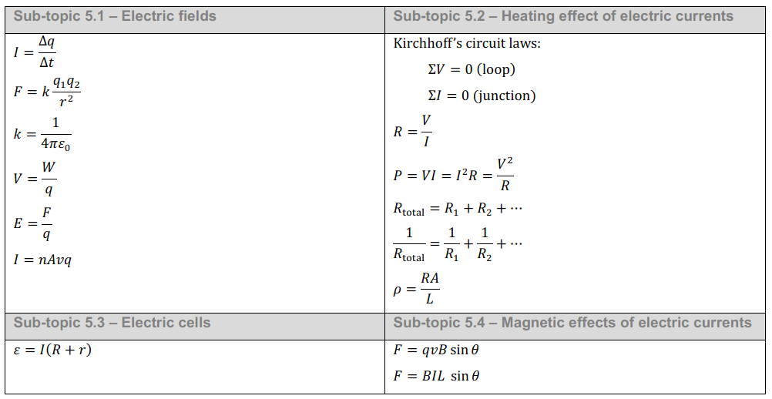
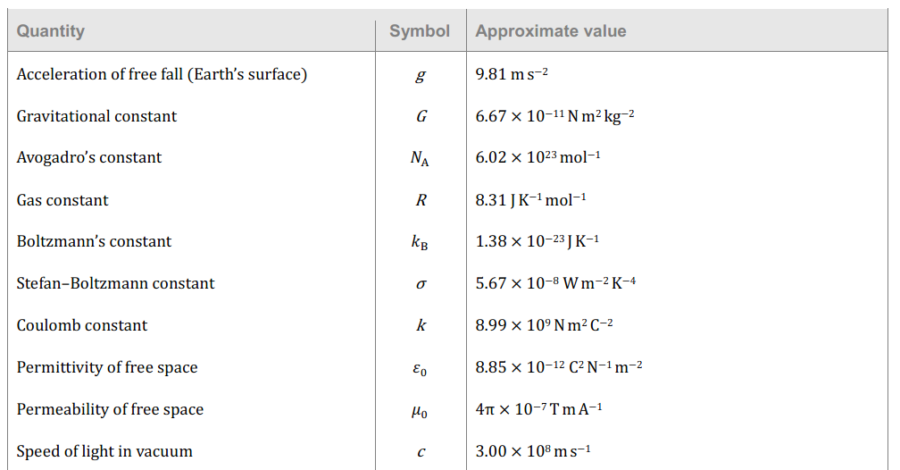
IB Physics Data Booklet
*Coulomb’s Law

Slide 16
Conceptual Math
What is the repulsion force on the positive charge below?
4 N
+
+
r
1 N
$$F=k\frac{q_{1}q_{2}}{{(2r)}^{2}}$$
+
+
2r
$$F=k\frac{q_{1}q_{2}}{{4r}^{2}}$$

Slide 17
Conceptual Math
What is the repulsion force on the positive charge below?
1 µC
1 µC
+
+
r
2 N
2 µC
1 µC
+
+
$$F=k\frac{{2q}_{1}q_{2}}{r^{2}}$$
4 N
r

Slide 18
Conceptual Math
Same!
Which pair has the greater electrostatic force?
+1
+1
$$F=k\frac{{2q}_{1}{2q}_{2}}{{(2r)}^{2}}$$
$$=k\frac{{4q}_{1}q_{2}}{{4r}^{2}}$$
$$=k\frac{q_{1}q_{2}}{r^{2}}$$
d
+2
+2
2d

