Slide 1
Magnetism & Right Hand Rule
IB Physics | Force Fields

Slide 2
Rules of Interaction
N S
N S
N S
S N
S N
N S

Slide 3
Cutting Magnets in Half
Poles cannot be isolated – a magnet cannot be broken to get a separate north and south pole. Instead, it creates two magnets, each with a north and south pole
N S
S
N

Slide 4
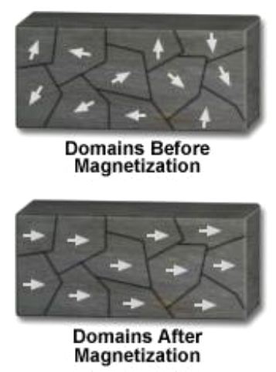
Magnetic Domains
In order for a material with domains to become magnetic, the domains have to be aligned by an external magnetic field.
If enough of a materials domains become aligned, the material forms a magnetic dipole and becomes a permanent magnet

Slide 5
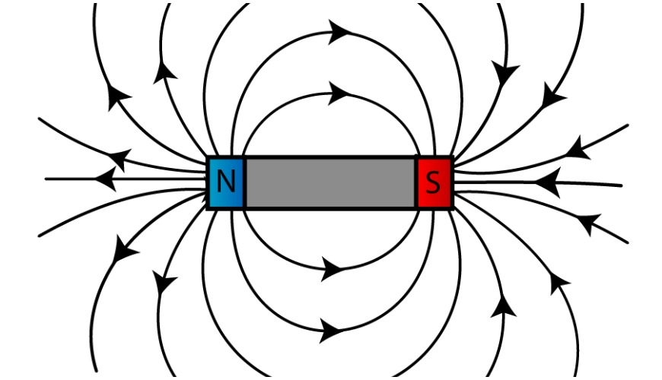
Magnetic Fields
North
South
Magnetic field lines point from _________ to _________
N S
A compass would align with these field lines

Slide 6
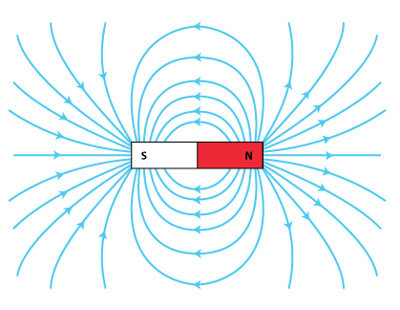
B-Field
B →
Magnetic Field Strength
Units
Tesla [T]

Slide 7
Magnetic Fields
A horseshoe magnet is just a bent bar magnet. The rules for magnetic fields still apply.
N
S

Slide 8
The Earth is a Magnet
S
N

Slide 9
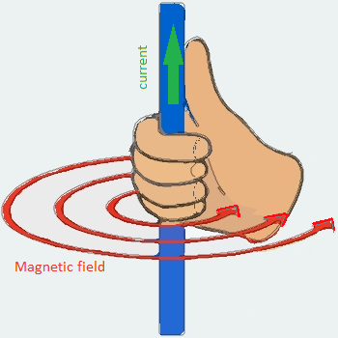
Right Hand Rule #1
If you make a “thumbs up” sign and point your thumb down a wire in the direction of the current, your other four fingers will point in the direction of the magnetic field.
Thumb points in direction of the current
Fingers point in direction of the field lines

Slide 10
Drawing in 3D
It can be hard to translate a 3rd dimension into a 2-dimensional diagram so there some conventions to help us out
How do you represent a direction that’s perpendicular to the paper?
Into the paper
Out of the paper

Slide 11
Drawing in 3D
Where is Magnetic Flux Density the highest?
I

Slide 12
Right Hand Rule #1
Draw in the magnetic field lines around these current carrying wires
I
I
I
I

Slide 13
Looped Wire
A wire in a loop has as stronger magnetic field inside the loop than outside…
weak B-field
I
strong B-field

Slide 14
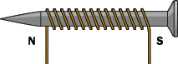
Creating an electromagnet

Slide 15
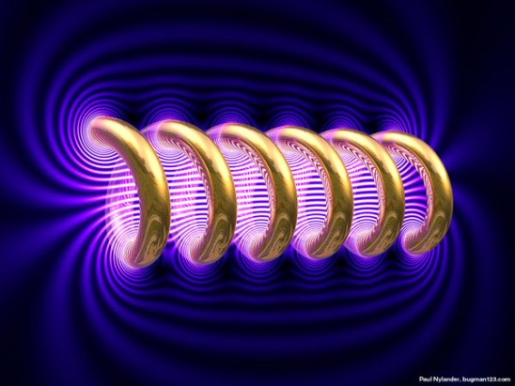
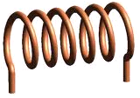
Magnetic Field
N
S

Slide 16
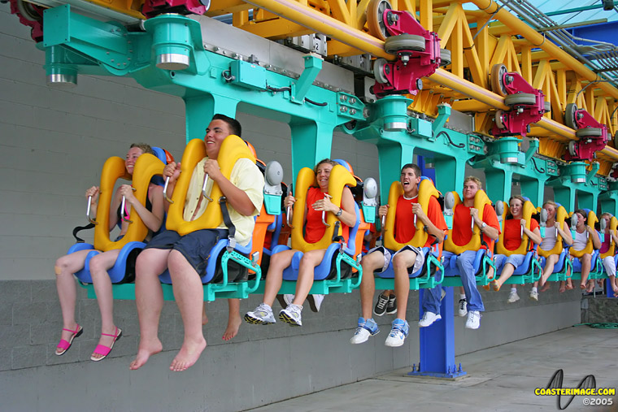
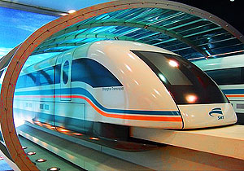
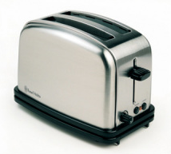
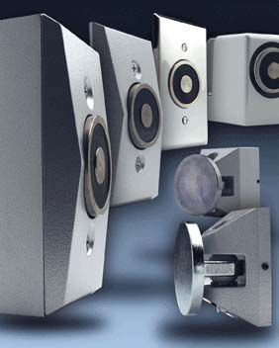
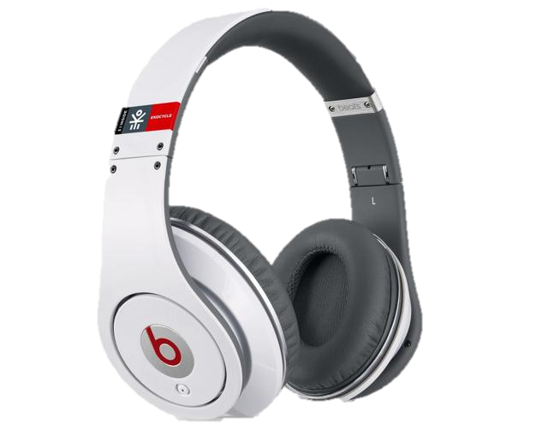
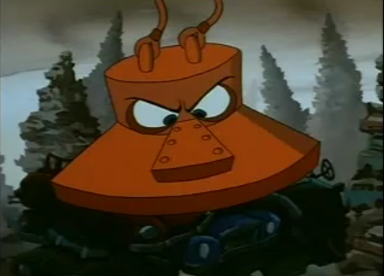
Electromagnet Applications

Slide 17
Draw in the Field Lines
N S

Slide 18
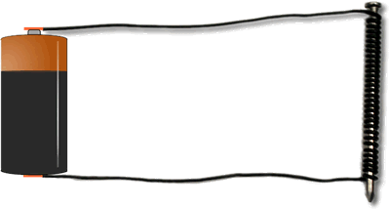
Build and Study Electromagnets
Explore what factors can be changed to increase the strength of an electromagnet

