Slide 1
Newton’s 1st Law & Net Force
IB Physics | Forces

Slide 2
What is a Newton??
Unit of Force
N
= kg × m s⁻²
*An apple weighs about 1 N
1 N

Slide 3
REMINDER: Vector vs Scalar
Vector Quantities | Scalar Quantities
Displacement
Distance
Velocity
Speed
Force
Energy
Can be negative to indicate direction
Only Positive

Slide 4
Newton’s First Law
A body will remain at rest or moving with constant velocity unless acted upon by an unbalanced force
“Law of
Inertia”

Slide 5
(Total)
Net Force
The vector sum of all the forces acting on an object
F_{net} =
22 N
20 N
8 N
10 N

Slide 6
Equilibrium
When all forces cancel out, the object is in equilibrium
F_{net} =
0 N
20 N
30 N
10 N

Slide 7
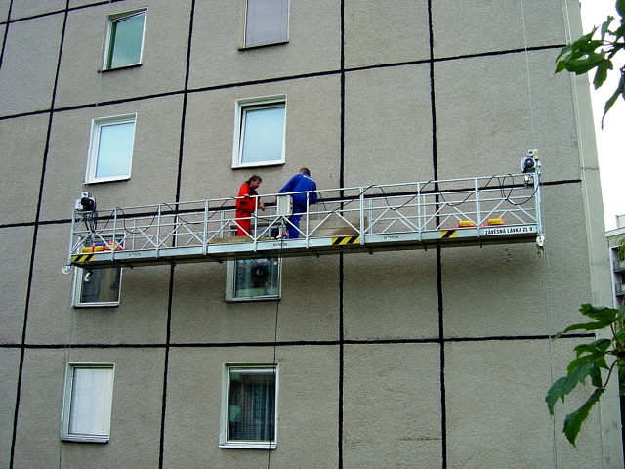
Using Equilibrium
What is the tension force on the second cable if the window washers are in equilibrium?
1350 N
T
$$F_{net}=0 N$$
$$1350+T−750−900−800=0 N$$
750 N
800 N
$$T=1100 N$$
900 N
Weight of Guy #1 = 750 N
Weight of Guy #2 = 800 N
Weight of Platform = 900 N

Slide 8
What is the Net Force? | 1
11 N
10 N
14 N
11 N
F_{net} = 4 N

Slide 9
What is the Net Force? | 2
8 N
14 N
4 N
4
10 N
3
5
3 N
11 N
F_{net} = 5 N

Slide 10
What is the Net Force? | 3
Remember SOHCAHTOA?
x = 20 cos(30) =
17.3 N
y = 20 sin(30) =
10 N
20 N
y
30°
10 N
x
17.3 N
10 N
10 N
F_{net} = 17.3 N

Slide 11
What is the Net Force? | 3
Remember SOHCAHTOA?
x = 20 cos(30) = 17.3 N
y = 20 sin(30) = 10 N
20 N
y
30°
10 N
x
17.3 N
10 N
F_{net} = 17.3 N
10 N

Slide 12
What is the Missing Force?
x = 50 cos(45)
= 35.4 N
y = 50 sin(45)
= 35.4 N
F_{net} = 0 N
50 N
50 N
y
y
45°
35.4 N
35.4 N
35.4 N
35.4 N
45°
x
x
35.4 N
35.4 N
35.4 N
35.4 N
F = 70.8 N
F

Slide 13
What is the Missing Force?
x = 50 cos(45)
= 35.4 N
y = 50 sin(45)
= 35.4 N
F_{net} = 0 N
50 N
50 N
y
y
45°
35.4 N
35.4 N
35.4 N
35.4 N
45°
x
x
35.4 N
35.4 N
35.4 N
35.4 N
F = 70.8 N
F

Slide 14
Cable Tension
What is the tension of these cables?
30°
30°
Each cable must support half the vertical force if the weight is evenly distributed
F
150 N
30°
F_{T} sin(30) = 150 N
300 N
300 N
300 N
F_{T} = 300 N
300 N

Slide 15
Lesson Takeaways
I can define a force (with proper units) in terms of the interaction between two objects
I can describe Newton’s first law
I can calculate the net force on an object
I can calculate an unknown force for an object in equilibrium

