Slide 1
Friction
IB Physics | Forces

Slide 2
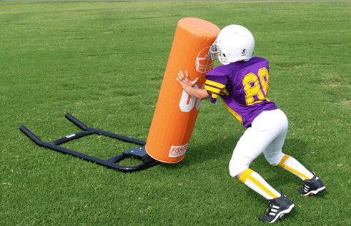
Types of Forces | Friction
F_{f}
*Always opposes motion

Slide 3
What is Friction?
The force ___________ the motion between two objects that are in ___________.
opposing
contact

Slide 4
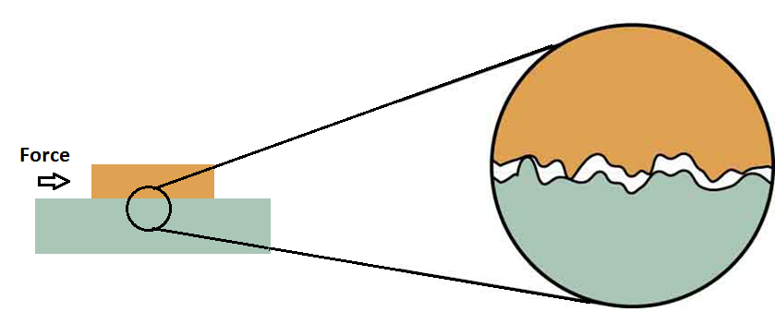
Types of Friction
Static Friction-
Dynamic (Kinetic) Friction-
Not Moving
In Motion
Static > Dynamic

Slide 5
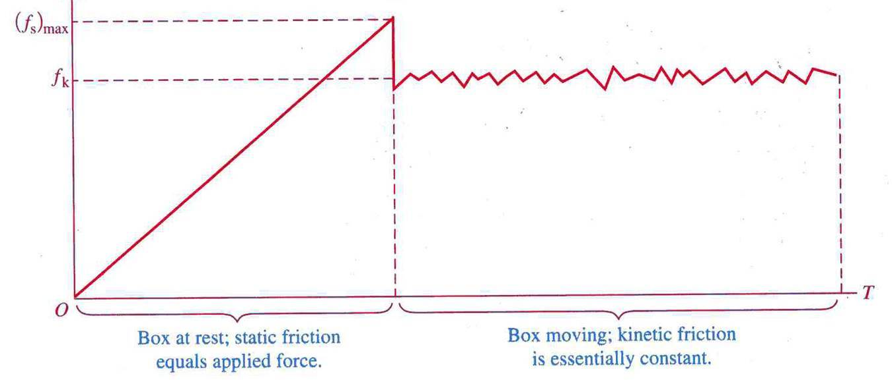
Static vs. Dynamic Friction
Friction decreases once motion starts

Slide 6
How do we Calculate Friction?
F_{f} = μ × R
Normal Reaction Force
Coefficient of Friction
Materials | μ_{s} | μ_{d}
Steel on ice | 0.1 | 0.05
Steel on steel (dry) | 0.6 | 0.4
Steel on steel (greased) | 0.1 | 0.05
Rope on wood | 0.5 | 0.3
Teflon on steel | 0.04 | 0.04
Shoes on ice | 0.1 | 0.05
Climbing boots on rock | 1.0 | 0.8
*unitless
Large μ → “Sticky”
Small μ → “Slippery”

Slide 7
Static Friction
μ_{s}× R calculates the limit of static friction but below that, it will be equal and opposite to external force

Slide 8
Physics Data Booklet
F_{f} = μR

Slide 9
How do we Calculate Friction?
F
F_{g}
R
F_{f}
R
External Force
g = 9.81 m s⁻²
F_{f}
F
mg
*when flat
F_{g}
F_{g}
μR

Slide 10
Calculate Friction | Try This…
Santa’s Sleigh is loaded up with toys for all the good little girls and boys until it has a total mass of 2000 kg. What is the static friction force that must be overcome if µ_{s} is 0.1?
R
F_{g} = mg
= (2000)(9.81) = 19,620 N
R = F_{g}
= 19,620 N
F_{f} = μR
= (0.1)(19,620) = 1,962 N
F_{g}

Slide 11
Calculating Acceleration w/ Friction
Step 1:
Find the Force from Friction
F_{g} = mg
R = F_{g}
F_{f} = μ × R
Step 2:
Find F_{net}
F_{net} = F_{push} - F_{f}
Step 3:
Find acceleration
R
F_{net} = ma
a = F_{net} / m
F_{f}
F_{push}
F_{g}

Slide 12
Calculate Friction | Try This…
Santa’s reindeer pull his 2000 kg sleigh with a force of 4980 N. How fast does the sleigh accelerate if the coefficient of kinetic friction (µ_{k}) is 0.05?
19,620 N
F_{g} = mg = (2000)(9.81) = 19,620 N
R
R = F_{g} = 19,620 N
F_{f}
F_{pull}
F_{f} = μR = (0.05)(19,620) = 981 N
981 N
4,980 N
F_{net}
= 4980 – 981 = 3999 N
F_{g}
a = F/m
= 3999/2000 = 2 m s⁻²
19,620 N

Slide 13
Lesson Takeaways
I can calculate the force of friction when given the reaction force and coefficient of friction
I can quantitatively compare surfaces based on their coefficients of friction
I can calculate the acceleration of an object with friction based on the external force and mass

