Slide 1
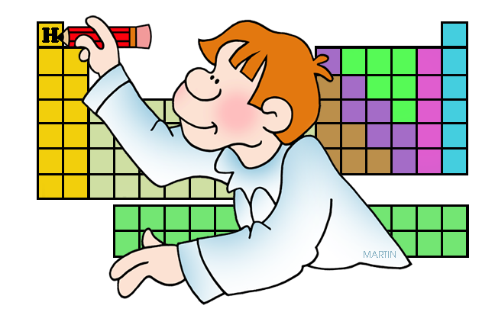
Locating Elements Walk Around

Slide 2
How many valence electrons does an atom of Oxygen have?
1
Notes:
6

Slide 3
In what period can you find the element Silver?
2
Notes:
5

Slide 4
How many valence electrons does an atom of Lithium have?
3
Notes:
1

Slide 5
In what period can you find the element Carbon?
4
Notes:
2

Slide 6
5
Element Symbol | ??
Period | 4
Valence Electrons | 5
Notes:
As

Slide 7
6
Element Symbol | ??
Period | 4
Valence Electrons | 2
Notes:
Ca

Slide 8
7
Element Symbol | ??
Period | 2
Valence Electrons | 4
Notes:
C

Slide 9
8
Element Symbol | ??
Period | 3
Valence Electrons | 7
Notes:
Cl

Slide 10
9
Element Symbol | ??
Period | 4
Valence Electrons | 8
Notes:
Kr

Slide 11
10
Element Symbol | ??
Period | 1
Valence Electrons | 1
Notes:
H

