Slide 1
Projectile Motion
IB Physics | Motion

Slide 2
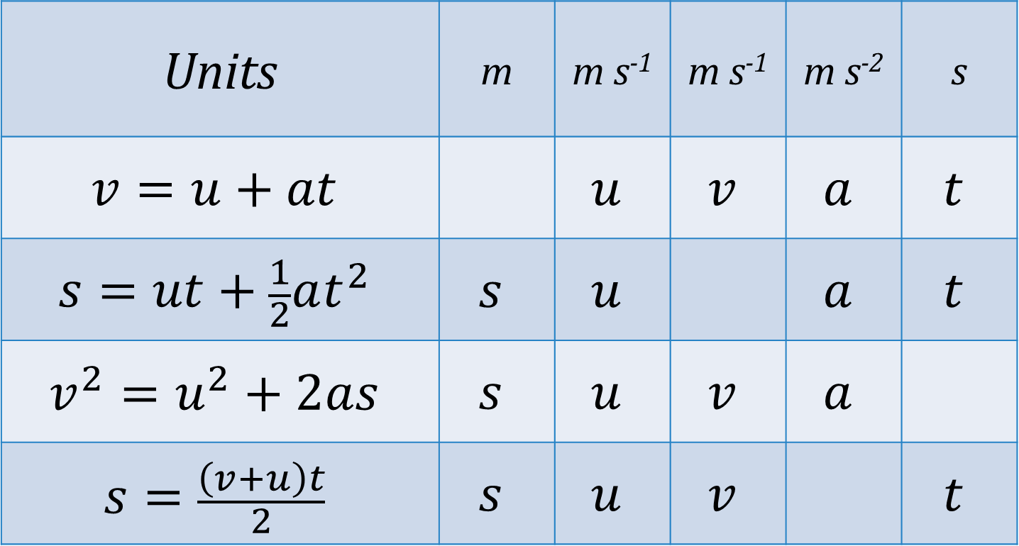
Reminder of our Equations
Units | m | m s⁻¹ | m s⁻¹ | m s⁻² | s
$$v=u+at$$ |  | $$u$$ | $$v$$ | $$a$$ | $$t$$
$$s=ut+\frac{1}{2}at^{2}$$ | $$s$$ | $$u$$ |  | $$a$$ | $$t$$
$$v^{2}=u^{2}+2as$$ | $$s$$ | $$u$$ | $$v$$ | $$a$$
$$s=\frac{\left(v+u\right)t}{2}$$ | $$s$$ | $$u$$ | $$v$$ |  | $$t$$

Slide 3
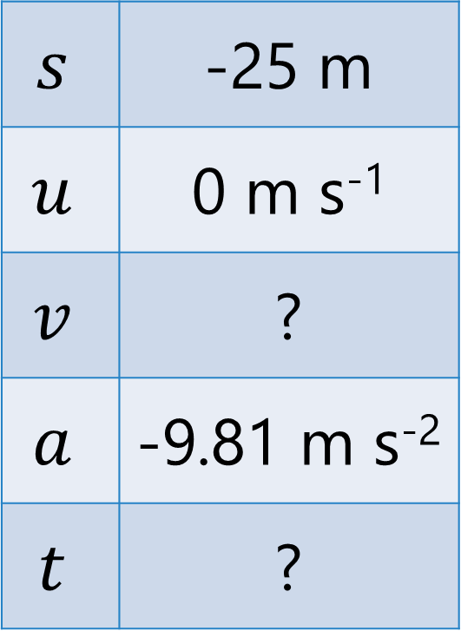
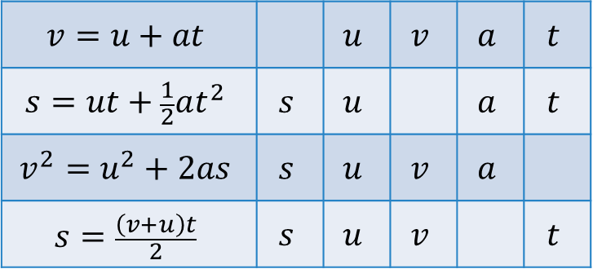
Dropping the Ball
How much time will it take this ball to hit the ground when dropped? The impact velocity?
$$s$$ | -25 m
$$u$$ | 0 m s⁻¹
$$v$$ | ?
$$a$$ | -9.81 m s⁻²
$$t$$ | ?
$$s=ut+\frac{1}{2}at^{2}$$
$$t=2.26 s$$
$$−25=\frac{1}{2}(−9.81)t^{2}$$
25 m
$$v=u+at$$ |  | $$u$$ | $$v$$ | $$a$$ | $$t$$
$$s=ut+\frac{1}{2}at^{2}$$ | $$s$$ | $$u$$ |  | $$a$$ | $$t$$
$$v^{2}=u^{2}+2as$$ | $$s$$ | $$u$$ | $$v$$ | $$a$$
$$s=\frac{\left(v+u\right)t}{2}$$ | $$s$$ | $$u$$ | $$v$$ |  | $$t$$
$$v^{2}=u^{2}+2as$$
$v=\sqrt{2as}=$ $\sqrt{2(−9.81)(−25)}$
$$v=−22.2 m s^{−1}$$

Slide 4
Air Time - Comparison
Which ball will have more air time?
10 m/s
The balls hit the ground at EXACTLY the same time

Slide 5
Air Time - Comparison

Slide 6
Constant
Velocity
Free Fall

Slide 7
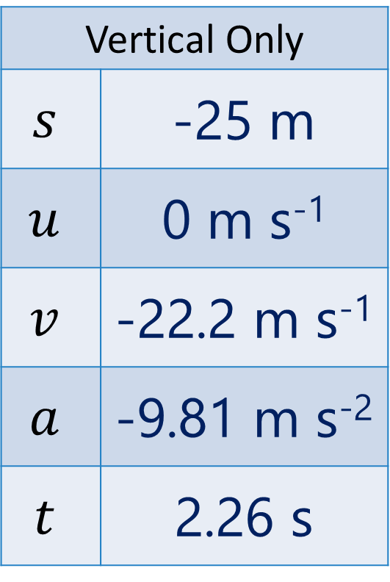
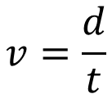
Horizontal Projectile
10 m/s
Vertical Only
$$s$$ | -25 m
$$u$$ | 0 m s⁻¹
$$v$$ | -22.2 m s⁻¹
$$a$$ | -9.81 m s⁻²
$$t$$ | 2.26 s
From Previous Problem
How far does the ball travel?
$$v=\frac{d}{t}$$
25 m
$$d=vt$$
$$=(10 m s^{−1})(2.26 s)$$
$$d=22.6 m$$

Slide 8
One Dimensional Motion
Vertical
Accelerating
Horizontal
Constant Velocity
[v = d/t]

Slide 9
Horizontal Projectile

Slide 10
Two-Dimensional Projectile
Same as the horizontal projectile

Slide 11
Which one lands first??
A
B

Slide 12
Which one lands first??
Only vertical velocity and height affects air time
A
B

Slide 13
Lesson Takeaways
I can compare the motion of an object dropped from rest and an object with an initial horizontal velocity
I can calculate the air time and speed for a horizontal projectile
I can describe how the vertical and horizontal components are independent from each other for a projectile’s motion
I can compare the air time for two projectiles given their trajectories.

