Slide 1
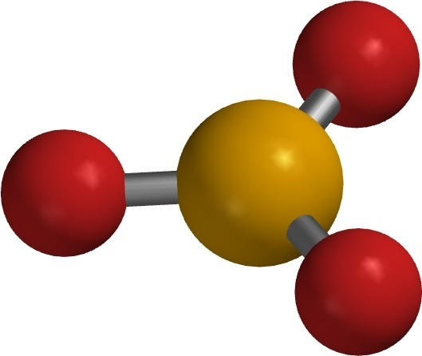
Naming Compounds Walk Around #2

Slide 2
N₂O₃
1
Notes:
Dinitrogen Trioxide

Slide 3
2
PbCO₃
Notes:
Lead (II) Carbonate

Slide 4
Na₃PO₄
3
Notes:
Sodium Phosphate

Slide 5
Zinc Bromide
4
Notes:
ZnBr₂

Slide 6
Silicon Tetrachloride
5
Notes:
SiCl₄

Slide 7
Iron (III) Nitrite
6
Notes:
Fe(NO₂)₃

