Slide 1
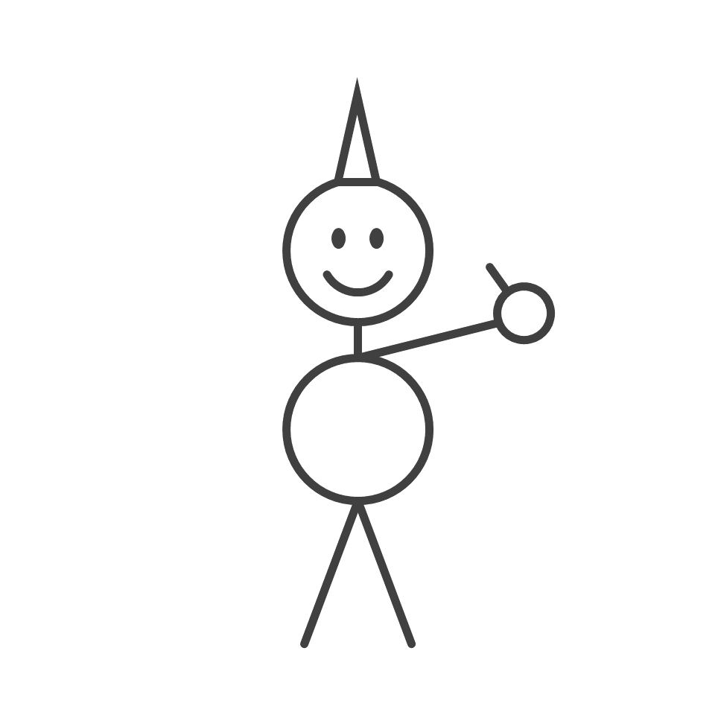
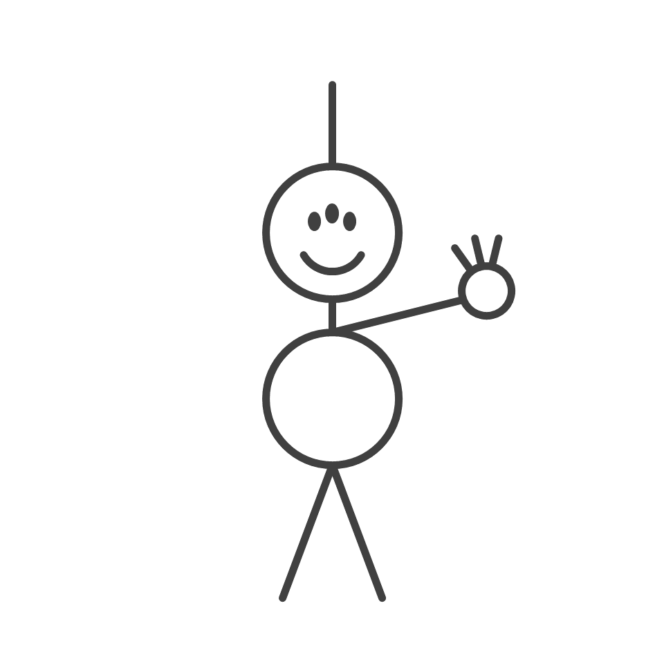
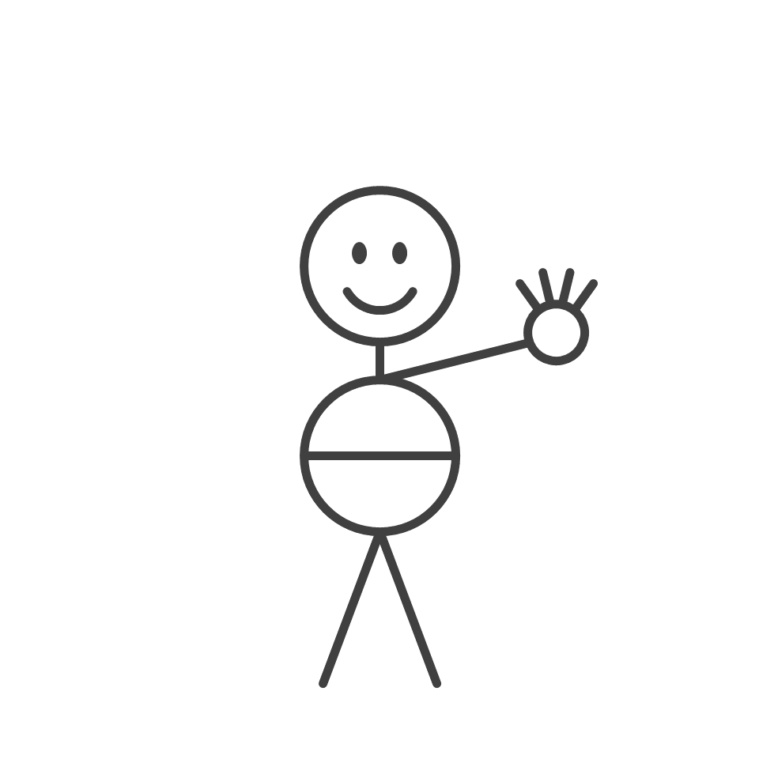
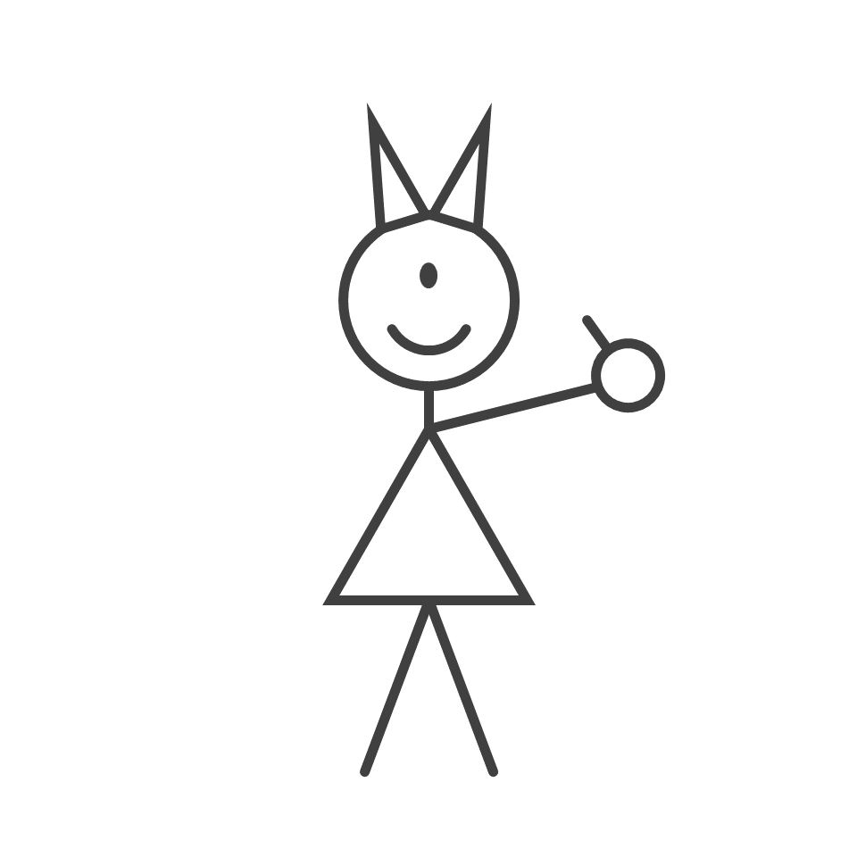
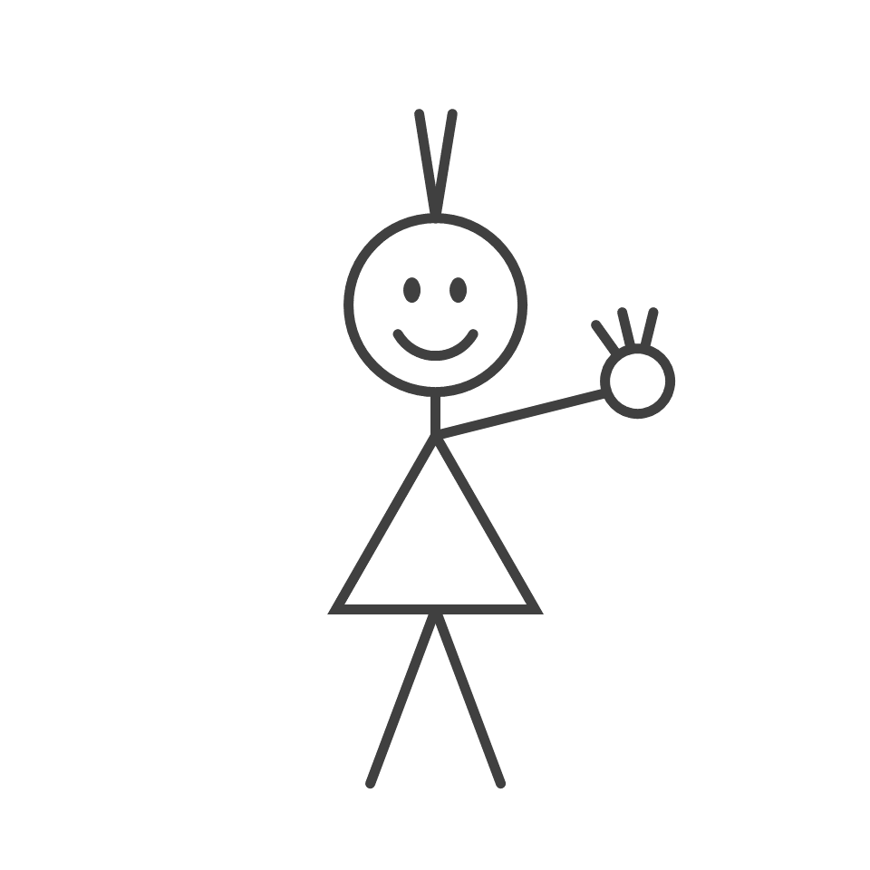
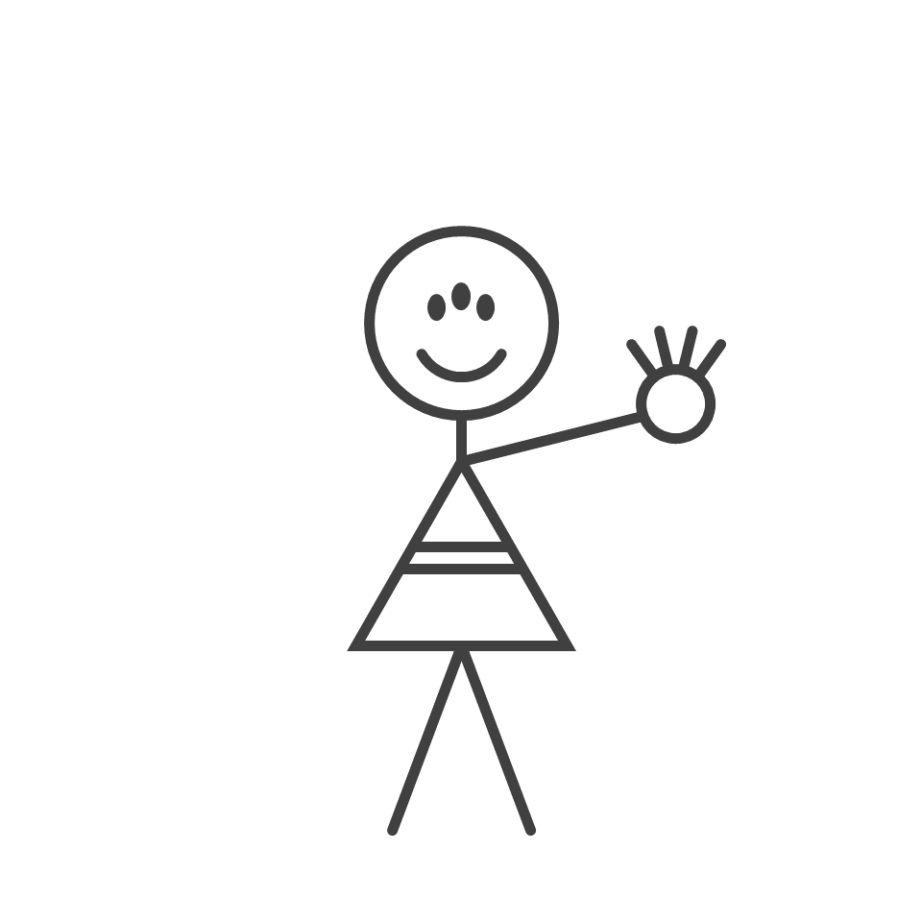
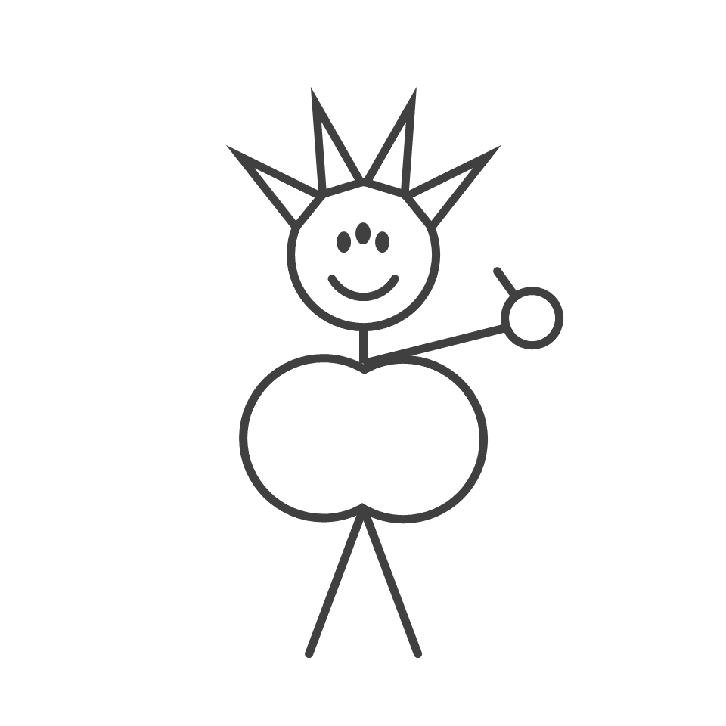
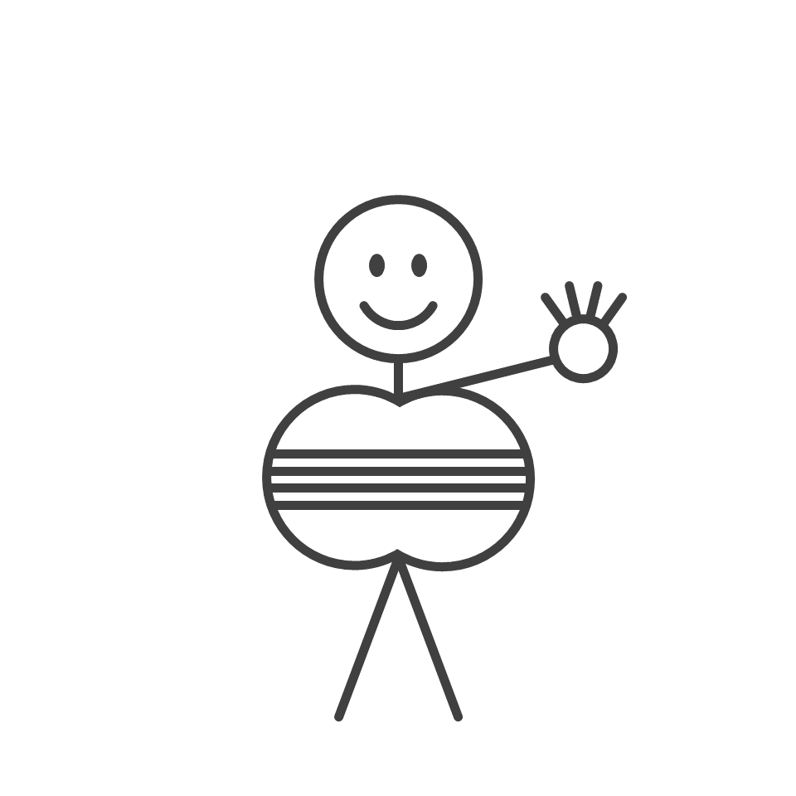
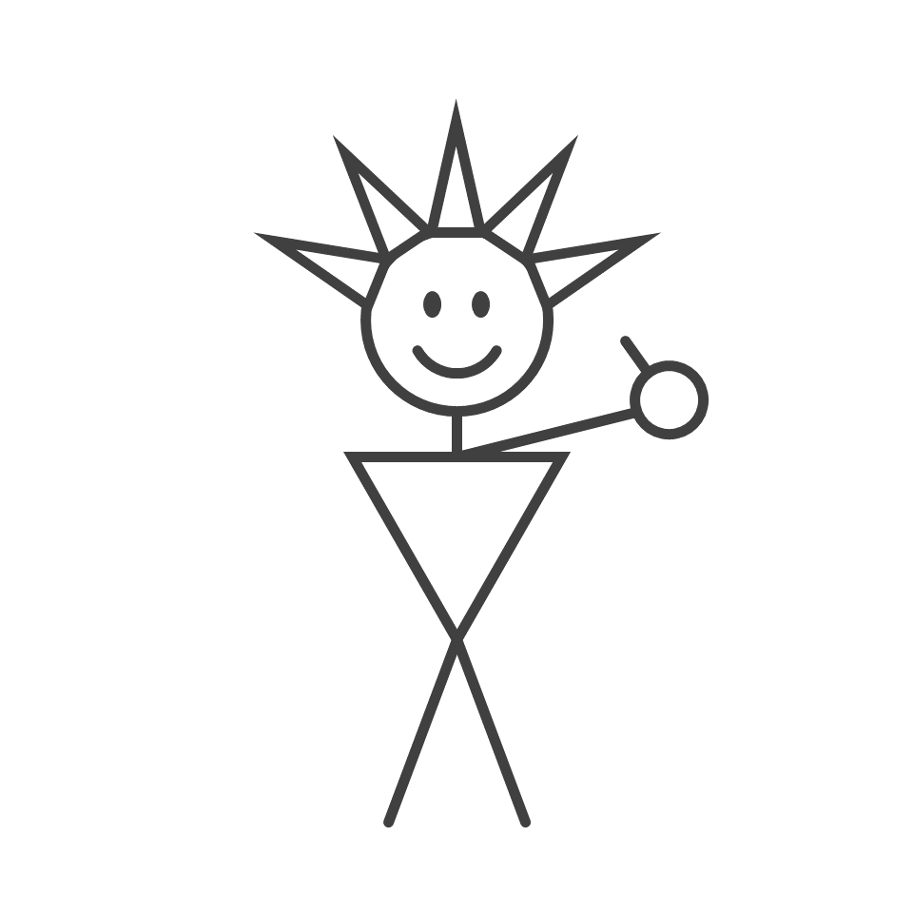
Periodic Aliens Solution | 40
Fingers counting up (4 to a hand)
Circle
Body
Three Eyes
Triangle
Body
Two Eyes
Rectangle
Body
Two Eyes
Double Circle
Body
Upside-down Triangle
Body
One Eye
Increasing hair spikes
Increasing foot size
Increasing hair number
Increasing body stripes
Increasing hat lines
Increasing smile size
Increasing hair length
Increasing leg number

