Slide 1
Units
IB Physics | Unit 1 | Science skills

Slide 2
Two Types of Observations
Provide some examples of each
Quantitative
Qualitative

Slide 3
Two Types of Observations
Provide some examples of each
Quantitative | “How Many” / “How Much” Numerical
Qualitative | Description

Slide 4
Measurement
How can you quantify a measurement?

Slide 5
Measurement
How can you quantify a measurement?

Slide 6
Systems and Units
Fundamental S.I. Units:
Length
Mass
Time
Electric Current
Temperature
Amount of Substance
Luminous Intensity

Slide 7
Systems and Units
Fundamental S.I. Units:
Length | Meter | m
Mass | Kilogram | kg
Time | Second | s
Electric Current | Ampere (amp) | A
Temperature | Kelvin | K
Amount of Substance | Mole | mol
Luminous Intensity | Candela | cd

Slide 8
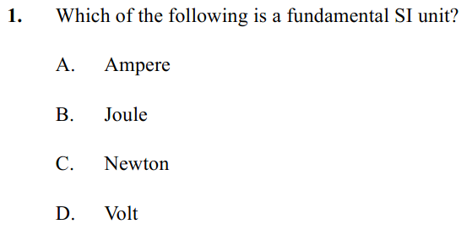
Example IB Question
FYI: IBO (International Baccalaureate Organization expects you to memorize the fundamental units

Slide 9
Example IB Question
FYI: IBO (International Baccalaureate Organization expects you to memorize the fundamental units

Slide 10
Units are Arbitrary
Take the history of the meter…
1790 - The length of a pendulum that swings half of its maximum distance in one second
1795 - The length of an official bar of brass fabricated to be exactly one meter as determined in 1791
1889 – The distance between two lines on an official bar of platinum-iridium alloy, measured at 0°C
1791 - The length of one ten-millionth of the distance between the North Pole and the equator
1799 - The length of an official bar of platinum, measured from the brass bar and stored at the French National archives
1983 – The length traveled by light in a vacuum during 1/299,792,458 of a second
1/10,000,000th

Slide 11
Units are Arbitrary
Take the history of the meter…
1790 - The length of a pendulum that swings half of its maximum distance in one second
1795 - The length of an official bar of brass fabricated to be exactly one meter as determined in 1791
1889 – The distance between two lines on an official bar of platinum-iridium alloy, measured at 0°C
1791 - The length of one ten-millionth of the distance between the North Pole and the equator
1799 - The length of an official bar of platinum, measured from the brass bar and stored at the French National archives
1983 – The length traveled by light in a vacuum during 1/299,792,458 of a second
1/10,000,000th

Slide 12
What’s ‘the standard’?
All of our base SI units are grounded in some “standard” that helps maintain consistency.
Some of these units even reference each other…
Definition of the Second
The “second” is defined as the interval required for 9,192,631,770 vibrations of the cesium-133 atom measured via an atomic beam clock

Slide 13
What’s ‘the standard’?
All of our base SI units are grounded in some “standard” that helps maintain consistency.
Some of these units even reference each other…
Definition of the Second
The “second” is defined as the interval required for 9,192,631,770 vibrations of the cesium-133 atom measured via an atomic beam clock

Slide 14
Primary and Secondary Colors
Primary Colors
Secondary Colors

Slide 15
Primary and Secondary Colors
Primary Colors
Secondary Colors

Slide 16
Fundamental vs Derived
Fundamental
S.I. Units
Derived Units
Velocity:
Acceleration:
Force:
Length | m
Mass | kg
Time | s

Slide 17
Fundamental vs Derived
Fundamental
S.I. Units
Derived Units
Velocity:
Acceleration:
Force:
$$m/s$$
Length | m
Mass | kg
Time | s
$$m/{s^{2}}={m/s}/s$$
$$N=kg×m/{s^{2}}$$

Slide 18
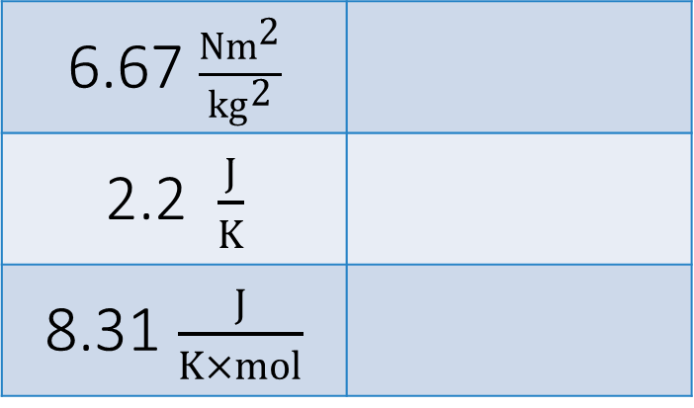
Welcome to IB Land!
Since this course is International all of the units must be in the “European” format rather than the “American” format
This means that instead of writing units with a fraction slash, we must use negative exponents
7 m/s
9.81 m/s²
87 g/cm³
6.67 $\frac{Nm^{2}}{{kg}^{2}}$
2.2 $\frac{J}{K}$
8.31 $\frac{J}{K×mol}$

Slide 19
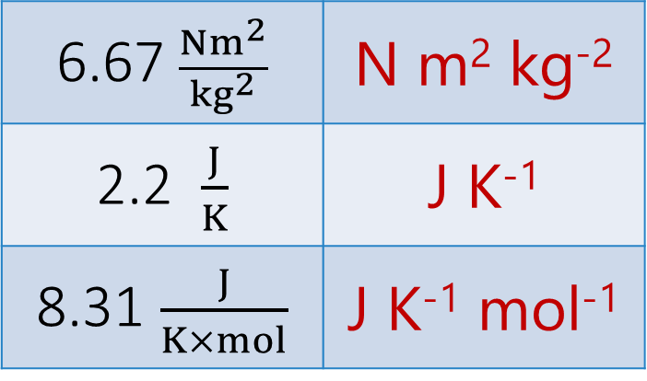
Welcome to IB Land!
Since this course is International all of the units must be in the “European” format rather than the “American” format
This means that instead of writing units with a fraction slash, we must use negative exponents
7 m/s | m s⁻¹
9.81 m/s² | m s⁻²
87 g/cm³ | g cm⁻³
6.67 $\frac{Nm^{2}}{{kg}^{2}}$ | N m² kg⁻²
2.2 $\frac{J}{K}$ | J K⁻¹
8.31 $\frac{J}{K×mol}$ | J K⁻¹ mol⁻¹

Slide 20
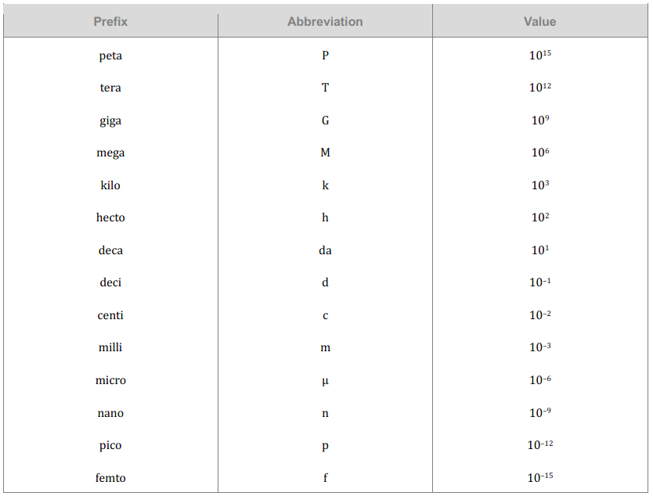
The Metric System
*Taken directly from the IB Physics Data Booklet

Slide 21
The Metric System
*Taken directly from the IB Physics Data Booklet

Slide 22
The Metric System
P
T
G
M
k
h
da
d
c
m
μ
n
p
f
The value given is the number of places the decimal moves
Please make sure that you go in the correct direction!
900 nm = 900,000,000,000 m
or
900 nm = 0.0000009 m

Slide 23
The Metric System
P
T
G
M
k
h
da
d
c
m
μ
n
p
f
The value given is the number of places the decimal moves
Please make sure that you go in the correct direction!
900 nm = 900,000,000,000 m
or
900 nm = 0.0000009 m

Slide 24
The Metric System
P
T
G
M
k
h
da
d
c
m
μ
n
p
f
900 nm → _______________ m

Slide 25
The Metric System
P
T
G
M
k
h
da
d
c
m
μ
n
p
f
0.0000009
900 nm → _______________ m
900 × 10⁻⁹ m
base
9

Slide 26
The Metric System
Prefix | Abbreviation | Power
giga- | G | 10⁹
mega- | M | 10⁶
kilo- | K | 10³
hecto- | h | 10²
deca- | da | 10¹
Base
deci- | d | 10⁻¹
centi- | c | 10⁻²
milli- | m | 10⁻³
micro- | μ | 10⁻⁶
nano- | n | 10⁻⁹
Conversions:
250 g = kg
0.00325 kg = μg
54 mm = km

Slide 27
The Metric System
Prefix | Abbreviation | Power
giga- | G | 10⁹
mega- | M | 10⁶
kilo- | K | 10³
hecto- | h | 10²
deca- | da | 10¹
Base
deci- | d | 10⁻¹
centi- | c | 10⁻²
milli- | m | 10⁻³
micro- | μ | 10⁻⁶
nano- | n | 10⁻⁹
Conversions:
250 g = kg
0.00325 kg = μg
54 mm = km
0.25
3
3
3
3,250,000
3
6
0.000054

Slide 28
The Metric System | Try These
Prefix | Abbreviation | Power
giga- | G | 10⁹
mega- | M | 10⁶
kilo- | K | 10³
hecto- | h | 10²
deca- | da | 10¹
Base
deci- | d | 10⁻¹
centi- | c | 10⁻²
milli- | m | 10⁻³
micro- | μ | 10⁻⁶
nano- | n | 10⁻⁹
65 μC = C
12 MW = W

Slide 29
The Metric System | Try These
Prefix | Abbreviation | Power
giga- | G | 10⁹
mega- | M | 10⁶
kilo- | K | 10³
hecto- | h | 10²
deca- | da | 10¹
Base
deci- | d | 10⁻¹
centi- | c | 10⁻²
milli- | m | 10⁻³
micro- | μ | 10⁻⁶
nano- | n | 10⁻⁹
65 μC = C
0.000065
6
12 MW = W
12,000,000
6

Slide 30
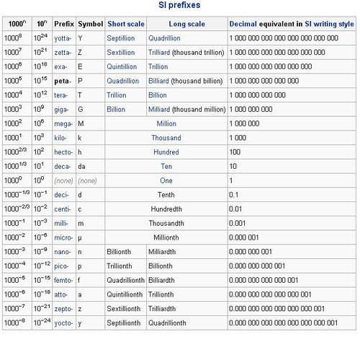
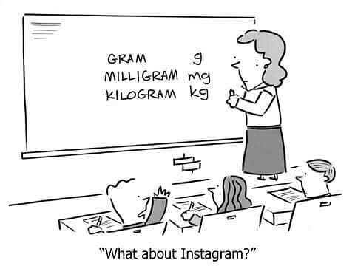
The Metric System
There’s more…

Slide 31
The Metric System
There’s more…

Slide 32
Homework: Study Class Names
It’s hard to operate as a productive team if we don’t know our teammates…
We will start tomorrow with a little challenge on how well you know the names of your classmates
Study up!

Slide 33
Homework: Study Class Names
It’s hard to operate as a productive team if we don’t know our teammates…
We will start tomorrow with a little challenge on how well you know the names of your classmates
Study up!

