Slide 1
Dimensional Analysis
IB Physics | Unit 1 | Science skills

Slide 2
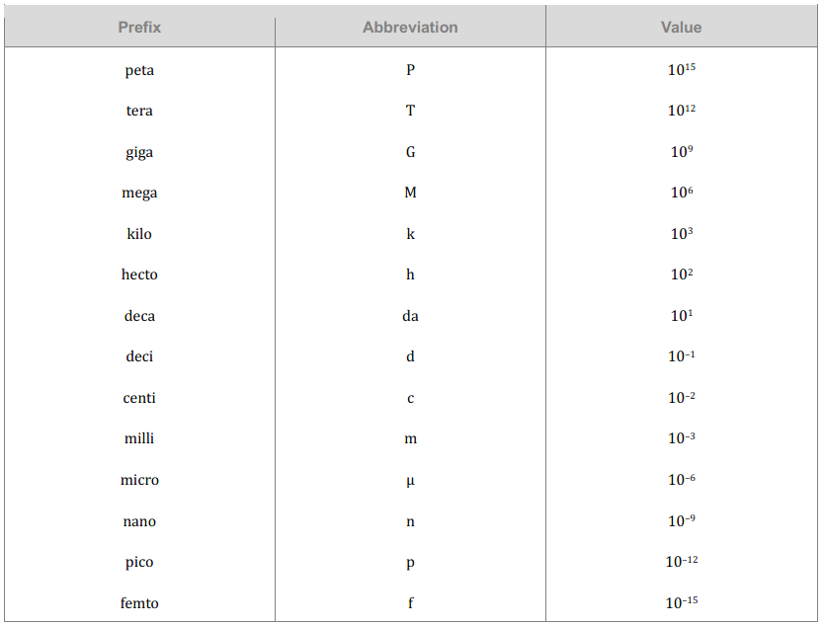
Warm Up
Convert 0.004 km to m
Convert 130 cm to m
Convert 764 ns to s

Slide 3
Warm Up
Convert 0.004 km to m
0.004 × 10³ = 4 m
Convert 130 cm to m
130 × 10⁻² = 1.3 m
Convert 764 ns to s
764 × 10⁻⁹ =
0.000000764 s

Slide 4
Conversions
Convert the Following:
26.2 miles → kilometers
1 Mile = 1.609 Kilometers

Slide 5
Conversions
Convert the Following:
26.2 miles → kilometers
1 Mile = 1.609 Kilometers
$$26.2 mi ×\frac{1.609 km}{1 mi}=$$
$$42.2 km$$

Slide 6
Conversions with fractions
Convert the Following:
35 mi hr⁻¹ → m s⁻¹
1 Mile = 1609 meters

Slide 7
Conversions with fractions
Convert the Following:
35 mi hr⁻¹ → m s⁻¹
1 Mile = 1609 meters
$$\frac{35 mi}{1 hr}×\frac{1609 m}{1 mi}×\frac{1 hr}{60 min}×\frac{1 min}{60 s}=$$
$$15.6 m s^{−1}$$

Slide 8
Conversions with Exponents
How many cm² are there in 1 m²?
How many cm³ are there in 1 m³?

Slide 9
Conversions with Exponents
How many cm² are there in 1 m²?
$$100×100={100}^{2}=10,000 {cm}^{2}$$
How many cm³ are there in 1 m³?
$$100×100×100={100}^{3}=1,000,000 {cm}^{2}$$

Slide 10
Conversions with Exponents
Convert the Following:
0.05 km² → m²

Slide 11
Conversions with Exponents
Convert the Following:
0.05 km² → m²
$$0.05 {km}^{2} ×\frac{1000 m}{1 km}×\frac{1000 m}{1 km}=$$
$$50,000 m^{2}$$
$$0.05 {km}^{2} ×{\left(\frac{1000 m}{1 km}\right)}^{2}=$$
$$50,000 m^{2}$$

Slide 12
Conversions with Exponents
Convert the Following:
5 m² → ft²
5 m³ → ft³
1 meter = 3.28 feet

Slide 13
Conversions with Exponents
Convert the Following:
5 m² → ft²
5 m³ → ft³
1 meter = 3.28 feet
$$5 m^{2} ×{\left(\frac{3.28 ft}{1 m}\right)}^{2}=$$
$$53.8 {ft}^{2}$$
$$5 m^{3} ×{\left(\frac{3.28 ft}{1 m}\right)}^{3}=$$
$$176.4 {ft}^{3}$$

Slide 14
Dimensional Analysis
Start with the formula and substitute units in for variables
v = d / t
Is this formula valid?
d = at

Slide 15
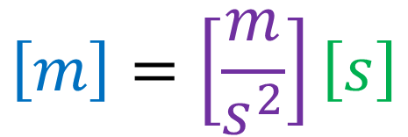
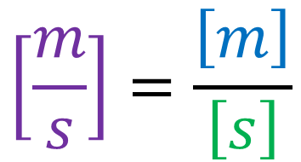

Dimensional Analysis
Start with the formula and substitute units in for variables
v = d / t
$$\left[\frac{m}{s}\right]=\frac{\left[m\right]}{\left[s\right]}$$
Is this formula valid?
$$\left[m\right]=\left[\frac{m}{s^{2}}\right]\left[s\right]$$
d = at
not valid
$$\left[m\right]=\left[\frac{m}{s}\right]$$

Slide 16
Dimensional Analysis
We can use equations with units that we know to find units that we don’t.
Variable | Unit
Momentum p
Mass m | Kilogram [kg]
Velocity v | Meters per second [ms⁻¹]
$$p=m×v$$

Slide 17
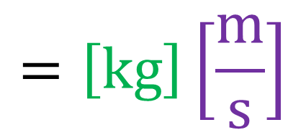
Dimensional Analysis
We can use equations with units that we know to find units that we don’t.
Variable | Unit
Momentum p | kg m s⁻¹
Mass m | Kilogram [kg]
Velocity v | Meters per second [ms⁻¹]
$$p=m×v$$
$$=\left[kg\right]\left[\frac{m}{s}\right]$$

Slide 18
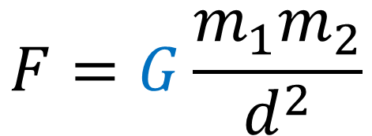
Dimensional Analysis
Constants have units too! That’s what makes our equation valid
Variable | Unit
Force F | Newton [N]
Mass m₁ and m₂ | Kilogram [kg]
Distance d | Meter [m]
Universal Gravitation Constant G
$$F=G\frac{m_{1}m_{2}}{d^{2}}$$

Slide 19
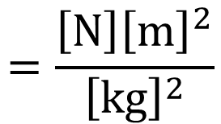
Dimensional Analysis
Constants have units too! That’s what makes our equation valid
Variable | Unit
Force F | Newton [N]
Mass m₁ and m₂ | Kilogram [kg]
Distance d | Meter [m]
Universal Gravitation Constant G | N m² kg⁻²
$$F=G\frac{m_{1}m_{2}}{d^{2}}$$
$$G=\frac{Fd^{2}}{m_{1}m_{2}}=\frac{\left[N\right]{\left[m\right]}^{2}}{\left[kg\right]\left[kg\right]}$$
$$=\frac{\left[N\right]{\left[m\right]}^{2}}{{\left[kg\right]}^{2}}$$

Slide 20
Example IB Question

Slide 21
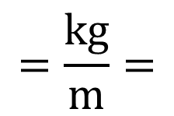
Example IB Question
$$F→\left[N\right]→\left[kg×m s^{−2}\right]$$
$$v→\left[m s^{−1}\right]$$
$$k=\frac{F}{v^{2}}=\frac{\left[kg×m s^{−2}\right]}{{\left[m s^{−1}\right]}^{2}}=\frac{kg×m s^{−2}}{m^{2} s^{−2}}$$
$$=\frac{kg}{m}=$$
$$kg m^{−1}$$

Slide 22
Normalized Scientific Notation
Helpful for very big numbers
89,000,000 =
750,000,000,000 =
8,759,000,000 =

Slide 23
Normalized Scientific Notation
Helpful for very big numbers
89,000,000 =
750,000,000,000 =
8,759,000,000 =
8.9 × 10⁷
or
8.9E7
7.5 × 10¹¹
or
7.5E11
8.759 × 10⁹
or
8.759E9

Slide 24
Normalized Scientific Notation
Helpful for very small numbers
0.00125 =
0.0000008255 =
0.00000082550 =

Slide 25
Normalized Scientific Notation
Helpful for very small numbers
0.00125 =
0.0000008255 =
0.00000082550 =
1.25 × 10⁻³
or
1.25E-3
8.255 × 10⁻⁷
or
8.255E-7
8.2550 × 10⁻⁷
or
8.2550E-7

Slide 26
Orders of Magnitude
If I have $144 in my pocket and you have $24 in your pocket, how many times larger is my wealth?

Slide 27
Orders of Magnitude
If I have $144 in my pocket and you have $24 in your pocket, how many times larger is my wealth?
$$\frac{144}{24}=6 times larger$$

Slide 28
Orders of Magnitude
How do we compare numbers in scientific notation?
8.9 × 10⁷ and 7.3 × 10¹⁵

Slide 29
Orders of Magnitude
How do we compare numbers in scientific notation?
8.9 × 10⁷ and 7.3 × 10¹⁵
$$\frac{7.3×{10}^{15}}{8.9×{10}^{7}}≈{10}^{8}$$
$$15−7=8$$

Slide 30
Orders of Magnitude
Mass of universe 10 ⁵⁰ kg
Diameter of universe 10 ²⁵ m
Diameter of galaxy 10 ²¹ m
Age of universe 10 ¹⁸ s
Speed of light 10 ⁸ m s⁻¹
Diameter of atom 10 ⁻¹⁰ m
Diameter of nucleus 10 ⁻¹⁵ m
Diameter of quark 10 ⁻¹⁸ m
Mass of proton 10 ⁻²⁷ kg
Mass of quark 10 ⁻³⁰ kg
Mass of electron 10 ⁻³¹ kg
Planck length 10 ⁻³⁵ m

Slide 31
Orders of Magnitude
Mass of universe 10 ⁵⁰ kg
Diameter of universe 10 ²⁵ m
Diameter of galaxy 10 ²¹ m
Age of universe 10 ¹⁸ s
Speed of light 10 ⁸ m s⁻¹
Diameter of atom 10 ⁻¹⁰ m
Diameter of nucleus 10 ⁻¹⁵ m
Diameter of quark 10 ⁻¹⁸ m
Mass of proton 10 ⁻²⁷ kg
Mass of quark 10 ⁻³⁰ kg
Mass of electron 10 ⁻³¹ kg
Planck length 10 ⁻³⁵ m

Slide 32
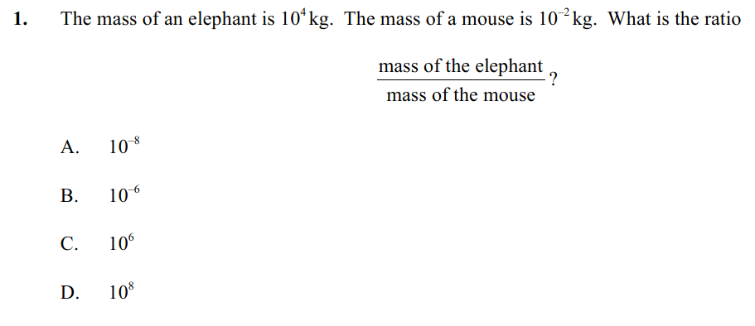
Example IB Question

Slide 33

Example IB Question
$$\frac{{10}^{4}}{{10}^{−2}}≈{10}^{6}$$
$$4−(−2)=6$$

