Slide 1
Uncertainty in Calculations
IB Physics | Unit 1 | Science skills

Slide 2
Estimating Uncertainty Range
When you have repeated measurements, report the average with an uncertainty of ± (half of the range)
Trial 1 | 2.01 s
Trial 2 | 1.82 s
Trial 3 | 1.97 s
Trial 4 | 2.16 s
Trial 5 | 1.94 s
Average = 1.98 s

Slide 3
Estimating Uncertainty Range
When you have repeated measurements, report the average with an uncertainty of ± (half of the range)
Trial 1 | 2.01 s
Trial 2 | 1.82 s
Trial 3 | 1.97 s
Trial 4 | 2.16 s
Trial 5 | 1.94 s
Average = 1.98 s
Range = 2.16 – 1.82 = 0.34 s
Uncertainty = 0.34/2
= ± 0.17 s

Slide 4
Three ways to Report
2.0 ± 0.3 g
Absolute Uncertainty
Fractional Uncertainty
Percentage Uncertainty

Slide 5
Three ways to Report
2.0 ± 0.3 g
Absolute Uncertainty | $$± 0.3 g$$
Fractional Uncertainty | $$\frac{Absolute}{Measurement}=\frac{0.3}{2.0}=0.15$$
Percentage Uncertainty | $$Fractional×100\%=15\%$$

Slide 6
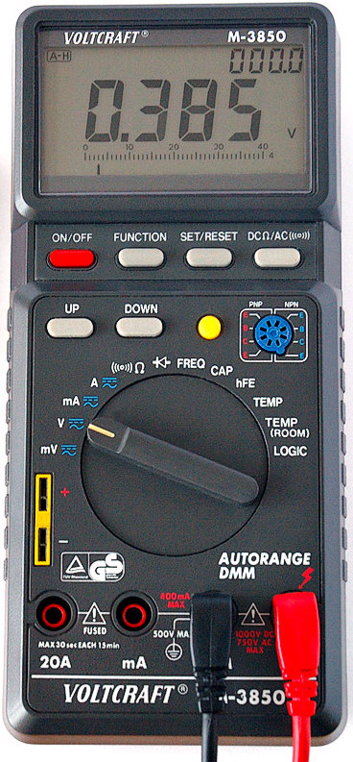
Three ways to Report
Absolute Uncertainty
Fractional Uncertainty
Percentage Uncertainty

Slide 7
Three ways to Report
Absolute Uncertainty | $$0.385±0.001 V$$
Fractional Uncertainty | $$\frac{0.001}{0.385}=0.0026$$
Percentage Uncertainty | $$0.0026×100\%=26\%$$

Slide 8
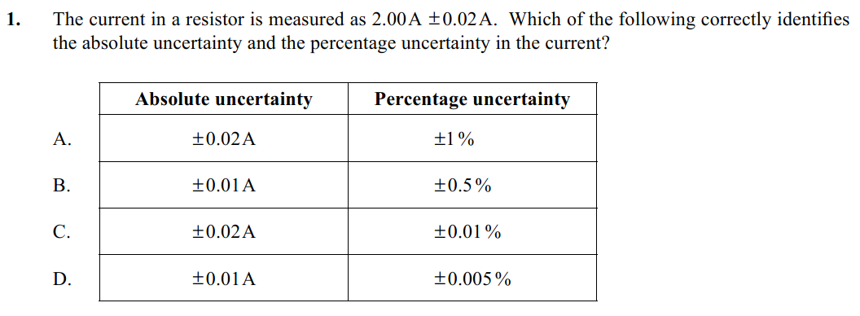
Example IB Question

Slide 9
Example IB Question
Absolute:
Percent:
$$± 0.02 A$$
$$\frac{0.02}{2.00}×100\%=1\%$$

Slide 10
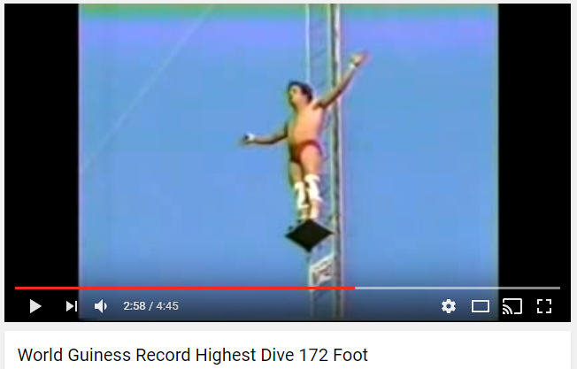
Timing World’s Highest Dive
Random
Error
Systematic
Error
or
Trial 1
Trial 2
Trial 3
Average
Uncertainty
Final Answer with Uncertainty:
Absolute
Percent

Slide 11
Timing World’s Highest Dive
Random
Error
Systematic
Error
or
Trial 1
Trial 2
Trial 3
Average
Uncertainty
Final Answer with Uncertainty:
Absolute
Percent

Slide 12
Uncertainty in Calculations
Adding or Subtracting
If y = a ± b then Δy = Δa + Δb
To find the uncertainty in a sum or difference you just add the uncertainties of all the ingredients.

Slide 13
Uncertainty in Calculations
Adding or Subtracting
Always Add
If y = a ± b then Δy = Δa + Δb
Absolute Uncertainty
To find the uncertainty in a sum or difference you just add the uncertainties of all the ingredients.

Slide 14
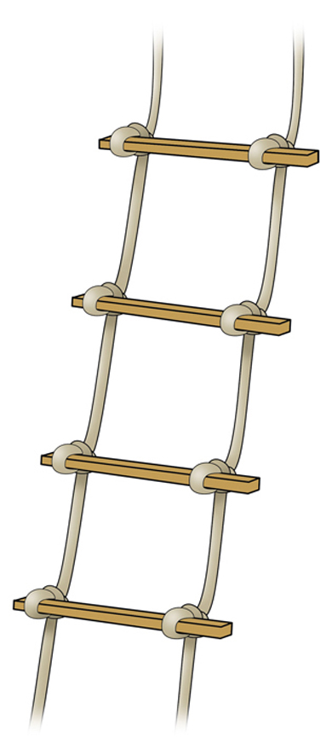
Try This
A 9.51 ± 0.15 meter rope ladder is hung from a roof that is 12.56 ± 0.07 meters above the ground. How far is the bottom of the ladder from the ground?

Slide 15
Try This
A 9.51 ± 0.15 meter rope ladder is hung from a roof that is 12.56 ± 0.07 meters above the ground. How far is the bottom of the ladder from the ground?
$$12.56−9.51=3.05 m$$
$$0.15+0.07=0.22 m$$
$$3.05±0.22 m$$

Slide 16
Uncertainty in Calculations
Multiplying or Dividing
If y = a × b ÷ c then Δy/y = Δa/a + Δb/b + Δc/c
To find the uncertainty in a product or quotient you just add the percentage or fractional uncertainties of all the ingredients.

Slide 17
Uncertainty in Calculations
Multiplying or Dividing
Always Add
If y = a × b ÷ c then Δy/y = Δa/a + Δb/b + Δc/c
Percent or Fractional Uncertainty
To find the uncertainty in a product or quotient you just add the percentage or fractional uncertainties of all the ingredients.

Slide 18
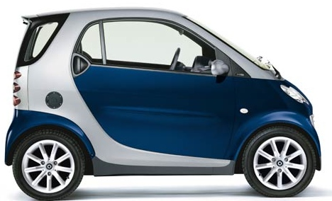
Try This
A car travels 64.7 ± 0.5 meters in 8.65 ± 0.05 seconds. What is its speed?

Slide 19
Try This
A car travels 64.7 ± 0.5 meters in 8.65 ± 0.05 seconds. What is its speed?
$$v=\frac{d}{t}=\frac{64.7}{8.65}=7.48 m s^{−1}$$
$$\frac{0.5}{64.7}×100\%=0.77\%$$
$$7.48 m s^{−1}±1.35\%$$
$$\frac{0.05}{8.65}×100\%=0.58\%$$
$$7.48 ×0.0135=0.1 m s^{−1}$$
$$7.48 ±0.1 m s^{−1}$$
$$0.77\%+0.58\%=1.35\%$$

Slide 20
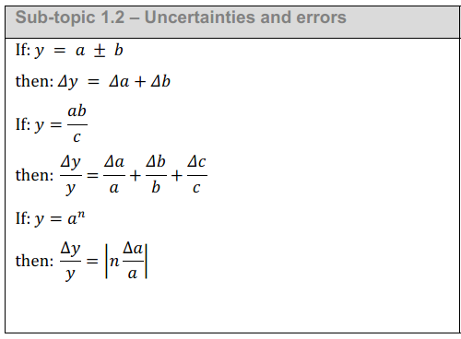
This is in the Data Booklet ☺

Slide 21
This is in the Data Booklet ☺

Slide 22
Example IB Question

Slide 23
Example IB Question
$$0.10±0.01 A$$
$$\frac{0.01}{0.10}×100\%=10\%$$
$$I^{2}=I×I$$
$$10\%+10\%=20\%$$

Slide 24
Example IB Questions

Slide 25
Example IB Questions
$$4πr^{3}$$
$$r×r×r$$
Exact Values
$$2\%+2\%+2\%=6\%$$
$$L^{3}=L×L×L$$
$$\frac{0.3}{10.0}×100\%=3\%$$
$$3\%+3\%+3\%=9\%$$
$${10}^{3}=1000 {cm}^{3}$$
$$1000 ×0.09=90 {cm}^{3}$$

