Slide 1
There’s Been a Murder!
As experts in physics, you have been recruited by the homicide division of the local Police Department.
It is 4:40 a.m. You wake up to the sound of your cell phone vibrating on your night stand. Groggy, you clumsily answer the phone to find out that a crew is awaiting your arrival at the crime scene. As this is your first official duty call, you run to your and drive to the scene of the crime.
On-site, you navigate through the media frenzy only to be greeted by the disheartening calmness of the homicide crew carrying about their work. The body lies lifeless on the floor of the apartment and the smell of gun smoke is clearly present in the room.
Police officer: Hello, Inspector.
You: Hello, Officer.
Police officer: The 911 dispatcher was called at 3:18 a.m. by a neighbor who heard gunshots coming from this apartment. So far, all we know is that between 2:30 a.m. and 3:20 a.m., there was a heated argument between two men, which ended with three gunshots.
You: Did you search the premises for indication of breaking and entering, gun slugs or any other clues?
Police officer: We have started to. As for slugs, the victim has two wounds, including one fatal wound in the cardiac region. We know that the gun was fired straight horizontally because of the positions of these gunshot wounds.
You: Are there any other wounds on the victim?
Police officer: None visible, Inspector.
You and your group decide to divide and conquer so that you can collect more evidence quickly and efficiently. You agree to come back in 10 minutes to report back what you have found out.

Slide 2
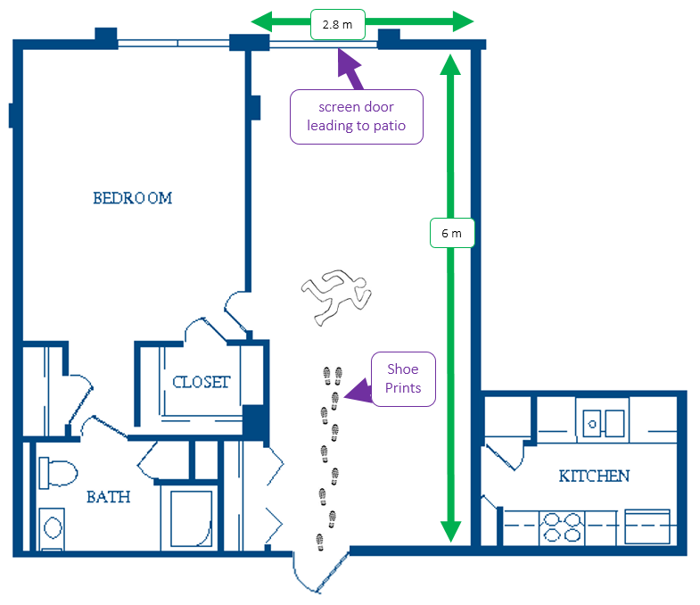
Clue #1
Apartment Floor Plan Sketch
During your time at the crime scene, you sketch out a quick drawing of apartment. You notice that there are some muddy shoe prints that enter the apartment and stop about two meters away from the door

Slide 3
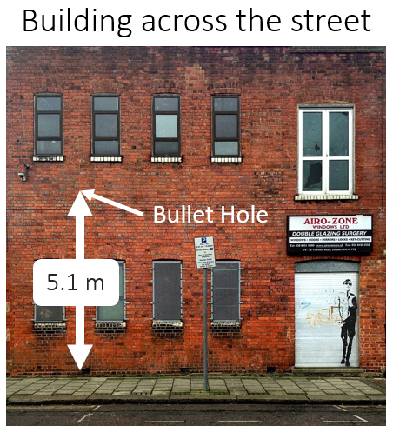
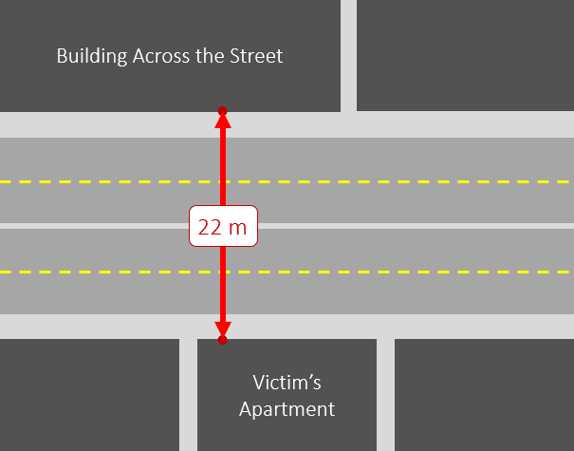
Clue #2
Evidence Outside of the Apartment
Upon further inspection, the investigation team locates a bullet hole in the brick wall for the building directly across the street from the apartment. You measure that this hole is about 5.1 m above the ground and confirm that the bullet matches those used on the victim.

Slide 4
Clue #3
Handgun Report
There were a total of four guns confiscated in the investigation of this crime. Each of them was analyzed and dusted for fingerprints. The results came back from the lab with fingerprints pointing to two potential suspects. Being a physicist, you are also interested in the muzzle speed, so the police provide you with a summarized report of handgun specifications.
Fingerprints? | Gun Style | Muzzle Speed (m/s)
Suspect 1 | 45 Colt | 106
Suspect 2 | 38 Special | 134
Suspect 1 | 9mm Luger | 182
Suspect 2 | 357 Magnum | 256

Slide 5
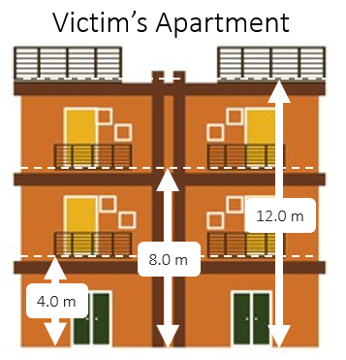
Clue #4
Apartment Balconies
You go outside the apartment and take some quick measurements of the different walkout levels. The victim lived in apartment #231 so you had to climb one set of stairs up to the second floor.

Slide 6
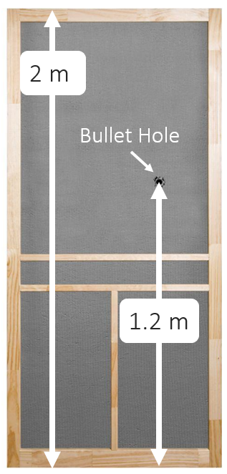
Clue #5
Screen Door
The interviews with the neighbors revealed that they heard three different gunshots but the investigation only found two gunshot wounds in the victim. You do a little poking around and find that there is a bullet hole roughly 1.2 meters above the floor. These interviews also revealed that some of the neighbors clearly heard something ricochet outside of the apartment almost immediately after they heard one of the gunshots.

Slide 7
Clue #6
The Suspects
The police have already done some investigative work and come to you with two suspects. You ask for some information and they provide you with this report:
 | Suspect #1 | Suspect #2
Date of Birth | 4/3/1983 | 7/4/1985
Weight | 165 lbs | 250 lbs
Height | 5’ 3” | 6’ 10”
2 m
1.5 m
1 m
0.5 m

Slide 8
Evidence Sheet
Evidence Sheet
What does the evidence tell you? What do you know?
How might this evidence help solve the mystery?
What does the evidence tell you? What do you know?
How might this evidence help solve the mystery?

Slide 9
Conclusion
It is our professional opinion that the police should arrest Suspect #____ because

Slide 10
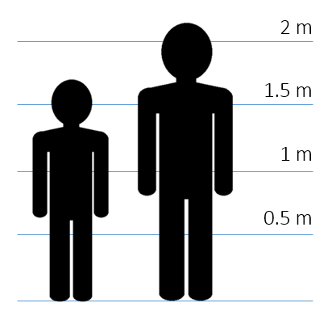
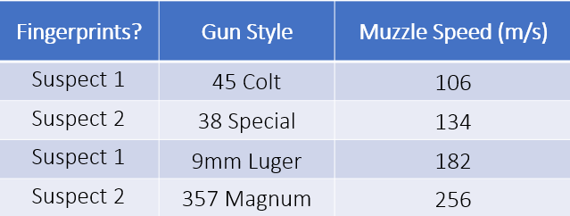
Solution - Conclusion
It is our professional opinion that the police should arrest Suspect #1 because an analysis of the bullet trajectory suggests that it must have left the gun at a speed of ~182 m/s. (see math on next slide) Of the recovered weapons, only the 9mm Luger has a muzzle speed that matches this result and this particular handgun had the fingerprints of suspect #1. Furthermore, the firing height of 1.2 m is much more likely from the shoulder height for Suspect #1 than from waist height for suspect #2.

Slide 11
Solution - The Scenario
d_{x} = 4 + 22 = 26 m
*assumption made that bullet was shot at the same height as the hole in the screen door. The actual firing height was a little higher but this is good enough for a rough estimate.
d_{y}* = 5.1 - 5.2 = - 0.1 m
2 m
4 m
22 m
1.2 m
5.1 m
4.0 m

Slide 12
Solution - The Math
$$v_{f}= v_{i}+at$$
$$d=\frac{1}{2}\left(v_{f}+v_{i}\right)t$$
$$d=v_{i}t+\frac{1}{2}at^{2}$$
$${v_{f}}^{2}={v_{i}}^{2}+2ad$$
 | X | Y
$$v_{i}$$ | 182 m/s | 0 m/s
$$v_{f}$$ | 182 m/s | -1.4 m/s
$$d$$ | 26 m | -0.1 m
$$a$$ | 0 m/s² | -9.81 m/s²
$$t$$ | 0.14 s

Slide 13
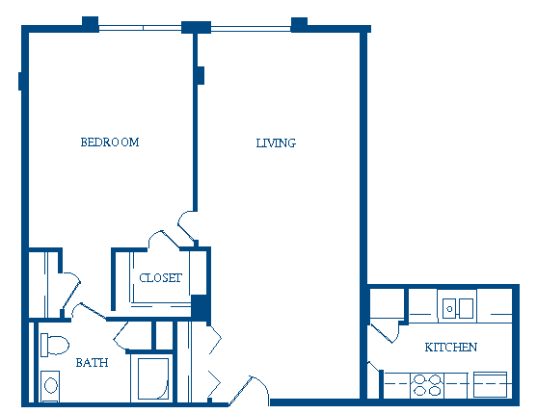
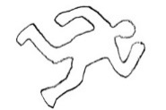
2.8 m
screen door leading to patio
6 m
Shoe Prints

Slide 14
Building Across the Street
●
22 m
●
Victim’s Apartment

Slide 15
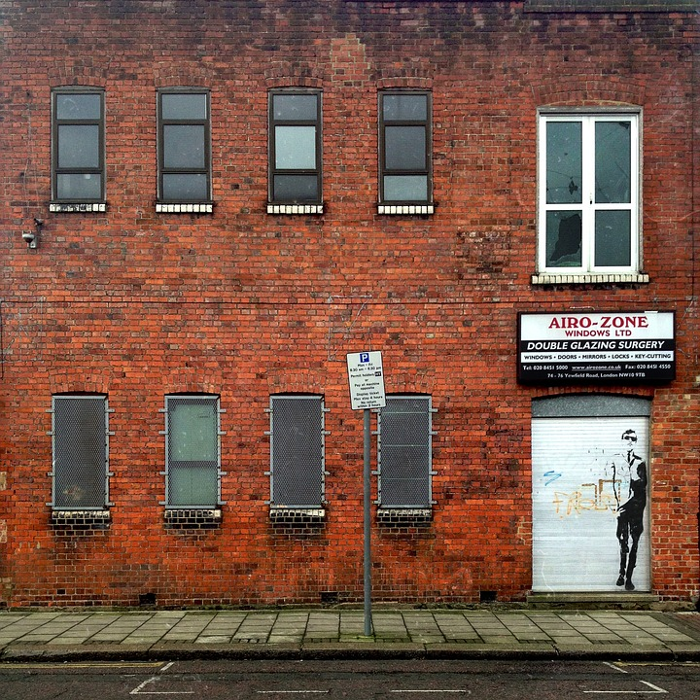
Building across the street
Victim’s Apartment
Bullet Hole
12.0 m
5.1 m
8.0 m
4.0 m

Slide 16
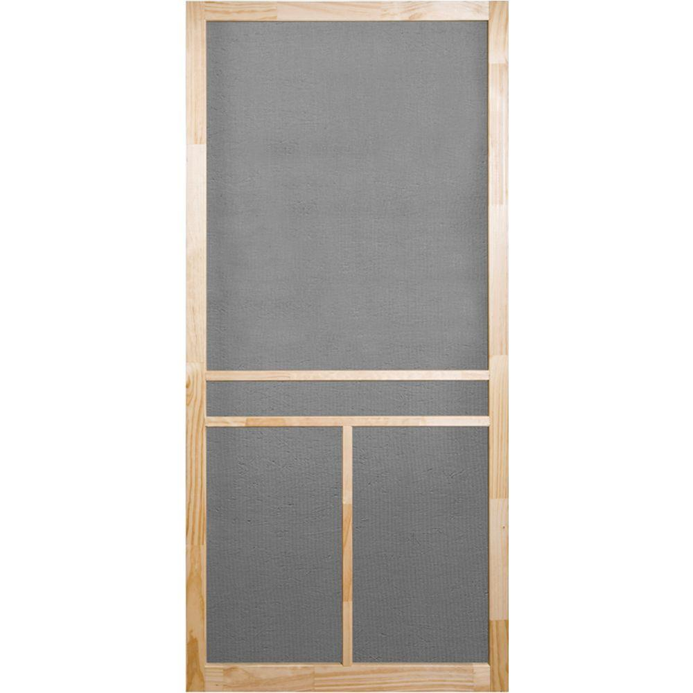
2 m
Bullet Hole
1.2 m

