Slide 1
Heat vs Temperature
IB Physics | Thermal Physics

Slide 2
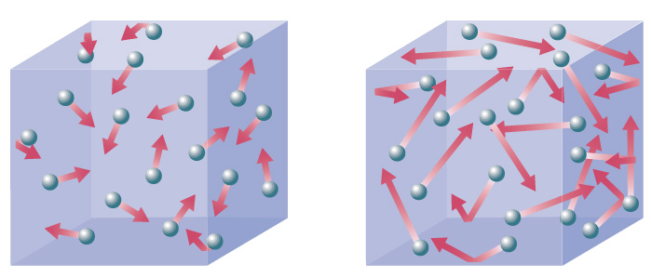
Temperature – What is it?
Quantitative
or Qualitative?
Measure of how hot or cold something feels
Kinetic Energy
Temperature is the average ______________________
of the molecules of a substance
$$E_{K}=\frac{1}{2}mv^{2}$$
The faster the particles move, the more temperature ____________
increases
More velocity
Circle the container with the highest temperature

Slide 3
Temperature
Which rock has a higher temperature (average kinetic energy)?
Same!
1000 kg
1 kg

Slide 4
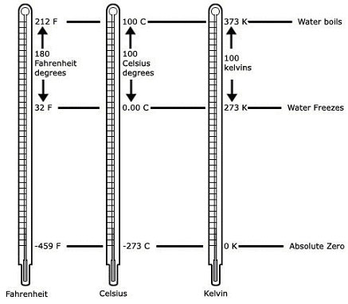
Temperature Scales
It is important that we can quantify temperature
212 °F
100 °C
373 K
Which temperature scale is the most precise?
On which temperature scale(s) would an increase of one degree be largest?
Fahrenheit (smallest increments)
32 °F
0 °C
273 K
Celsius or Kelvin
-459 °F
-273 °C
0 K

Slide 5
Absolute Zero
stop moving
At absolute zero, all molecules _______________________

Slide 6
Celsius and Kelvin
T (K) = T (°C) + 273
 | 233 K
0°C
 | 295 K
100°C
-40°C
273 K
22°C
373 K

Slide 7
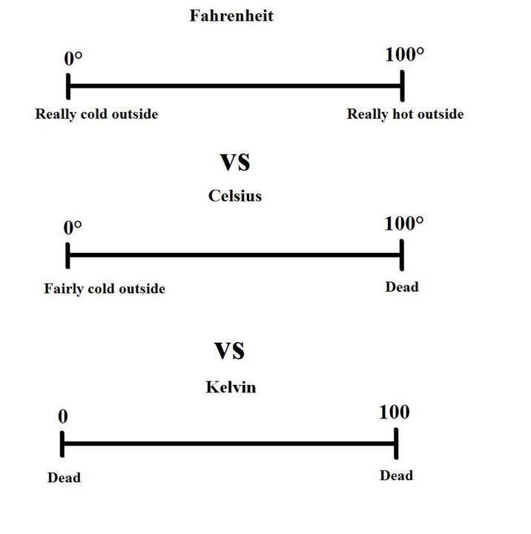
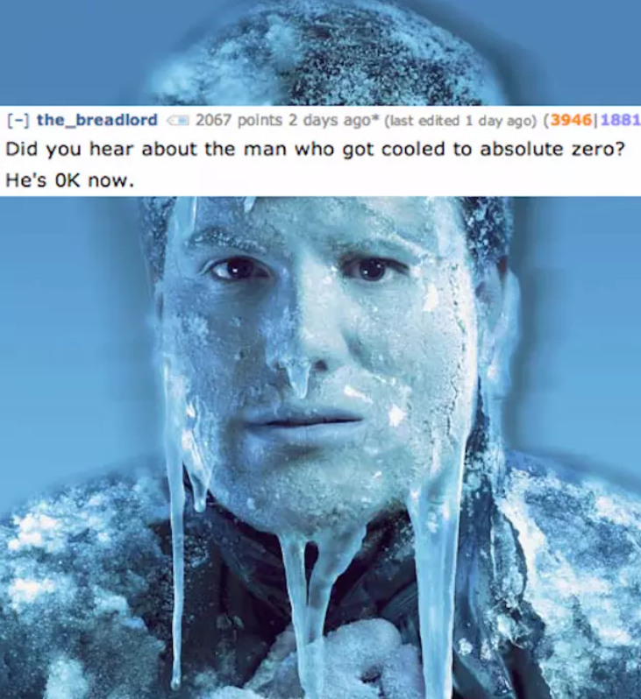
Temperature Scales

Slide 8
Temperature
Which has a higher temperature?
Burning Match
Ice Sculpture

Slide 9
Total Internal Energy
E_{INT} = E_{K} + E_{P}
Potential Energy
State of Matter
Kinetic Energy
Temperature

Slide 10
Internal Energy
Which rock has a higher internal energy?
Larger Rock
More mass means larger total energy
1000 kg
1 kg

Slide 11
Internal Energy
Which has more internal energy?
Burning Match
Ice Sculpture
More Mass = Larger Total Energy

Slide 12
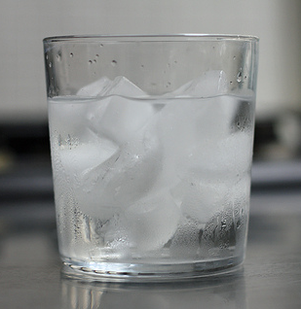
Heat
transfer
Heat is the ________ of thermal energy
hot
cold
Always flows from ________ to _________

Slide 13
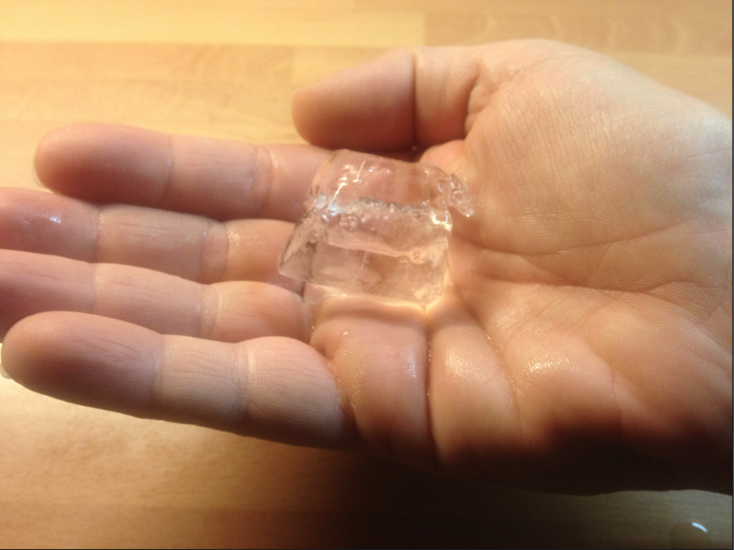
Heat Flow
Which is correct?
Heat flows from the hand to the ice cube
Heat flows from the ice cube to the hand

Slide 14
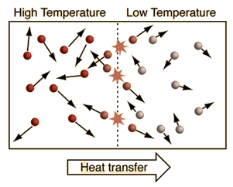
Heat Flow
Why does heat flow?
Fast moving particles collide with slow moving particles and increase their velocity, kinetic energy, and temperature

Slide 15
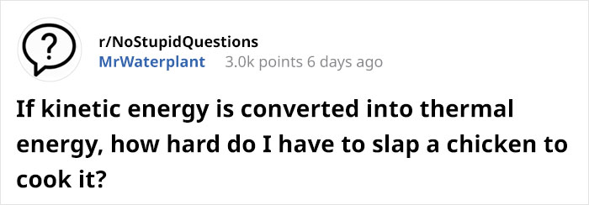
Energy is Energy

Slide 16
Lesson Takeaways
I can explain the relationship between temperature and molecular kinetic energy
I can describe the energies present in an object’s total internal energy
I can convert between Celsius and Kelvin
I can describe the nature of molecules when at a temperature of absolute zero
I can explain the difference between temperature, internal energy, and heat

