Slide 1
Latent Heat and Heating Curves
IB Physics | Thermal Physics

Slide 2
Review of Specific Heat
Quantity | Symbol | Unit
Heat Energy | Q | [J]
Mass | m | [kg]
Specific Heat | c | [J kg⁻¹ K⁻¹]
Change in Temp | ΔT | K or °C
$$Q=mc∆T$$

Slide 3
Calculating Heat Transfer
How much heat energy is required to heat up 2 kg of liquid water from its freezing point to its boiling point?
$$Q=mc∆T$$
$$=(2)(4180)(100−0)$$
Specific Heat of Water
4180 J kg⁻¹ K⁻¹
$$Q=836,000 J$$
100°C
Temperature (°C)
0°C
Heat Added
836,000 J

Slide 4
Heating Curve
GAS
100°C
Temperature (°C)
LIQUID
0°C
SOLID
Heat Added

Slide 5
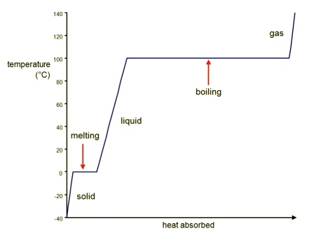
Why a Plateau?
Bonds are breaking as solid changes to liquid and then again when liquid changes to gas. This takes time!

Slide 6
Adding Heat | Internal Energy
All heat added becomes internal energy
E_{INT} = E_{K} + E_{P}
Changing the temperature of the solid, liquid, or gas?
Changing E_{K} (Kinetic Energy)
Causing the substance to change phases?
Changing E_{P} (Potential Energy)

Slide 7
Specific Latent Heat
Specific Latent Heat is the amount energy transferred when 1 kg of the substance changes phase at a constant temp.
Melting or Freezing | Latent Heat of Fusion | L_{f}
Boiling or Condensing | Latent Heat of Vaporization | L_{v}
Specific Latent Heat for Water (H₂O):
Latent Heat of Fusion | 334,000 J kg⁻¹
Latent Heat of Vaporization | 2,260,000 J kg⁻¹

Slide 8
Specific Latent Heat Equation
Quantity | Symbol | Unit
Heat Energy
Mass
Specific Latent Heat
$$Q=mL$$
$$Q$$
$$\left[J\right]$$
*This equation works for heat energy gained as well as heat energy lost*
$$m$$
$$\left[kg\right]$$
$$L$$
$$\left[J{ kg}^{−1}\right]$$

Slide 9
Heating Curve
Q = mcΔT
Gas Changing Temp
100°C
Temperature (°C)
Liquid Changing Temp
0°C
Solid Changing Temp
Heat Added

Slide 10
Heating Curve
Q = mcΔT
100°C
Temperature (°C)
0°C
Heat Added

Slide 11
Heating Curve
Q = mcΔT
100°C
Temperature (°C)
0°C
Heat Added

Slide 12
Heating Curve
Q = mL
Condensing
100°C
Vaporization
Temperature (°C)
Freezing
0°C
Melting/Fusion
Heat Added

Slide 13
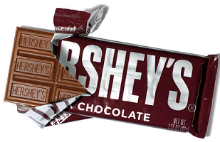
Try This…
If the latent heat of fusion of a certain kind of chocolate is 160,000 J kg⁻¹, how much thermal energy is removed from you when a 10 g bar of chocolate melts in your mouth?
$$Q=mL$$
$$=(0.01 kg)(160,000 J{ kg}^{−1})$$
$$Q=1,600 J$$

Slide 14
Specific Heat Combined
$$Q_{total}=mc∆T+mL$$
100°C
Temperature (°C)
Sometimes, the heat that is added is used to change temperature AND cause a phase change
0°C
Heat Added

Slide 15
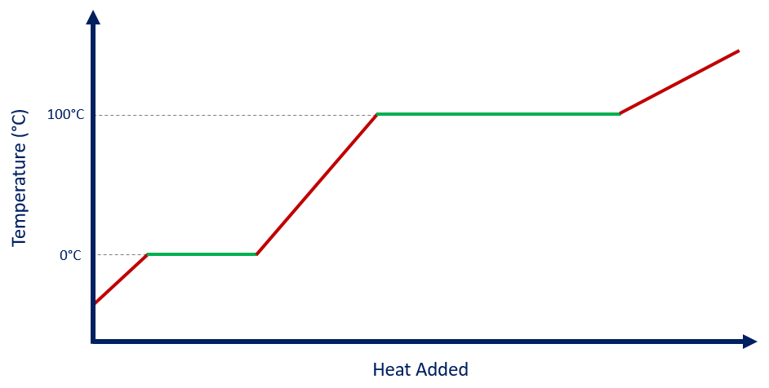
Try This…
How much heat is needed to transform 0.5 kg of ice at -20 °C into water at 50 °C ?
Specific Heat of Ice | 2090 J kg⁻¹ K⁻¹
Specific Heat of Water | 4180 J kg⁻¹ K⁻¹
Latent Heat of Fusion | 334,000 J kg⁻¹
Latent Heat of Vaporization | 2,260,000 J kg⁻¹
$$Q_{total}=$$
$$mc∆T$$
$$+ mL$$
$$+ mc∆T$$
$$∆T=0℃−(−20℃)$$
$$∆T=50℃−0℃$$
$$\left(0.5\right)\left(2090\right)\left(20\right)$$
$$\left(0.5\right)\left(334,000\right)$$
$$(0.5)(4180)(50)$$
$$Q= + +$$
$$20,900$$
$$167,000$$
$$104,500$$
$$Q=292,000 J$$

Slide 16
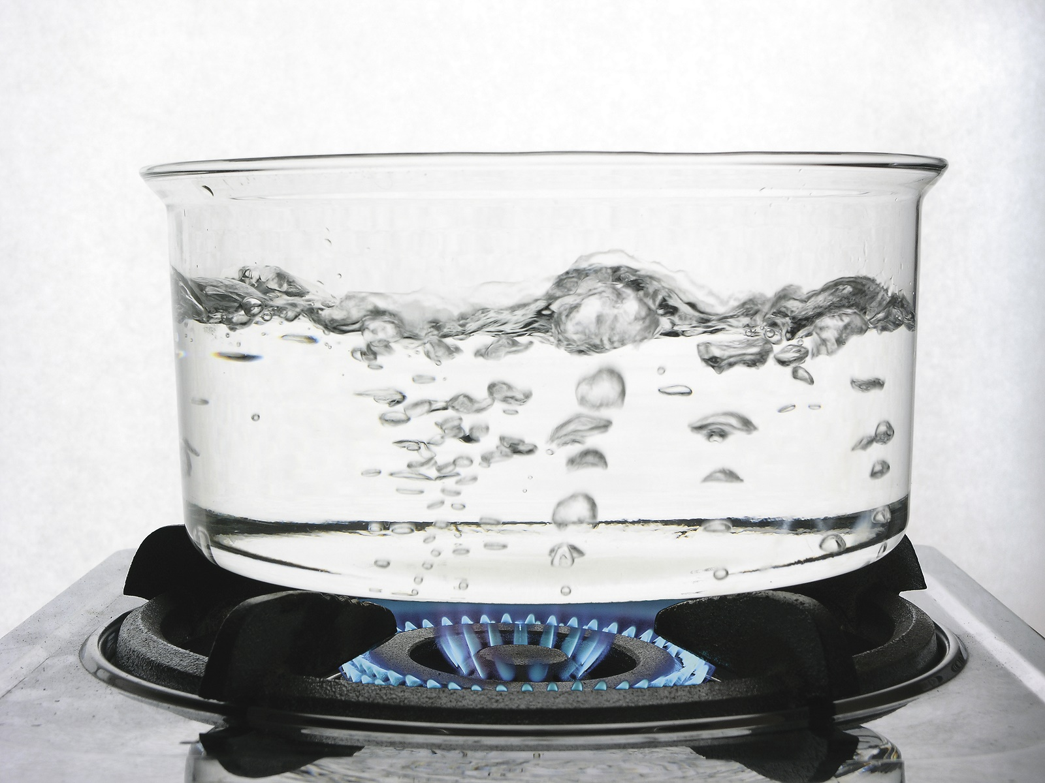
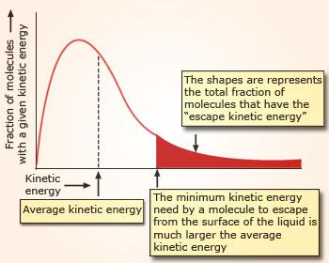
Evaporation vs Boiling
Evaporation:
Boiling:
Occurs only at the surface of a liquid
Can occur at any temperature
Bubbles form throughout liquid
Occurs at a precise temperature
Some molecules have a KE high enough to escape and become a gas
When these faster molecules are lost, the average KE of the liquid decreases, resulting in evaporative cooling
KE is high enough for molecules to form bubbles within the liquid

Slide 17
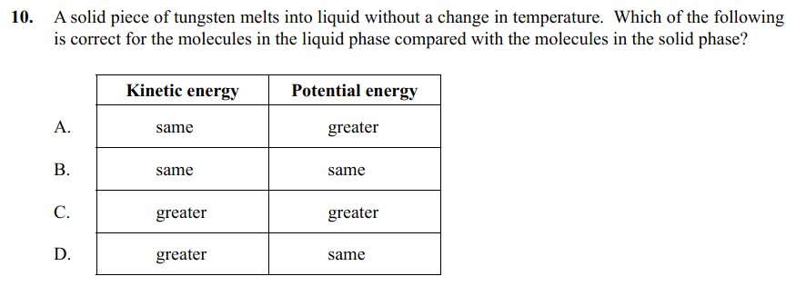
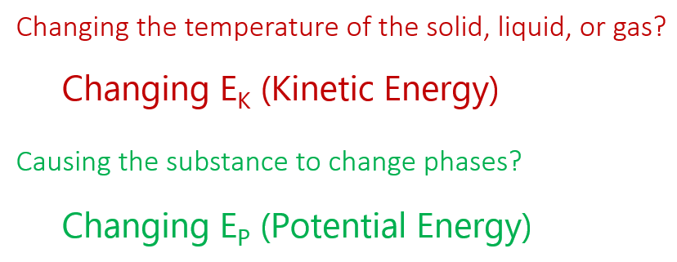
Example IB Questions
L → [J kg⁻¹]

Slide 18
Try This…
How much heat is needed to transform 1.4 kg of water at 23°C into water vapor at 120 °C?
Specific Heat of Water Vapor | 2000 J kg⁻¹ K⁻¹
Specific Heat of Water | 4180 J kg⁻¹ K⁻¹
Latent Heat of Fusion | 334,000 J kg⁻¹
Latent Heat of Vaporization | 2,260,000 J kg⁻¹
$Q_{total}=mc∆T+mL$ $+ mc∆T$
$$∆T=100℃−23℃$$
$$∆T=120℃−100℃$$
$$Q=$$
$$\left(1.4\right)\left(4180\right)\left(77\right)$$
$$+ \left(1.4\right)\left(2,260,000\right)$$
$$+ (1.4)(2000)(20)$$
$$450,604$$
$$3,164,000$$
$$56,000$$
$$Q=3,670,604 J$$

Slide 19
Lesson Takeaways
I can describe the features of a heating curve and why it plateaus during phase changes
I can define specific latent heat with proper units
I can calculate the heat required to cause a certain amount of a substance to change phases
I can compare the processes of evaporation and boiling

