Slide 1
Kinetic Molecular Theory
IB Physics | Thermal Physics

Slide 2
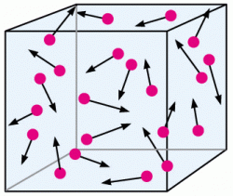
Kinetic Theory of Gases
Assumptions:
If these assumptions are true we have an
Ideal Gas
Large # of identical molecules
Volume of molecules is negligible
Motion is random
No forces between molecules
All collisions are elastic
Kinetic Energy is conserved

Slide 3
Review of Momentum / Collisions
What is the force of this ball on the wall?
u = 8 m s⁻¹
$$Impulse=F∆t=∆p$$
$$∆v=16 ms^{−1}$$
$$F=\frac{∆p}{∆t}$$
$$=\frac{m∆v}{∆t}$$
$$=\frac{(5)(16)}{(0.2)}$$
v = -8 m s⁻¹
m = 5 kg
Δt = 0.2 s
$$F=400 N$$

Slide 4
Pressure
When many molecules collide with the sides of a container it is measured as pressure
Quantity | Symbol | Unit
Force
Area
Pressure
$$p=\frac{F}{A}$$
$$F$$
$$[N]$$
$$A$$
$$\left[m^{2}\right]$$
$$p$$
=
$$\left[N m^{−2}\right]$$
$\left[Pa\right]$ Pascal

Slide 5
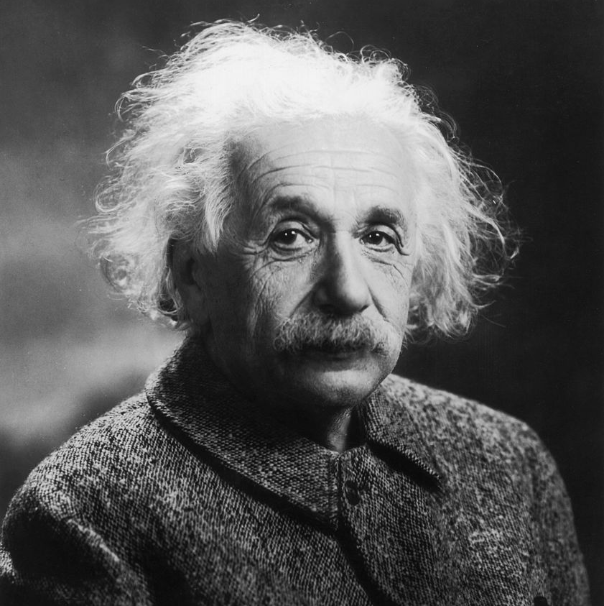
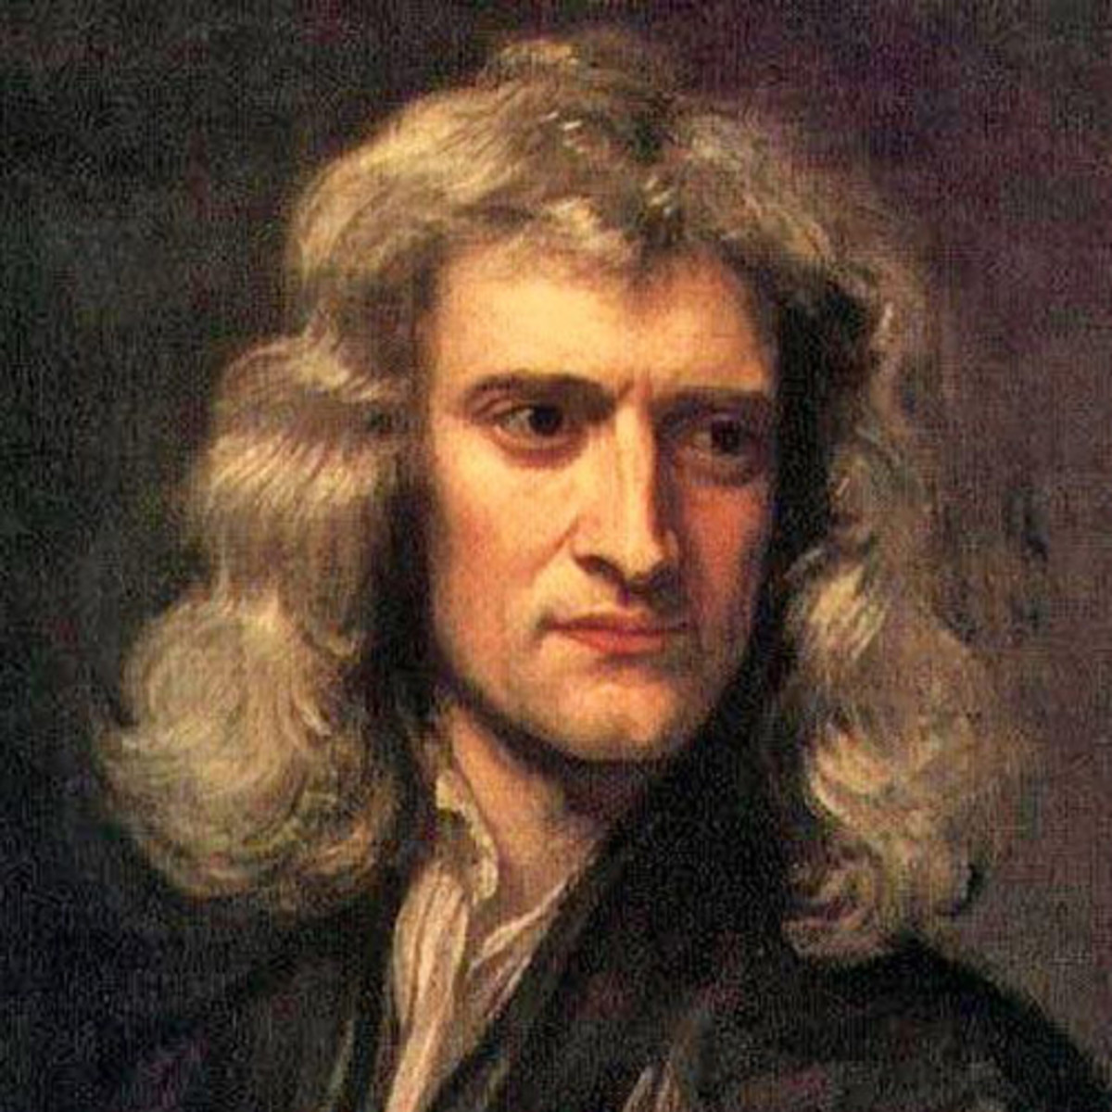
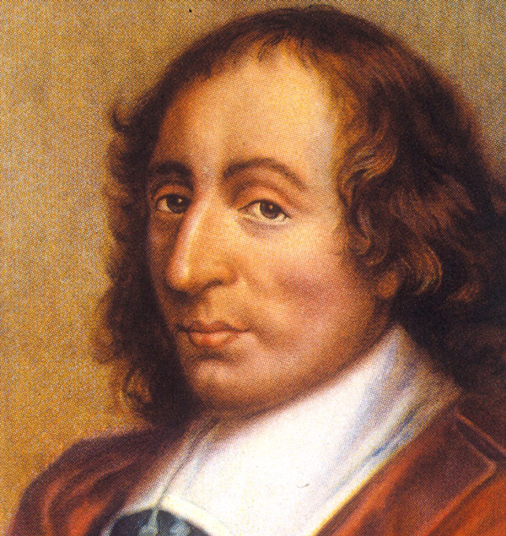
A brief interlude…
$$\frac{N}{m^{2}}$$
$$=Pa$$

Slide 6
Units of Pressure
There are several different units used to measure pressure of a gas
1 atm
= 101,325 Pa
= 760 Torr
= 760 mm Hg
100 kPa is a pretty good approximation

Slide 7
Atmospheric Pressure
What is the force from atmospheric pressure on this doormat?
$$\left(101,325 N m^{−2}\right)\left(0.33 m^{2}\right)$$
$$F=33,100 N$$
0.43 m
0.76 m
0.33 m²

Slide 8
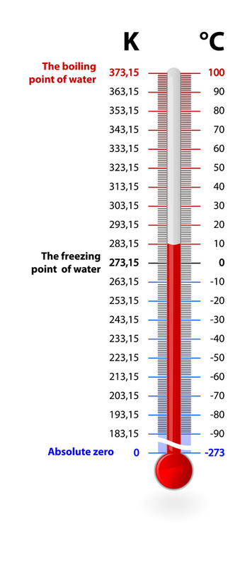
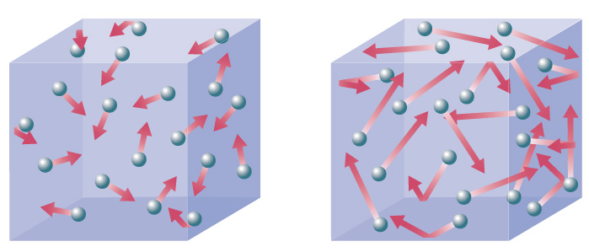
Temperature Review
Measure of how hot or cold something feels
Temperature is the average kinetic energy of the molecules of a substance
Kelvin Scale (K)
Absolute Temperature

Slide 9
Average Kinetic Energy
$${\overline{E}}_{K}=\frac{3}{2}k_{B}T$$
$$k_{B}→Boltzmann^{′}s constant$$
$$k_{B}=1.38×{10}^{−23} J K^{−1}$$
Quantity | Symbol | Unit
Average Kinetic Energy
Absolute Temperature
$${\overline{E}}_{K}$$
$$[J]$$
$$T$$
$$[K]$$

Slide 10
IB Physics Data Booklet

Slide 11
Try This | 1
Calculate the average translational kinetic energy of molecules in the air at 27°C
$$k_{B}=1.38×{10}^{−23} J{ K}^{−1}$$
$$T=27℃$$
$$+273=300 K$$
$${\overline{E}}_{k}=\frac{3}{2}k_{B}T$$
$$=\frac{3}{2}(1.38×{10}^{−23})(300)$$
$${\overline{E}}_{k}=6.21×{10}^{−21} J$$

Slide 12
What is Kinetic Energy?
$${\overline{E}}_{K}=\frac{3}{2}k_{B}T$$
$$k_{B}→Boltzmann^{′}s constant$$
$$k_{B}=1.38×{10}^{−23} J K^{−1}$$
$${\overline{E}}_{K}=\frac{1}{2}mv^{2}$$

Slide 13
Try This | 2
Calculate the average speed for oxygen molecules at 0°C.
(the mass of an oxygen molecule is 5.32 × 10⁻²⁶ kg)
$$m=5.32×{10}^{−26} kg$$
$${\overline{E}}_{k}=\frac{3}{2}k_{B}T$$
$$= \frac{1}{2}mv^{2}$$
$$k_{B}=1.38×{10}^{−23} J{ K}^{−1}$$
$$T=0℃$$
$$+ 273=273 K$$
$$\frac{3}{2}(1.38×{10}^{−23})(273)=\frac{1}{2}(5.32×{10}^{−26})v^{2}$$
$$5.62×{10}^{−21} J=\frac{1}{2}(5.32×{10}^{−26})v^{2}$$
$$v=461 ms^{−1}$$

Slide 14
Which molecules move faster?
H₂ gas at 23°C
O₂ gas at 23°C
H
$${\overline{E}}_{k}= \frac{1}{2}mv^{2}$$
1
O
8
If the gases have the same kinetic energy (temp), the lighter one must be moving faster
1.01
16.00

Slide 15
Lesson Takeaways
I can describe the conditions necessary for a substance to be considered an ideal gas
I can define pressure with appropriate fundamental and derived units
I can relate average molecular kinetic energy with absolute temperature
I can calculate the average molecule speed for a molecule at a certain temperature
I can discuss how the mass of a molecule changes its overall speed at a given temperature

