Slide 1
Gas Laws
IB Physics | Thermal Physics

Slide 2
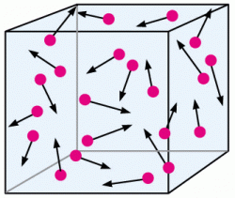
Ideal Gas
Assumptions:
Large # of identical molecules
Volume of molecules is negligible
Motion is random
No forces between molecules
All collisions are elastic
No longer ideal when…
Compressed
Molecules close together
Close to Phase Change
All internal energy is from E_{k}

Slide 3
Boyle’s Law | Volume and Pressure
$$p∝\frac{1}{V}$$
Volume
Pressure
$$p$$
$$V$$

Slide 4
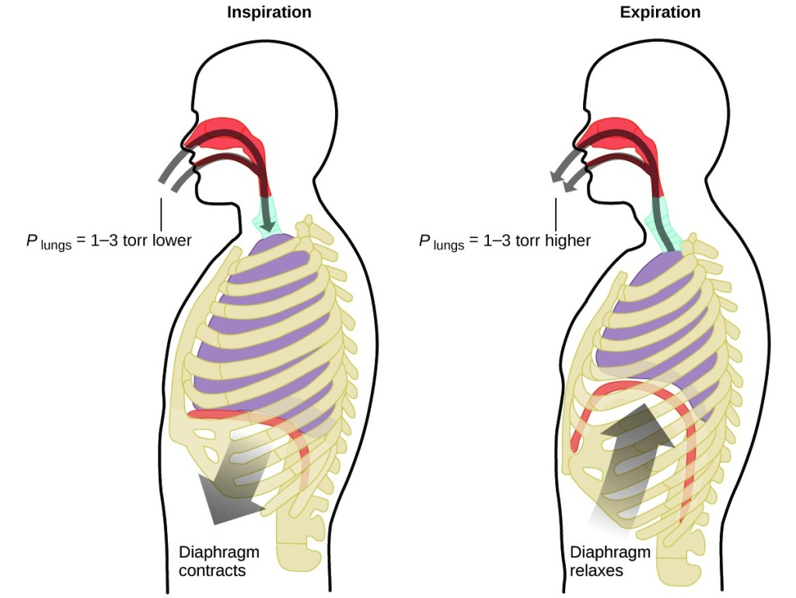
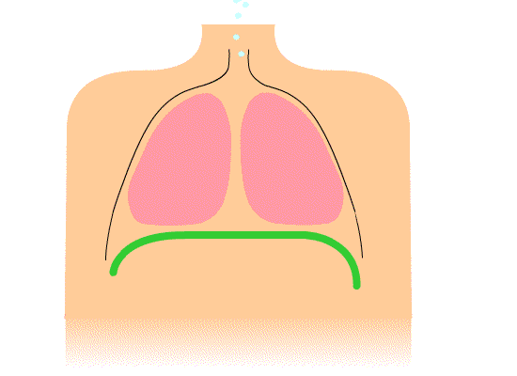
Boyle’s Law | Volume and Pressure
When diaphragm contracts the lung volume increases, decreasing the air pressure inside. With a pressure differential, air flows into the lungs (high pressure to low pressure)

Slide 5
Pressure Law | Temp and Pressure
$$p∝T$$
Temperature
Pressure

Slide 6
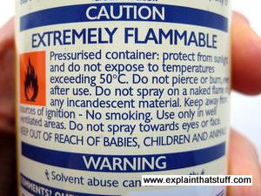
Pressure Law | Temp and Pressure
When you spray, the pressure decreases dramatically and the temperature drops
If temperature exceeds a certain amount, the increasing pressure could make a pressurized container explode!

Slide 7
Charles’s Law | Temp and Volume
$$V∝T$$
Temperature
Volume

Slide 8
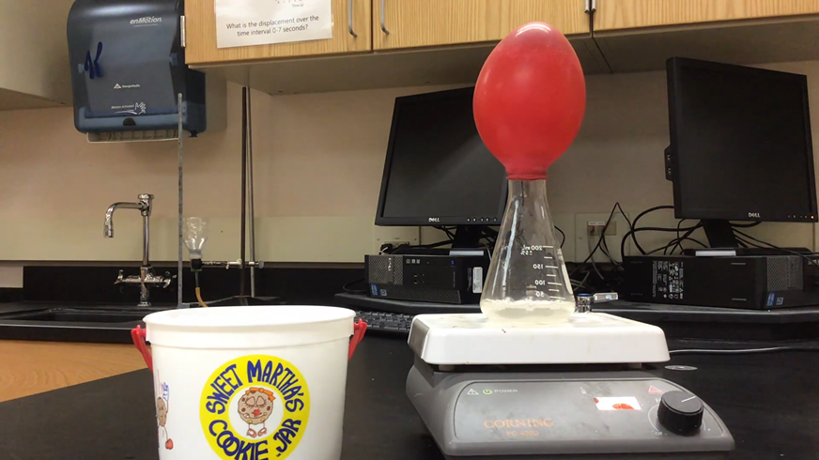
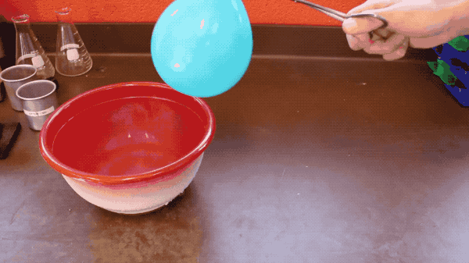
Charles’s Law | Temp and Volume
When the temperature of the air inside a balloon decreases, so does the volume. (this effect is even more dramatic when the gas condenses into a liquid)

Slide 9
Ideal Gas Law
$$p∝\frac{1}{V}$$
$$p∝T$$
$$V∝T$$
$$pV=nRT$$

Slide 10
Ideal Gas Law
Quantity | Symbol | Unit
Pressure
Volume
Amount
Temperature
$$pV=nRT$$
$$p$$
$$[Pa]$$
$$\left[atm\right]$$
$$V$$
$$[m^{3}]$$
$$\left[L\right]$$
$$n$$
$$[mol]$$
Gas Constant
$$T$$
$$[K]$$
R = 8.31 J K⁻¹ mol⁻¹

Slide 11
IB Physics Data Booklet

Slide 12
Try This
What is the pressure of 23 mol of a gas behaving ideally in a 0.25 m³ container at 310 K?
$$p=?$$
$$pV=nRT$$
$$V=0.25 m^{3}$$
$$p(0.25)=(23)(8.31)(310)$$
$$n=23 mol$$
$$R=\text{8.31 }\text{J} \text{K}\text{−1} \text{mol}\text{−1}$$
$$p=237,000 Pa$$
$$T=310 K$$

Slide 13
Change in Volume
A fixed mass of an ideal gas has a volume of 0.14 m³ at 301 K. If its temperature is increased to 365 K at the same pressure, what is its new volume, V₂?
$$pV=nRT$$
$$pV=nRT$$
$$pV=nRT$$
$$pV=nRT$$
$$\frac{V_{1}}{T_{1}}=\frac{V_{2}}{T_{2}}$$
$$\frac{0.14 m^{3}}{301 K}=\frac{V_{2}}{365 K}$$
Rearrange so constants are on one side
$$\frac{V}{T}=\frac{nR}{p}$$
$$V_{2}=0.17 m^{3}$$

Slide 14
Try This
A sample of ammonia is found to occupy 0.250 L under laboratory conditions of 27 °C and 0.850 atm. Find the volume of this sample at 0 °C and 1.00 atm.
$$\frac{{p_{1}V}_{1}}{T_{1}}=\frac{{p_{2}V}_{2}}{T_{2}}$$
$$pV=nRT$$
$$pV=nRT$$
$$pV=nRT$$
Rearrange so constants are on one side
$$\frac{(0.850)(0.250)}{(27+273)}=\frac{{(1.00)(V}_{2})}{(0+273)}$$
$$\frac{pV}{T}=nR$$
$$V_{2}=0.19 L$$

Slide 15
Draw these graphs
$$pV=nRT$$
$$p$$
$$p$$
$$V$$
$$V$$
$$T$$
$$T$$

Slide 16
Related Constants
Gas Constant
R = 8.31 J K⁻¹ mol⁻¹
$$N_{A}$$
$$\frac{R}{k_{B}}$$
$$=\frac{\text{8.31 }\text{J} \text{K}\text{−1} \text{mol}\text{−1}}{\text{1.38 }\text{×} {10}^{−23} \text{J} \text{K}\text{−1}}$$
$$=6.02×{10}^{23} {mol}^{−1}$$
𝐵𝑜𝑙𝑡𝑧𝑚𝑎𝑛𝑛′ 𝑠 𝑐𝑜𝑛𝑠𝑡𝑎𝑛𝑡
k_{B} = 1.38 × 10⁻²³ J K⁻¹

Slide 17
Average Kinetic Energy
$${\overline{E}}_{K}=\frac{3}{2}k_{B}T$$
$$=\frac{3}{2} \frac{R}{N_{A}} T$$
Same Constant Value
𝐵𝑜𝑙𝑡𝑧𝑚𝑎𝑛𝑛′ 𝑠 𝑐𝑜𝑛𝑠𝑡𝑎𝑛𝑡
Gas Constant
k_{B} = 1.38 × 10⁻²³ J K⁻¹
R = 8.31 J K⁻¹ mol⁻¹

Slide 18
IB Physics Data Booklet

Slide 19
Lesson Takeaways
I can identify conditions when a substance is no longer considered an ideal gas
I can describe the relationships between volume, temperature, and pressure in an ideal gas
I can use the Ideal Gas Law to solve for pressure, volume, amount, or temperature
I can use the Ideal Gas Law to describe how changing one or more variable(s) would affect another

