Slide 1
Wave Properties Walk Around

Slide 2
1
What kind of wave is this?
Notes:
Transverse

Slide 3
2
How many complete waves are pictured?
Notes:
2

Slide 4
3
You are standing with on the beach with your feet in the water and notice that a new wave comes crashing in every 8 seconds, what is the frequency of these waves?
Notes:
0.125

Slide 5
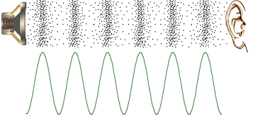
4
What is the wavelength of a sound wave with a frequency of 50 Hz and a speed of 340 m/s?
Notes:
6.8

Slide 6
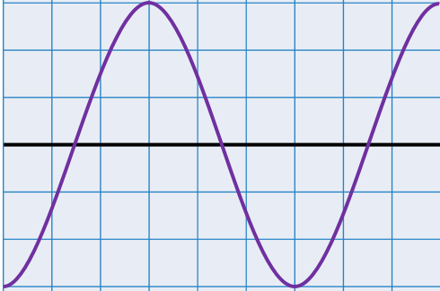
5
What is the frequency of this wave if it travels at 120 m/s and each box is 1 m?
Notes:
20

Slide 7
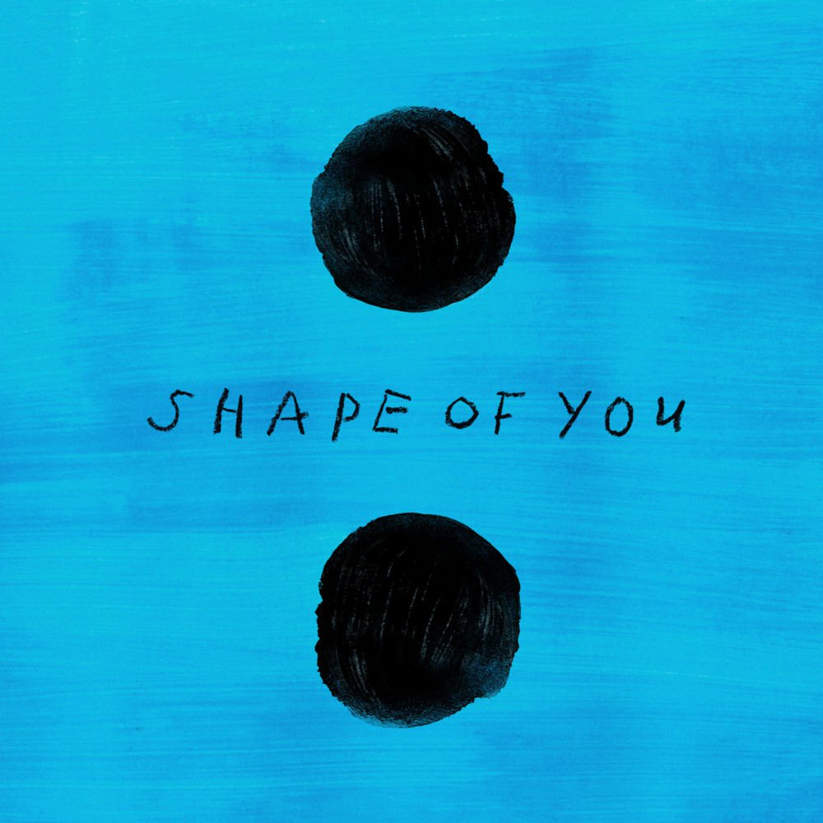
6
Ed Sheeran’s “Shape of You” has a tempo of 96 beats per minute (1.6 Hz) how many seconds are in between each beat (the period)
Notes:
0.625

Slide 8
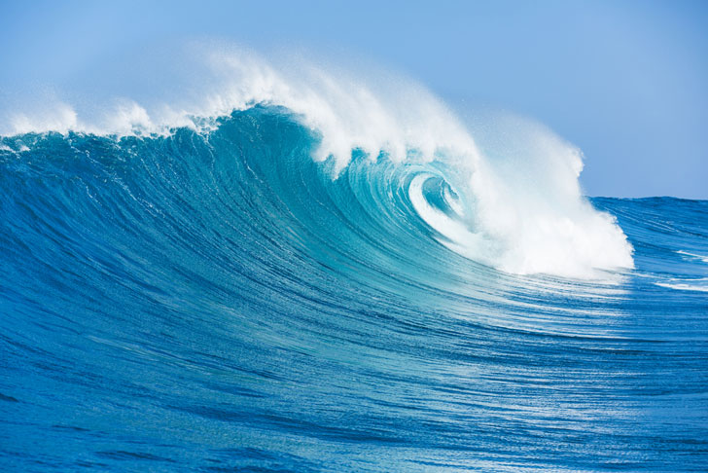
7
What is the wave speed of an ocean wave that has a frequency of 0.4 Hz and distance between waves of 9 m?
Notes:
3.6

Slide 9
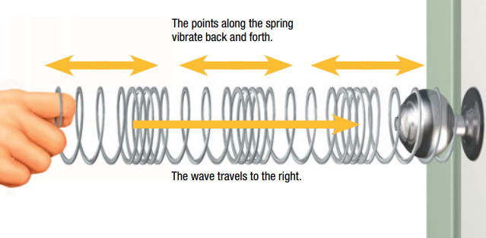
8
Name one real life example of a longitudinal wave
Notes:
Sound, quake

Slide 10
9
What is the wavelength of wave that has a period of 0.02 seconds and wave speed of 25 m/s?
Notes:
0.5

