Slide 1
Simple Harmonic Motion
IB Physics | Waves - Sound

Slide 2
Warm up
What words would you use to describe the motion of a bobble head doll?
Oscillating
Back and Forth
Repeating
Etc.

Slide 3
A Mass on a Spring
Simple Harmonic Motion
Maximum
Equilibrium Position
Minimum

Slide 4
Let’s look at the forces…
Restoring Force
Always toward equilibrium
–
F_{net}
+

Slide 5
Force and Displacement
Hooke’s Law: F = -kΔx
Force is opposite to the displacement
–
-F
-a
+Δx
Acceleration is in the same direction as the force
F_{net}
F = ma
-Δx
+
+F
+a

Slide 6
Why the Negative Sign??
“Acceleration is proportional to the opposite of the displacement”
a ∝ -x
Proportional to
-a
+Δx
-Δx
+a

Slide 7
Let’s look at this one more time…
When is the force largest?
When is the acceleration largest?
When is the velocity largest?
–
–
F_{net}
a
+
+

Slide 8
Where is the Greatest…
Displacement | Velocity | Acceleration
C
X
X
B
X
A
X
X

Slide 9
Graphing Displacement vs Time

Slide 10
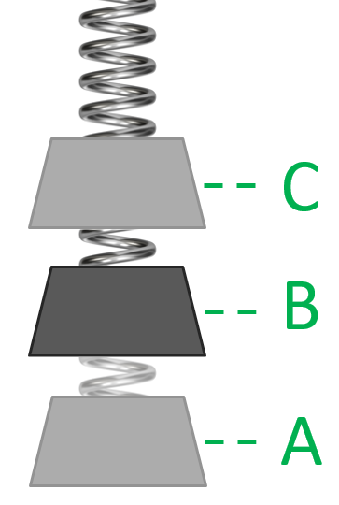
C
B
B
+Δx
Displacement
Time
A
-Δx
B
A
C
Time
Velocity
Slope of d vs t
B
A
B
Time
Slope of v vs t
Acceleration
B
Opposite of disp
C

Slide 11
Energy for SHM
Displacement
Time
PE
Energy
Time

Slide 12
Energy for SHM
Velocity
Time
KE
Energy
Time

Slide 13
Energy for SHM
Velocity
Displacement
Time
Total Energy
PE
KE
Energy
Time

Slide 14
Acceleration vs Displacement
Acceleration
C
–
B
Displacement
a
+
A
A
B
C

Slide 15
Velocity vs Displacement
Velocity
C
Displacement
B
v
A
A
B
C

Slide 16
_____ vs Displacement
Velocity
Acceleration
Displacement
Displacement
A
B
C
A
B
C

Slide 17
Timing SHM
Period
C
B
A

Slide 18
Properties of SHM
Displacement
Time
Property | What is it? | Symbol | Unit
Period
Frequency
Time per cycle
T
[s]
Cycles per second
f
[Hz]

Slide 19
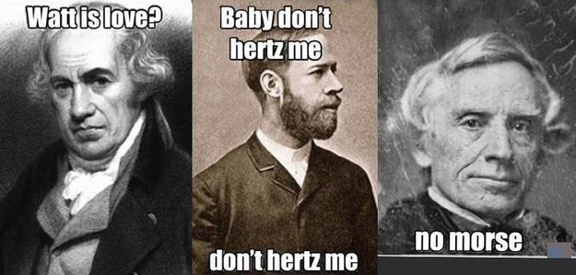
Period is related to Frequency
Period = 1 / Frequency

Slide 20
Period is related to Frequency
Period = 1 / Frequency
$$f=\frac{1}{T}$$
$$T=\frac{1}{f}$$

Slide 21
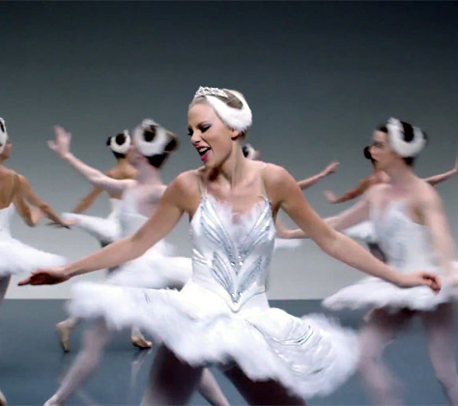
$$f=\frac{1}{T}$$
$$T=\frac{1}{f}$$
Try this…
Taylor Swift’s song Shake it Off has a tempo of 160 beats per minute (2.67 Hz) how many seconds are in between each beat (the period)
$$f=2.67 Hz$$
$$T=\frac{1}{f}$$
$$=\frac{1}{2.67 Hz}$$
$$T= ??$$
$$=0.37 s$$

Slide 22
$$f=\frac{1}{T}$$
$$T=\frac{1}{f}$$
Try this…
You are standing on the beach with your feet in the water and notice that a new wave comes crashing in every 4 seconds, what is the frequency of these waves?
$$T=4 s$$
$$f=\frac{1}{T}$$
$$=\frac{1}{4 s}$$
$$f=??$$
$$=0.25 Hz$$

Slide 23
A little harder…
You are pushing your younger brother on a swing and you end up pushing 12 times in one minute. What is the period and frequency of the swing?
$$T=\frac{60 seconds}{12 times}$$
$$=5 s$$
$$f=\frac{1}{T}$$
$$=\frac{1}{5 s}$$
$$=0.2 Hz$$

Slide 24
Lesson Takeaways
I can relate the acceleration of an object in simple harmonic motion to its position
I can graph the displacement, velocity, and acceleration vs time for simple harmonic motion
I can describe and relate the properties of period and frequency
I can calculate period and frequency from a scenario

