Slide 1
Sound and Standing Waves
IB Physics | Waves - Sound

Slide 2
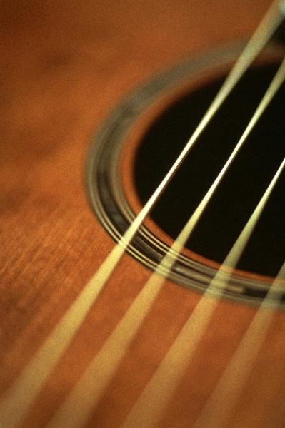
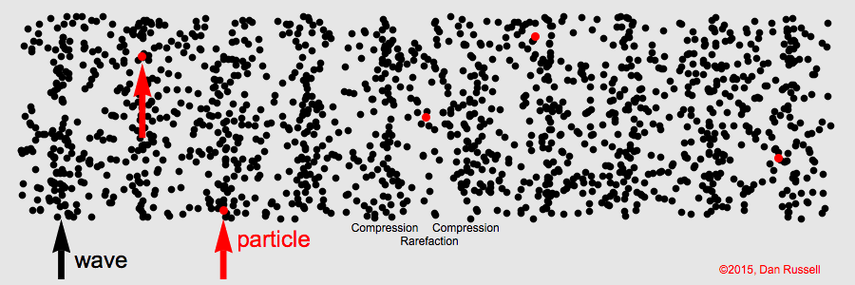
Sound Waves start as Vibrations
What kind of wave is sound?
Longitudinal

Slide 3
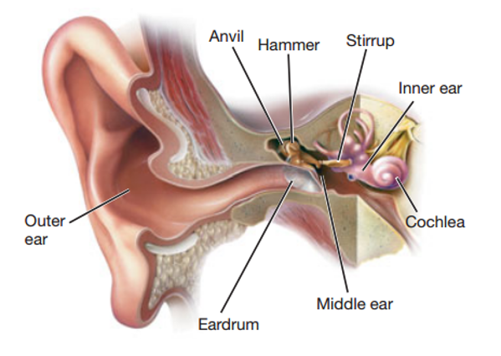
Sound is Pressure
Vibrations pressurize the air molecules and those pressure waves cause our ears to vibrate too!

Slide 4
Pitch is Related to Frequency
high
High pitched sounds have _________ frequencies
low
Low pitched sounds have _________ frequencies

Slide 5
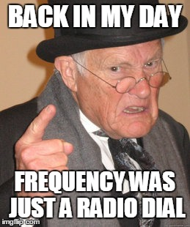
Sensing Pitch
Sadly, the range of frequencies that we can hear diminishes with age…
Frequency
8,000 Hz
10,000 Hz
12,000 Hz
14,000 Hz
16,000 Hz
18,000 Hz
20,000 Hz

Slide 6
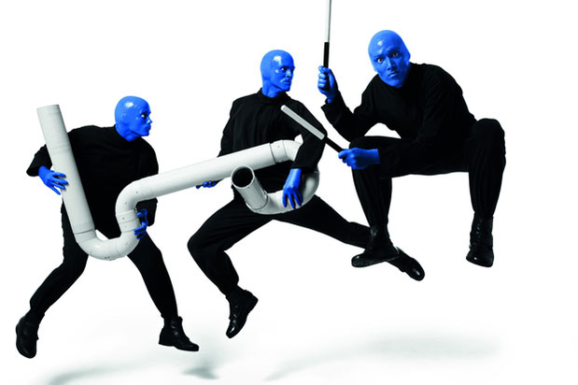
What do you notice from the video?

Slide 7
Standing Waves
Nodes
Antinodes

Slide 8
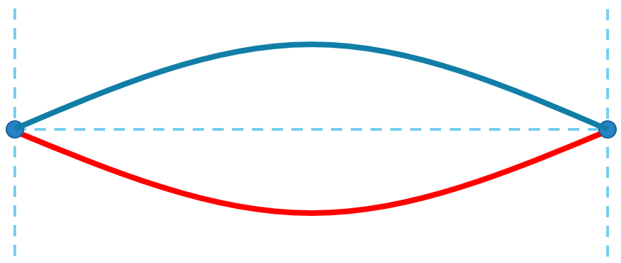
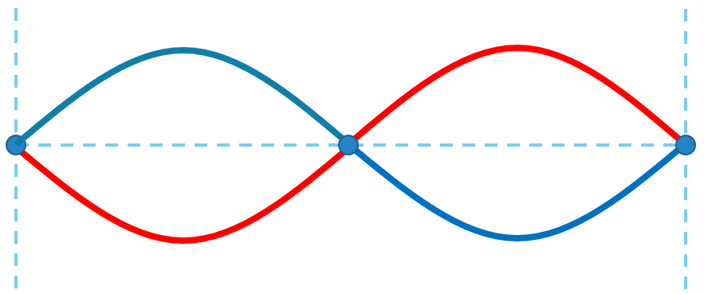
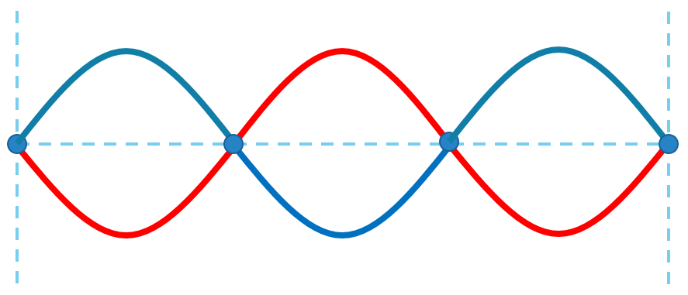
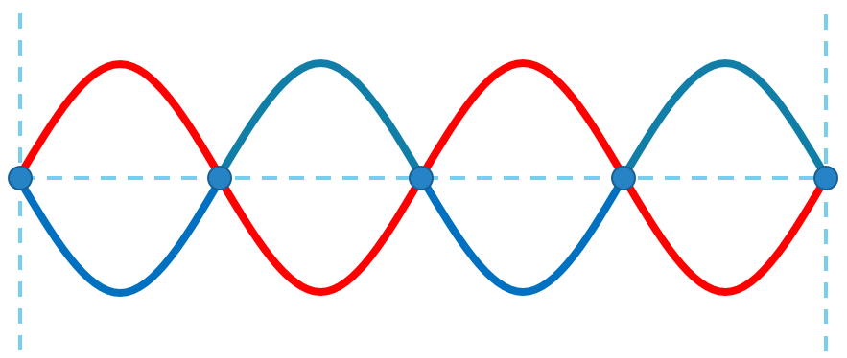
Standing Waves
12 m
# of Standing Waves | # of Wavelengths | Wavelength (m)
1
0.5
24
2
1
12
3
1.5
8
4
2
6

Slide 9
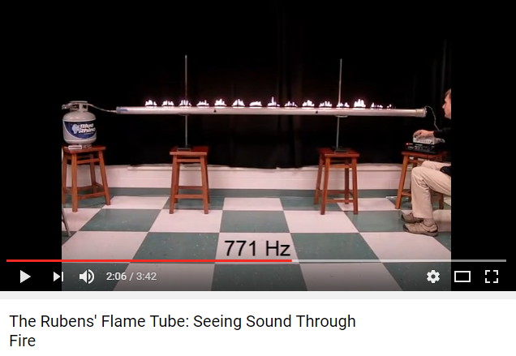
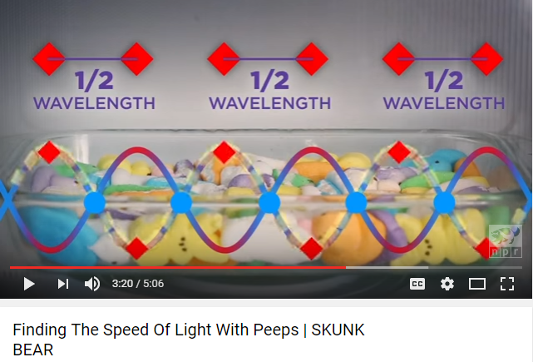
“Seeing” Standing Waves

Slide 10
Lesson Takeaways
I can relate the pitch of a sound to the frequency of the sound wave
I can identify and label the node and antinodes on a standing wave diagram

